Slide 1
Presenting slide of my project “JAHAN’s CAR RENTAL”
SUBMITTED TO :
MD. MOSHAIDUL ISLAM
CONSULTANT OF IDB-BISEW
JAVA & WPH
SUBMITTED BY:
ISRAT JAHAN
ID : 1244155
Round-37, JAVA

Slide 2
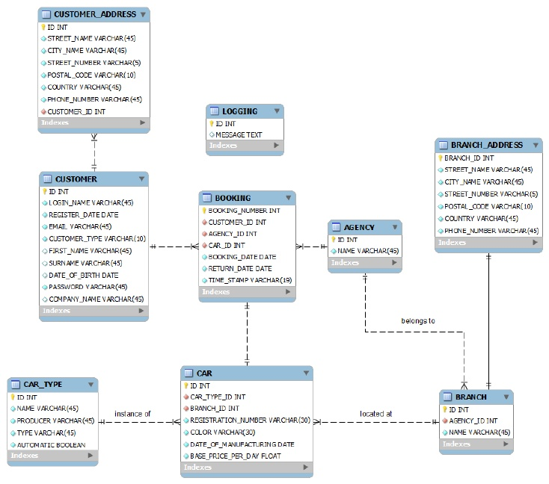
Class diagram

Slide 3
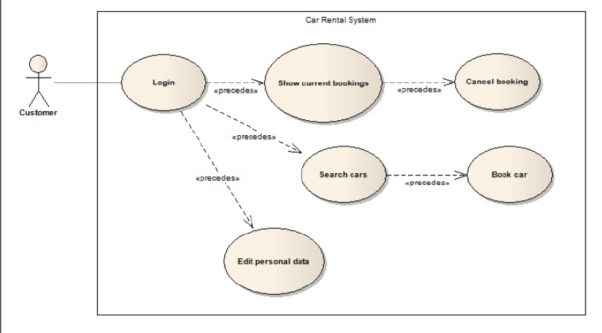
Use Case Diagram

Slide 4

Home page

Slide 5

About page

Slide 6
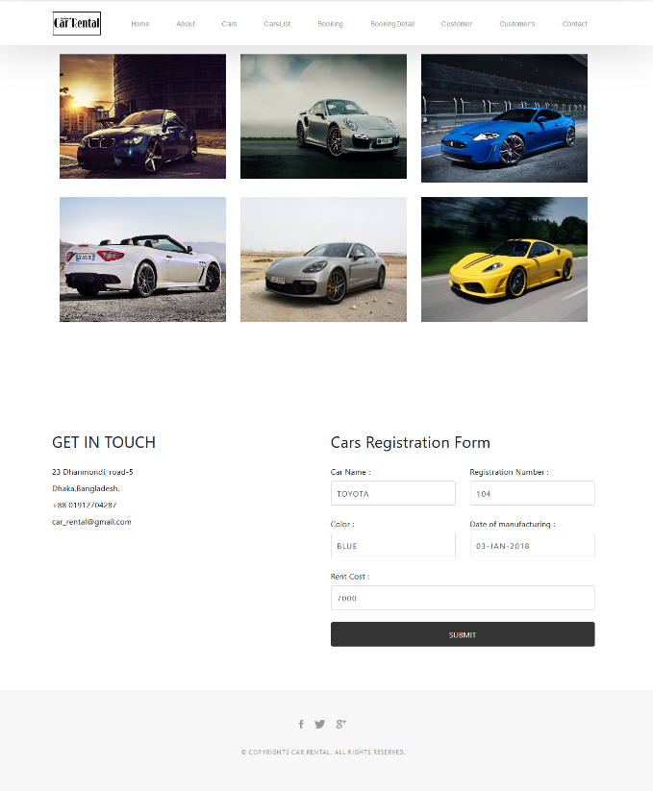
Car Registration page

Slide 7
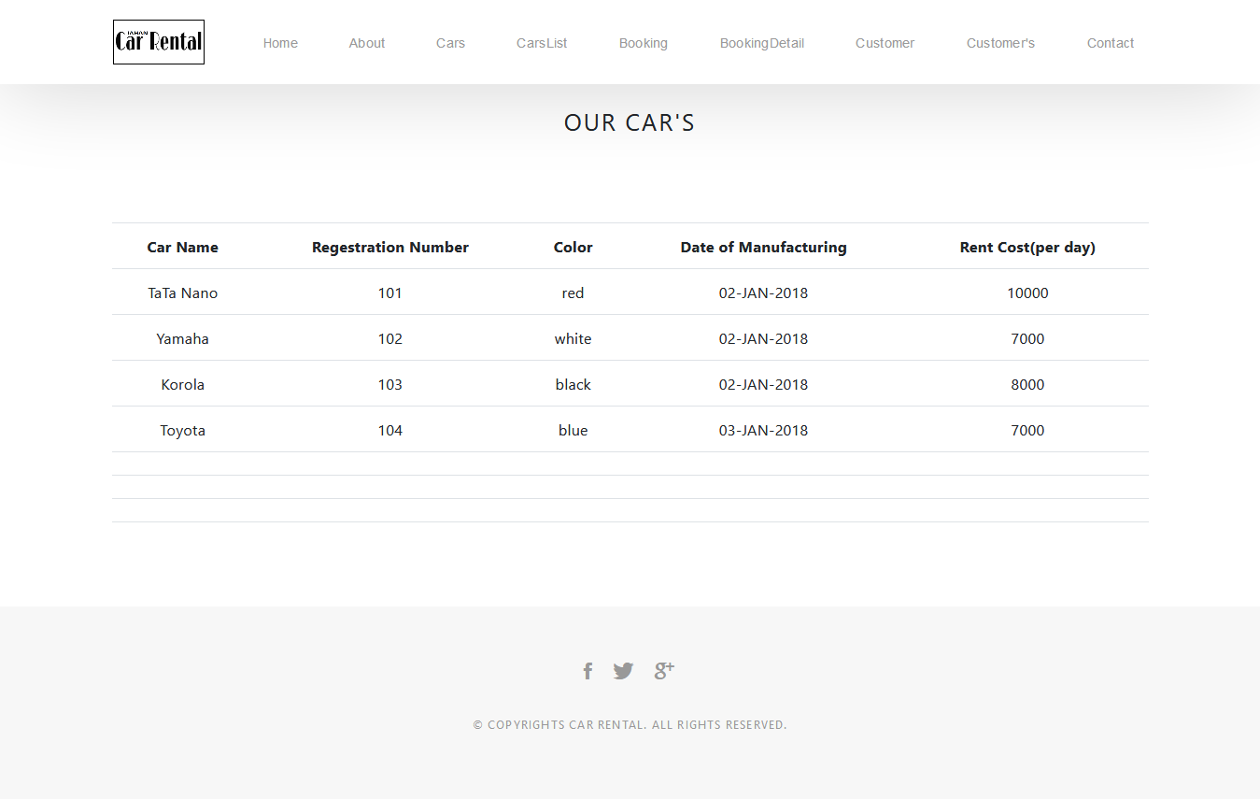
Cars list page

Slide 8
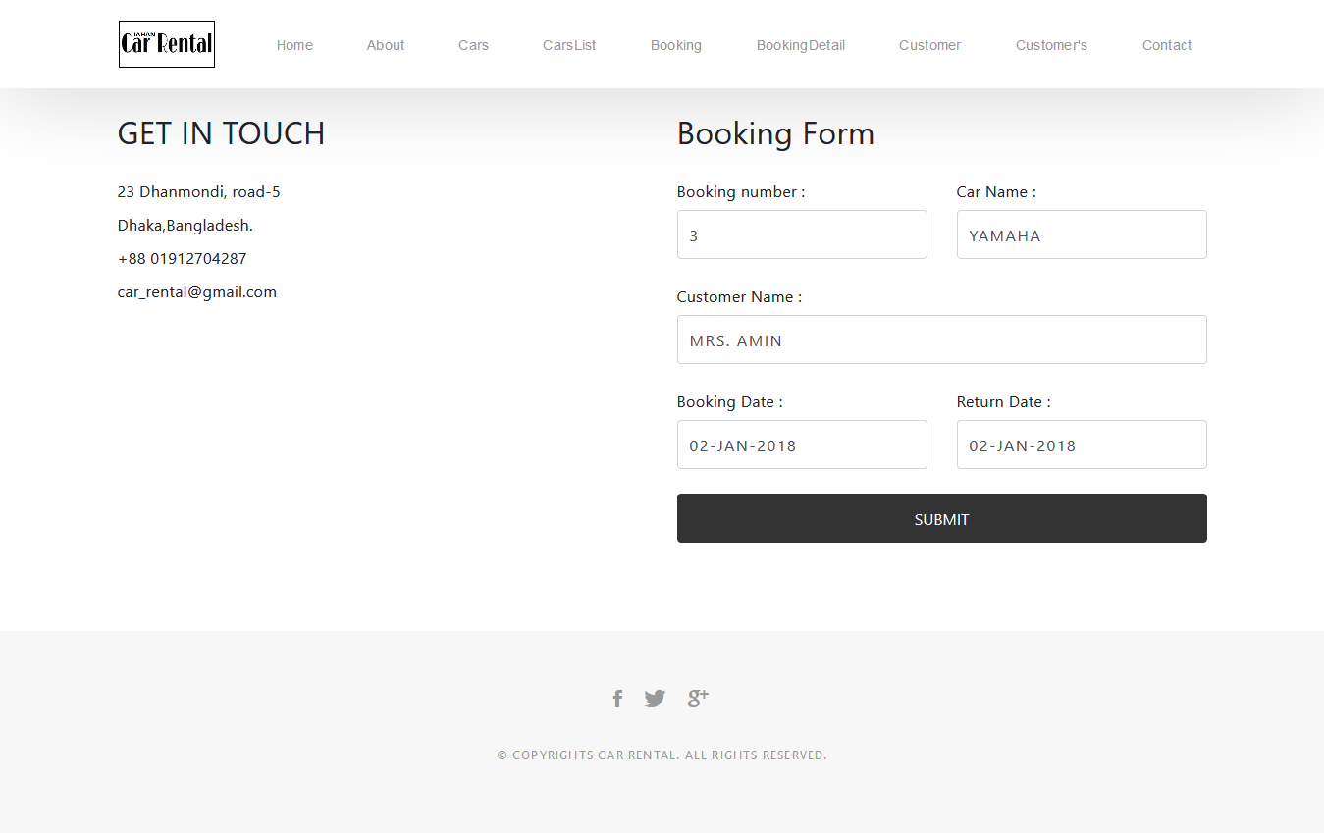
Booking page

Slide 9
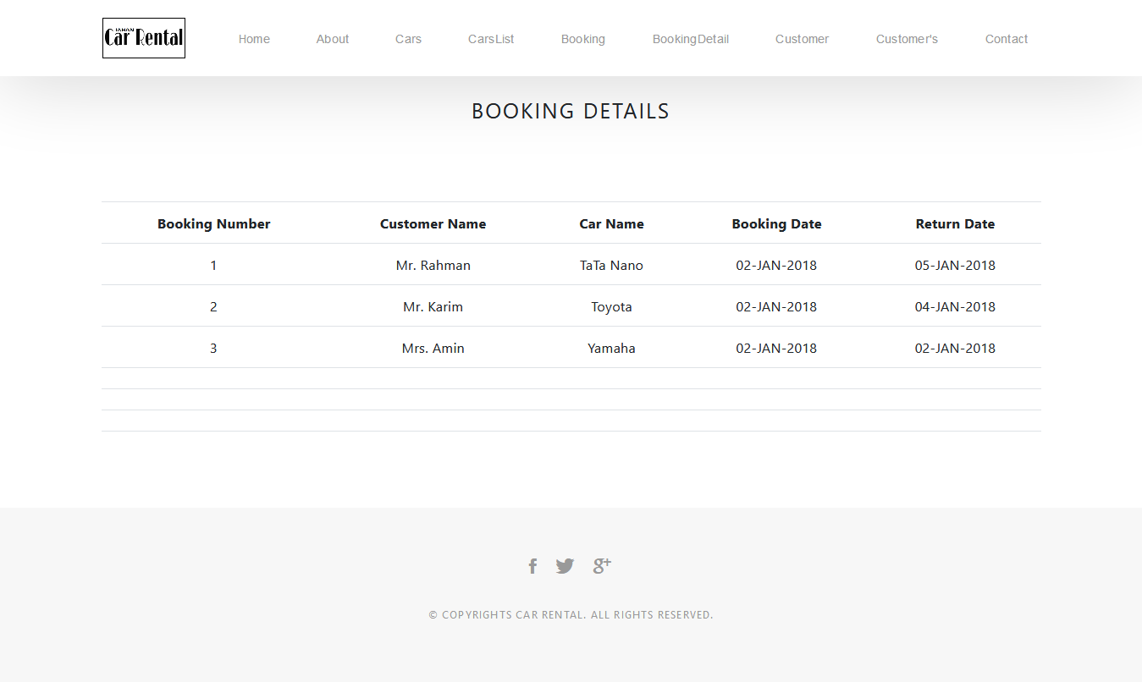
Booking details page

Slide 10
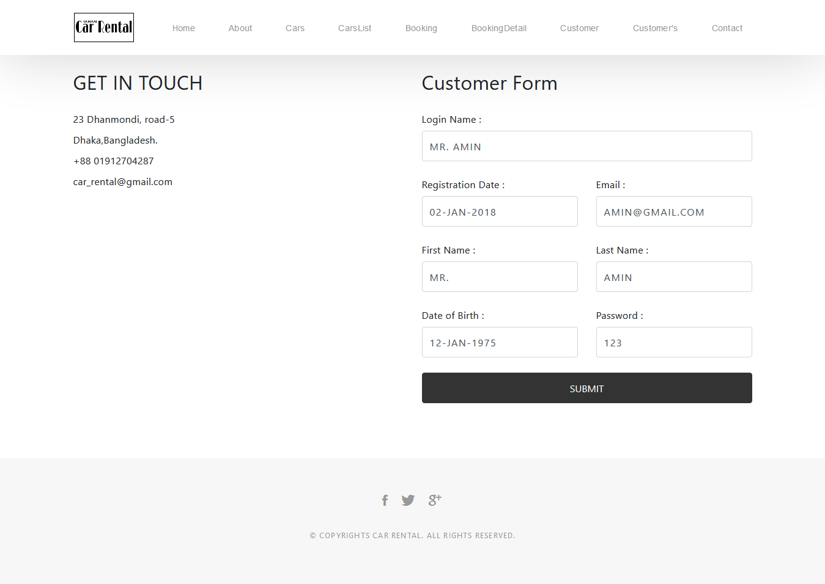
Customer form page

Slide 11
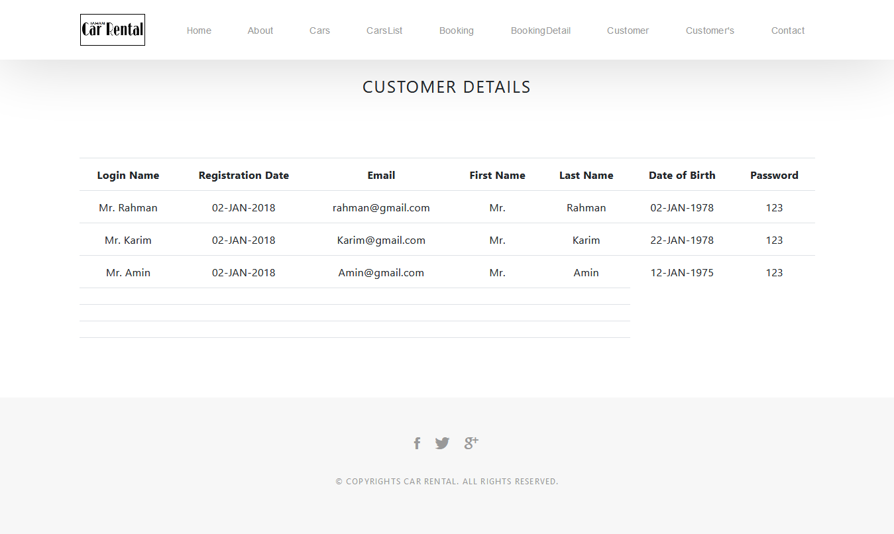
Customer detail page

Slide 12
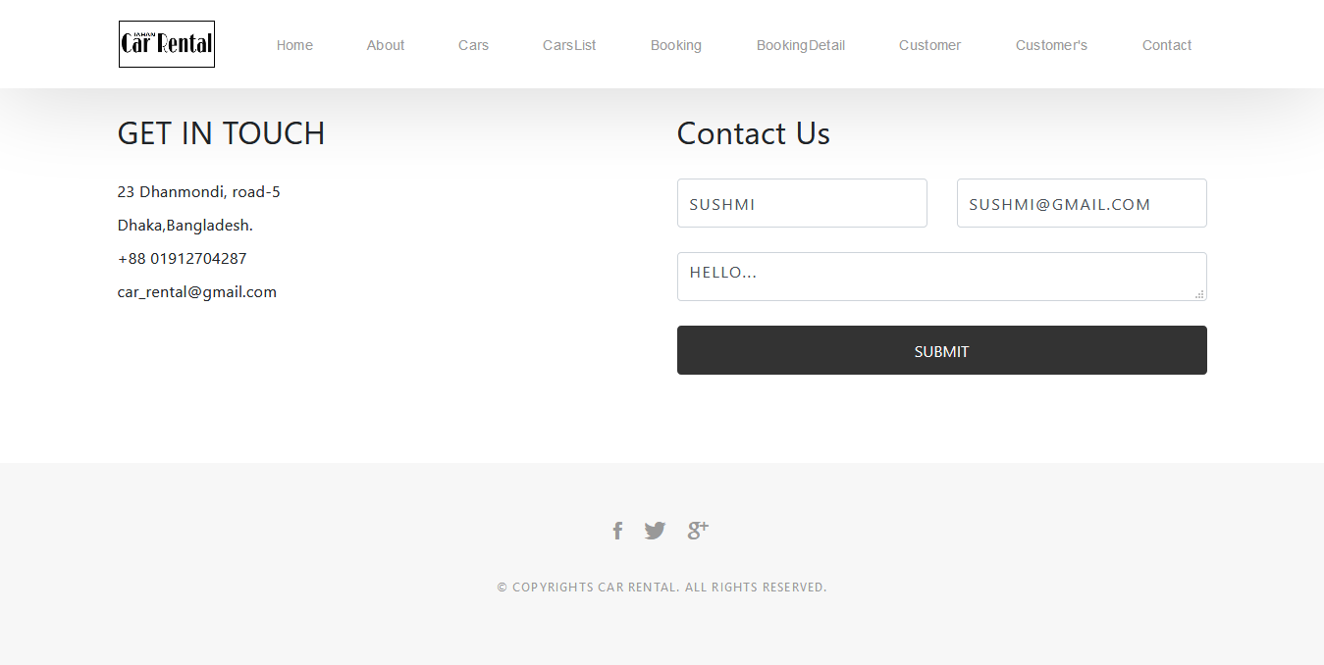
Contact page

Slide 13
Thank you for watching

