Slide 1
AI-Powered Employee Skill Gap Analyser
Intelligent Career Progression & Personalized Learning
Team D11 | Maitri · Ria · Sagar · Puneet

Slide 2
The Challenge in Modern Workforce Development
Dynamic Job Roles: Technology evolves rapidly, making it hard to keep up.
Vague Career Paths: Employees don't know exactly what skills they need to transition.
Generic Training: HR prescribes 'one-size-fits-all' training instead of personalized plans.
Manual Gap Analysis: Mapping skills against future requirements is tedious.

Slide 3
The Skill Gap Analyser App
Deterministic Skill Assessment: Evaluates current proficiency against hardcoded industry standards.
Instant Gap Matrix: Visually highlights areas of deficiency.
AI Career Insights: Uses Groq LLM (Llama 3) for professional feedback.
Targeted Recommendations: Queries Udemy dataset to suggest relevant courses.
Auto-Generated Roadmap: Uses AI to generate a structured 6-month study plan.

Slide 4
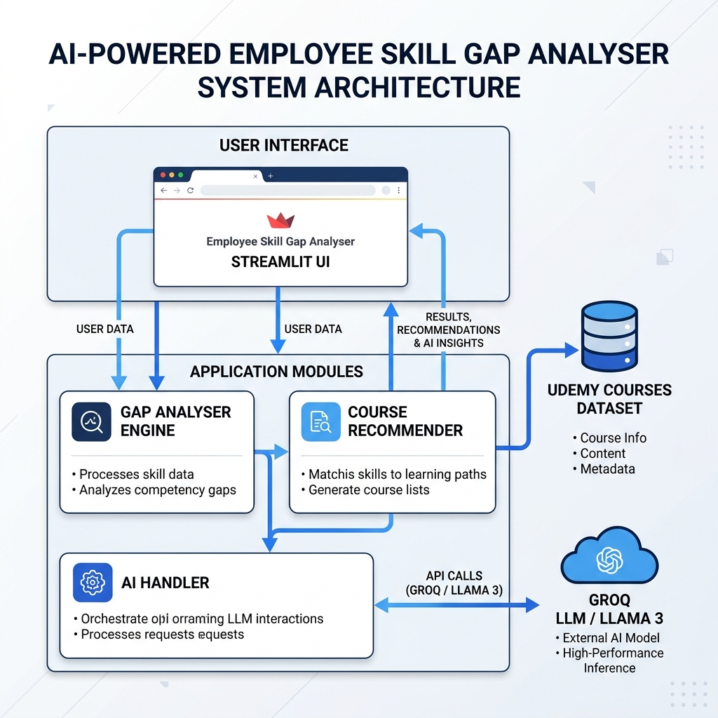
How It Works Under The Hood
Frontend: Streamlit dashboard for employee inputs.
Core Engine: Standardizes inputs and calculates mathematical gap scores.
Recommender: Parses missing skills against udemy_courses.csv.
AI Integration: Connects to Groq Cloud (Llama 3) for roadmap generation.

Slide 5
Technology Stack & Data Sources
Language: Python
Frontend Framework: Streamlit (Custom CSS)
AI/LLM Provider: Groq API (Llama-3.3-70b)
Datasets: O*NET Database & Udemy Course Catalog
Reporting: Python-docx

Slide 6
Future Scope & Enhancements
Live API Integrations: Pulling real-time course data from Udemy/Coursera.
HR Dashboard: Unified view for managers to see department-wide gaps.
Resume Parsing: Automatically extract current skill levels from CV uploads.
Progress Tracking: Integrating interactive checkboxes for tracking milestones.

Slide 7
Empowering the Workforce of Tomorrow
Bridging the gap between where employees are and where they want to be.
Thank You!
Any Questions?

