Slide 1

BillMaster
Ben Elgart
Sushmita Subramanian
Daniel Weiss

Slide 2
Transactional Online Bill Paying
How do you make a statement
personalized?
How do you make billpaying
interesting and insightful?

Slide 3

Research
Focus: People who micromanage their money
  Goal: Provide control without the effort?

Slide 4
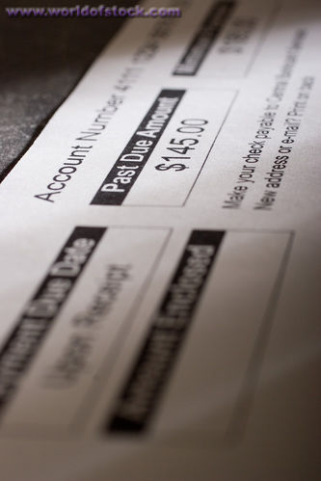
What’s Wrong Now?
Static statement
Not personal
Can't see any granularity
No big picture view

Slide 5
Our Vision
My Expenses are My Experiences

Slide 6
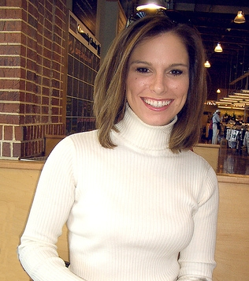
Diane Hunter
  Meet Diane:
  -31 yr old, associate editor at Washington Life magazine
  -Married to Aaron (who is a lawyer at Deloitte and Touche,) for 5 yrs.
  Activities:
  -Bought a house in Adams Morgan a year ago, so they are involved in small home remodeling projects.
  -Aaron likes to cook, and throws dinner parties for Diane and friends.
  -Diane manages the money.

