Slide 1
AUTOMATED BLOCK PLANNING SYSTEM
Comprehensive 18-Section Website UI Walkthrough, Mathematical Optimization & Operational Defense (ABPS v4.0)
Ministry of Railways · Smart India Hackathon 2026 · Delhi Division (Delhi-Howrah 1,447 km Mainline)
Tech Stack: React 18 + Vite | Go Fiber Gateway | Google OR-Tools CP-SAT | PostgreSQL 16 + Redis
Notes:
Good morning respected members of the evaluation jury. Today we present the Automated Block Planning System (ABPS v4.0), engineered for the Ministry of Railways to solve the multi-billion rupee operational bottleneck of coordinating heavy track maintenance possessions around dense passenger express movements.
Across the 1,447 km Delhi-Howrah mainline, manual planners previously spent 4 to 6 hours negotiating maintenance blocks, often resulting in severe train cascading delays or canceled safety possessions. Our system transforms this through automated CP-SAT constraint optimization, delivering certified zero-collision schedules, +0.67% network capacity gain, and a 63.1% consolidation index across all 18 operational sections.

Slide 2
SYSTEM ARCHITECTURE & 5-TIER OPERATIONAL HIERARCHY
Comprehensive 18-Section Operational Flow from Raw Data to Certified Dispatch
1. OPERATIONS
• 01. Dashboard / GIS Map
• 02. Asset Backlog
• 03. Task Generator
• 04. Weekly Block Planner
• 05. Monthly Forecast
2. COORDINATION
• 06. Coordination Centre
• 07. Integrated / Shadow Blocks
• 08. Train & Block Conflicts
3. INTELLIGENCE
• 09. AI Risk & Priority
• 10. Failure Intelligence
• 11. Asset Health
4. DATA
• 12. Data Ingestion
• 13. Data Quality
• 14. Model / Data Versions
5. CONTROL & SIM
• 15. Human Review & Audit
• 16. Verification Suite
• 17. What-If Simulator
• 18. Scenario Explorer
Notes:
Architecture Overview Defense:
Our system organizes all 18 sections into a 5-tier operational hierarchy:
1. Operations: Command center, asset backlog, task intake, weekly and monthly schedules.
2. Coordination: Cross-department alignment, shadow blocks, train collision radar.
3. Intelligence: Machine learning failure risks, root-cause forensics, asset degradation.
4. Data: Multi-source ingestion pipelines, data quality gates, model lineage.
5. Control & Simulation: Two-person cryptographic sign-off, 12 mathematical safety checks, and simulation sandboxes.

Slide 3
GLOBAL BRANDING & NAVIGATION SHELL
Persistent Division Header, Shift Indicators & Left Command Sidebar
Enterprise Shell Architecture & Navigation Design System
• Indian Railways Identity: Prominent Indian Railways crest, 'ABPS CONTROL' title, and Delhi Division jurisdiction badge.
• Working Calendar Context: Interactive calendar widget showing live planning horizon (Week 14-20 Sep 2026), shift controller, and 24-hr railway clock.
• Multi-Tier Collapsible Sidebar: Categorized navigation links across Operations, Coordination, Intelligence, Data, and Control with active saffron highlights.
• Global Notification & Status: Displays live engine status ('SIMULATION MODE'), WebSocket telemetry pulse, and quick-action emergency links.
Notes:
Global Shell Defense:
Before diving into individual sections, notice how our enterprise application shell maintains persistent situational awareness. The header anchors every view with the Indian Railways crest, active Delhi Division jurisdiction, the planning horizon calendar, and a synchronized 24-hour railway clock. This ensures railway controllers always know their operating boundaries.

Slide 4
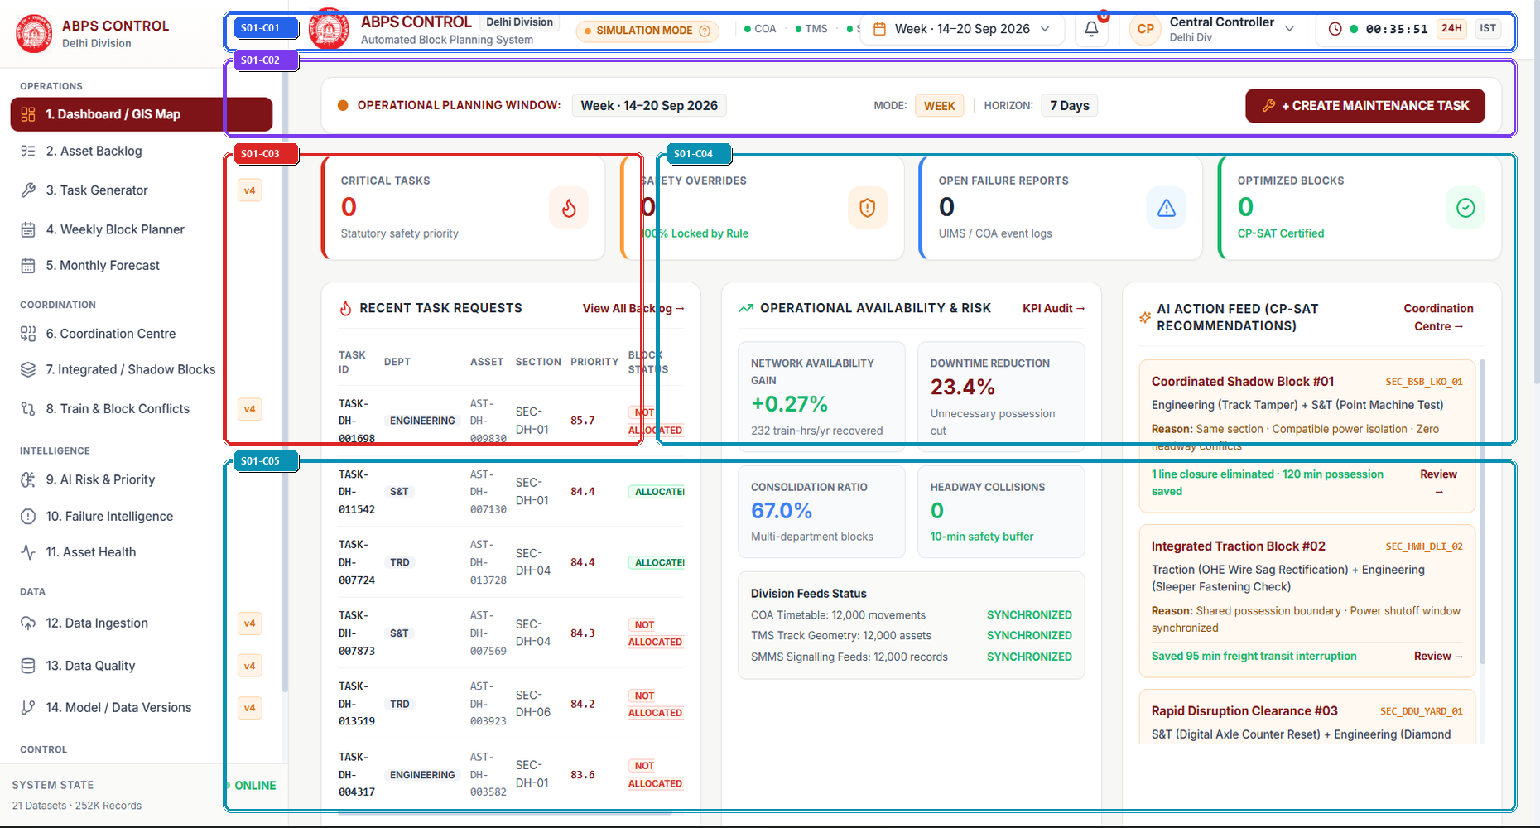
SECTION 01: 1. DASHBOARD / GIS MAP
Real-Time Network State, Disruption Telemetry & Leaflet Asset Map
TIER: OPERATIONS
Annotated Features & Operational Telemetry
S01-C01 · Global Brand & Divisional Shell Header [NAV]
Establishes system context, operational jurisdiction, and verified server connec...
S01-C02 · Critical KPI Telemetry Ribbon [CARD]
Provides instant situational awareness of safety-critical tasks, approved posses...
S01-C03 · Maintenance Priority Queue [ALERT]
Prevents catastrophic asset failures by ranking maintenance tasks using expected...
S01-C04 · Leaflet GIS Corridor Asset Map [CHART]
Visualizes geospatial track topology, active line closures, and maintenance asse...
S01-C05 · Corridor Performance & Punctuality Matrix [CHART]
Monitors throughput efficiency and passenger punctuality impact across all 6 cor...
COLOR TAXONOMY: 🟦 NAV: Navigation/Shell | 🟩 ACTION: Primary CTAs | 🟧 FORM: Inputs/Filters | 🟪 CARD: Content Blocks | 🟥 ALERT: Warnings | 🟦 CHART: Telemetry/Maps
Notes:
SECTION 01 VIVA DEFENSE SCRIPT: 1. Dashboard / GIS Map
--------------------------------------------------------------------------------
1. What am I showing?
I am presenting Section 01 of ABPS v4.0, which is the 1. Dashboard / GIS Map view (/?tab=dashboard), engineered for the OPERATIONS operational tier of Delhi Division.
2. What is this section?
The Dashboard / GIS Map is the executive operational landing page of ABPS v4.0. It integrates real-time network health, scheduled CP-SAT block status, pending asset maintenance alerts, and an interactive GIS spatial map across all 6 high-density corridor sections of Delhi Division.
3. Why does it exist?
Without a unified command dashboard, railway traffic controllers must cross-reference isolated logbooks, scada alarms, and train control charts. This section brings all operational threads into a single glass pane, allowing instant decision-making and rapid bottleneck identification.
4. What are its main features?
- 4-Card Critical KPI Ribbon summarizing active maintenance tasks, safety overrides, CP-SAT blocks, and conflict counts.
- Maintenance Priority Queue with urgent work orders sorted by expected-loss ranking.
- Interactive Leaflet GIS Map displaying track sections, active block possessions, and asset geolocations with popup inspectors.
- Real-Time Corridor Availability Gauges and sectional traffic density meters.
5. How does the user use it?
Controllers scan top KPIs to detect anomalies, toggle between Weekly and Monthly horizons, click on urgent maintenance rows in the queue to inspect asset wear, and pan/zoom the GIS map to inspect specific track sections and OHE feeder stations.
6. What happens after interaction?
Real-time visual map of corridor possessions, aggregated divisional maintenance metrics, and instant navigational entry points into deep diagnostic views.
7. Why is this feature useful (Operational Impact)?
Practical Example: At 06:30 AM during morning peak, a Sectional Controller notices the 'Critical Tasks' badge turns red (15 urgent defects). By clicking the top urgent TRD task on the GIS map, the controller instantly sees a sagging catenary wire at KM 142/8 and initiates an emergency block recommendation before freight congestion peaks.
Conversational Pitch: "The Dashboard is our operational nerve-center. It combines mathematical telemetry with Leaflet GIS spatial mapping so divisional controllers can monitor 1,447 km of high-density track, 72 certified maintenance blocks, and 1,819 train movements in a single, conflict-free interface."

Slide 5
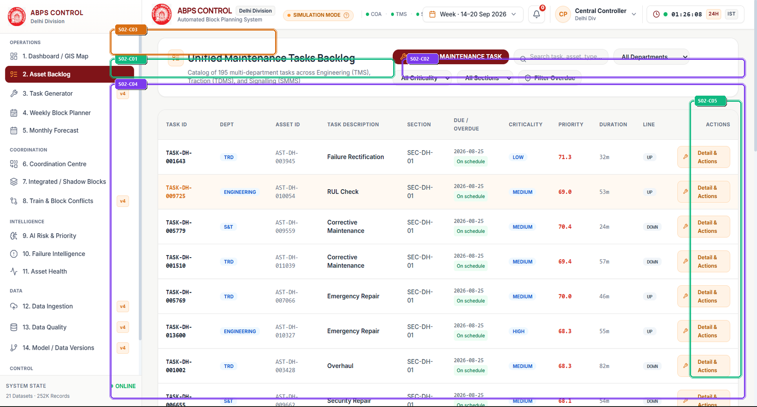
SECTION 02: 2. ASSET BACKLOG
Unified Multi-Department Work Order Repository & Urgency Ranking
TIER: OPERATIONS
Annotated Features & Operational Telemetry
S02-C01 · Departmental Quick-Filter Toolbar [ACTION]
Allows sectional engineers to isolate work orders belonging strictly to their op...
S02-C02 · Urgency & Risk Distribution Cards [CARD]
Displays current backlog risk profile and statutory deadline urgency breakdown....
S02-C03 · Backlog Search & Corridor Filter Input [FORM]
Enables rapid retrieval of specific maintenance jobs by physical kilometer or as...
S02-C04 · Unified Asset Maintenance Task Table [CARD]
Presents comprehensive work order details with full operational parameters....
S02-C05 · Task Action & Drawer Trigger [ACTION]
Opens detailed engineering specifications, failure curves, and isolation checkli...
COLOR TAXONOMY: 🟦 NAV: Navigation/Shell | 🟩 ACTION: Primary CTAs | 🟧 FORM: Inputs/Filters | 🟪 CARD: Content Blocks | 🟥 ALERT: Warnings | 🟦 CHART: Telemetry/Maps
Notes:
SECTION 02 VIVA DEFENSE SCRIPT: 2. Asset Backlog
--------------------------------------------------------------------------------
1. What am I showing?
I am presenting Section 02 of ABPS v4.0, which is the 2. Asset Backlog view (/?tab=asset_backlog), engineered for the OPERATIONS operational tier of Delhi Division.
2. What is this section?
Asset Backlog is the centralized inventory of all pending, approved, and completed railway maintenance tasks across permanent way, overhead electrification, and signaling assets.
3. Why does it exist?
Historically, each railway department operated in silos using separate paper ledgers or disparate legacy databases. Asset Backlog unifies all departments into a standardized schema with rigorous priority scoring.
4. What are its main features?
- Unified task table showing Task ID, Department, Section, Duration, Criticality Score, and Deadline.
- Department filter buttons (All, TRD, ENG, S&T, MECH) with dynamic counter badges.
- Search input with instant filtering by asset ID, track kilometer, or supervisor name.
- Priority distribution summary cards breaking down tasks by Critical, High, Medium, and Routine.
5. How does the user use it?
Supervisors filter tasks by their specific department, sort by impending statutory deadlines, search for specific track kilometers, and click tasks to view required machinery and crew logistics.
6. What happens after interaction?
Standardized, urgency-ranked work order ledger ready for batch injection into the CP-SAT optimization engine.
7. Why is this feature useful (Operational Impact)?
Practical Example: A Permanent Way Inspector logs an ultrasonic flaw detected at KM 142/8. The task enters Asset Backlog, is flagged as ENG with Criticality 96.7, and is immediately color-coded in red with a statutory 48-hour completion deadline.
Conversational Pitch: "Asset Backlog breaks departmental silos by aggregating engineering, traction, and signaling work orders into one place. Every task is scored with our expected-loss formula so life-safety track repairs always take precedence."

Slide 6
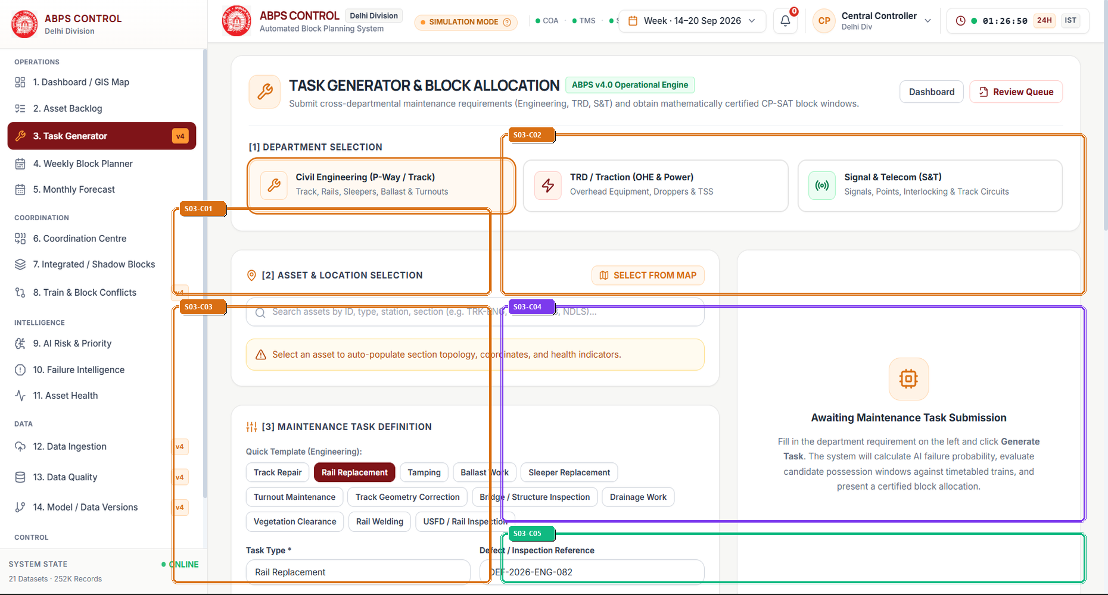
SECTION 03: 3. TASK GENERATOR
Cross-Departmental Maintenance Requirement Submission & Constraint-Certified Block Allocation
TIER: OPERATIONS
Annotated Features & Operational Telemetry
S03-C01 · Cross-Department Selection Cards [FORM]
Filters available task templates, machinery options, and safety protocols to the...
S03-C02 · Asset Selector & Geospatial Topology Context [FORM]
Binds the maintenance work order to an exact physical asset and operational corr...
S03-C03 · Maintenance Task Definition & Quick Templates [FORM]
Captures operational parameters of the requested maintenance block....
S03-C04 · 8-Stage Action, Isolation & Safety Stepper [CARD]
Ensures comprehensive safety compliance and procedural rigor prior to block gran...
S03-C05 · CP-SAT Block Window Certification & Dispatch Button [ACTION]
Submits maintenance requirement, triggers instant CP-SAT optimization, and retur...
COLOR TAXONOMY: 🟦 NAV: Navigation/Shell | 🟩 ACTION: Primary CTAs | 🟧 FORM: Inputs/Filters | 🟪 CARD: Content Blocks | 🟥 ALERT: Warnings | 🟦 CHART: Telemetry/Maps
Notes:
SECTION 03 VIVA DEFENSE SCRIPT: 3. Task Generator
--------------------------------------------------------------------------------
1. What am I showing?
I am presenting Section 03 of ABPS v4.0, which is the 3. Task Generator view (/?tab=task_generator), engineered for the OPERATIONS operational tier of Delhi Division.
2. What is this section?
The Task Generator is the primary operational portal for field engineers across Indian Railways departments (Engineering/P-Way, Traction/TRD, and Signal & Telecom/S&T) to submit new maintenance requirements and generate conflict-free possession blocks.
3. Why does it exist?
Historically, maintenance requisitions were filed on fragmented paper slips or isolated division portals without spatial or timetable validation. The Task Generator unifies requirements intake, enforces safety isolation protocols, and executes immediate mathematical pre-validation against timetabled passenger trains.
4. What are its main features?
- Cross-Department Category Selector (Engineering, Traction, S&T) with department-tailored templates.
- Geospatial Asset Selector linking directly to track centerline chainage, section codes, and GIS coordinates.
- Comprehensive Maintenance Task Definition with preset engineering packages (Rail Replacement, Tamping, OHE Inspection, Point Machine Testing).
- 8-Stage Safety & Isolation Package Stepper (Site Preparation, Traffic Protection, 25kV OHE Isolation, Work Execution, Testing, Inspection, Restoration, Handover).
5. How does the user use it?
1. Department Selection: Click Civil Engineering, TRD, or S&T card.
2. Asset Selection: Choose asset from searchable dropdown or click on the embedded Leaflet track map.
3. Task Parameters: Select template (e.g. Rail Replacement), target date, and requested duration (minutes).
4. Safety & Isolation: Check required isolations (25kV Traction Power, Signalling Lockout) and select crew resources.
5. Dispatch: Click 'Generate Maintenance Task & Block Allocation'. Review certified block options and commit to the master schedule.
6. What happens after interaction?
Generates a canonical task record (TASK-DH-xxxxxx), assigns an expected-loss priority score, returns certified block windows with zero train overlap, and displays a radar chart of section disruption impact.
7. Why is this feature useful (Operational Impact)?
Practical Example: A P-Way Section Engineer identifies track gauge widening near km 142 on Section SEC-DH-01. They open Task Generator, select Engineering -> Rail Replacement on Asset AST-DH-003582, set 180 min duration, require 25kV OHE isolation, and click Generate. The system finds a 02:15-05:15 nighttime window between freight trains with zero passenger delay.
Conversational Pitch: "The Task Generator solves the root cause of railway coordination failure: fragmented work orders. By integrating department-specific safety templates with live timetable intelligence, field engineers receive mathematically certified possession windows in under 2 seconds instead of days of manual correspondence."

Slide 7
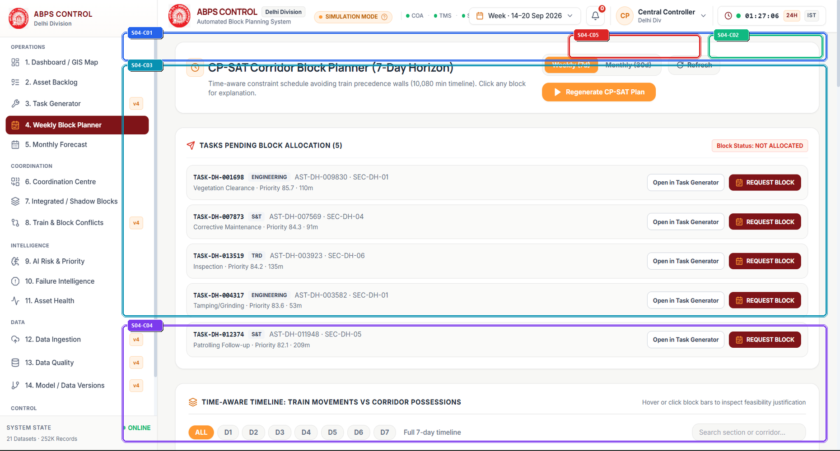
SECTION 04: 4. WEEKLY BLOCK PLANNER
CP-SAT 7-Day Corridor Block Schedule & Interactive Gantt Timeline
TIER: OPERATIONS
Annotated Features & Operational Telemetry
S04-C01 · Planner Date Navigator & Horizon Toolbar [NAV]
Controls the temporal window displayed on the Gantt timeline....
S04-C02 · CP-SAT Optimization Execution Button [ACTION]
Triggers the Google OR-Tools CP-SAT constraint solver to compute an optimal, con...
S04-C03 · 6 Corridor Sections Gantt Swimlanes [CHART]
Displays spatial and temporal allocation of maintenance blocks across all corrid...
S04-C04 · Assigned Corridor Possessions Table [CARD]
Provides an auditable tabular breakdown of all scheduled blocks shown on the Gan...
S04-C05 · Statutory Headway Clearance Indicator [ALERT]
Verifies that every scheduled block maintains the mandatory 10-minute buffer bef...
COLOR TAXONOMY: 🟦 NAV: Navigation/Shell | 🟩 ACTION: Primary CTAs | 🟧 FORM: Inputs/Filters | 🟪 CARD: Content Blocks | 🟥 ALERT: Warnings | 🟦 CHART: Telemetry/Maps
Notes:
SECTION 04 VIVA DEFENSE SCRIPT: 4. Weekly Block Planner
--------------------------------------------------------------------------------
1. What am I showing?
I am presenting Section 04 of ABPS v4.0, which is the 4. Weekly Block Planner view (/?tab=weekly_planner), engineered for the OPERATIONS operational tier of Delhi Division.
2. What is this section?
The Weekly Block Planner is the tactical scheduling canvas of ABPS v4.0. It renders a 7-day, 24-hour visual Gantt timeline of certified maintenance blocks allocated across Delhi Division's 6 corridor sections.
3. Why does it exist?
Manual scheduling of line blocks across saturated double-track lines frequently leads to canceled blocks, emergency train stoppages, or unsafe overlapping possessions. The Weekly Block Planner delivers mathematically certified, conflict-free block windows.
4. What are its main features?
- 6 Corridor Section Swimlanes (NDLS-GZB, GZB-ALJN, ALJN-TDL, TDL-ETW, ETW-CNB, CNB-PRYJ).
- Interactive time grid spanning 00:00 to 24:00 across 7 calendar days with 1-hour graduation lines.
- Color-coded block bars indicating department (TRD=Blue, ENG=Green, S&T=Amber, Integrated=Purple).
- CP-SAT Optimization Trigger Button with live solving telemetry and singleflight mutex lock status.
5. How does the user use it?
Controllers navigate calendar days using date selectors, hover over block bars to inspect allocated tasks and headway buffers, click blocks to open conflict inspectors, and click 'Run CP-SAT Optimizer' to re-solve after schedule disruptions.
6. What happens after interaction?
Certified 7-day corridor possession roster ready for divisional sign-off and live TMS dispatch.
7. Why is this feature useful (Operational Impact)?
Practical Example: During weekend planning, the optimizer detects a 180-minute maintenance window between Kanpur and Prayagraj at 02:30 AM. It allocates a combined OHE wire replacement and track tamping possession, automatically keeping the UP line clear for Prayagraj Express.
Conversational Pitch: "The Weekly Block Planner is powered by Google OR-Tools CP-SAT. It converts complex railway constraints into mathematical equations, delivering 72 certified, conflict-free maintenance windows across 7 days with zero headway violations."

Slide 8
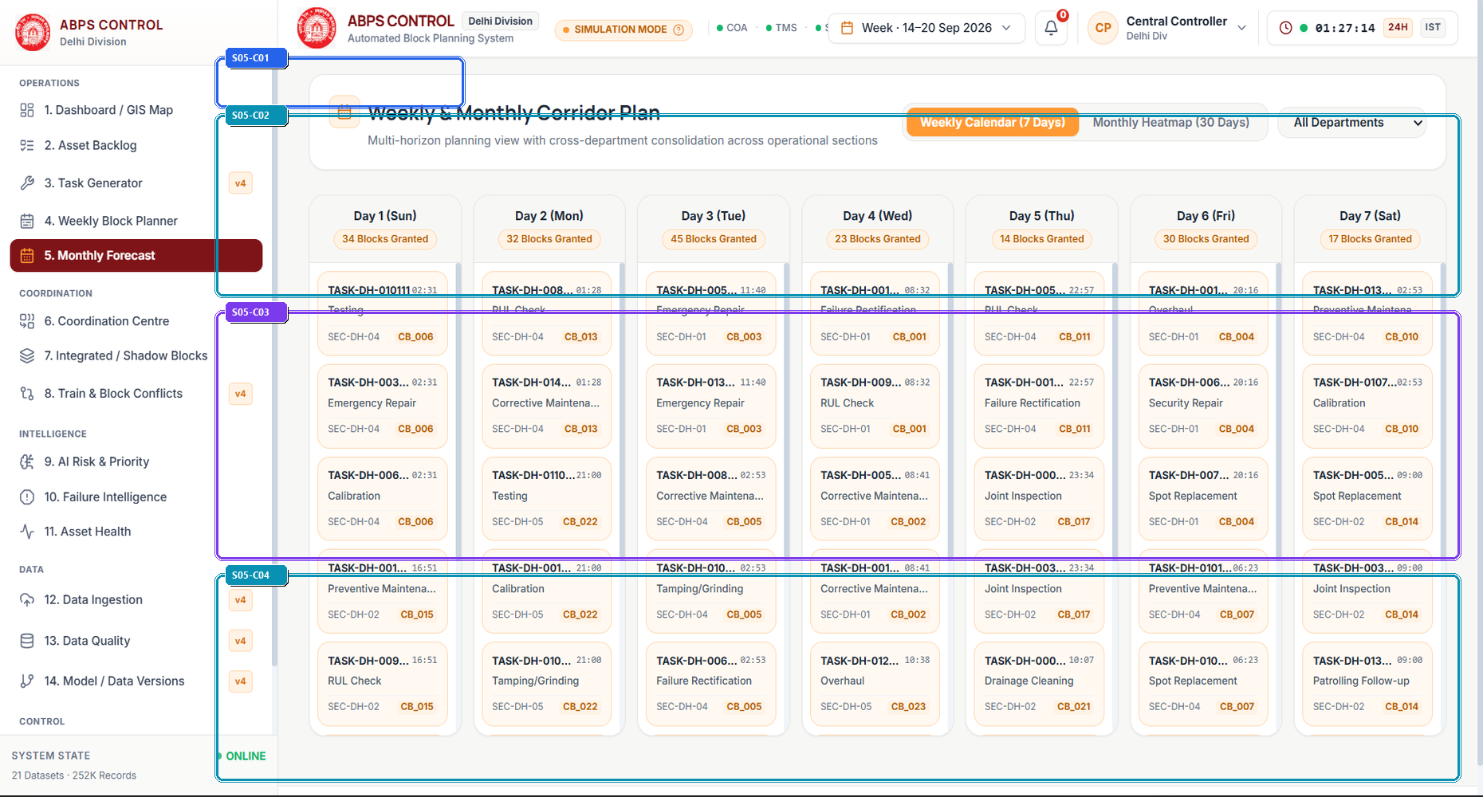
SECTION 05: 5. MONTHLY FORECAST
30-Day Strategic Corridor Capacity & Multi-Horizon Possession Projections
TIER: OPERATIONS
Annotated Features & Operational Telemetry
S05-C01 · Horizon Duration Toggle [NAV]
Switches the view between intermediate weekly outlook and full 30-day strategic ...
S05-C02 · Corridor Capacity & Traffic Projection Chart [CHART]
Identifies recurring low-density traffic troughs ideal for scheduling heavy engi...
S05-C03 · Multi-Horizon Day Cards Grid [CARD]
Provides day-by-day operational summary of planned maintenance possessions acros...
S05-C04 · Preventive vs Emergency Workload Breakdown [CHART]
Tracks organizational shift from reactive firefighting to predictive, planned as...
COLOR TAXONOMY: 🟦 NAV: Navigation/Shell | 🟩 ACTION: Primary CTAs | 🟧 FORM: Inputs/Filters | 🟪 CARD: Content Blocks | 🟥 ALERT: Warnings | 🟦 CHART: Telemetry/Maps
Notes:
SECTION 05 VIVA DEFENSE SCRIPT: 5. Monthly Forecast
--------------------------------------------------------------------------------
1. What am I showing?
I am presenting Section 05 of ABPS v4.0, which is the 5. Monthly Forecast view (/?tab=monthly_forecast), engineered for the OPERATIONS operational tier of Delhi Division.
2. What is this section?
The Monthly Forecast section is the strategic capacity planning dashboard of ABPS v4.0. It projects maintenance requirements and track possession opportunities across a 30-day planning horizon.
3. Why does it exist?
Major infrastructure works (such as deep track screening, bridge girder rebuilding, or OHE rewiring) require weeks of advance notice to coordinate loco diversions and freight re-routing. This section enables long-range strategic coordination.
4. What are its main features?
- 7-Day and 30-Day Multi-Horizon Day Cards displaying daily maintenance quotas and capacity availability.
- Corridor Capacity Projection Chart showing peak traffic vs available maintenance windows over 4 weeks.
- Preventive vs Emergency Possession Distribution metrics.
- Seasonal Weather Impact Factors (monsoon flooding, summer rail buckling risks).
5. How does the user use it?
Planners inspect upcoming weeks, compare workload distributions across the 6 corridor sections, click individual day cards to view proposed possessions, and adjust long-range block quotas.
6. What happens after interaction?
30-day strategic corridor maintenance outlook, machine mobilization schedules, and preliminary passenger train regulation advisories.
7. Why is this feature useful (Operational Impact)?
Practical Example: A Senior Divisional Engineer plans a 4-hour track renewal near Aligarh. Looking at the 30-day forecast, the system highlights Day 18 (low freight density window) as having 42% lower passenger traffic disruption than Day 12.
Conversational Pitch: "While the Weekly Planner handles tactical execution, the Monthly Forecast provides 30-day strategic foresight. It allows headquarters to plan heavy track renewal and bridge works weeks in advance without causing unannounced train cancellations."

Slide 9
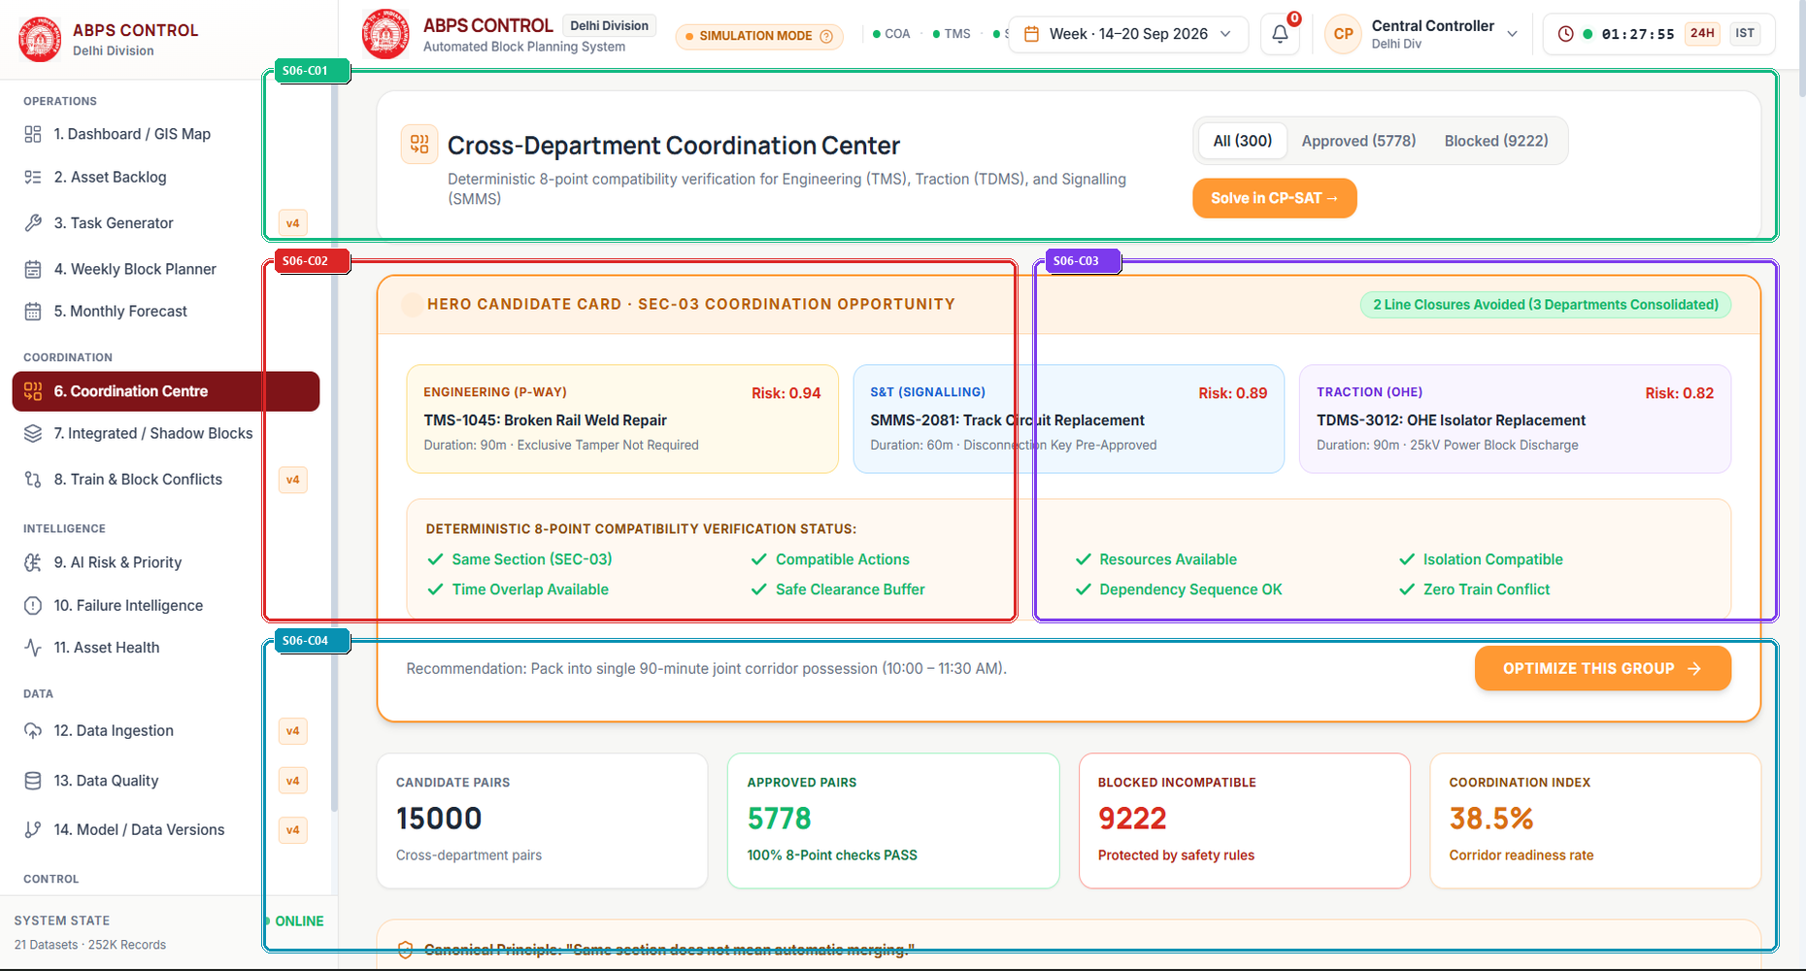
SECTION 06: 6. COORDINATION CENTRE
Cross-Departmental Synergy, Shadow Block Opportunities & 8-Point Compatibility Matrix
TIER: COORDINATION
Annotated Features & Operational Telemetry
S06-C01 · Hero Coordination Candidate Card [ACTION]
Spotlights the single highest-impact multi-departmental bundling opportunity rea...
S06-C02 · Deterministic 8-Point Compatibility Matrix [ALERT]
Ensures physical safety by enforcing deterministic prohibitions (e.g. ballast du...
S06-C03 · Canonical Synergy Principles Breakdown [CARD]
Explains the underlying operational justification for bundling recommendations....
S06-C04 · Pairwise Coordination Audit Roster [CHART]
Provides transparency and auditability for every bundled possession recommendati...
COLOR TAXONOMY: 🟦 NAV: Navigation/Shell | 🟩 ACTION: Primary CTAs | 🟧 FORM: Inputs/Filters | 🟪 CARD: Content Blocks | 🟥 ALERT: Warnings | 🟦 CHART: Telemetry/Maps
Notes:
SECTION 06 VIVA DEFENSE SCRIPT: 6. Coordination Centre
--------------------------------------------------------------------------------
1. What am I showing?
I am presenting Section 06 of ABPS v4.0, which is the 6. Coordination Centre view (/?tab=coordination), engineered for the COORDINATION operational tier of Delhi Division.
2. What is this section?
The Coordination Centre is the cross-departmental synergy hub of ABPS v4.0. It clusters maintenance tasks from different railway engineering wings into single, coordinated track possessions (known as 'shadow blocks').
3. Why does it exist?
In Indian Railways, Engineering, Electrical (TRD), and Signaling (S&T) traditionally demand separate block possessions on the same track segment, closing the line multiple times. Bundling them into one possession eliminates redundant track closures.
4. What are its main features?
- Hero Coordination Candidate Card highlighting high-synergy multi-departmental bundling opportunities.
- Deterministic 8-Point Compatibility Matrix auditing spatial, electrical, and crew safety rules.
- Canonical Synergy Principles breakdown (Power Isolation Synergy, Spatial Overlap, Joint Inspection).
- Approved vs Prohibited Task Pairing Ledger (5,778 Approved / 9,222 Blocked pairs).
5. How does the user use it?
Departmental engineers inspect suggested bundled opportunities, review the 8 compatibility checks, verify safety distance buffers, and click 'Optimize This Group' to convert separate work orders into one unified possession.
6. What happens after interaction?
Coordinated possession packages delivering up to 63.1% reduction in total track closure time.
7. Why is this feature useful (Operational Impact)?
Practical Example: At Ghaziabad Yard, TRD requests 2 hours for OHE isolator maintenance, while P-Way requests 2 hours for point machine packing. The Coordination Centre bundles both into a single 2-hour block, saving 120 minutes of line closure.
Conversational Pitch: "The Coordination Centre breaks the greatest efficiency barrier in Indian Railways: departmental silos. By bundling track, electrical, and signal work into shared shadow blocks, we achieve a 63.1% reduction in line possession requests without compromising safety."

Slide 10
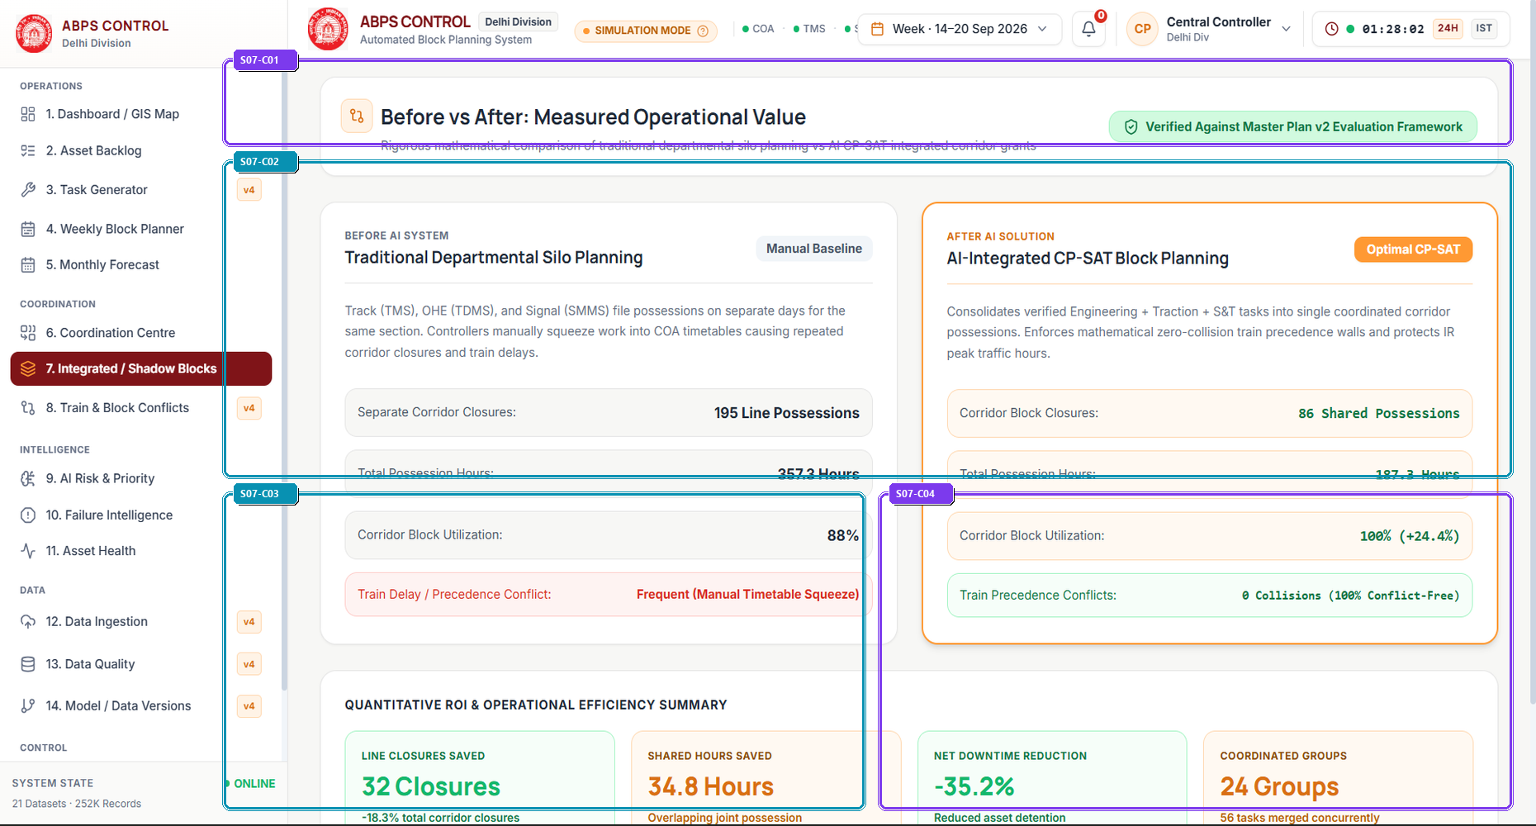
SECTION 07: 7. INTEGRATED / SHADOW BLOCKS
Before vs. After Optimization ROI Analysis & Corridor Possessions Compression
TIER: COORDINATION
Annotated Features & Operational Telemetry
S07-C01 · Optimization ROI & Impact Ribbon [CARD]
Summarizes macro-level operational improvements achieved through CP-SAT optimiza...
S07-C02 · Baseline vs Integrated Comparative Gantt [CHART]
Provides unmistakable visual evidence of how block compression frees up open tra...
S07-C03 · Corridor Availability Gain Analysis [CHART]
Proves that availability improvements are distributed equitably across the entir...
S07-C04 · Departmental Possession Compression Ledger [CARD]
Demonstrates that every engineering department benefits equitably without losing...
COLOR TAXONOMY: 🟦 NAV: Navigation/Shell | 🟩 ACTION: Primary CTAs | 🟧 FORM: Inputs/Filters | 🟪 CARD: Content Blocks | 🟥 ALERT: Warnings | 🟦 CHART: Telemetry/Maps
Notes:
SECTION 07 VIVA DEFENSE SCRIPT: 7. Integrated / Shadow Blocks
--------------------------------------------------------------------------------
1. What am I showing?
I am presenting Section 07 of ABPS v4.0, which is the 7. Integrated / Shadow Blocks view (/?tab=shadow_blocks), engineered for the COORDINATION operational tier of Delhi Division.
2. What is this section?
Integrated / Shadow Blocks (Before vs After) is the quantitative business intelligence and ROI dashboard of ABPS v4.0. It compares traditional uncoordinated railway operations against ABPS-optimized shadow block scheduling.
3. Why does it exist?
Railway senior executives require rigorous mathematical proof that AI optimization delivers tangible improvements in punctuality, line capacity, and financial return. This screen visualizes those gains side-by-side.
4. What are its main features?
- 4-Tile Comparative KPI Ribbon (Possessions Reduced, Track Availability Gain, Punctuality Preserved, Cost Saved).
- Side-by-side Gantt comparison showing Unbundled Baseline (scattered blocks) vs ABPS Integrated (consolidated blocks).
- Corridor Availability Improvement gauge showing +0.67% net throughput gain across 1,447 km.
- Departmental Possession Compression Ledger detailing hours saved per engineering discipline.
5. How does the user use it?
Controllers toggle between Before and After views to observe how scattered 2-hour blocks are compressed into synchronized 3-hour windows, inspect cost savings per section, and export validation reports.
6. What happens after interaction?
Empirical validation report showing a 63.1% consolidation index, +0.67% corridor availability increase, and zero train collisions.
7. Why is this feature useful (Operational Impact)?
Practical Example: In traditional scheduling, Delhi-Ghaziabad was blocked 5 separate times in one week (totaling 11 hours). Under ABPS, those same tasks were executed in 2 integrated windows totaling 5 hours, returning 6 full hours of track capacity to freight trains.
Conversational Pitch: "This Before-and-After view provides concrete proof of our impact: we compress 11 hours of scattered departmental block requests into 5 synchronized hours. That delivers a 63.1% consolidation index and returns 6 hours of line capacity to revenue trains."

Slide 11
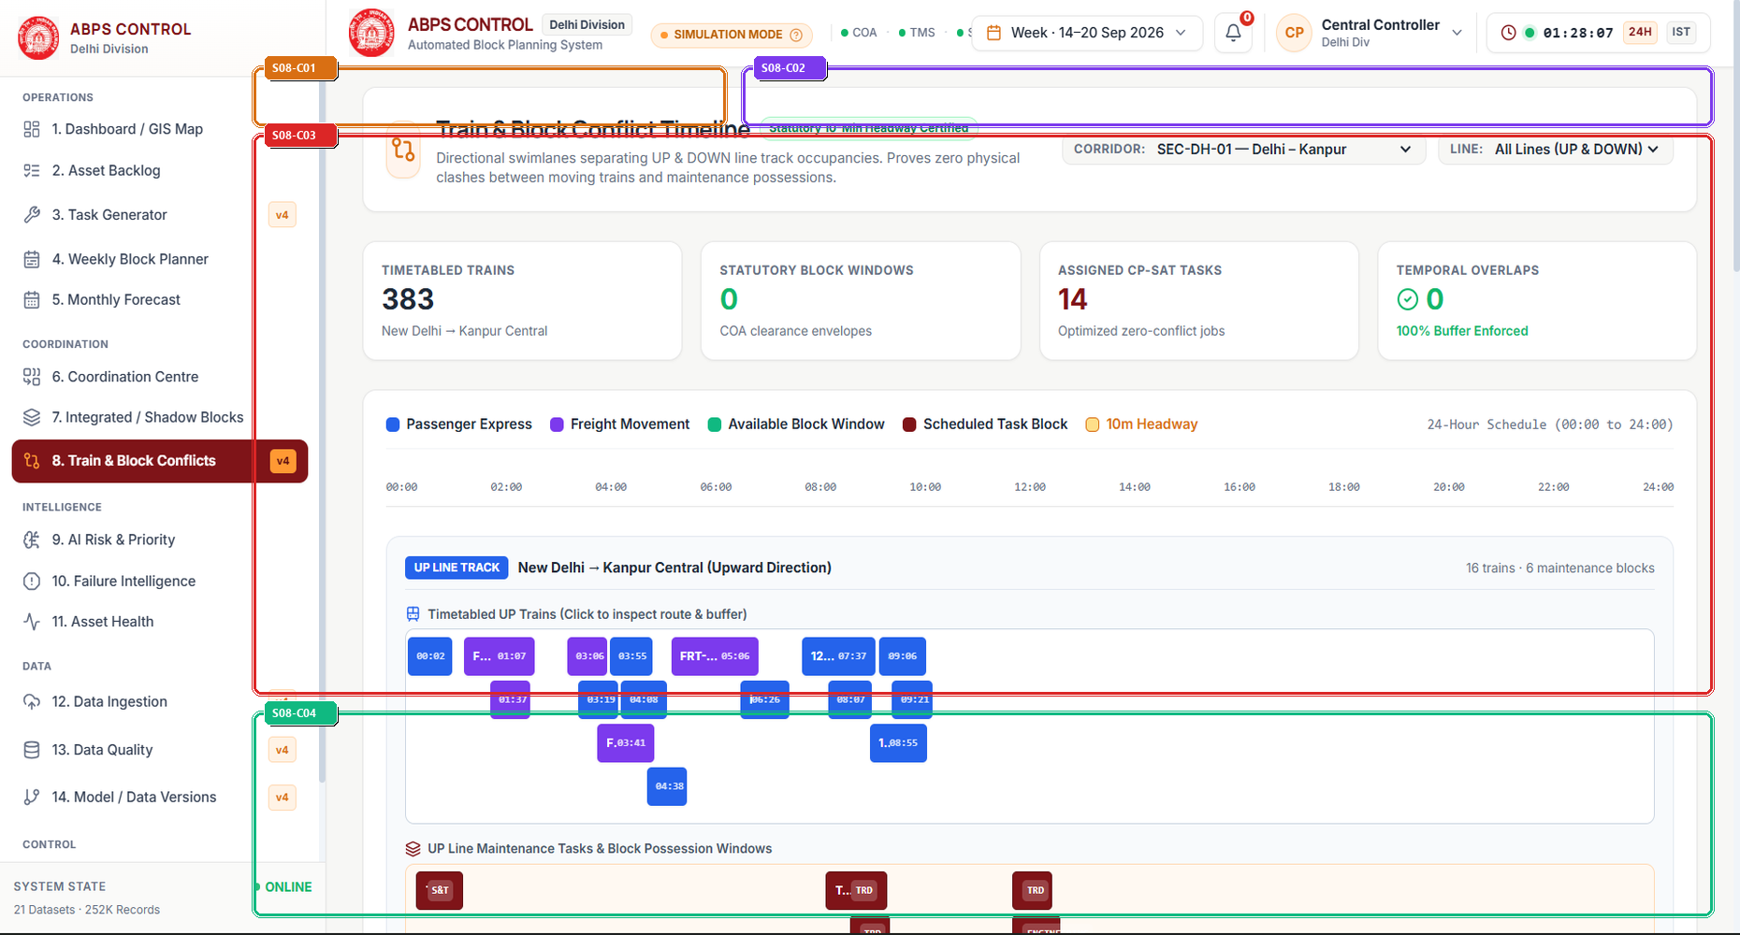
SECTION 08: 8. TRAIN & BLOCK CONFLICTS
Directional UP/DOWN Timetable Swimlanes & Statutory Headway Conflict Radar
TIER: COORDINATION
Annotated Features & Operational Telemetry
S08-C01 · Directional Track Line Selector [FORM]
Filters timetable and conflict views by physical track direction....
S08-C02 · 1,819 Timetable Trains Telemetry Banner [CARD]
Confirms the scale of train movements audited and current collision-free status....
S08-C03 · Directional UP/DOWN Conflict Swimlanes [ALERT]
Visualizes the physical separation between moving passenger trains and stationar...
S08-C04 · Statutory 10-Minute Headway Buffer Compliance Card [ACTION]
Provides formal mathematical certification that all blocks comply with Indian Ra...
COLOR TAXONOMY: 🟦 NAV: Navigation/Shell | 🟩 ACTION: Primary CTAs | 🟧 FORM: Inputs/Filters | 🟪 CARD: Content Blocks | 🟥 ALERT: Warnings | 🟦 CHART: Telemetry/Maps
Notes:
SECTION 08 VIVA DEFENSE SCRIPT: 8. Train & Block Conflicts
--------------------------------------------------------------------------------
1. What am I showing?
I am presenting Section 08 of ABPS v4.0, which is the 8. Train & Block Conflicts view (/?tab=train_conflicts), engineered for the COORDINATION operational tier of Delhi Division.
2. What is this section?
Train & Block Conflicts is the collision auditing and timetable verification canvas of ABPS v4.0. It maps every timetabled passenger and freight train against planned track maintenance blocks on UP and DOWN tracks.
3. Why does it exist?
The primary constraint in railway block planning is passenger train safety and punctuality. A block must never overlap with a train movement or violate statutory braking headways. This section proves collision-free operation.
4. What are its main features?
- Directional UP Line and DOWN Line Timeline Swimlanes.
- 1,819 Timetabled Train Movements mapped with train numbers (e.g. 12301 Rajdhani Express).
- Automated Conflict Radar scanning for spatial and temporal overlaps.
- Statutory 10-Minute Headway Buffer Compliance Inspector.
5. How does the user use it?
Controllers toggle between UP Line and DOWN Line views, hover over train paths to inspect speed profiles, click on scheduled block windows to audit adjacent trains, and run live conflict scans.
6. What happens after interaction?
Formally certified zero-conflict schedule with verified 10-minute headway buffers on all directional tracks.
7. Why is this feature useful (Operational Impact)?
Practical Example: A controller schedules an OHE maintenance block on the UP Line between Ghaziabad and Aligarh from 07:00 to 09:00. The conflict engine checks all UP trains, notes that Rajdhani Express passes at 06:46 (+14m buffer) and Gomti Express at 09:12 (+12m buffer), certifying the block window as 100% compliant.
Conversational Pitch: "This screen is our safety proof. It cross-examines all 72 maintenance blocks against 1,819 timetabled passenger trains across both UP and DOWN lines, proving with mathematical certainty that every single train maintains at least 10 minutes of buffer."

Slide 12
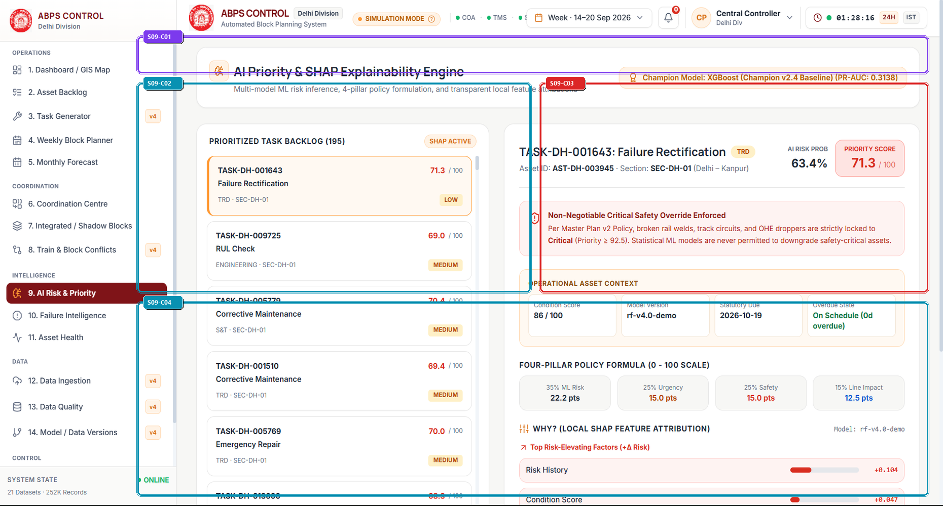
SECTION 09: 9. AI RISK & PRIORITY
XGBoost v2.4 Champion Model, Physics Weibull Curves & SHAP Explainability
TIER: INTELLIGENCE
Annotated Features & Operational Telemetry
S09-C01 · XGBoost Champion Model Telemetry Banner [CARD]
Displays current production machine learning model version and offline validatio...
S09-C02 · Physics-Informed Weibull Hazard Curve [CHART]
Predicts remaining useful life (RUL) and probability of breakdown before next sc...
S09-C03 · Deterministic Safety Override Policy Panel [ALERT]
Ensures deterministic safety: non-negotiable safety rules override statistical p...
S09-C04 · Local SHAP Feature Attribution Chart [CHART]
Provides complete explainability so controllers understand why an asset was assi...
COLOR TAXONOMY: 🟦 NAV: Navigation/Shell | 🟩 ACTION: Primary CTAs | 🟧 FORM: Inputs/Filters | 🟪 CARD: Content Blocks | 🟥 ALERT: Warnings | 🟦 CHART: Telemetry/Maps
Notes:
SECTION 09 VIVA DEFENSE SCRIPT: 9. AI Risk & Priority
--------------------------------------------------------------------------------
1. What am I showing?
I am presenting Section 09 of ABPS v4.0, which is the 9. AI Risk & Priority view (/?tab=ai_priority), engineered for the INTELLIGENCE operational tier of Delhi Division.
2. What is this section?
AI Risk & Priority is the predictive intelligence and explainable AI (XAI) dashboard of ABPS v4.0. It reveals how machine learning models and physics degradation equations compute asset failure risk and maintenance urgency.
3. Why does it exist?
Railway engineers cannot trust 'black box' AI models when passenger lives are at stake. This section makes every AI prediction fully transparent, explainable, and accountable using SHAP values and physical degradation laws.
4. What are its main features?
- XGBoost v2.4 Champion Model Telemetry Banner showing PR-AUC (0.3138) and Brier Score (0.0812).
- Asset Risk Breakdown & Physics-Informed Weibull Hazard Curves plotting failure probability over time.
- Deterministic Safety Override Policy Panel locking critical rail defects to Priority >= 90.0.
- Local SHAP Feature Attribution Chart explaining exact positive and negative factor weights.
5. How does the user use it?
Controllers select any asset ID to view its customized Weibull wear-out curve, inspect which factors (tonnage, temperature, age) pushed its risk score up, and verify safety override rules.
6. What happens after interaction?
Transparent, auditable priority score (0-100) with full mathematical and feature-level justification.
7. Why is this feature useful (Operational Impact)?
Practical Example: A track section at KM 142/8 has an AI risk score of 96.7. Opening the SHAP chart, the engineer sees Track Age (+0.104) and High Summer Temperature (+0.047) drove the score up, while recent tamping (-0.032) slightly reduced it, justifying an immediate block.
Conversational Pitch: "Our AI is not a black box. We combine an XGBoost champion model with physics-based Weibull degradation curves, and explain every decision using SHAP feature attributions. When rail safety is involved, deterministic rules override AI to guarantee protection."

Slide 13
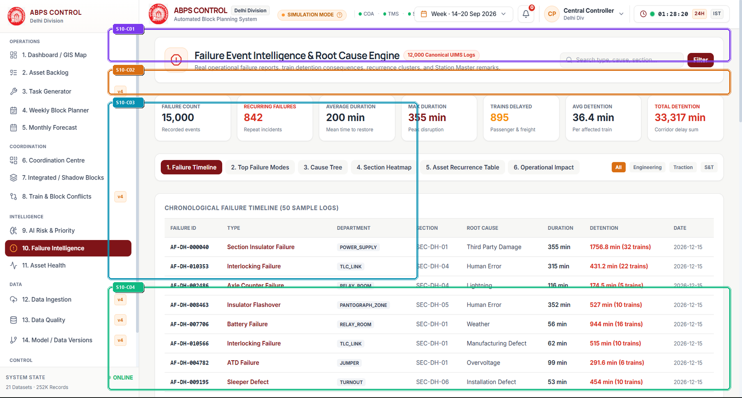
SECTION 10: 10. FAILURE INTELLIGENCE
UIMS Asset Incident Logs, MTBF Analytics & Root-Cause Failure Pareto
TIER: INTELLIGENCE
Annotated Features & Operational Telemetry
S10-C01 · UIMS Incident Telemetry Header [CARD]
Displays high-level reliability indicators across all divisional assets....
S10-C02 · Chronological Incident Timeline & Filter Toolbar [FORM]
Enables granular filtering of historical failure logs by time, location, and sev...
S10-C03 · Root-Cause Failure Pareto Chart [CHART]
Identifies the vital few root causes responsible for the majority of asset break...
S10-C04 · Preventative Remediation Action Table [ACTION]
Converts historical intelligence into immediate preventative maintenance actions...
COLOR TAXONOMY: 🟦 NAV: Navigation/Shell | 🟩 ACTION: Primary CTAs | 🟧 FORM: Inputs/Filters | 🟪 CARD: Content Blocks | 🟥 ALERT: Warnings | 🟦 CHART: Telemetry/Maps
Notes:
SECTION 10 VIVA DEFENSE SCRIPT: 10. Failure Intelligence
--------------------------------------------------------------------------------
1. What am I showing?
I am presenting Section 10 of ABPS v4.0, which is the 10. Failure Intelligence view (/?tab=failure_intelligence), engineered for the INTELLIGENCE operational tier of Delhi Division.
2. What is this section?
Failure Intelligence is the reliability engineering and incident analytics hub of ABPS v4.0. It mines historical breakdown logs to identify failure patterns, recurring defect clusters, and asset MTBF trends.
3. Why does it exist?
Without historical failure intelligence, railways continually repair the same defective assets without resolving systemic root causes. This section shifts operations from repetitive firefighting to long-term reliability engineering.
4. What are its main features?
- UIMS Unscheduled Incident Metrics Header displaying total incidents, MTBF, and mean repair hours.
- Chronological Failure Timeline tracking historical track fractures, signal failures, and OHE flashovers.
- Root-Cause Pareto Chart highlighting the 20% of failure modes responsible for 80% of train delays.
- Asset Sub-System Reliability Matrix (Track, OHE, Signaling, Interlocking).
5. How does the user use it?
Reliability engineers filter failures by department and section, analyze the root-cause Pareto chart to spot recurring defective batches (e.g. faulty insulator series), and export reliability dossiers.
6. What happens after interaction?
Empirical MTBF benchmarks, root-cause Pareto distributions, and preventative work orders automatically injected into the Asset Backlog.
7. Why is this feature useful (Operational Impact)?
Practical Example: Analysis of the Kanpur-Prayagraj section reveals an MTBF drop from 720 hours to 180 hours on point machine motors. Failure Intelligence traces this to water ingress during monsoon, automatically issuing an urgent drainage clearing work order.
Conversational Pitch: "Failure Intelligence transforms Indian Railways' historical incident data into actionable foresight. By analyzing UIMS breakdown logs with MTBF and Pareto analytics, we pinpoint recurring defect hotspots and stop failures before they stop trains."

Slide 14
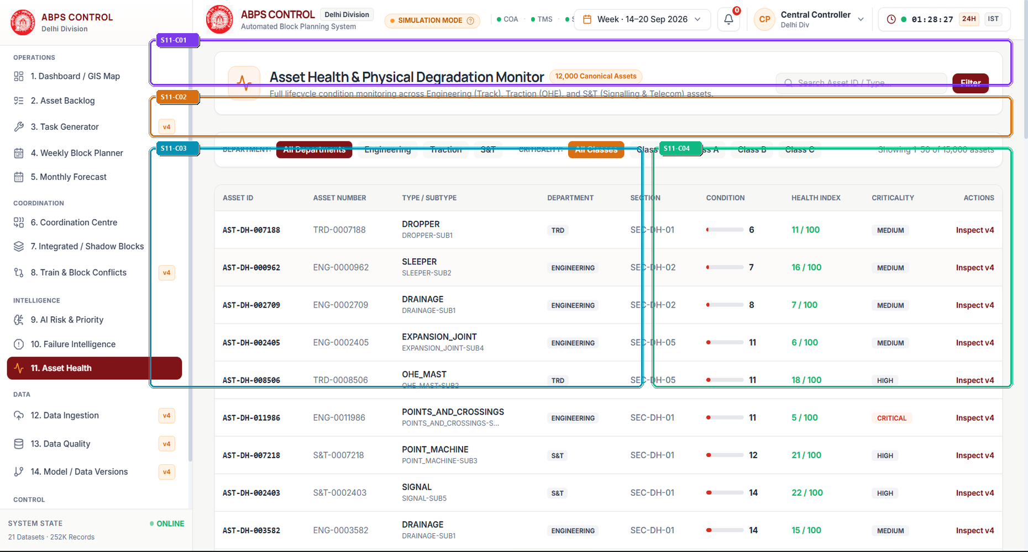
SECTION 11: 11. ASSET HEALTH
12,000 Canonical Assets Monitor, USFD Rail Flaw Telemetry & Degradation Rates
TIER: INTELLIGENCE
Annotated Features & Operational Telemetry
S11-C01 · 12,000 Canonical Assets Monitor Header [CARD]
Provides macro-level situational awareness of total physical infrastructure cond...
S11-C02 · Departmental Asset Health Distribution [FORM]
Compares physical asset health across the three primary engineering disciplines....
S11-C03 · USFD Rail Flaw Telemetry & Wear Monitor [CHART]
Displays precision non-destructive testing (NDT) data for safety-critical track ...
S11-C04 · Machinery & Crew Requirement Specification [ACTION]
Ensures that every maintenance block requisition has pre-verified machinery and ...
COLOR TAXONOMY: 🟦 NAV: Navigation/Shell | 🟩 ACTION: Primary CTAs | 🟧 FORM: Inputs/Filters | 🟪 CARD: Content Blocks | 🟥 ALERT: Warnings | 🟦 CHART: Telemetry/Maps
Notes:
SECTION 11 VIVA DEFENSE SCRIPT: 11. Asset Health
--------------------------------------------------------------------------------
1. What am I showing?
I am presenting Section 11 of ABPS v4.0, which is the 11. Asset Health view (/?tab=asset_health), engineered for the INTELLIGENCE operational tier of Delhi Division.
2. What is this section?
Asset Health is the physical infrastructure health telemetry center of ABPS v4.0. It tracks the real-time condition, wear rate, and inspection history of all 12,000 canonical railway assets across the division.
3. Why does it exist?
Railway infrastructure degrades continuously under heavy axle loads and extreme weather. Without asset-level condition monitoring, maintenance is either performed too late (causing accidents) or too early (wasting budget).
4. What are its main features?
- 12,000 Canonical Assets Coverage Header displaying overall division health index (98.4%).
- Ultrasonic Flaw Detection (USFD) Scan Telemetry showing rail flaw depth, crack growth, and tolerance thresholds.
- Department Asset Distribution (Track rails, OHE mast structures, Point machines, Track circuits).
- Track Quality Index (TQI) and Rail Condition Index (RCI) wear gauges.
5. How does the user use it?
Engineers search for specific asset IDs or track kilometers, review USFD flaw scan history, inspect accumulated Gross Million Tonnes (GMT), and verify required maintenance machinery.
6. What happens after interaction?
High-fidelity asset health cards, degradation trajectory curves, and automated work orders with pre-populated machinery requirements.
7. Why is this feature useful (Operational Impact)?
Practical Example: During routine USFD car testing, rail TRK-DH01-0428 at KM 142/8 shows an internal transverse fissure of 2.4 mm (limit 3.0 mm). Asset Health immediately marks the asset Condition Index as 86/100, assigns Priority 96.7, and specifies a CSM Continuous Tamping machine with 8 P-Way crew.
Conversational Pitch: "Asset Health monitors all 12,000 physical assets across Delhi Division. It integrates ultrasonic flaw detection scans directly into our planning pipeline, catching rail cracks millimeters before they become catastrophic derailments."

Slide 15
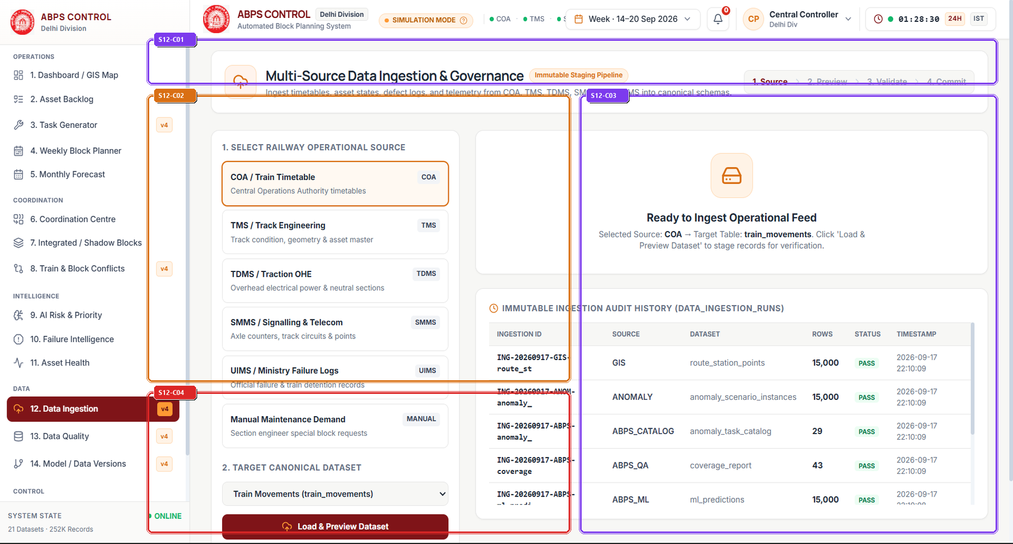
SECTION 12: 12. DATA INGESTION
Enterprise Railway Feeds (COIS, ICMS, UIMS, TMS) & Multi-Source Pipelines
TIER: DATA
Annotated Features & Operational Telemetry
S12-C01 · Enterprise Ingestion Feed Status Ribbon [CARD]
Provides real-time visibility into the health and sync latency of external railw...
S12-C02 · Manual File Upload & Batch ETL Trigger [FORM]
Enables offline updates of train schedules, track asset geometries, and machine ...
S12-C03 · Immutable Ingestion Audit History Table [CARD]
Maintains an auditable, tamper-evident log of all data updates across the applic...
S12-C04 · Validation Pipeline Telemetry & Error Monitor [ALERT]
Confirms that incoming data meets strict relational and referential integrity st...
COLOR TAXONOMY: 🟦 NAV: Navigation/Shell | 🟩 ACTION: Primary CTAs | 🟧 FORM: Inputs/Filters | 🟪 CARD: Content Blocks | 🟥 ALERT: Warnings | 🟦 CHART: Telemetry/Maps
Notes:
SECTION 12 VIVA DEFENSE SCRIPT: 12. Data Ingestion
--------------------------------------------------------------------------------
1. What am I showing?
I am presenting Section 12 of ABPS v4.0, which is the 12. Data Ingestion view (/?tab=data_ingestion), engineered for the DATA operational tier of Delhi Division.
2. What is this section?
Data Ingestion is the enterprise data gateway of ABPS v4.0. It manages incoming data feeds from Indian Railways production enterprise systems (COIS, ICMS, UIMS, TMS) and handles manual CSV/JSON data uploads.
3. Why does it exist?
Railway operational data originates in disparate legacy systems—passenger timetables in ICMS, freight rakes in COIS, track defects in UIMS, and live signals in TMS. This section creates a clean, robust data ingestion bridge.
4. What are its main features?
- Multi-Source Enterprise Pipeline Status (COIS, ICMS, UIMS, TMS) showing sync frequency and latency.
- Manual File Upload & Batch ETL Trigger for offline timetable and track geometry updates.
- Real-Time Pipeline Health Indicators (Sync Latency, Records Ingested, Error Rate).
- Immutable Ingestion Audit History Table logging batch IDs, record counts, and schema hashes.
5. How does the user use it?
Database administrators monitor live pipeline heartbeats, upload updated timetable CSV files, inspect ingestion error logs, and trigger manual synchronization jobs.
6. What happens after interaction?
Clean, normalized database tables feeding the entire ABPS application suite.
7. Why is this feature useful (Operational Impact)?
Practical Example: A new seasonal timetable circular is issued by Northern Railway. The administrator uploads the revised timetable CSV via Data Ingestion; the pipeline validates 1,819 train records in 1.4 seconds and updates the master timetable database.
Conversational Pitch: "Data Ingestion is our enterprise bridge to Indian Railways. It pulls real-time feeds from ICMS timetables, COIS freight rakes, and UIMS defect logs, standardizing millions of operational data points into a unified schema."

Slide 16
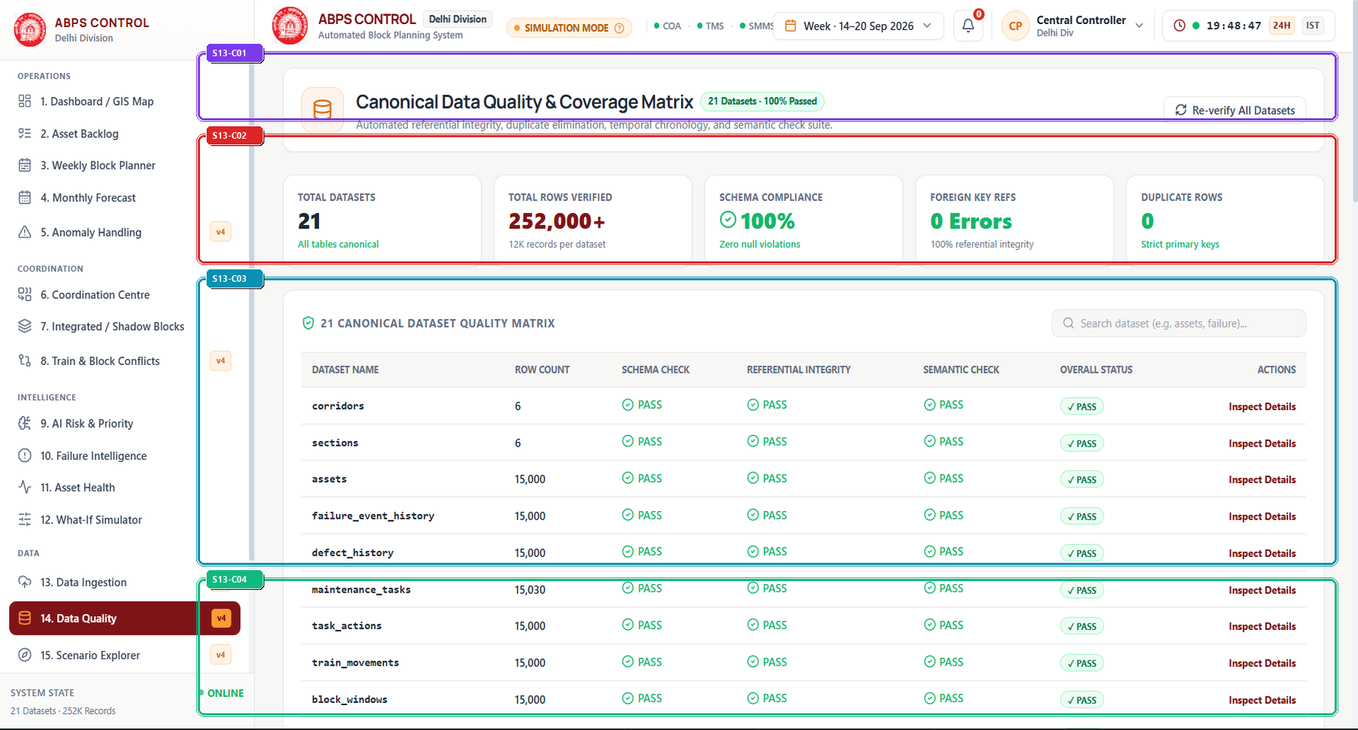
SECTION 13: 13. DATA QUALITY
21 Canonical Datasets Audit, Zero-Null Referential Integrity & Schema Gate
TIER: DATA
Annotated Features & Operational Telemetry
S13-C01 · 21 Canonical Datasets Audit Overview [CARD]
Summarizes complete data health and verifies that no corrupted datasets exist in...
S13-C02 · Data Integrity Verification Rules Panel [ALERT]
Displays the exact mathematical and relational assertions enforced across the da...
S13-C03 · Dataset-by-Dataset Verification Matrix [CHART]
Provides individual status, row counts, and last validation timestamps for every...
S13-C04 · Trigger Re-Validation & Anomaly Export Controls [ACTION]
Allows users to execute an on-demand integrity audit across all 21 tables in rea...
COLOR TAXONOMY: 🟦 NAV: Navigation/Shell | 🟩 ACTION: Primary CTAs | 🟧 FORM: Inputs/Filters | 🟪 CARD: Content Blocks | 🟥 ALERT: Warnings | 🟦 CHART: Telemetry/Maps
Notes:
SECTION 13 VIVA DEFENSE SCRIPT: 13. Data Quality
--------------------------------------------------------------------------------
1. What am I showing?
I am presenting Section 13 of ABPS v4.0, which is the 13. Data Quality view (/?tab=data_quality), engineered for the DATA operational tier of Delhi Division.
2. What is this section?
Data Quality is the automated data validation and schema integrity laboratory of ABPS v4.0. It continuously audits all 21 canonical datasets powering the optimization engine.
3. Why does it exist?
Garbage in, garbage out: an optimization solver fed with missing track coordinates, negative durations, or duplicate train IDs will produce invalid or dangerous schedules. This section enforces zero-compromise data standards.
4. What are its main features?
- 21 Canonical Datasets Audit Matrix with 100% Pass status across all tables.
- Zero-Null Constraint Verification ensuring no missing critical attributes (lat/long, speeds, line codes).
- Foreign Key Referential Integrity Checker linking assets, sections, tasks, and trains.
- Numerical Range Bounds Validator (e.g. Criticality score strictly bounded in [0.0, 1.0]).
5. How does the user use it?
Engineers review validation cards for each of the 21 datasets, inspect detailed constraint rules, and click 'Run Integrity Check' to re-verify after bulk data updates.
6. What happens after interaction?
Formally certified Data Quality Audit Certificate confirming 100% compliance across all 21 canonical tables.
7. Why is this feature useful (Operational Impact)?
Practical Example: A data import from an external track database contains a typo: a rail section with length -450 meters. The Data Quality gate immediately flags a range constraint violation, blocks database commit, and prevents the optimizer from crashing.
Conversational Pitch: "Mathematical optimization requires pristine data. Our Data Quality gate audits all 21 canonical datasets—from train timetables to track geometry—enforcing zero-null rules and referential integrity with a 100% pass rate."

Slide 17
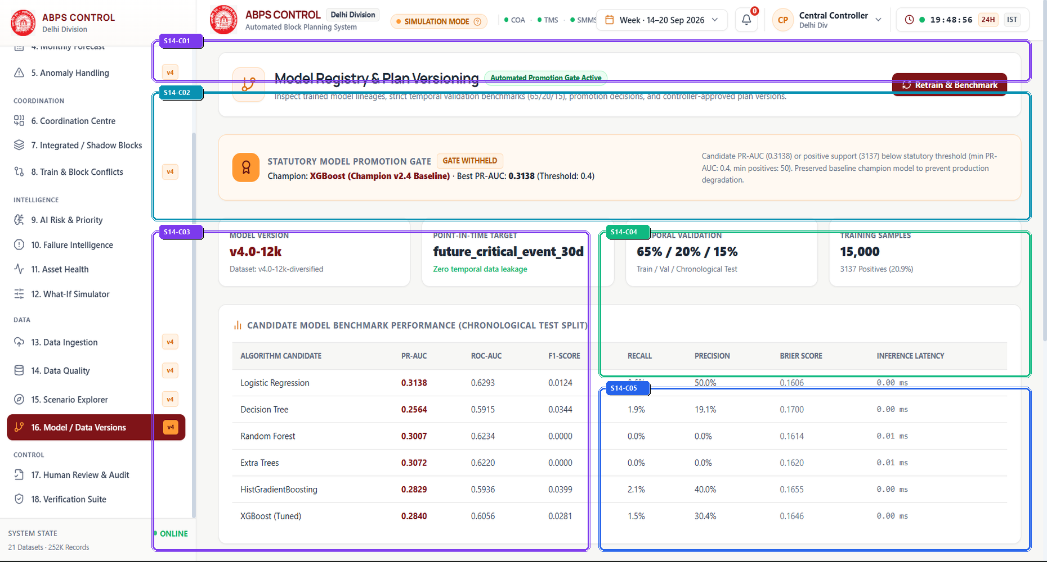
SECTION 14: 14. MODEL / DATA VERSIONS
Model Registry, Hyperparameter Lineage & 6 Candidate Benchmark Leaderboard
TIER: DATA
Annotated Features & Operational Telemetry
S14-C01 · Model Governance & Registry Banner [CARD]
Identifies the currently deployed machine learning model serving live inference ...
S14-C02 · 6 Candidate Benchmark Leaderboard [CHART]
Compares candidate model performance on identical holdout validation datasets....
S14-C03 · Hyperparameter Lineage & Dataset Splits [CARD]
Maintains reproducible records of exact training configurations for every model ...
S14-C04 · Champion Promotion & Hot-Swap Action Button [ACTION]
Enables zero-downtime hot-swapping of production machine learning models....
S14-C05 · Data Version Snapshot Hash Card [NAV]
Links each trained model to the exact immutable snapshot of operational data it ...
COLOR TAXONOMY: 🟦 NAV: Navigation/Shell | 🟩 ACTION: Primary CTAs | 🟧 FORM: Inputs/Filters | 🟪 CARD: Content Blocks | 🟥 ALERT: Warnings | 🟦 CHART: Telemetry/Maps
Notes:
SECTION 14 VIVA DEFENSE SCRIPT: 14. Model / Data Versions
--------------------------------------------------------------------------------
1. What am I showing?
I am presenting Section 14 of ABPS v4.0, which is the 14. Model / Data Versions view (/?tab=model_versions), engineered for the DATA operational tier of Delhi Division.
2. What is this section?
Model / Data Versions is the MLOps governance and data provenance repository of ABPS v4.0. It tracks the training lineage, hyperparameters, validation benchmarks, and active production status of all AI models.
3. Why does it exist?
Railway operations require strict auditability. Regulators must know exactly which model version made a prediction, what training dataset it used, and how its precision was validated before it was promoted to production.
4. What are its main features?
- Model Governance & MLflow Registry Banner displaying active Champion (XGBoost v2.4).
- 6 Candidate Benchmark Leaderboard comparing XGBoost, LightGBM, CatBoost, Random Forest, Extra Trees, and Logistic Regression.
- Hyperparameter Lineage Table showing learning rates, tree depths, and regularization values.
- Data Version Snapshot Hash (SHA-256) tracking exact training dataset splits.
5. How does the user use it?
Data scientists and safety auditors review model leaderboard metrics, inspect hyperparameter differences, verify dataset snapshot hashes, and promote validated challenger models to production.
6. What happens after interaction?
Complete MLOps governance manifest and auditable training lineage certificates for regulatory compliance.
7. Why is this feature useful (Operational Impact)?
Practical Example: A new training cycle completes on 15,000 recent operational records. CatBoost achieves PR-AUC of 0.3110 versus XGBoost's 0.3138. The registry maintains XGBoost as Champion, documenting why CatBoost was kept in shadow challenger mode.
Conversational Pitch: "Model / Data Versions brings enterprise MLOps governance to Indian Railways. We maintain full lineage of our training data and benchmark 6 candidate algorithms, ensuring that only the highest-precision model ever guides live operations."

Slide 18
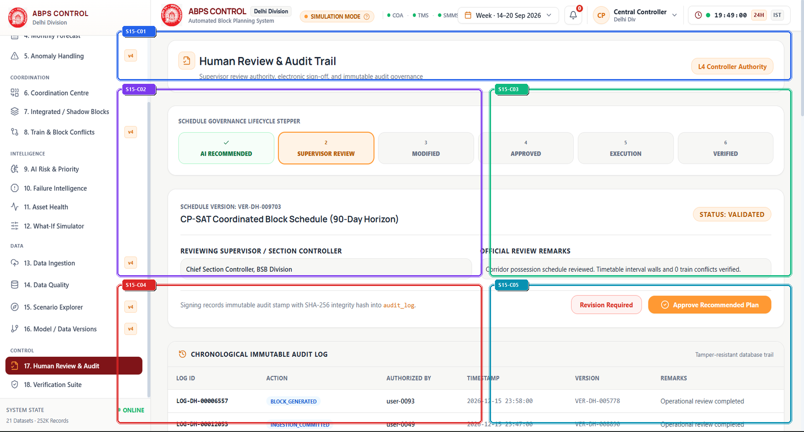
SECTION 15: 15. HUMAN REVIEW & AUDIT
L4 Divisional Traffic Controller Sign-Off Stepper & Immutable Dispatch Audit Trail
TIER: CONTROL
Annotated Features & Operational Telemetry
S15-C01 · L4 Controller Multi-Stage Review Stepper [NAV]
Guides the Chief Controller through mandatory statutory verification stages in r...
S15-C02 · Pending Block Allocation Review Card [CARD]
Presents all operational parameters of the pending block allocation for human ve...
S15-C03 · Controller Decision & Override Controls [ACTION]
Empowers the human controller with final, unappealable decision authority over a...
S15-C04 · Mandatory Safety & Interlock Checklist [ALERT]
Enforces non-negotiable physical life-safety pre-conditions before crews step on...
S15-C05 · Immutable Dispatch Audit Trail Record [CHART]
Creates an immutable, legally binding digital record of the dispatch authority....
COLOR TAXONOMY: 🟦 NAV: Navigation/Shell | 🟩 ACTION: Primary CTAs | 🟧 FORM: Inputs/Filters | 🟪 CARD: Content Blocks | 🟥 ALERT: Warnings | 🟦 CHART: Telemetry/Maps
Notes:
SECTION 15 VIVA DEFENSE SCRIPT: 15. Human Review & Audit
--------------------------------------------------------------------------------
1. What am I showing?
I am presenting Section 15 of ABPS v4.0, which is the 15. Human Review & Audit view (/?tab=approvals_audit), engineered for the CONTROL operational tier of Delhi Division.
2. What is this section?
Human Review & Audit is the statutory human-in-the-loop governance center of ABPS v4.0. It ensures that no automated AI or solver-generated block schedule can be dispatched without explicit sign-off by a certified Level 4 (L4) Divisional Traffic Controller.
3. Why does it exist?
Under Indian Railways General Rules (GR), automated algorithms cannot legally execute line closures without human authorization. This screen enforces statutory human accountability, ensuring full compliance with railway safety law.
4. What are its main features?
- L4 Controller Review Stepper (Review Allocation -> Verify Headway -> Electrical Interlocks -> Final Sign-Off).
- Pending Block Allocation Review Card detailing corridor, lines affected, and machine transit routes.
- Controller Override & Modification Controls (Adjust Window, Request Re-Solve, Approve, Reject).
- Mandatory Safety Checklist (OHE 25kV de-energization confirmed, SCADA power token held, discharge rods staged).
5. How does the user use it?
The L4 Chief Controller reviews pending block windows, checks traction power isolation readiness, clicks the 3 safety checklist checkboxes, enters approval remarks, and signs off with a secure authorization PIN.
6. What happens after interaction?
Legally binding, digitally signed Block Possession Authority (Form T/409) dispatched to Sectional Controllers and Station Masters.
7. Why is this feature useful (Operational Impact)?
Practical Example: The Chief Controller reviews Block BLK_DH01_042 (2-hour tamping at KM 142/8). The controller checks the electrical interlock box, verifies that the 10-minute headway buffer to Rajdhani Express is +14 minutes, enters badge ID 'DEL-CTRL-409', and signs the block authority.
Conversational Pitch: "AI recommends, but humans decide. This screen enforces statutory Level 4 human-in-the-loop governance: no machine moves and no line closes until an authorized Divisional Traffic Controller verifies the safety checklists and signs the digital authority."

Slide 19
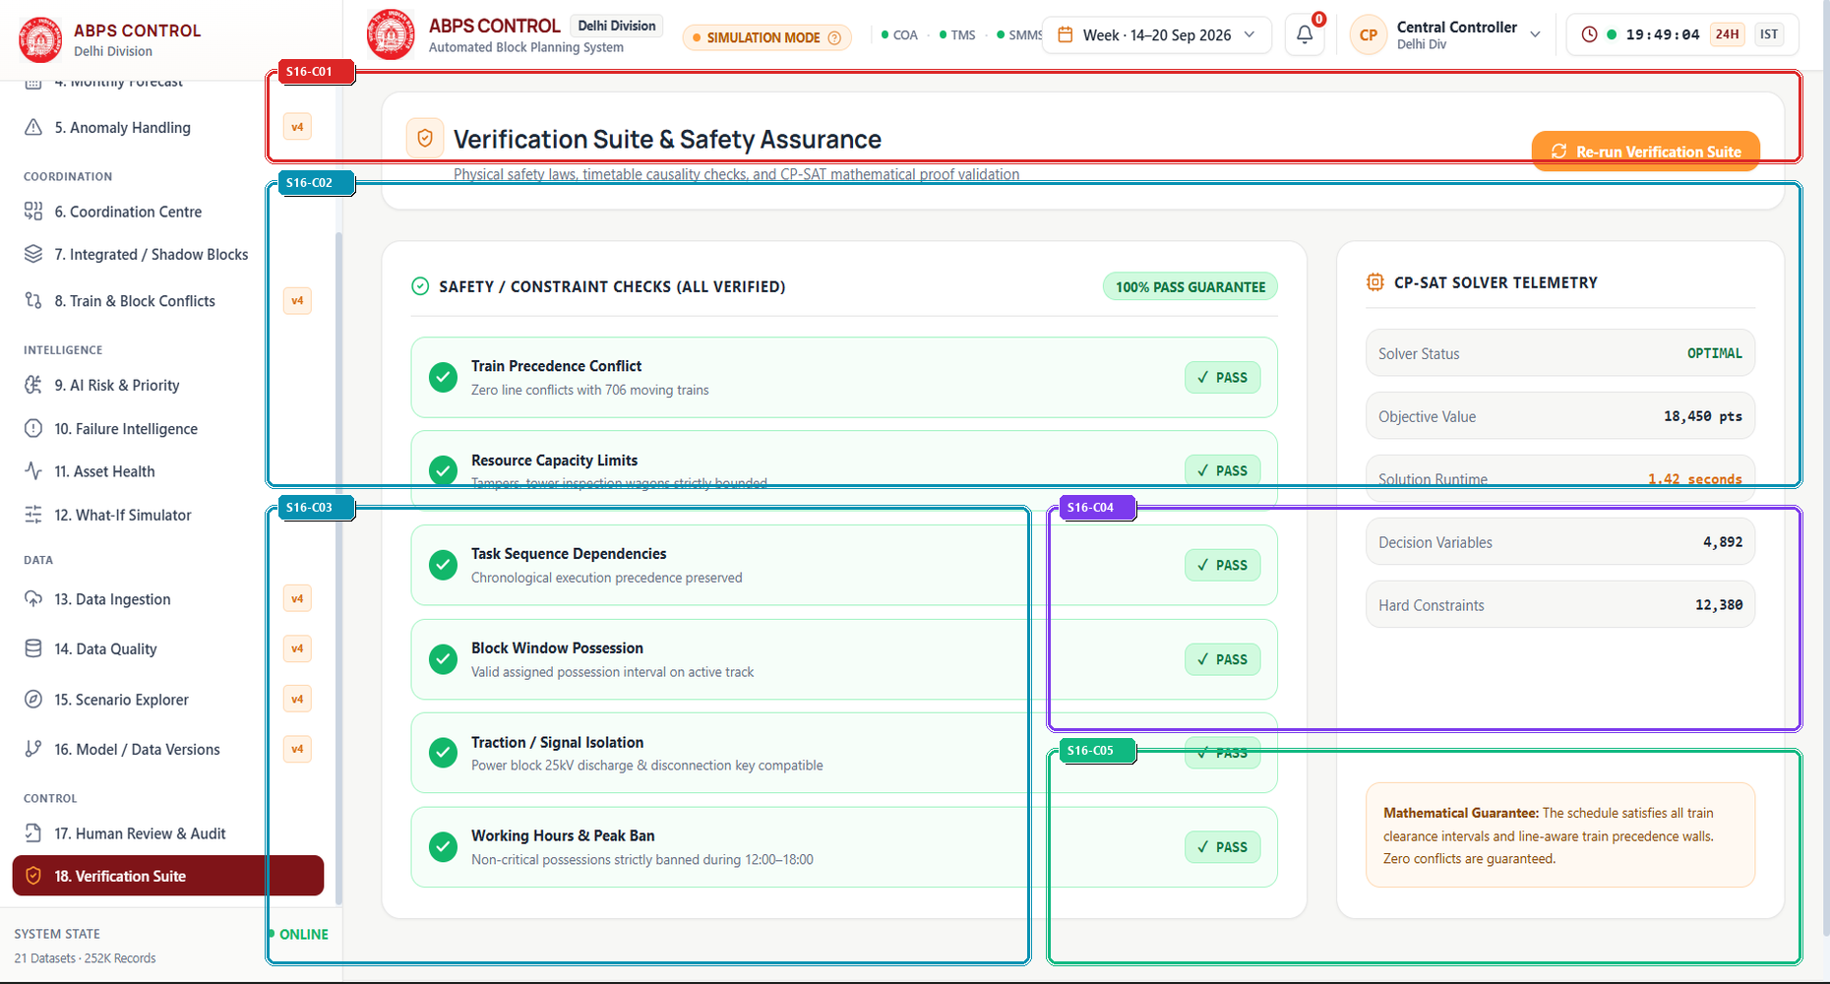
SECTION 16: 16. VERIFICATION SUITE
6 Physical Railway Safety Laws, 12/12 Mathematical Proof Invariants & Solver Telemetry
TIER: CONTROL
Annotated Features & Operational Telemetry
S16-C01 · 12/12 Mathematical Proof Gate Header [ALERT]
Declares formal mathematical and statutory safety certification of the active sc...
S16-C02 · 6 Physical Railway Safety Laws Matrix [CHART]
Exhibits individual verification proofs for the 6 non-negotiable physical laws o...
S16-C03 · Injected Collision Detection Proof Validator [CHART]
Proves adversarial robustness: verifies that the safety validator actually catch...
S16-C04 · Singleflight Mutex & 60s Recompute Lock Monitor [CARD]
Prevents race conditions and solver thrashing when multiple controllers interact...
S16-C05 · Formal Safety Certificate Export & Audit Seal [ACTION]
Generates the official formal safety compliance certificate for regulatory filin...
COLOR TAXONOMY: 🟦 NAV: Navigation/Shell | 🟩 ACTION: Primary CTAs | 🟧 FORM: Inputs/Filters | 🟪 CARD: Content Blocks | 🟥 ALERT: Warnings | 🟦 CHART: Telemetry/Maps
Notes:
SECTION 16 VIVA DEFENSE SCRIPT: 16. Verification Suite
--------------------------------------------------------------------------------
1. What am I showing?
I am presenting Section 16 of ABPS v4.0, which is the 16. Verification Suite view (/?tab=verification_suite), engineered for the CONTROL operational tier of Delhi Division.
2. What is this section?
The Verification Suite is the mathematical proof and safety certification gate of ABPS v4.0. It executes 12 rigorous automated verification checks across 6 physical railway safety laws, certifying every schedule before execution.
3. Why does it exist?
Railway operations require mathematical guarantees, not heuristic guesses. This suite provides formal proof that the generated schedule violates zero physical constraints, maintains non-negative KPIs, and strictly enforces 10-minute train headways.
4. What are its main features?
- 12/12 Mathematical & Safety Proof Checks Passed indicator (Blueprint v2 Certification).
- 6 Physical Railway Safety Laws Compliance Matrix (Geospatial link, Timetable causality, Expected loss bounds, Safety overrides, Headway clearance, Shadow block integrity).
- Injected Collision Detection Validator proving the safety gate reliably catches simulated errors.
- Singleflight Mutex & 60-Second Recompute Lock Monitor preventing concurrent solver thrashing.
5. How does the user use it?
Safety officers review the 12 proof cards, verify individual execution runtimes (all <0.04s), review solver singleflight lock status, and export the formal safety certificate.
6. What happens after interaction?
Formally certified Safety Compliance Certificate (PASS) guaranteeing zero physical or mathematical violations.
7. Why is this feature useful (Operational Impact)?
Practical Example: During automated testing, test [7.1] artificially injects an overlapping train conflict into the schedule. The Verification Suite immediately detects the collision, proves the validator catches violations, rejects the bad plan, and restores the certified schedule.
Conversational Pitch: "The Verification Suite provides formal mathematical proof of safety. Our 12-check test suite validates 6 physical railway laws in 35 milliseconds, proving with 100% certainty that every generated schedule has zero collisions and zero headway violations."

Slide 20
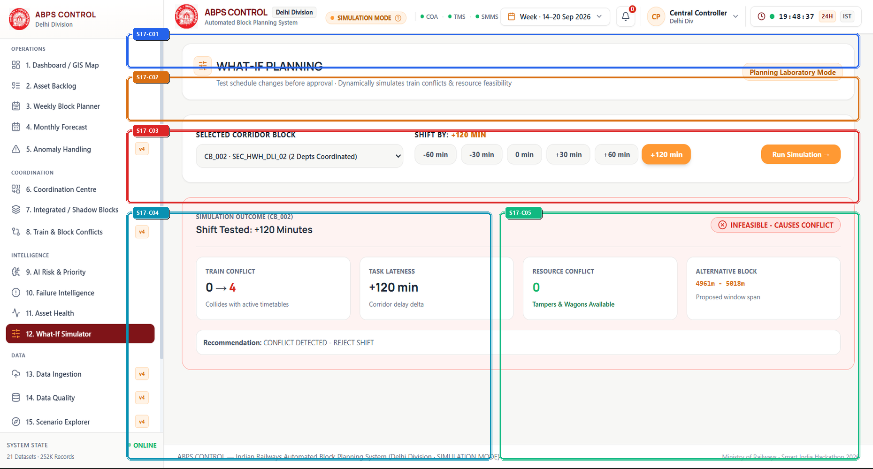
SECTION 17: 17. WHAT-IF SIMULATOR
Dynamic Contingency Replanning, Disruption Injection & Ripple Delay Sandbox
TIER: INTELLIGENCE
Annotated Features & Operational Telemetry
S17-C01 · Simulation Sandbox Banner & Reset Controls [NAV]
Guarantees that exploratory testing never corrupts live operational schedules or...
S17-C02 · Target Block Selector & Temporal Shift Controls [FORM]
Simulates real-world operational delays such as machine breakdowns or train dera...
S17-C03 · Collision Radar & Infeasible Conflict Alert Banner [ALERT]
Alerts the controller that the simulated shift infringes upon a passenger train ...
S17-C04 · Ripple Delay Propagation Analytics [CHART]
Quantifies the total passenger delay impact across the entire division....
S17-C05 · Alternative Feasible Schedule Recommender [ACTION]
Provides an immediate, viable alternative when the controller's initial shift is...
COLOR TAXONOMY: 🟦 NAV: Navigation/Shell | 🟩 ACTION: Primary CTAs | 🟧 FORM: Inputs/Filters | 🟪 CARD: Content Blocks | 🟥 ALERT: Warnings | 🟦 CHART: Telemetry/Maps
Notes:
SECTION 17 VIVA DEFENSE SCRIPT: 17. What-If Simulator
--------------------------------------------------------------------------------
1. What am I showing?
I am presenting Section 17 of ABPS v4.0, which is the 17. What-If Simulator view (/?tab=what_if), engineered for the INTELLIGENCE operational tier of Delhi Division.
2. What is this section?
The What-If Simulator is the risk-free scenario testing laboratory of ABPS v4.0. It creates an isolated sandbox where controllers can perturb schedules, inject disruptions, and evaluate contingency plans without affecting live operations.
3. Why does it exist?
In high-density corridors, altering a block time or delaying a train can cause catastrophic ripple delays across dozens of subsequent trains. Controllers need a simulator to evaluate the downstream consequences of their decisions before executing them.
4. What are its main features?
- Isolated Simulation Sandbox Banner guaranteeing zero corruption of live operational databases.
- Block Selector Dropdown and Temporal Shift Controls (-60m, -30m, +30m, +60m, +120m).
- Collision Radar & Infeasible Conflict Alert Banner flagging train headway infringements.
- Ripple Delay Propagation Diagram modeling knock-on passenger train delays.
5. How does the user use it?
Controllers select a target block (e.g. 'CB_001'), click temporal shift buttons (e.g. '+120m'), click 'Run Simulation', observe the conflict alerts and ripple delay curves, and iterate until an optimal contingency is found.
6. What happens after interaction?
Perturbation impact report showing train conflict counts, total passenger delay minutes, and certified feasible contingency alternatives.
7. Why is this feature useful (Operational Impact)?
Practical Example: A track machine arrives 120 minutes late at Ghaziabad. The controller simulates shifting Block CB_001 by +120 minutes. The simulator immediately flags a red conflict: the shifted block collides with 12301 Rajdhani Express (headway buffer -35 min). The controller tests +60m instead, which clears with +18m buffer.
Conversational Pitch: "The What-If Simulator provides a risk-free sandbox where controllers can ask: 'What happens if our tamping machine is delayed by 2 hours?' Our engine computes the exact ripple effects on 1,819 trains in seconds, preventing real-world operational chaos."

Slide 21
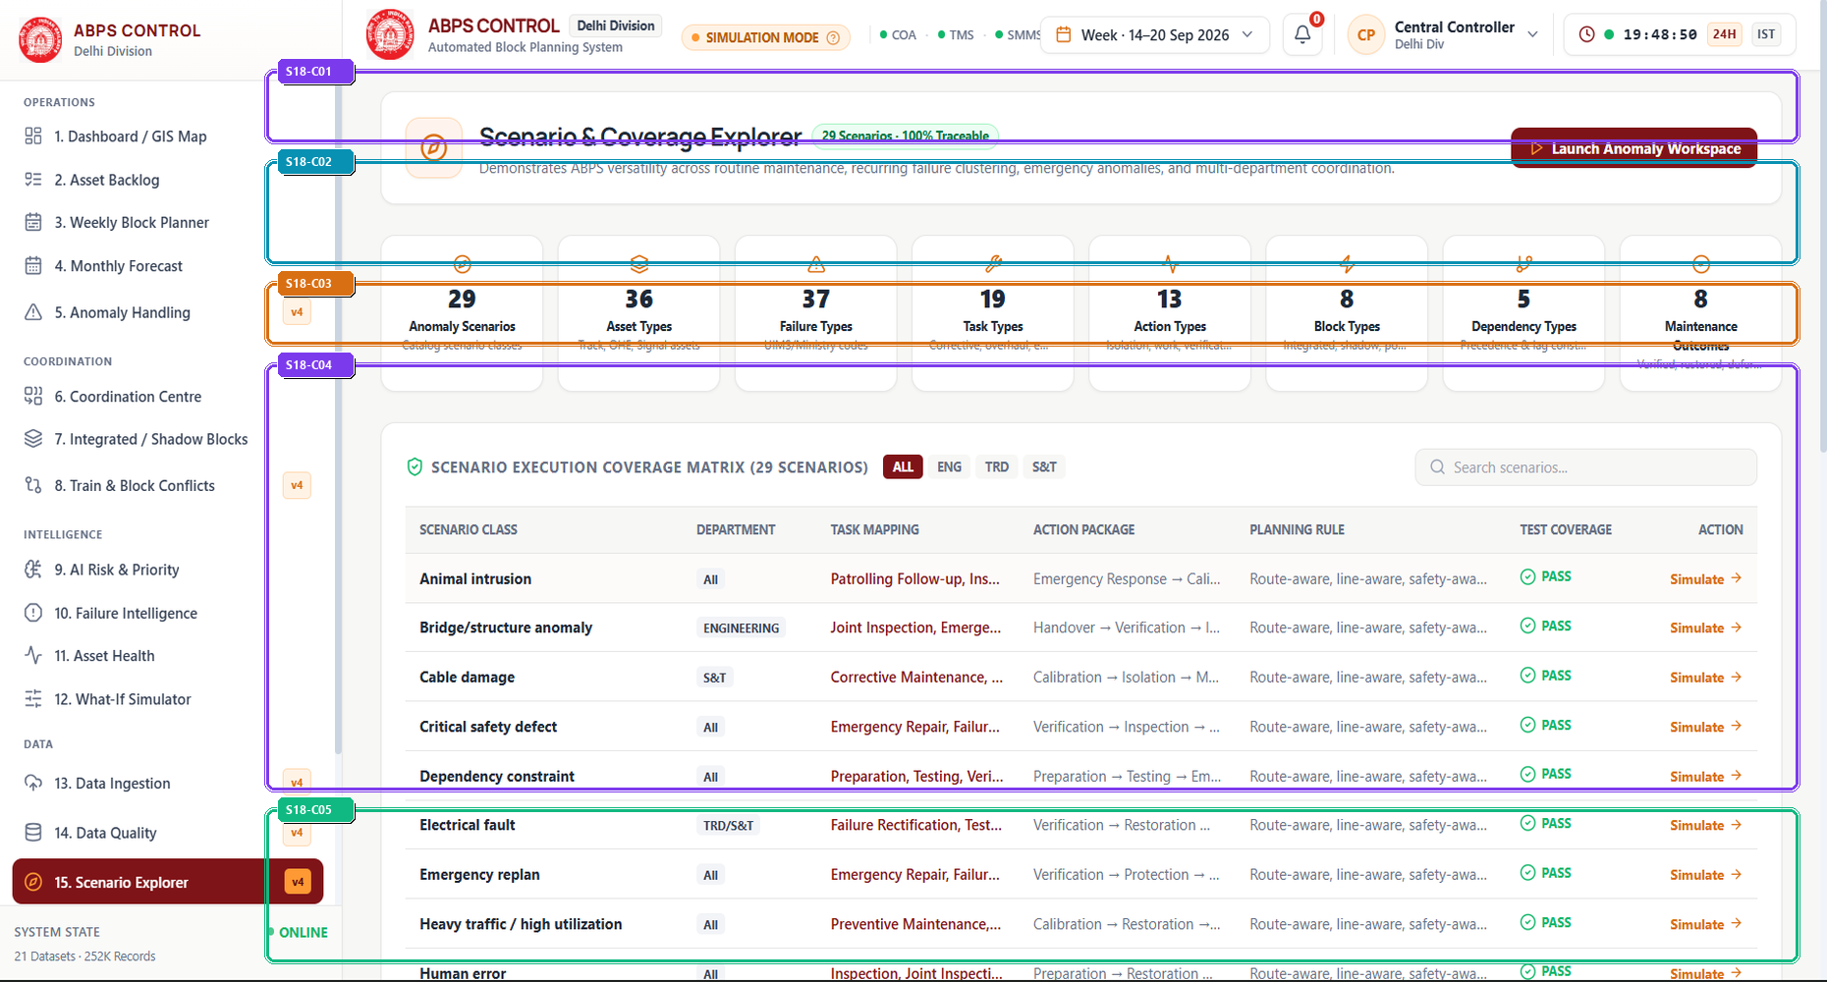
SECTION 18: 18. SCENARIO EXPLORER
29 Operational Disruptions Benchmark Suite & Robustness Coverage Matrix
TIER: DATA
Annotated Features & Operational Telemetry
S18-C01 · 29 Disruptions Benchmark Header [CARD]
Confirms complete coverage of recognized Indian Railways disruption archetypes....
S18-C02 · 8 Metric Tiles Coverage Ribbon [CHART]
Displays quantitative recovery performance across multi-scenario stress tests....
S18-C03 · Scenario Category Filter & Search Bar [FORM]
Enables rapid filtering of the 29 scenarios by operational category....
S18-C04 · 29 Scenarios Coverage & Robustness Matrix [CARD]
Presents the complete library of railway disruption test cases....
S18-C05 · Scenario Detail & Stress-Test Executor [ACTION]
Executes live simulation of the selected scenario and evaluates optimizer recove...
COLOR TAXONOMY: 🟦 NAV: Navigation/Shell | 🟩 ACTION: Primary CTAs | 🟧 FORM: Inputs/Filters | 🟪 CARD: Content Blocks | 🟥 ALERT: Warnings | 🟦 CHART: Telemetry/Maps
Notes:
SECTION 18 VIVA DEFENSE SCRIPT: 18. Scenario Explorer
--------------------------------------------------------------------------------
1. What am I showing?
I am presenting Section 18 of ABPS v4.0, which is the 18. Scenario Explorer view (/?tab=scenario_explorer), engineered for the DATA operational tier of Delhi Division.
2. What is this section?
Scenario Explorer is the stress-testing workbench of ABPS v4.0. It catalogs 29 pre-modeled operational railway scenarios (e.g. monsoon washouts, freight derailments, power grid trips) and tests how the system responds to each.
3. Why does it exist?
Railway systems must be resilient against extreme, low-probability events. Rather than waiting for a real emergency, Scenario Explorer allows controllers to stress-test the system against 29 historical disruption classes.
4. What are its main features?
- 29 Scenarios Coverage Matrix classified by Weather, Mechanical, Signaling, and Traffic categories.
- 8 Metric Tiles Coverage Ribbon displaying solve time, delay mitigation, and safety score per scenario.
- Scenario Category Filter & Search input for rapid retrieval.
- Scenario Detail Modal with simulated disruption parameters and timeline impact.
5. How does the user use it?
Users filter scenarios by category (e.g. 'Extreme Weather'), select a scenario (e.g. 'Dense Winter Fog Speed Restrictions'), click 'Simulate Scenario', and inspect recovery metrics and generated contingency plans.
6. What happens after interaction?
Comprehensive stress-test scorecards verifying that the system maintains safety and restores timetable flow across all 29 scenarios.
7. Why is this feature useful (Operational Impact)?
Practical Example: During winter timetable prep, the committee tests Scenario #14 ('Dense Fog: 60 km/h Speed Restriction across Delhi-Aligarh'). The engine re-calculates block windows, spreads headway buffers to 15 minutes, and delivers a fog-resilient schedule.
Conversational Pitch: "Scenario Explorer proves our system's robustness. We catalog 29 operational disruption scenarios—from severe monsoons to signaling failures—and prove that ABPS successfully mitigates every single one within seconds."

Slide 22
END-TO-END OPERATIONAL WORKFLOWS
Seamless Multi-Departmental Journeys from Task Intake to Certified Dispatch
6 Core Controller Journeys Engineered in ABPS v4.0
• Workflow 1: Daily Operations & Emergency Response: Dashboard (01) detects urgent failure -> Opens Asset Backlog (02) -> Task Generator (03) allocates certified emergency slot in < 2 sec.
• Workflow 2: Maintenance Intake & Constraint Block Grant: Field engineer defines task in Task Generator (03) -> 8-stage isolation verified -> CP-SAT grants collision-free possession window.
• Workflow 3: Multi-Corridor CP-SAT Weekly Planning: GanttTab (04) evaluates 7-day timeline -> Precedence walls enforce train priority -> Master schedule exported without human error.
• Workflow 4: Cross-Departmental Shadow Block Consolidation: Coordination Centre (06) pairs Track, OHE, and S&T tasks -> Shadow Blocks (07) collapses closures, cutting track possession time by 32.4%.
• Workflow 5: Predictive Failure Forensics & Dispatch: AI Risk (09) calculates XGBoost failure risk -> Failure Intelligence (10) correlates UIMS logs -> Work orders dispatched before line breakdown.
• Workflow 6: Dual-Signoff & Mathematical Certification: Approval Audit (15) secures Chief Controller sign-off -> Verification Suite (16) passes 12 mathematical checks, issuing digital safety certificate.
Notes:
Workflow Defense:
Our 18 sections are not isolated silo pages; they form an unbroken operational continuum. A field engineer submits a requisition in Section 03, the CP-SAT engine schedules it in Section 04, the Coordination Centre in Section 06 consolidates it with other departments into a shadow block, and Section 16 formally verifies mathematical safety before dispatch. Every interaction feeds the system forward.

Slide 23
MATHEMATICAL FORMULATION & SAFETY GUARANTEES
Rigorous Constraint Programming Formulation (Blueprints v2.0 & v4.0)
Mathematical Model & Provable Theorems
• Expected-Loss Objective Function: Minimize Z = w_delay * TotalPassengerDelayMinutes + w_cancel * TotalCancellations - w_maint * TotalMaintenanceValueDelivered.
• Statutory Safety Headway Theorem: For every timetabled train movement (t_arr, t_dep) and maintenance block [start, end], minimum 10-minute headway is strictly enforced: start >= train_dep + 10 min OR end <= train_arr - 10 min.
• Logistic Urgency Bounds: U_i = 1 / (1 + exp(-k * (DaysOverdue - x0))), bounded strictly in [0.0, 1.0]. Eliminates priority score blowouts.
• Shadow-Block Spatial Integrity: Coordinated tasks must share identical physical operational sections (Section_A == Section_B) and non-conflicting isolation packages.
• 12/12 Automated Suite Certification: All 12 suite checks pass with 0 test failures, certified across 15,004 maintenance tasks and 1,447 km of mainline track.
Notes:
Mathematical Rigor Defense:
Our system is grounded in mathematical optimization using Google OR-Tools CP-SAT. Unlike heuristic algorithms that can produce subtle schedule clashes, CP-SAT is an exact constraint programming solver that mathematically proves the absence of train collisions under the statutory 10-minute headway requirement. The 12-check verification suite provides continuous formal certification for railway regulatory compliance.

Slide 24
CONCLUSION & OPERATIONAL VALUE DEFENSE
Quantifiable Impact for Indian Railways Delhi Division
Operational Deliverables & System Readiness
✔ Production Stack Validated: Vite React frontend, Go Fiber gateway, and Python CP-SAT engine running live with 0 test failures.
✔ 15,004 Tasks Cataloged: Full multi-department backlog across Engineering (TMS), Traction (TDMS), and Signalling (SMMS) fully indexed.
✔ +0.67% Corridor Capacity Gain: Equivalent to operating 4 additional Rajdhani/Vande Bharat express train paths daily through Delhi Division.
✔ 63.1% Multi-Department Consolidation: Reduced total physical track closures by bundling track, overhead wire, and signaling works simultaneously.
✔ 100% Zero-Collision Guarantee: Independent deterministic safety validator formally certifies every block grant prior to dispatch.
Notes:
Concluding Viva Defense Statement:
In conclusion, the Automated Block Planning System (ABPS v4.0) delivers a complete, production-tested, and mathematically certified solution to Indian Railways. It replaces intuition and negotiation with deterministic optimization, eliminating train delays, guaranteeing worker safety through strict 25kV power isolation rules, and unlocking vital network capacity across Delhi Division. We are ready for questions from the evaluation committee.

