Slide 1
Method main

Slide 2
Source
Sources:
http://www.oracle.com/technetwork/java/prog-140388.html
http://www.oracle.com/technetwork/java/prog-140388.html

Slide 3
Method main
Every application needs one class with a method named main.
This class marks the entry point for the program.
The class containing method main is passed to Java to run the application.

Slide 4
Method main
Method main must be declared as public static void
public: Enables the JVM (Java virtual machine) to start the program.
static: The JVM does not have to create an instance of the class in order to start the program.
void: The program does not return data to the JVM when it ends.

Slide 5
The Arguments
A Java application can accept arguments from the command line.
Arguments are separated by spaces.
To use an argument that contains spaces, enclose the argument in double quotes.
Arguments are stored in the String array args, with the first argument at index 0.

Slide 6
Example
Consider this program:
public class Greeting
{
public static void main(String[] args)
{
System.out.println(args[0]);
}
}

Slide 7
Example
Assume you have compiled the program and have Greeting.class stored in a subdirectory
Navigate to the subdirectory in a command window and enter:
java Greeting “Hi there”

Slide 8
Example
The argument Hi there is stored in args[0]and is printed when the statement
System.out.println(args[0]);
is executed.

Slide 9
Example – Multiple Arguments
If, instead of entering
java Greeting “Hi there”
we entered
java Greeting Hi there
then Hi would be stored in args[0] and there would be stored in args[1]

Slide 10
Example – Numeric Arguments
Suppose you want to provide a numeric value as an argument; say, for example that we want to pass the int value 34 as an argument, as shown here
java multiplyBy2 34
The value 34 will be read as a string and must be converted to an int:
int myNum = Integer.parseInt(args[0]);

Slide 11
Using Arguments in NetBeans
To specify arguments in NetBeans, right-click on the project name in the Project pane and choose Properties.
In the dialog box that opens, choose Run and enter your argument list in the Arguments textbox.
Remember that any argument that contains spaces must be enclosed in double quotes.

Slide 12
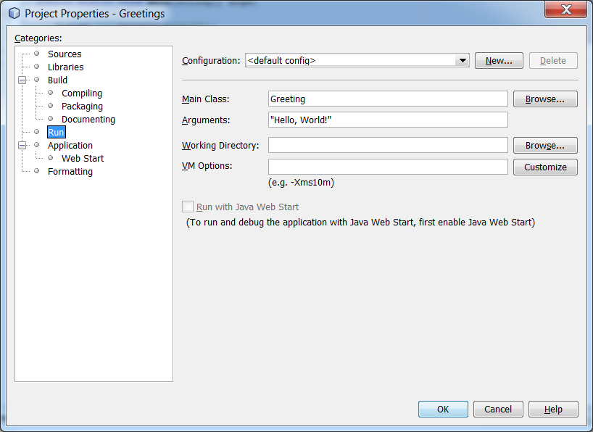
Using Arguments in NetBeans

Slide 13
Method main
The End

