Slide 1

Apache
Kafka

Slide 2
Outline
What is Apache Kafka?
Why Kafka?
Kafka
Architecture
Use Cases
Applications
How fast is Kafka
Why is Kafka fast
Topic
Partition
Advantages of Kafka
Disadvantages of Kafka

Slide 3
What is Apache Kafka?
It is an open-source distributed event streaming platform
It is used by many companies for high-performance data pipelines, streaming analytics, data integration and mission-critical applications
It is designed to support:
High throughput: Kafka can handle thousands of messages per second even on basic hardware
Persistent messaging with O(1) disk structures offers constant time performance even with many TB of stored messages
Supports parallel data load into Hadoop

Slide 4
Why Kafka?
It is scalable, fast, durable and fault tolerant publish-subscribe messaging system
Kafka brokers support huge message streams in Hadoop or Spark for follow up analysis
Real time streaming data processed for real time analytics
Track every call, Service calls, IOT sensors

Slide 5
Kafka Architecture
Kafka Ecosystem
Producer Group
Kafka cluster
Consumer Group
Broker 1
Producer1
Consumer1
Push msg
Broker 2
Pull msg
Producer1
Consumer1
Broker 3
Producer1
Get Kafka broker id
Consumer1
Zookeeper
Updates offset

Slide 6
Kafka Architecture (Cont..)
Kafka Architecture contains:
Broker
Zookeeper
Producer
Consumer

Slide 7
Broker:
Kafka cluster typically consists of multiple brokers to maintain load balance
Kafka brokers are stateless, so they use Zookeeper for maintaining their cluster state
One Kafka broker instance can handle hundreds of thousands of reads and writes per second and each broker can handle TB of messages without performance impact
Kafka broker leader election can be done by Zookeeper

Slide 8
ZooKeeper:
ZooKeeper is used for managing and coordinating Kafka broker
ZooKeeper service is mainly used to notify producer and consumer about the presence of any new broker in the Kafka system or failure of the broker in the Kafka system
As per the notification received by the ZooKeeper regarding presence or failure of the broker then producer and consumer takes decision and starts coordinating their task with some other broker

Slide 9
Producer :
Producers push data to brokers
When the new broker is started, all the producers search it and automatically sends a message to that new broker
Kafka producer doesn’t wait for acknowledgements from the broker and sends messages as fast as the broker can handle

Slide 10
Consumer:
Kafka brokers are stateless, which means that the consumer must maintain how many messages have been consumed by using partition offset
If the consumer acknowledges a particular message offset, it implies that the consumer has consumed all prior messages
The consumer issues an asynchronous pull request to the broker to have a buffer of bytes ready to consume
The consumers can rewind or skip to any point in a partition simply by supplying an offset value. Consumer offset value is notified by ZooKeeper

Slide 11
Kafka Use Cases
Stream Processing
Website Activity Tracking
Metrics Collection and Monitoring
Log Aggregation
Real time analytics
Capture and ingest data into Spark/Hadoop
CRQS, replay, error recovery
Guaranteed distributed commit log for in-memory computing

Slide 12
Kafka Applications
LinkedIn: activity streams, operational metrics, data bus
400 nodes, 18k topics, 220B msg/day
Netflix: real-time monitoring and event processing
Twitter: as part of their Storm real-time data pipelines
Mozilla: telemetry data
Loggly: processing and collection of log
Square, Uber, Cisco, Airbnb, Gnip, Ooyala, InfoChimps etc..,

Slide 13
How fast is Kafka?
Up to 2 million writes/sec on 3 cheap machines
Using 3 producers on 3 different machines, 3x async replication
only one producer/machine because NIC already saturated
Sustained throughput as stored data grows
Slightly different test config than 2M writes/sec above

Slide 14
Why is Kafka fast?
Batch Data in Chunks: Batches the data into chunks
end to end from Producer to file system to Consumer
provides more efficient data compression. Reduces I/O latency
Zero Copy Principle: calls the OS kernel direct rather to move data fast
Horizontal Scale: uses 100s to thousands of partitions for a single topic
spread out to thousands of servers
handle massive loads
Optimal Data Structure: Tree vs. Queue: The tree seems to be the data structure of choice when it comes to data storage. Most of the modern databases use some form of the tree data structure. Eg. MongoDB uses BTree

Slide 15
Why is Kafka fast? (Cont…)
Kafka Avoids the Seek Time: Kafka smartly avoids the seek time by using a concept called Sequential I/O
Horizontal Scaling: Kafka has the ability to have multiple partitions for a single topic that can be spread across thousands of machines. This enables it to maintain the high-throughput and provide low latency
Compression & Batching of Data: Kafka batches the data into chunks which helps in reducing the network calls and converting most of the random writes to sequential ones. It’s more efficient to compress a batch of data as compared to compressing individual messages

Slide 16
Topic
Data is stored in topics
Topics are partitioned .These are replicated across brokers
Producers write data to topics, whereas Consumers read data from topics
A topic can have zero, one or multiple consumers
Topics can be created automatically or manually
Kafka Topic
Producer A1
Producer A2
….
Old msgs
New msgs
Producer An

Slide 17
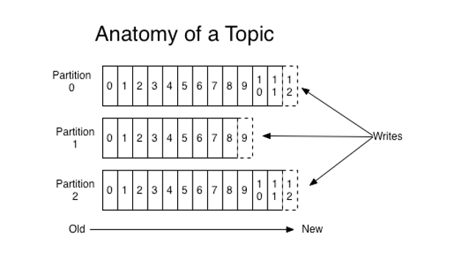
Partitions
A topic consists of Partitions
These are ordered and immutable sequence of messages that are appended continuously

Slide 18
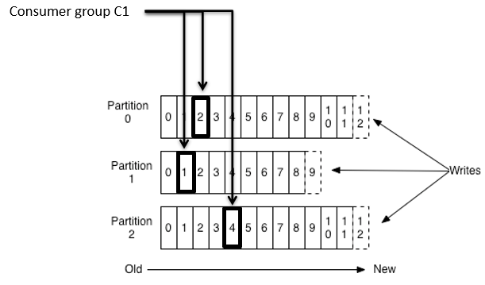
Partitions (Cont..)
Reading Records from Partitions:
Kafka does not push messages to consumers like other implementations do
Consumers must instead retrieve messages from Kafka topic partitions
When a consumer connects to a broker's partition, they read the messages in the order in which they were written
Offset:
The Offset of a message serves as the consumer side cursor
The consumer maintains the track of messages, it has already read

Slide 19
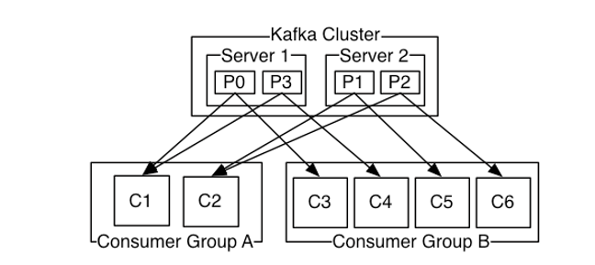
Partitions (Cont..)
Consumer groups:
Several consumers are grouped to consume a given topic
Consumers in the same consumer group have the same group-id value
It ensures that each partition is consumed by exactly one consumer in the group

Slide 20
Advantages of Kafka
Low Latency:
Kafka offers low latency value, up to 10 milliseconds
Because it decouples the message which lets the consumer to consume that message anytime
High Throughput:
Due to low latency, Kafka able to handle numerous messages of high volume and high velocity
Kafka can support thousands of messages in a second
Many companies such as Uber use Kafka to load a high volume of data

Slide 21
Advantages of Kafka (Cont…)
Fault tolerance:
It has an essential feature to provide resistant to node/machine failure within the cluster
Durability:
Kafka offers the replication feature, which makes data or messages to persist more on the cluster over a disk
This makes it durable
Easily accessible:
As all data gets stored in Kafka, it becomes easily accessible to anyone

Slide 22
Advantages of Kafka (Cont…)
Reduces the need for multiple integrations:
All the data that a producer writes go through Kafka
Just need to create one integration with Kafka, which automatically integrates with each producing and consuming system
Distributed System:
Apache Kafka contains a distributed architecture which makes it scalable
Partitioning and replication are the two capabilities under the distributed system

Slide 23
Advantages of Kafka(Cont…)
Real-Time handling:
Apache Kafka handle real-time data pipeline
Building a real-time data pipeline includes processors, analytics, storage, etc.
Batch approach:
Kafka uses batch-like use cases
It can also work like an ETL tool because of its data persistence capability
Scalability:
The quality of Kafka to handle large number of messages simultaneously make it a scalable software product

Slide 24
Disadvantages of Kafka
Message tweaking issues:
Kafka broker uses system calls to deliver messages to the consumer
If the message needs some tweaking, the performance of Kafka gets significantly reduced
So, it works well if the message does not need to change
Do not support wildcard topic selection:
Apache Kafka does not support wildcard topic selection
It matches only the exact topic name
Selecting wildcard topics make it incapable to address certain use cases

Slide 25
Disadvantages of Kafka (Cont…)
Reduces Performance:
Brokers and consumers reduce the performance of Kafka by compressing and decompressing the data flow.
This not only affects its performance but also affects its throughput.
Clumsy Behavior:
It most often behaves a bit clumsy when the number of queues increases in the Kafka Cluster.
Lack some message paradigms:
Certain message paradigms such as point-to-point queues, request/reply, etc. are missing in Kafka for some use cases.

Slide 26
Disadvantages of Kafka (Cont…)
Do not have complete set of monitoring tools:
Apache Kafka does not contain a complete set of monitoring as well as managing tools
New startups or enterprises fear to work with Kafka

Slide 27
Reference
cloudurable.com
tutorialspoint.com
csee.umbc.edu
javatpoint.com

