Slide 1
Map Reduce

Slide 2
Outline
Introduction
MapReduce Architecture
Flow diagram of MapReduce program
Job Tracker & Task Tracker
Phases of MapReduce program
Example of Word Count using MapReduce

Slide 3
Introduction
MapReduce is a Hadoop framework used for writing applications that can process vast amounts of data on large clusters
There are two primary tasks in MapReduce:
Map
Reduce
In the map job, we split the input dataset into chunks
Map task processes these chunks in parallel

Slide 4
Introduction (Cont…)
The map we use outputs as inputs for the reduce tasks
Reducer process the intermediate data from the maps into smaller tuples, that reduces the tasks, leading to the final output of the framework

Slide 5
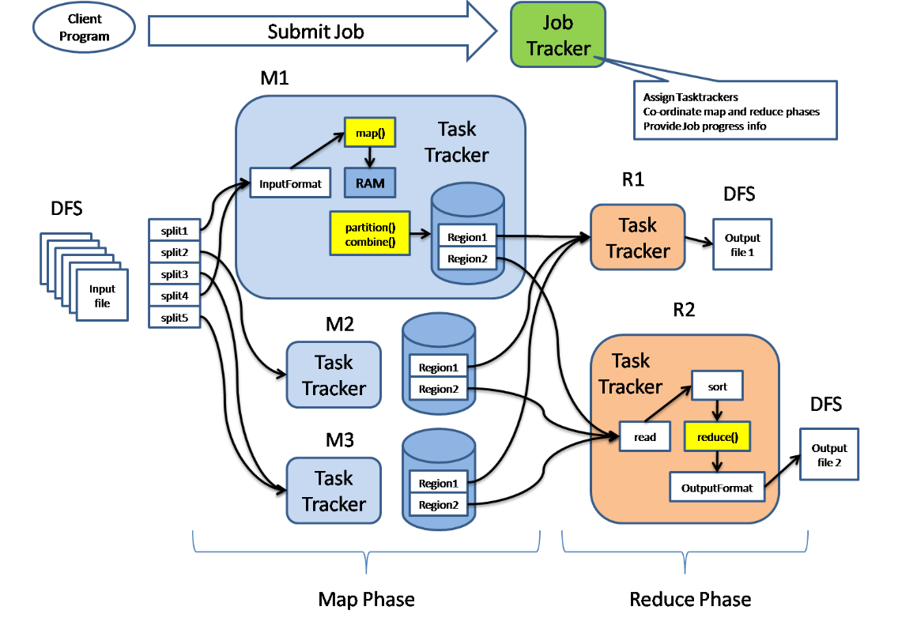
MapReduce Architecture

Slide 6
MapReduce Architecture(Cont..)
In the MapReduce architecture, clients submit jobs to the MapReduce Master
This master will then sub-divide the job into equal sub-parts
The job-parts will be used for the two main tasks in MapReduce:
Mapping and
Reducing

Slide 7
Flow diagram of Map Reduce program
The map task plays the role of splitting jobs into job-parts and mapping intermediate data.
The reduce task plays the role of shuffling and reducing intermediate data into smaller units.

Slide 8
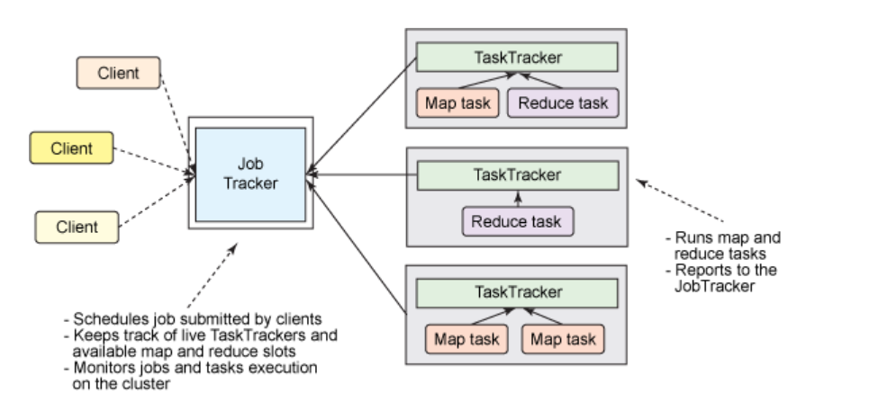
Job Tracker & Task Tracker

Slide 9
Phases of MapReduce program
The MapReduce program is executed in three main phases:
Mapping
Shuffling and
Reducing
Mapping Phase:
There are two steps in this phase:
Splitting and
Mapping
A dataset is split into equal units called chunks (input splits) in the splitting step

Slide 10
Phases of MapReduce program(Cont..)
Hadoop consists of a RecordReader that uses TextInputFormat to transform input splits into key-value pairs.
The key-value pairs are then used as inputs in the mapping step.
The mapper processes the key-value pairs and produces an output of the same form (key-value pairs).

Slide 11
Phases of MapReduce program(Cont..)
Shuffling phase:
It consists of two main steps:
Sorting and
Merging
In the sorting step, the key-value pairs are sorted using the keys
Merging ensures that key-value pairs are combined.

Slide 12
Phases of MapReduce program(Cont..)
Reducing phase:
In the reducer phase, the output of the shuffling phase is used as the input.
The reducer processes this input further to reduce the intermediate values into smaller values.
It provides a summary of the entire dataset.
The output from this phase is stored in the HDFS.

Slide 13
Example of Word count using MapReduce
Input Splitting Mapping Shuffling Reducing Final Result
(k1,v1) List(k2,v2) k2,list(v2) List(k3,v3)
John – 1
Smith – 1
Mike - 1
John (1,1,1)
John ,3
John Smith Mike
John, 3
Mike, 1
River,3
Smith,2
John Smith Mike
Smith River John
River River John
Smith – 1
River – 1
John - 1
Mike (1)
Mike , 1
Smith River John
River (1,1,1)
River , 3
River – 1
River – 1
John - 1
River River John
Smith(1,1)
Smith, 2

Slide 14
References
MapReduce in Hadoop

