Slide 1
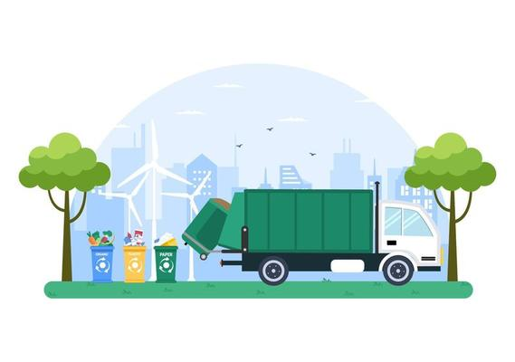
INTELLIGENT WASTE SORTING SYSTEM USING DEEP LEARNING
Sony – 4NM20CS184
Srajana S N – 4NM20CS185
Zulaikha Ashiq – 4NM20CS218
Sushmitha S – 4NM21CS416

Slide 2
INTELLIGENT WASTE SORTING SYSTEM USING DEEP LEARNING
Project Report submitted by
SONY SRAJANA S N
(4NM20CS184) (4NM20CS185)
ZULAIKHA ASHIQ SUSHMITHA S
(4NM20CS218) (4NM21CS416)
Under the Guidance of
Mr. ASHWIN SHENOY M
Asst. Professor
Dept. of CSE, NMAMIT, NITTE
In partial fulfillment of the requirements for the award of
the Degree of
Bachelor of Engineering in Computer Science and Engineering
from
Visvesvaraya Technological University, Belagavi
Department of Computer Science and Engineering
NMAM Institute of Technology, Nitte - 574110
(An Autonomous Institution affiliated to VTU, Belagavi)
APRIL 2024

Slide 3
TABLE OF CONTENTS
 | CONTENTS | PAGE NO.
Chapter 1 | ABSTRACT | 5
Chapter 2 | INTRODUCTION | 6-7
Chapter 3 | LITREATURE SURVEY
 | 2.1 Survey on intelligent waste sorting system | 8-23
 | 2.2 Litreature survey summary | 24
Chapter 4 | OBJECTIVES | 25
Chapter 5 | PROBLEM STATEMENT | 26
Chapter 6 | SYSTEM AND REQUIREMENTS SPECIFICATIONS | 27-28

Slide 4
TABLE OF CONTENTS
 | CONTENTS | PAGE NO.
Chapter 7 | SYSTEM DESIGN | 29-30
Chapter 8 | IMPLEMENTATION | 31-33
Chapter 9 | RESULTS | 34
Chapter 10 | CONCLUSION | 35
Chapter 11 | REFERENCES | 36=39

Slide 5
ABSTRACT
The IWSS utilizes deep learning via YOLOv7 to achieve 92% accuracy in waste categorization, eliminating hardware needs for accessibility and cost-effectiveness. This adaptable system continuously improves through real-time learning, reducing manual sorting reliance, promoting recycling, and minimizing environmental impact.
Through rigorous validation, IWSS demonstrates its effectiveness in addressing municipal solid waste challenges, paving the way for sustainable practices in urban and rural areas, thus contributing to a cleaner and greener future.

Slide 6
INTRODUCTION
Waste management is crucial for environmental safety
Requires efficient collection, sorting, and disposal methods to minimize hazards and promote sustainability
Traditional waste sorting systems face limitations
The project aims to classify and sort waste items in real-time, enhancing efficiency and promoting proper recycling and disposal to reduce environmental impact
Technological advancements in waste segregation, offer unprecedented accuracy and efficiency in waste analysis and classification

Slide 7
Project implementation involves data analysis, model training, and image prediction with YOLOv7
The goal is to achieve precise waste item classifications, improving sorting efficiency, and minimizing environmental impact
Data analysis optimization aims to extract valuable insights to inform decision-making in waste management
By leveraging deep learning technologies, the project aims to revolutionize waste segregation, recycling, and resource recovery efforts

Slide 8
LITERATURE SURVEY
A literature survey allows us to explore and understand existing technologies
It allows us to understand how data generated by waste sorting systems is managed and analyzed. This knowledge helps us develop robust data management and analytics capabilities, facilitating better decision-making
It reveals common challenges and solutions encountered by researchers and developers
Helps in designing algorithms and functionalities that enhance the efficiency and accuracy of waste sorting in your software

Slide 9
2.1 Survey on intelligent waste sorting system Paper 1:
Title | Authors | Description | Methods | Limitations
Intelligent waste classification system using deep learning convolutional neural network. | [1] Adedeji, Olugboja, and Zenghui | The study introduces a waste classification system using ResNet-50 CNN and Support Vector Machine, achieving 87% accuracy on materials like glass and metal. Limitations include potential dataset bias, real-world variability, and dependency on image quality for optimal performance. | ResNet-50 Convolutional Neural Network ,Support Vector Machine (SVM) for Classification ,Trash image dataset by Gary Thung and Mindy Yang | 1. Dataset Bias: The accuracy relies on dataset representativness. 2. Real-World Variability: Performance may be affected by variations in waste materials 3. Dependency on Image Quality: System performance relies on image quality, and poor-quality images may lead to misclassifications.

Slide 10
Paper 2:
Title | Authors | Description | Methods | Limitations
Intelligent waste management system using deep learning with IoT | [2] Md Wahidur Rahman and others. | The study introduces an advanced waste management system combining deep learning (CNN) and IoT technologies, achieving a 95.31% waste classification accuracy and an 86% System Usability Scale score. The system's adaptability and real-time monitoring capabilities make it promising for household integration and efficient waste management. | Convolutional Neural Network (CNN) ,Smart Trash Bin with Sensors , | 1. Data Variability: Performance may be impacted by variability in waste materials. 2. Dependency on Connectivity: The reliance on IoT and Bluetooth may be challenging in certain areas.

Slide 11
Paper 3:
Title | Authors | Description | Methods | Limitations
Intelligent Waste Management System Using Deep Learning. | [3] Kumar, G. Shravan, et al. Journal of Survey in Fisheries Sciences (2023): 2767-2772. | The new waste sorting system, using advanced technology like deep learning with CNNs and ResNet models, accurately identifies and separates waste in real-time, making urban waste management more efficient. It helps optimize waste collection, reduce landfill usage, and promote eco-friendly practices, suitable for various environments. | The waste classification system uses deep learning with CNNs and ResNet models to achieve high accuracies of 78% and 91%. | Potential limitations include the need for further optimization for real-time detection and challenges in adapting to diverse urban waste scenarios.Additionally, scalability and adaptability may require careful consideration for practical implementation in various settings.

Slide 12
Paper 4:
Title | Authors | Description | Methods | Limitations
Autonomous garbage detection for intelligent urban management.(MATEC Web of Conferences) | [4] Wang, Ying, and Xu Zhang Vol. 232. EDP Sciences, 2018. | This study uses deep learning for garbage detection in smart cities, employing Faster R-CNN with ResNet and data fusion for accuracy. It achieves near-real-time, high-precision results but emphasizes the ongoing challenge of reducing detection time for even faster outcomes. | The study uses advanced deep learning techniques, employing a Faster R-CNN framework with a region proposal network and the ResNet algorithm for garbage detection in urban images | Computational Demand: The adoption of a deep learning strategy, specifically using Faster R-CNN with a region proposal network and ResNet Detection Time Challenge: The paper acknowledges the challenge of further reducing detection time

Slide 13
Paper 5:
Title | Authors | Description | Methods | Limitations
A rapid recognition method for electronic components based on the improved YOLO-V3 network. | [5] Huang, Rui, et al Electronics 8.8 (2019): 825. | This study introduces a rapid recognition method for identifying electronic components in industrial settings, achieving improved detection speed with the YOLOV3–Mobilenet model. While outperforming other methods like SSD and Faster R-CNN, further optimization for real-time detection and refinement for video-based applications on embedded devices is crucial for practical use. | The study specifically introducing an improved YOLO V3 (YOLOV3–Mobilenet) model for rapid identification of electronic components | The study achieves high accuracy (95.21%) and fast speed (0.0794 s) with improved YOLO-V3 network. However, challenges include optimizing for real-time detection, deploying on embedded devices, and assessing effectiveness in diverse industrial environments.

Slide 14
Paper 6:
Title | Authors | Description | Methods | Limitations
WasteSegNet: A Deep Learning Approach for Smart Waste Segregation in Urban Environments | [6] Aatmaj Amol Salunke | WasteSegNet, a custom CNN, achieves 87.5% accuracy in automated waste segregation, demonstrating superior performance over traditional methods. Despite challenges, its potential for streamlining waste management processes and contributing to sustainability makes it a promising solution for urban environments | WasteSegNet,Convolutional Neural Network, is proposed to automate waste segregation into Recyclable categories, aiming to enhance waste management efficiency and promote sustainability. a custom-designed Convolutional Neural Network (CNN) for automated waste segregation into Organic and Recyclable categories | WasteSegNet's accuracy may be constrained by its specific training data, impacting performance in varied waste scenarios. Addressing challenges like class imbalance and overfitting is crucial for broader applicability, emphasizing the need for interpretability in practical waste management implementation.

Slide 15
Paper 7:
Title | Authors | Description | Methods | Limitations
Machine learning methods for the prediction of organic solid waste treatment and recycling processes | [7] Hao-nan Guo ª ^{b}, Shu-biao Wu ^{c}, Ying-jie Tian ^{d}, Jun Zhang ^{e}, Hong-tao Liu ª ^{f} | Machine learning applications in organic solid waste (OSW) treatment, especially in municipal solid waste management, anaerobic digestion, and thermal treatment, have shown promise. The prevalent use of artificial neural networks (ANN) addresses complex non-linear problems, yet challenges persist, including insufficient data, low interpretability, and unclear model selection in the reviewed literature between 2003 and 2020. | The Machine learning in organic waste treatment. It focuses on municipal waste, anaerobic digestion, thermal treatment, composting, and landfills. The dominant model is artificial neural networks (ANN, 54%), addressing complex issues, yet challenges include not enough data, low and unclear model selection. | The study reviews machine learning applications in organic waste treatment (2003-2020), emphasizing municipal solid waste management, anaerobic digestion, and thermal treatment. Predominant use of artificial neural networks (ANN, 54%) is noted, with challenges including insufficient data and low interpretability, highlighting an exploratory stage in the field.

Slide 16
Paper 8:
Title | Authors | Description | Methods | Limitations
Multilayer Hybrid Deep-Learning Method for Waste Classification and Recycling | [8] Yinghao Chu 1 Chen Huang,1 Xiaodan Xie,2 Bohai Tan,3 Shyam Kamal , 4 Xiaogang Xiong | The study suggests an innovative Multilayer Hybrid Deep Learning (MHS) system, using high-resolution cameras, sensors, and interconnected subsystems, including an AlexNet CNN and MLPs, to effectively classify waste as recyclable or non-recyclable. This approach aims to tackle the global solid waste issue in urban public areas. | Multilayer Hybrid System (MHS) for waste classification, incorporating subsystems like convolutional neural networks (CNN) and multilayer perceptrons (MLP). The evaluation metrics for assessing system performance are also introduced in this section. | Limited training dataset diversity may hinder MHS accuracy in classifying a broad spectrum of waste items. Real-world scalability, environmental robustness, and careful consideration of costs and impacts are essential for practical MHS implementation in urban areas.

Slide 17
Paper 9:
Title | Authors | Description | Methods | Limitations
Machine-learning approaches in geo-environmental engineering: Exploring smart solid waste management | [9] Abderrahim Lakhouit, Mahmoud Shaban , Aishah Alataw,Sumaya Y.H. Abbas , Emad Asiri , Tareq Al Juhni, Mohamed Elsawy | Managing municipal solid waste involves fiscal, social, and environmental complexities. The study utilizes machine-learning algorithms, like linear regression and support vector machines, demonstrating their potential to predict and manage domestic waste, offering solutions to mitigate the impacts of rising waste production in urban areas. | The study employs machine-learning (ML) algorithms, including linear regression, regression trees, Gaussian process regression, support vector machines, and autoregressive integrated moving average methods, for the estimation and prediction of domestic waste quantities | The study's machine-learning algorithms may struggle to predict various types of domestic waste accurately.Sustainable waste strategies faces challenges due to technical and budget constraints, and its success relies on practical factors like infrastructure, public cooperation, and policy implementation.

Slide 18
Paper 10:
Title | Authors | Description | Methods | Limitations
Garbage detection and classification using a new deep learning-based machine vision system as a tool for sustainable waste recycling | [10] Jin a, Zixuan Yang a, Grzegorz Królczykg b, Xinying Liu a, Paolo Gardoni c, Zhixiong Li d e | The study presents an advanced garbage classification system using a modified MobileNetV2 model and attention mechanism, achieving 90.7% accuracy on Raspberry Pi 4B in real-time. With a 30.1% model size reduction and low consumption cost, the prototype attains 89.26% accuracy, showcasing promising prospects for efficient waste recycling. | As a typical lightweight network, the MobileNetV2 (Sandler et al. 2018) is the second generation of the Google MobileNetV1 (Zoph et al. 2018). Compared with the MobileNetV1 | The study presents a garbage sorting system with a better model, reaching 90.7% accuracy and reducing size on Raspberry Pi 4B. While it works in real-time with PCA, challenges exist in setting up initial parameters, and achieving 89.26% accuracy in the prototype indicates effectiveness but challenges in broader applications.

Slide 19
Paper 11:
Title | Authors | Description | Methods | Limitations
Intelligent Waste Management System Using Deep Learning | [11] G Shravan Kumar, P. Prerana, J Deekshitha, L.Anirudh | The Intelligent Waste Management System employs deep learning to address urban waste accumulation. It reduces human involvement, optimizes waste collection, and promotes recycling, and composting, resulting in operational efficiency, cost savings, and a scalable solution for diverse urban settings. | The system utilizes CNNs (78% accuracy) and ResNet models (91% accuracy) to autonomously identify and classify waste materials. Image datasets optimize waste collection routes, reduce landfill waste, and promote recycling and composting. | Limited by the quality and diversity of image datasets, potential challenges in real-world environmental conditions (e.g., varied lighting, weather), and dependency on continuous technological updates for optimal performance. The accuracy rates may vary in dynamic urban environments.

Slide 20
Paper 12:
Title | Authors | Description | Methods | Limitations
Intelligent Waste Classification System Using Deep Learning Convolutional Neural Network | [12] Olugboja Adedeji, Zenghui Wang | The research proposes an intelligent waste material classification system using a ResNet-50 CNN and SVM. It emphasizes automation, achieving an 87% accuracy on a trash image dataset, and aims to streamline waste separation, reduce human intervention, and address environmental and health concerns in urban areas. Future work includes extending the system's capabilities by adjusting parameters and expanding the dataset. | The system employs a ResNet-50 CNN for feature extraction and Support Vector Machine (SVM) for waste classification, achieving an 87% accuracy on a trash image dataset. This combination streamlines waste separation, reduces human intervention, and aims to mitigate pollution and infections. | The system's accuracy is contingent on the quality and diversity of the dataset. It may face challenges in real-world scenarios, and expanding the dataset is suggested for improved accuracy. The current capabilities are limited to the classification of waste items, and future work involves adjusting parameters for classifying additional waste categories.

Slide 21
Paper13:
Title | Authors | Description | Methods | Limitations
YOLO TrashNet: Garbage Detection in Video Streams | [13] Berardina De Carolis, Francesco Ladogana, Nicola Macchiarulo | YOLO TrashNet is a software system using YOLOv3 for real-time urban waste detection. It recognizes garbage and relevant infrastructure, contributing to smart city waste management. Future work involves dataset expansion and the development of an intelligent agent for wider integration. | YOLO TrashNet employs a fine-tuned YOLOv3 model for real-time garbage detection in urban areas. It identifies waste and recognizes Garbage Dumpsters and Bins, aiding smart city waste management | The system's efficacy depends on dataset quality and may face challenges in varied conditions. Future plans include expanding the dataset and developing an intelligent agent for broader integration.

Slide 22
Paper 14:
Title | Authors | Description | Methods | Limitations
Waste Object Detection and Classification using Deep Learning Algorithm: YOLOv4 and YOLOv4-tiny | [14] Andhy Panca, Saputra, Kusrini | YOLOv4 and YOLOv4-tiny offer a waste management solution, emphasizing YOLOv4's accuracy and YOLOv4-tiny's speed. The study explores subdivision values and data augmentation, with potential applications in urban waste classification. Future research targets dataset expansion and newer YOLO versions. | YOLOv4 and YOLOv4-tiny with Darknet-53 detect waste in a dataset of 3870 images across glass, metal, paper, and plastic. YOLOv4 excels in accuracy, YOLOv4-tiny in speed. Subdivision values and data augmentation impact performance. | Challenges include dataset quality and the accuracy-speed trade-off. Future work includes dataset expansion, more waste categories, and exploring newer YOLO versions.

Slide 23
Paper 15:
Title | Authors | Description | Methods | Limitations
Deep learning-based object detection for smart solid waste management system | [15] Meron Desta, Tagel Aboneh and Bisrat Derebssa | The research addresses waste pollution in Ethiopia, presenting a YOLOv4-waste model with emphasis on accuracy. YOLOv4 outperforms YOLOv4-tiny, highlighting the need to optimize parameters for effective waste management in the context of urbanization and industrialization in Ethiopia. | YOLOv4-waste model is introduced for real-time waste detection, using a dataset of 3529 images across 7 classes. YOLOv4 outperforms YOLOv4-tiny in accuracy. Key metrics evaluated include mAP, precision, recall, F1-score, and Average IoU. | Challenges include diverse environmental conditions and the trade-off between speed and detection capabilities. Optimizing subdivision values and data augmentation is crucial.

Slide 24
2.2 LITREATURE SURVEY SUMMARY
These studies highlight the versatility of deep learning technologies in addressing various challenges within waste management, from urban garbage detection using Faster R-CNN to electronic waste recognition with modified YOLO models
Integration of IoT devices and sensors further augments real-time data monitoring and remote control capabilities, facilitating proactive and efficient waste management strategies
By reducing reliance on manual labor, optimizing resource utilization, and minimizing environmental impact, intelligent waste management systems offer scalable and cost-effective solutions for addressing the global waste crisis while enabling predictive analytics and data-driven decision-making for more informed waste management practices

Slide 25
OBJECTIVES
To analyse the given data set, achieve preprocessing, and train the model based on the pre-processed categorized data
To classify the categorized pre-processed data and achieve image prediction using YOLOv7 algorithms
Achieve precise classifications of waste items to improve sorting efficiency
Preprocess and train the model on the dataset for effective data analysis and categorization
Utilize YOLOv7 algorithms for image prediction and classifying preprocessed waste data
Achieve precise waste item classification to improve sorting efficiency and optimize waste management processes

Slide 26
PROBLEM STATEMENT
The goal is to develop an automated system that utilizes deep learning techniques,specifically YOLOv7, to accurately classify waste items in real time. By integratingYOLOv7, the system can identify and categorize waste items with high accuracy and efficiency, streamlining the sorting process. This intelligent waste sorting system aims to improve sorting accuracy,increase sorting speed, and optimize waste management operations.

Slide 27
SYSTEM REQUIREMENTS SPECIFICATION
HARDWARE REQUIREMENTS:
Processor: Intel i3 or above processor.
Hard Disk: 8 TB
Memory: 8 GB
SOFTWARE REQUIREMENTS:
Operating System: windows 10/11
Programming Language: Python
Dataset: Custom waste detection from Kaggle
IDE: Thonny

Slide 28
FUNCTIONAL REQUIREMENTS:
Object detection: The images should be detected properly based on the training of the model
Waste classification: The images of waste should be classified into different categories correctly using YOLOv7
Multi-class classification: The system should detect and classify both single and multi-class classification
USER REQUIREMENTS:
Ease of use: The system should be easy to use and navigate for the users
Accuracy: The detection and classification works should be done accurately with zero or minimal errors
Real-time monitoring: The system should be capable of real-time monitoring and respond promptly
Cost-effectiveness: The system should provide a cost-effective solution for the waste management

Slide 29
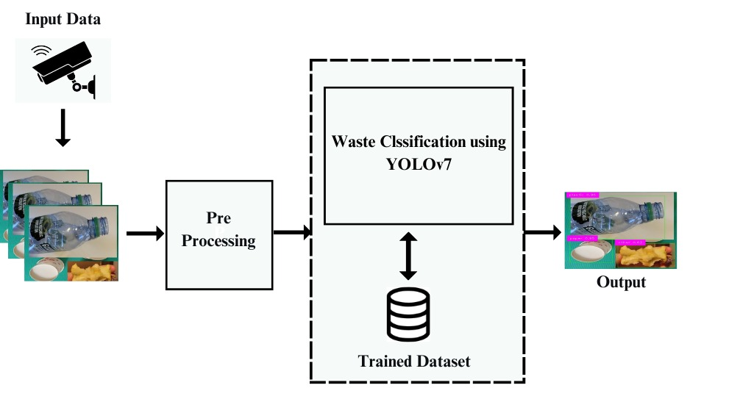
SYSTEM DESIGN

Slide 30
Dataset: Custom waste detection datasets on Kaggle typically involve acquiring waste image datasets, which are used to train deep learning models to identify and classify different types of waste materials from images or sensor data. This process includes data collection, annotation, preprocessing, model training, and evaluation.
Input: Gathering a dataset of waste images and annotating them. Here we use the custom waste detection dataset from Kaggle.
Preprocessing: In this step we are preparing raw data to make it suitable for building and training the model,
YOLO v7 Model: YOLO is a family of real-time object detection models. It provides a faster and stronger network architecture that provides a more effective feature integration method, more accurate object detection performance, a more robust loss function, and an increased label assignment and model training efficiency.
Output: The output typically consists of bounding boxes around the detected waste materials along with their corresponding class labels and confidence scores.

Slide 31
IMPLEMENTATION
IWSS powered by Machine learning revolutionize waste segregation processes, offering enhanced accuracy and efficiency compared to traditional methods.
Machine learning enables automatic classification and sorting of materials and reducing the need for manual intervention.
These systems accurately identify different types of waste materials, leading to reduced waste sent to landfills and promoting a more circular economy through resource conservation.
Machine learning algorithms continuously learn and improve over time, enhancing their sorting capabilities and scalability in handling diverse waste streams across industries.
Adoption of IWSSs yields benefits such as reduced waste management costs, improved recycling rates, compliance with environmental regulations, and overall enhancement of sustainability practices

Slide 32
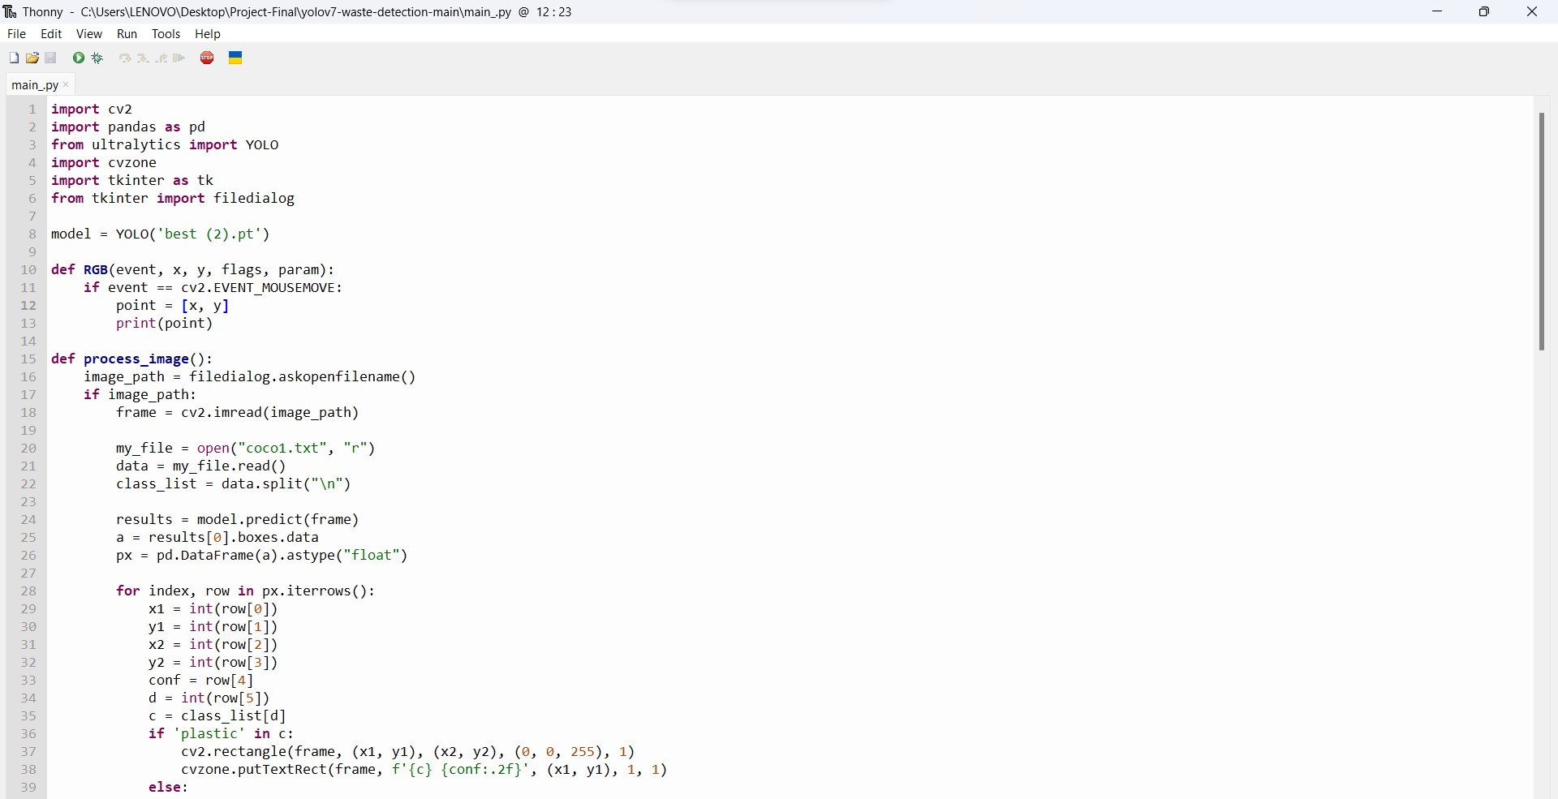
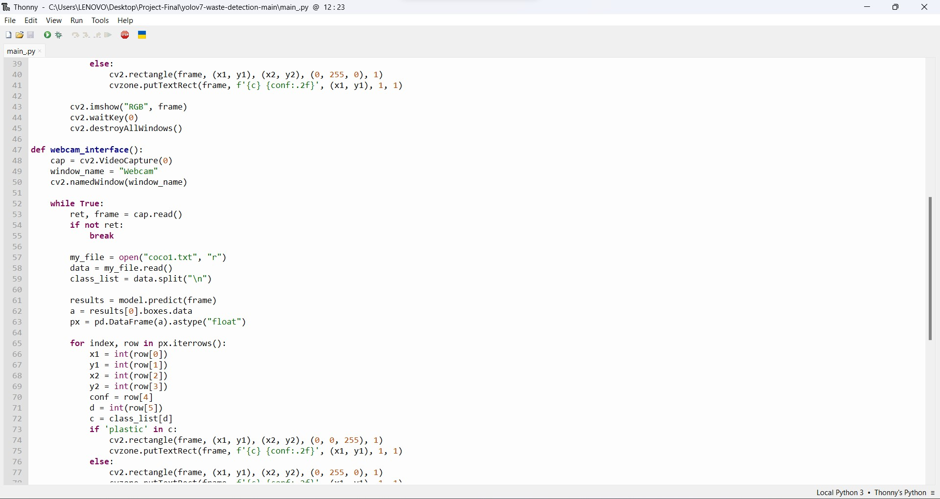
Fig 1: code for yoloV7 algorithm
Fig 2: code for yoloV7 algorithm

Slide 33
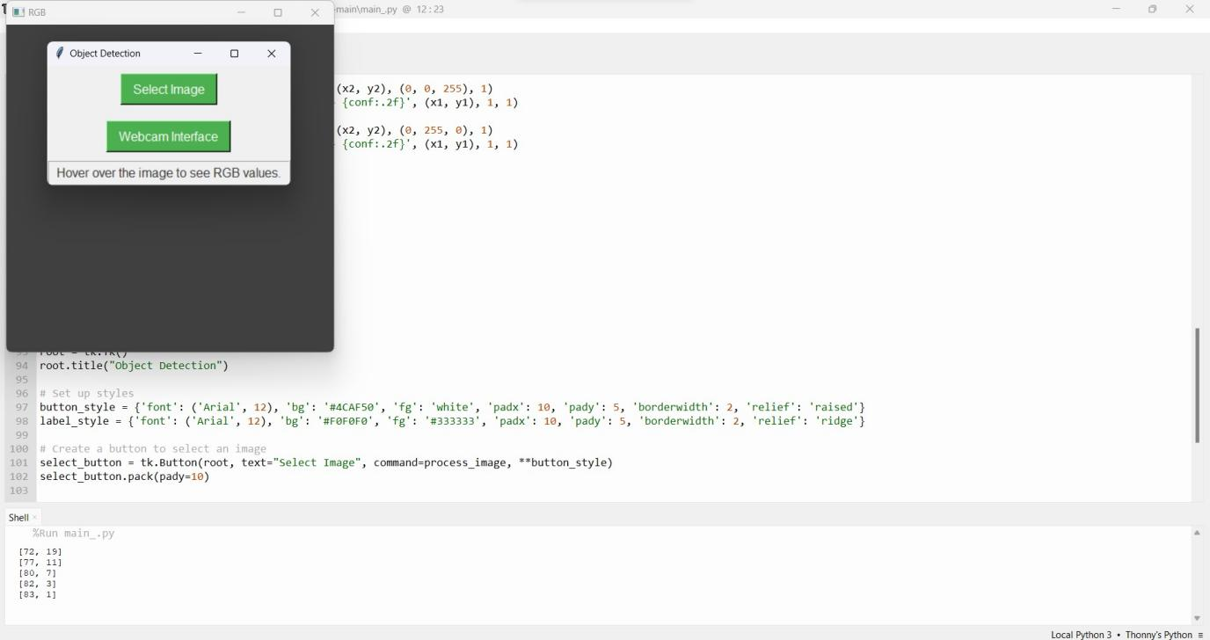
Fig 3: user interface

Slide 34
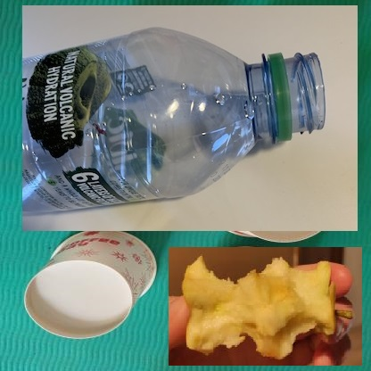
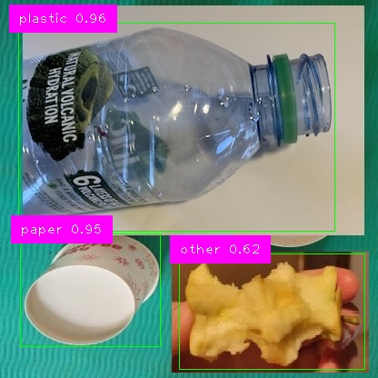
RESULTS
INPUT
OUTPUT

Slide 35
CONCLUSION
The Intelligent Waste Sorting System using YOLOv7 software presents a promising solution for automating the waste sorting process. The project highlights the impactful role of deep learning and machine learning in revolutionizing waste management practices. The use of YOLOv7 for object detection enables automated waste classification and enhances collection processes, offering a significant step towards reducing environmental and health hazards associated with improper waste disposal.
This project aims to harness advanced technology to address critical challenges in waste management, ultimately fostering a cleaner, more sustainable environment while streamlining waste-handling operations for maximum effectiveness and minimal disruption.

Slide 36
REFERENCES
[1] Adedeji, Olugboja, and Zenghui Wang. "Intelligent waste classification system using deep learning convolutional neural network." Procedia Manufacturing 35 (2019): 607-612.
[2] Rahman, Md Wahidur, et al. "Intelligent waste management system using deep learning with IoT." Journal of King Saud University-Computer and Information Sciences 34.5 (2022): 2072-2087.
[3] Kumar, G. Shravan, et al. "Intelligent Waste Management System Using Deep Learning." Journal of Survey in Fisheries Sciences (2023): 2767-2772.
[4] Wang, Ying, and Xu Zhang. "Autonomous garbage detection for intelligent urban management." MATEC Web of Conferences. Vol. 232. EDP Sciences, 2018.
[5] Huang, Rui, et al. "A rapid recognition method for electronic components based on the improved YOLO-V3 network." Electronics 8.8 (2019): 825.

Slide 37
[6] WasteSegNet: A Deep Learning Approach for Smart Waste Segregation in Urban Environments Aatmaj Amol Salunke.
[7] Adedeji, O.; Wang, Z. Intelligent waste classification system using deep learning convolutional neural network. In Proceedings of the Procedia Manufacturing; Elsevier B.V.: Amsterdam, The Netherlands, 2019; Volume 35, pp. 607–612.
[8] Chu, Y.; Huang, C.; Xie, X.; Tan, B.; Kamal, S.; Xiong, X. Multilayer hybrid deep-learning method for waste classification and recycling. Comput. Intell. Neurosci. 2018, 2018, 5060857.
[9] Machine-learning approaches in geo-environmental engineering: Exploring smart solid waste management
Author panelAbderrahim Lakhouit a, Mahmoud Shaban b c, Aishah Alatawi d, SumayaY.H. Abbas e, Emad Asiri a, Tareq Al Juhni a, Mohamed Elsawy a f.
[10] Garbage detection and classification using a new deep learning-based machine vision system as a tool for sustainable waste recycling.

Slide 38
[11] Kumar, G. Shravan, et al. "Intelligent Waste Management System Using Deep Learning." Journal of Survey in Fisheries Sciences (2023): 2767-2772.
[12] Adedeji, Olugboja, and Zenghui Wang. "Intelligent waste classification system using deep learning convolutional neural network." Procedia Manufacturing 35 (2019): 607-612.
[13] De Carolis, Berardina, Francesco Ladogana, and Nicola Macchiarulo. "Yolo trashnet: Garbage detection in video streams." 2020 IEEE Conference on Evolving and Adaptive Intelligent Systems (EAIS). IEEE, 2020.
[14] Andhy Panca Saputra, Kusrini. "Waste Object Detection and Classification using Deep Learning Algorithm: YOLOv4 and YOLOv4-tiny." Turkish Journal of Computer and Mathematics Education (TURCOMAT) 12.14 (2021): 1666-1677.
[15] Desta, Meron, Tagel Aboneh, and Bisrat Derebssa. "Deep learning-based object detection for smart solid waste management system." Annals of Environmental Science and Toxicology 7.1 (2023): 052-060.

Slide 39
[16] T.D. Bui et al. Identifying sustainable solid waste management barriers in practice using the fuzzy Delphi method Resour. Conserv. Recycl. (2020)
[17] G. Aid et al. Expanding roles for the Swedish waste management sector in inter-organizational resource management Resour. Conserv. Recycl. (2017)
[18] O.I. Funch et al. Detecting glass and metal in consumer trash bags during waste collection using convolutional neural networks Waste Manage. (2021)
[19] P. Nowakowski et al. Application of deep learning object classifier to improve e-waste collection planning Waste Manage. (2020)
[20] M. Toğaçar et al. Waste classification using AutoEncoder network with integrated feature selection method in convolutional neural network models Measurement. (2020)
[21] custom_waste_detection (kaggle.com)
[22] (PDF) Waste Object Detection and Classification using Deep Learning Algorithm: YOLOv4 and YOLOv4-tiny (researchgate.net)

Slide 40

THANK YOU

