Slide 1

Big Data Analysis of Ecommerce Behavior Data from Multi Category Store Faculty Mentor: Dr. Jongwook Woo
Lekha AjitKumar
Sushmitha Dandu
Dauren Omarov
Navyasree Sriramoju
(M.S. Information Systems)

Slide 2
Introduction
The increasing amount of data generated by various sources, including social media, sensors, and mobile devices, has created a need for tools and technologies to manage and analyze large datasets.
Big Data analytics can provide valuable insights into customer behavior, market trends, and operational efficiency, helping organizations make data-driven decisions and gain a competitive advantage.
This study analyzes customer behavior patterns for an online eCommerce multi-category store by interpreting data from customer buying and viewing behavior for a particular brand and category.
This Poster explains the method and process used for data manipulation and further analysis, including data cleaning processes using Hadoop and Beeline.
Data interpretation and analysis of this data was done using Excel, Tableau, and Power BI, visualizing customer behavior patterns in charts and visuals such as bar diagrams and timelines.
The dataset contains customer behavior data for October and November 2019, with a size of 5GB and 10 columns. The goal of the analysis is to help companies understand user requirements and maximize sales and production of demanding goods.
The dataset is publicly open and stored in a CSV file format with a size of 14.68 GB, covering several days in October and November, and can be applied to similar datasets of a larger or smaller size.
The methodology illustrates the process of data collection, cleaning, and analysis using various tools and platforms.

Slide 3
Research Background
The goal of this study is to analyze customer buying behaviour using the dataset.
The study will also compare the buying and viewing patterns of customers in the two different months to identify any differences.
The dataset was chosen because it can help companies understand user requirements and maximize sales and production of high-demand goods.
Analyzing customer behaviour data can help companies make informed decisions about product development, marketing strategies, and pricing.
This research can also help identify potential gaps in the market that could be filled by new or existing products.
Analyzing large datasets like this can be challenging, but data analysis techniques make it possible to extract valuable insights from the data.
The results of this study could have significant implications for companies in a wide range of industries, including e-commerce, retail, and manufacturing.

Slide 4
Methodology
Dataset size: 14.68 GB covering several days in October and November
Data consists of irregularities, with the majority occurring in November
Dataset includes two data logs in CSV format uploaded to Hadoop File System
Tables were created and raw data was loaded into tables using Beeline
Each file was separately cleaned and then exported for further analysis
A cleaned table was created to portray all cleaned data in a separate table for easy querying
Data was extracted into Excel, Power BI, and Tableau for further analysis
Pie charts, bar graphs, line graphs, and dotted graphs were used to represent sales, brands, count, categories, user details, and purchases
The visualization tools helped interpret customer behavior.

Slide 5
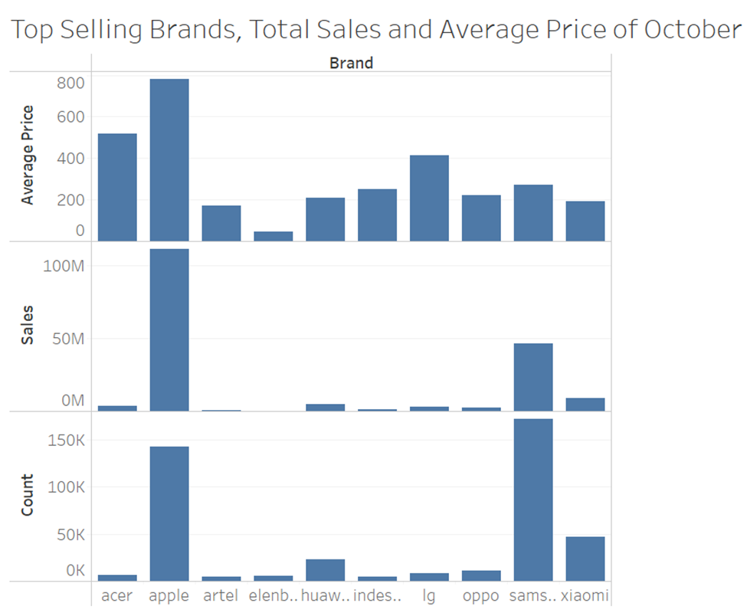
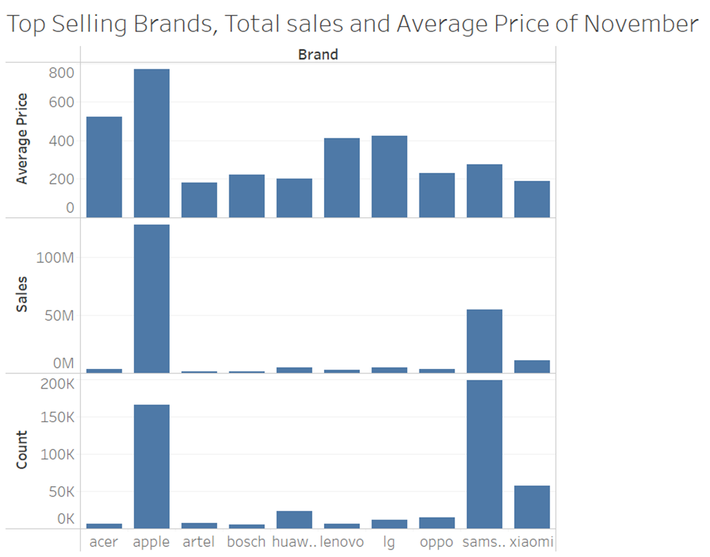
Data Analysis

Slide 6
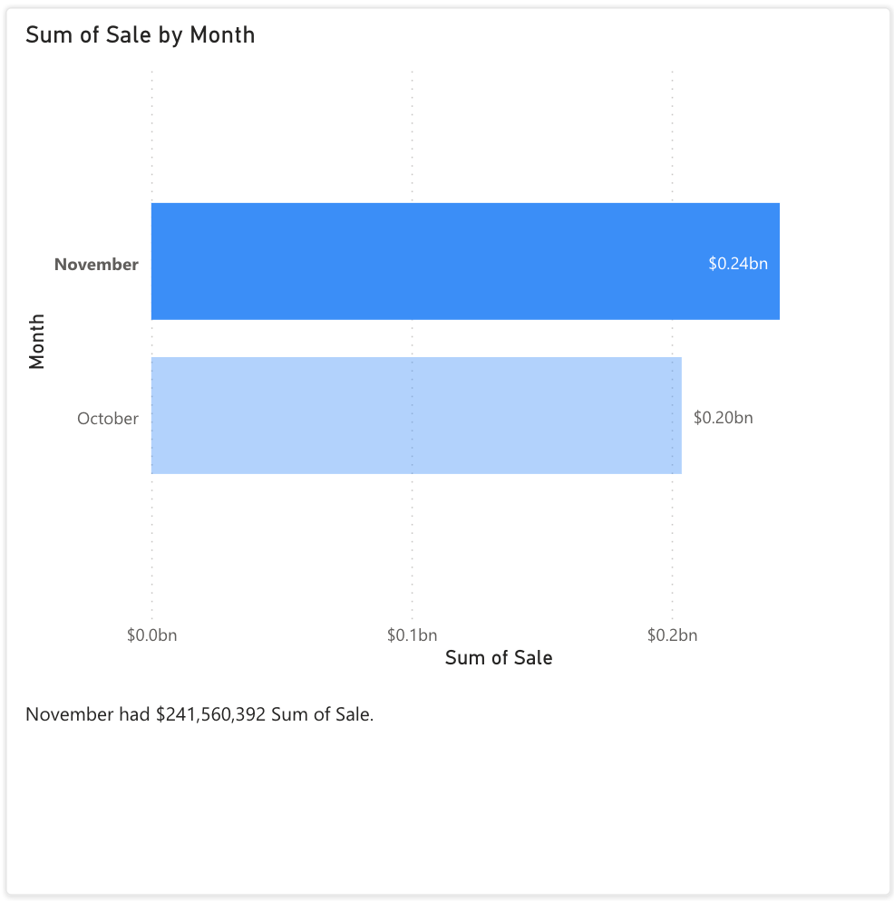
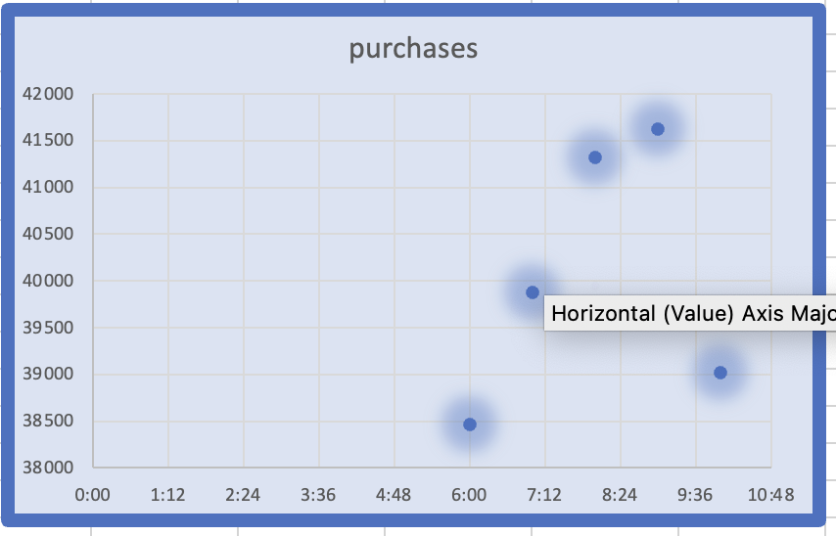

Slide 7
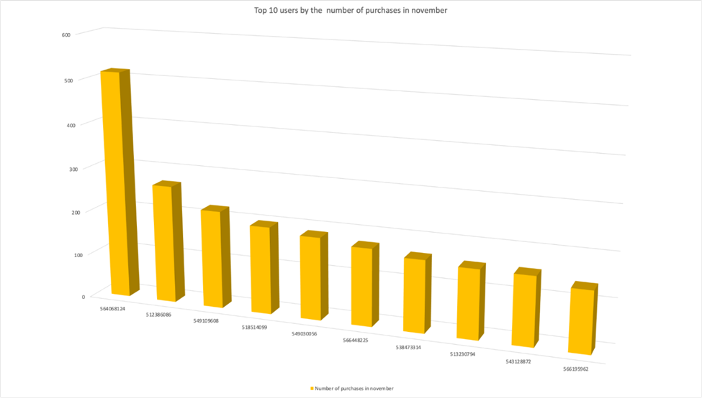
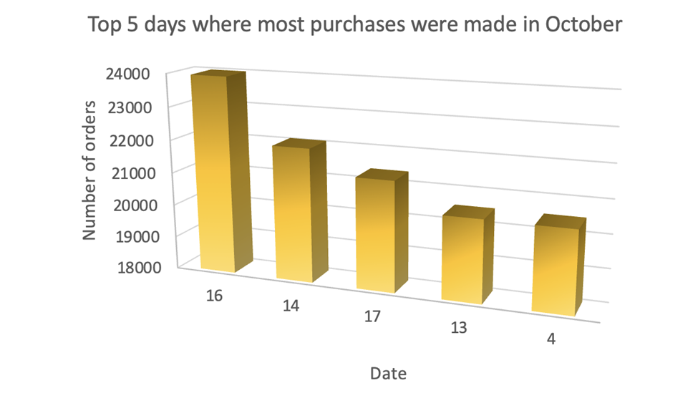

Slide 8
Results
From all the above work we can conclude the following:
Marketing: Companies could use the insights from this analysis to inform their marketing strategies, tailoring their messaging and promotions to target audiences more effectively.
Product development: This analysis could help companies identify areas where there is high demand for certain products or features, allowing them to develop new offerings that meet consumer needs.
Pricing: By understanding which factors are most important to consumers when making purchasing decisions, companies could adjust their pricing strategies accordingly to maximize profits.
Customer service: Companies could use the insights from this analysis to improve their customer service offerings, addressing common pain points and providing more personalized support.
Competitive analysis: This analysis could help companies better understand their competition and identify areas where they can differentiate themselves and gain a competitive edge.
Consumer advocacy: Finally, this analysis could be used by consumer advocacy groups to identify areas where consumers are being underserved or exploited, advocating for policy changes that benefit consumers.
Overall, the insights gleaned from this analysis could help businesses be more competitive, better serve their customers, and ultimately drive growth and success.

Slide 9
References
IvanIvan 11, et al. “Hive SQL. Find Most Popular Value across Multiple Columns.” Stack Overflow, 1 May 1965, https://stackoverflow.com/questions/51097895/hive-sqlfind-most-popular-value-across-multiple-columns.
“Types of Data Analysis Used in e-Commerce to Get Key Business Insights.” TechNWeb, Inc. (Dba. PowerSync), 3 Feb. 2023, https://powersync.biz/blog/types-of-data-analysis-used-in-ecommerce-to-get-key-business-insights.
SANYASACHDEVA1. “SANYASACHDEVA1/Portfolio: My Portfolio.” GitHub, https://github.com/sanyasachdeva1/Portfolio.

