Slide 1


5280 Group 1
Team Members

Slide 2
Security Challenges in the Integration of IoT with WSN for Smart Grid Applications
Athira Viswanathan, Sai Shibu N B, Sethuraman N Rao, Maneesha Vinodini Ramesh Center for Wireless Networks & Applications (WNA) Amrita Vishwa vidyapeetham Amritapuri India

Slide 3
Abstract
Internet of Things (IoT) is an emerging technology paradigm that can be incorporated in various applications such as Smart Grid, Smart Home, and Communication Networks etc. Wireless Sensor Networks (WSN) are playing a key role in various applications such as landslide detection, waste management, water quality monitoring in rivers and lakes etc. One of the most data critical applications of WSN is Smart grids.
The major problem in the existing power grid is the lack of reliability as one cannot predict power failure. The primary cause of power failure is the energy scarcity and the lack of awareness among the users of the energy availability and their usage limits.
This result in increase in the energy consumption costs and projects the impression that electricity is unaffordable in the user's mind. Smart Grid offers promising solutions in transforming the existing power grids into a reliable and cost-efficient grid by using WSN. This paper focuses on incorporating IoT into Smart Grid and then various security challenges faced therein. It also introduces a solar energy harvester for Smart City Framework, a community of buildings, each equipped with a solar energy harvesting system, which can share their energy according to the decision taken by the control station. There by, it proposes a cost-effective smart Grid model using distributed renewable energy generators that helps meet the local power demands.

Slide 4
Introduction
The integration of Internet of Things (IoT) and Wireless Sensor Networks (WSN) in Smart Grid applications has the potential to transform existing power grids into more reliable and cost-efficient systems. This paper focuses on the challenges and risks associated with this integration and proposes a system that addresses these challenges. The proposed system is a solar energy harvesting system that can be used in a Smart City Framework, where buildings in a community are equipped with solar panels and can share energy according to decisions made by a control station. This system can result in a more efficient use of solar energy and better management of power generation and consumption in communities. The authors also highlights the security challenges that arise in this context and suggests ways to address them. The paper presents a cost-effective Smart Grid model using distributed renewable energy generators that helps meet the local power demands while protecting secret details and avoiding cyber-physical security risks.

Slide 5
Methodology
"The research methodology used in this paper is mainly simulation, where the authors estimate the reliability indices by simulating the actual process and the random behavior of the system. They treat problems as a series of real experiments. The authors mention that the reliability of the system can be evaluated by using simulation methods, although the paper does not provide a detailed description about the simulation methodology used. The paper also highlights the security challenges that arise in this context and suggests ways to address them. It does not provide a description about the research methodologies used like study design, data collection, analysis and evaluation."

Slide 6
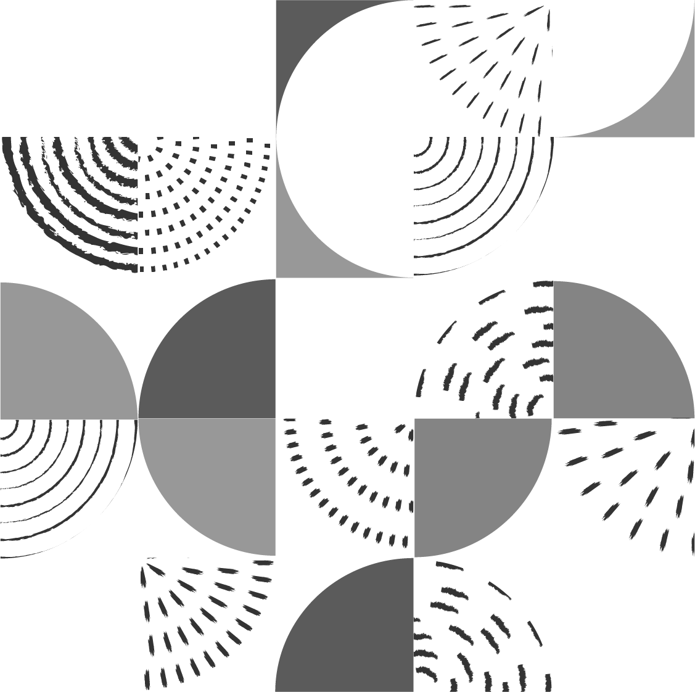
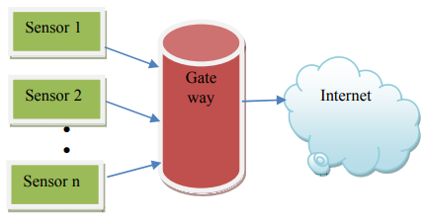
WIRELESS SENSOR NETWORKS AND INTERNET OF THINGS
Each sensor node periodically measures the surrounding air temperature and sends it if it exceeds the threshold. The sensor nodes are directly connected to the gateways, which autonomously connect to the server. The out of field communication from gateway to the server can be done using GPRS and Internet. The gateways process, store and send the collected information periodically to the server.

Slide 7
Security Challenges
Protecting personal information and secret documents stored and transmitted through the cloud as part of the IoT and WSN infrastructure.
Identifying the chances of occurrence of faults in the long running cable of the grid from the control station itself without human help.
Cyber security challenges: The various characteristics of smart grid such as scalability, delay constraints, bandwidth etc. make it more challenging to design a uniform security approach throughout the network.
Cyber physical security risks: As the applications and infrastructure of smart grid are not designed to integrate easily with IT network and these vulnerabilities can lead to cyber physical security risks.
Lack of reliability: The major problem in the existing power grid is the lack of reliability as one cannot predict power failure.

Slide 8
Research Result and its Impact
The research paper primarily focuses on the challenges and risks associated with integrating IoT with WSN in Smart Grid applications and proposes a system that can help address these challenges. The authors propose a solar energy harvesting system that can be used in a Smart City Framework, where buildings in a community are equipped with solar panels and can share energy according to decisions made by a control station. The paper suggests that this integration can help to transform existing power grids into more reliable and cost-efficient systems. The results presented in the paper is mainly about the potential benefits of integrating IoT and WSN in the context of Smart Grid applications, which include two-way interactions between the utility grid and its customers, that improve the monitoring of the grid's performance and providing a more efficient and cost-effective solution for meeting local power demands. The authors also highlight the security challenges that arise in this context, such as protecting personal information and secret documents stored and transmitted through the cloud as part of the IoT and WSN infrastructure and identifying the chances of occurrence of faults in the long running cable of the grid and cyber security challenges. They proposed a cost-effective Smart Grid model using distributed renewable energy generators, which will helps meet the local power demands but also states that it should adopt necessary security solutions to protect the secret details. It also discussed about the simulation methodology of evaluating the reliability of smart grids, but there is no data-based results presented in the paper.
However, the impact of the results are not quantitatively shown, it has been described mainly in the form of explanation and examples. It might be beneficial if the paper included more information such as experiment, data or case study that would provide more quantitative evidence to support their claims of impact.

