Slide 1
IBM Transactions for Anti Money Laundering (AML)
CIS 5560 INTRO TO BIG DATA SCIENCE
Professor: Jongwook Woo
Submitted by:
Lekha Ajit Kumar
Sushmitha Dandu
Dauren Omarov
Navyasree Sriramoju

Slide 2
AGENDA
Introduction
Dataset Specifications
Technical Specifications
Prediction System Flowchart
Machine Learning Algorithms
Feature Importance
Algorithms Comparison
Classification
GitHub Link
References
Summary

Slide 3
INTRODUCTION
The IBM Transactions for Anti Money Laundering (AML) dataset is a synthetic dataset that contains financial transactions involving individuals, companies, and banks.
The dataset contains both legitimate and laundering transactions that are labeled, making it ideal for training and testing Anti Money Laundering models.
We chose "LI_Medium_Trans.csv," file from the Dataset which is of 2.98gb and has 11 Columns

Slide 4
Dataset Specifications
DATASET NAME:
IBM Transactions for Anti Money Laundering (AML)
TOTAL DATASET SIZE AND FORAMT:
2.98 GB. CSV
DATASET URL:
https://www.kaggle.com/datasets/ealtman2019/ibm-transactions-for-anti-money-laundering-aml?select=LI-Medium_Trans.csv

Slide 5
Github link
https://github.com/Lekha19202/CIS-5560-big-data-science-project

Slide 6
TECHNICAL specification
HDFS ORACALE SPCIFICATION
DATABRICKS SPCIFICATION
Hadoop Version: 3.1.2
No. of CPUs: 8
Py Spark version: 3.0.2
Nodes: 3
Total Storage:390.7 GB
Cpu speed: 1995.3 MHz
Core: 4 core CPU
Databricks Community Version: 10.4 LTS (includes Apache Spark 3.1.1, Scala 2.12)
File System: DBFS (Data Bricks File System)
Nodes: 1
Python Version: 3.10.4

Slide 7
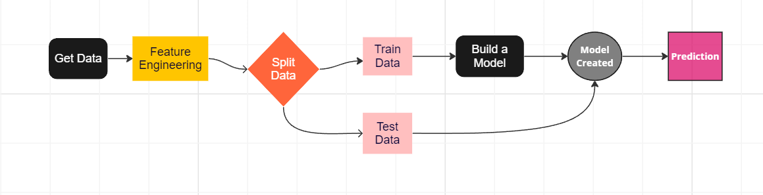
Prediction System Flowchart
Using built-in Pyspark ML lib & tuning parameters
Evaluate models by using measures for accuracy like AUC, Recall and Precision
Kaggle
Databricks, zepplin, spark CLI
70/30 split

Slide 8
Classification
The Classification algorithm is a Supervised Learning technique that is used to identify the category of new observations based on training data.
In Classification, a program learns from the given dataset or observations and then classifies new observation into a number of classes or groups. Such as, Yes or No, 0 or 1

Slide 9
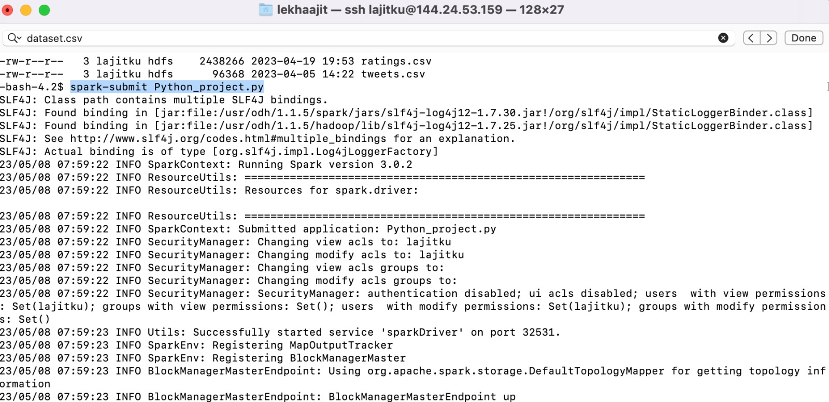
Uploading the data set in both databricks and HDFS and running them

Slide 10
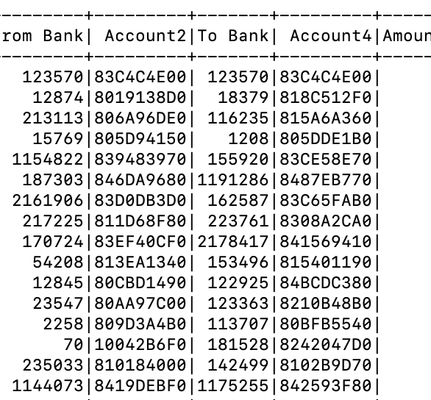
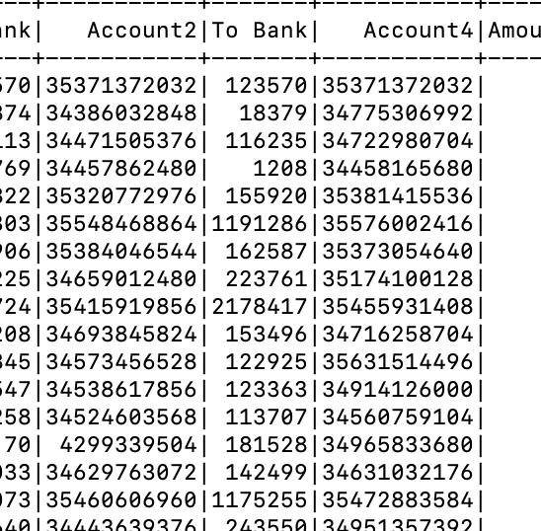





Data after cleaning – converting hexadecimal values to integers

Slide 11
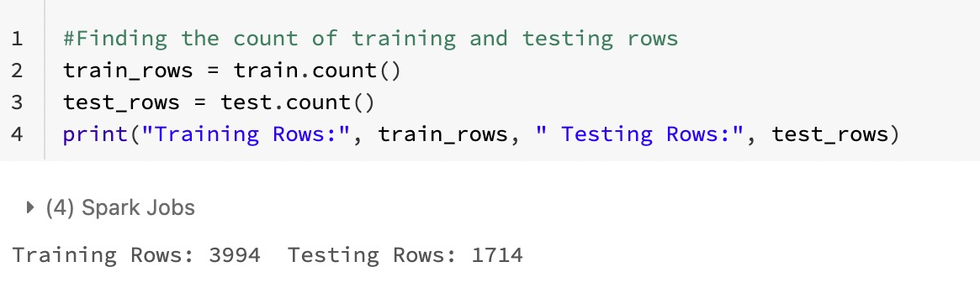
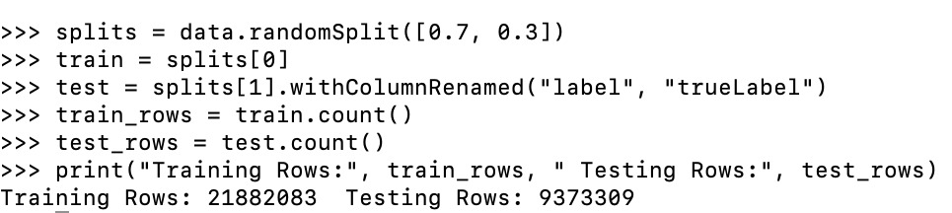
Splitting the dataset
Sample Data
Training rows: 3994
Testing rows: 1714
Full Data Set
Training rows: 21882083
Testing rows: 9373309

Slide 12
Machine Learning Algorithms
Logistic Regression
Gradient Boost Tree
Decision Tree
Random Forest
Factorization Machine
Support Vector Machine

Slide 13
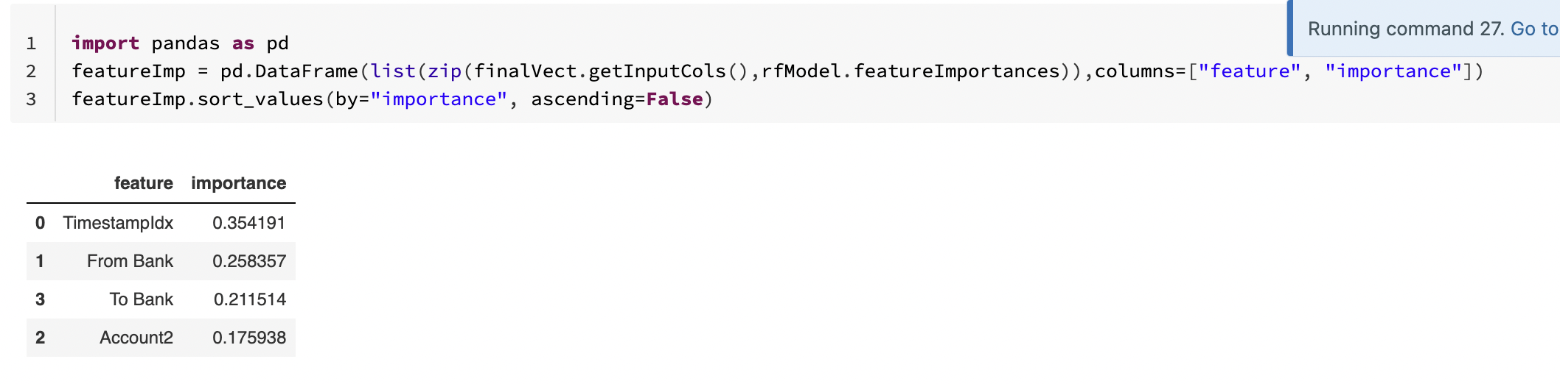
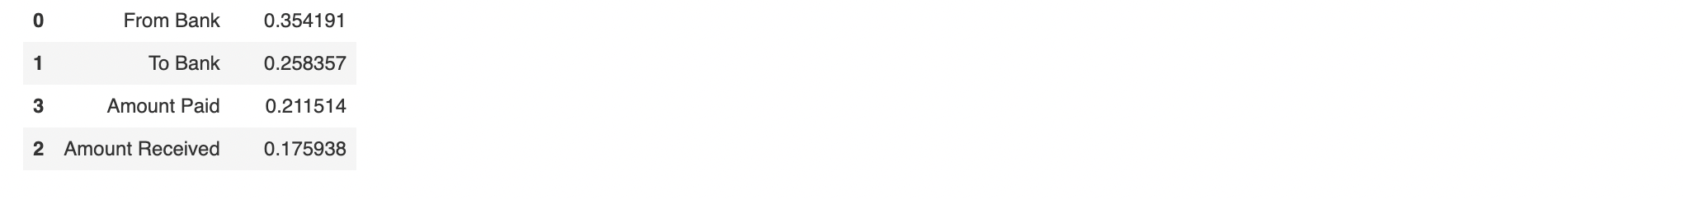
Feature importance
Feature Importance indicates how much each feature contributes to the model prediction. Basically, it determines the degree of usefulness of a specific variable for a current model and prediction.
We can see the time when the transaction was done(0.3), from which bank(0.35) it was done, and to which bank account(0.28) the money went to has the highest feature importance.

Slide 14
algorithms Comparison TVS hadoop
Algorithms | AUC | Computation time
Gradient Boost Tree | 0.7975834172723539 | 14 mins
Random Forest | 0.8198836168890412 | 13 mins
Factorization Machine | 0.45905890835389823 | 18 mins
Decision Tree | 0.5 | 9 mins
Logistic Regression | 0.521614 | 54 mins
Support Vector Machine | 0.5 | 26 mins

Slide 15
algorithms Comparison CV hadoop
Algorithms | AUC | Computation Time
Gradient Boost Tree | 0.8002939704922793 | 14 mins
Random Forest | 0.8063263296553247 | 12 mins
Factorization Machine | 0.45901019055433573 | 19 mins
Decision Tree | 0.5 | 7.4 mins
Logistic Regression | 0.521614 | 70 mins
Support Vector Machine | 0.5 | 16 mins

Slide 16
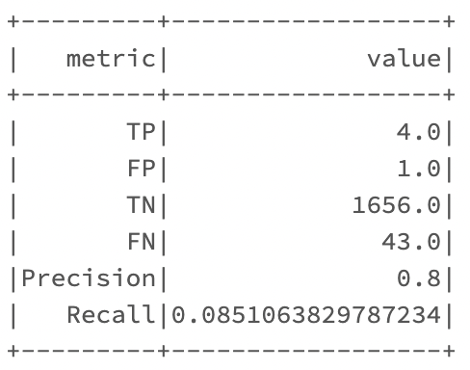
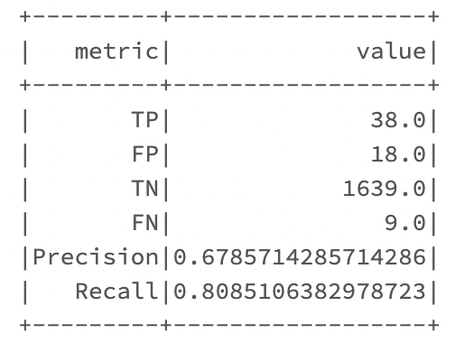
algorithms Comparison without CV and tvs
Algorithms | AUC | Computation Time | Precision | Recall
Decision Tree | 0.991872 | 7.4 mins | 0.6785 | 0.8085
Logistic Regression | 0.94714878 | 8 mins | 0.8 | 0.0851

Slide 17
Major diffrences in databricks and hadoop AUC
Algorithms | AUC in DB | AUC in Hadoop
Decision Tree | 0.991872 | 0.5151375
Logistic Regression | 0.94714878 | 0.7316513662948
FM TVS | 0.795949 | 0.4590589083538

Slide 18
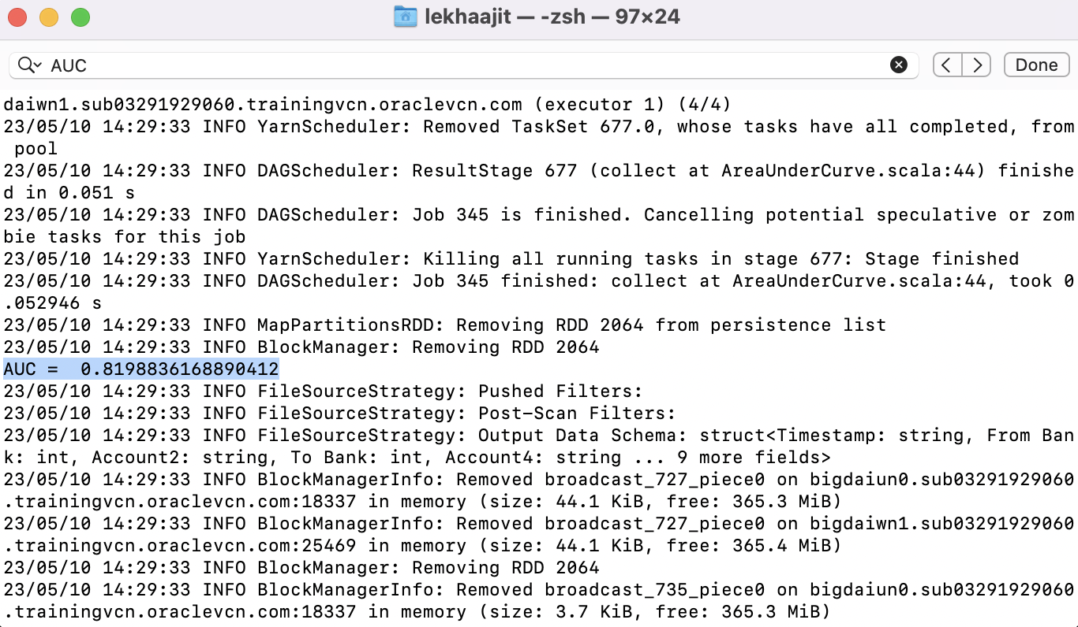
Sample AUC in hadoop

Slide 19
Summary
1
Random forest TVS has the highest area under curve which is 0.81. Next highest was GBT_CV with 0.806 and RF_CV with 0.8002
2
Logistic regression CV took the highest computation time of 1.2 hrs
3
Decision Tree also had the fastest computation time of 7.4 mins.
4
Logistic regression had the highest Precision of 0.8. Decision Tree had the highest Recall of 0.80

Slide 20
References
Li, Susan. “Machine Learning with Pyspark and MLlib - Solving a Binary Classification Problem.” Medium, Towards Data Science, 7 May 2018, https://towardsdatascience.com/machine-learning-with-pyspark-and-mllib-solving-a-binary-classification-problem-96396065d2aa.
“Regression Analysis.” Corporate Finance Institute, 3 May 2023, https://corporatefinanceinstitute.com/resources/data-science/regression-analysis/.
Jagdeesh. “PySpark Decision Tree – How to Build and Evaluate Decision Tree Model for Classification Using PySpark MLlib.” Machine Learning Plus, 1 May 2023, https://www.machinelearningplus.com/pyspark/pyspark-decision-tree/.

Slide 21
THANK YOU!

