Slide 1
Practical Business Applications of Large Language Models: An Exploration of GPT4All CIS-5850
Notes:
Hello, and welcome to our presentation on LLMs, or Large Language Models. This presentation is being conducted for CIS 5850 at California State University, Los Angeles.

Slide 2
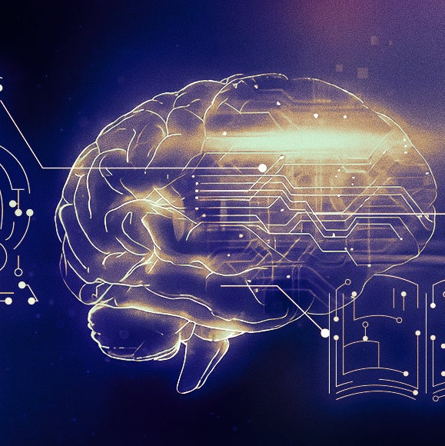
INTRODUCTION
Dauren Omarov
Navyasree Sriramoju
Sushmitha Dandu
Notes:
I'm Gentre Thomsen and my co-presenter is Oliver Diaz. We're both MSIS majors at CSULA. In this presentation we'll discuss a brief history of large language models and this GPT technology that has taken the world by storm. We'll also be surveying this still-burgeoning technology as it stands in May of 2023. We'll then demonstrate the accessibility of this technology before digging into potential applications, or use cases, before discussing prime areas for further research.

Slide 3
LLM overview
OpenAI’s ChatGPT has taken the world by storm, demonstrating the uncanny capacity for computer systems to respond to text prompts with very human-like responses
The current iteration of ChatGPT can accurately conduct research, write or debug code, write poetry, and more
In this presentation, we aim to explore how, and by which approaches, this might be achieved
Notes:
LLMs, or large language models are a type of artificial intelligence typically leverage deep neural networks - computing systems inspired by biological neural networks in animal brains, to determine responses or "output"s to queries. Responses are determined mathematically, based on their training data, to be most probable. There's a lot of math and technicality to this technology, but a deep dive would be out of scope for this presentation.

Slide 4
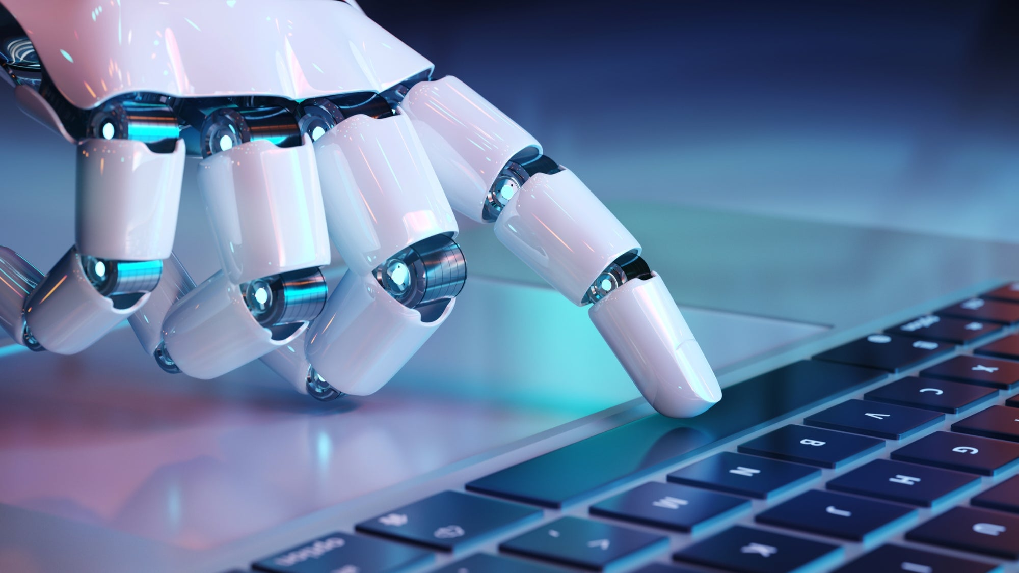
Artificial intelligence (ai)
Notes:
Artificial intelligence is defined as "the theory and development of computer systems able to perform tasks that normally require human intelligence, such as visual perception, speech recognition, decision-making, and translation between languages."
While laypeople have only really been leveraging AI in recent years, with the emergence of ChatGPT by OpenAI, which became widely-known and widely-used in 2022, the pursuit of such systems has roots going back to the mid-20th century with computing legends such as Alan Turing and John McArthy pushing boundaries of computation along the path to what Mr. McArthy perceived to be an inevitable end... that being computing systems that could "understand" and "reason" as human beings do.

Slide 5
Historical milestones
1964 – Eliza – Joseph Weizenbaum
1972 – Parry – Kenneth Colby
1981 – Jabberwocky – Rollo Carpenter
1995 – ALICE – Richard Wallace
2011 – Watson – IBM
2022 – ChatGPT - OpenAI
Notes:
One early milestone along the path to the LLM explosion arrived in 1964 at MIT with the demonstration of Eliza, which was arguably the world's first chatbot. Eliza was designed by Joseph Weizenbaum and was able to respond to the user by "recognizing" key phrases and using them to identify appropriate "canned" responses. Fast forward to 1995, when ALICE, or Artificial Linguistic Internet Computer Entity was introduced by Richard Wallace. ALICE was inspired by Eliza and engaged in "conversation" by use of heuristical pattern matching rules applied to user queries. While ALICE was not able to succeed in passing the infamous Turing Test, a test in which a chatbot is evaluated in its ability to perform well enough that a human is unable to discern that they are interacting with a machine rather than another human, ALICE certainly made a mark on the AI timeline.

