Slide 1

JAYAPRAKASH NARAYAN COLLEGE OF ENGINEERING
Calorie Burner
Group Members :-
B.SRI CHANDANA(22361A05A2)
P.SUCHITRA (22361A05A7)
G.SUSHMITHA(23365A05A8)
SYED NUVER(23365A0511)
Guided By :-
Mrs.CHANDRAKALA

Slide 2
ABSTRACT
The Calorie Burner is an innovative system that merges fitness and functionality. It features a traditional bicycle enhanced with smart capabilities such as real-time calorie tracking, speed display, and an onboard mixer powered by pedaling. The cycle uses an ESP8266 (NodeMCU) microcontroller, sensors, and a TFT display. It promotes physical activity while harnessing human-generated energy for utility, such as blending juice. This project is a step toward sustainable energy use and IoT-based health monitoring.

Slide 3
INTRODUCTION​
In the modern era, people seek ways to stay fit and productive. The Calorie Burner was developed to encourage a healthy lifestyle by tracking calories burned while also performing a practical task-blending juice using pedaling power. The system integrates sensors and a microcontroller to make the cycling experience both informative and functional.

Slide 4
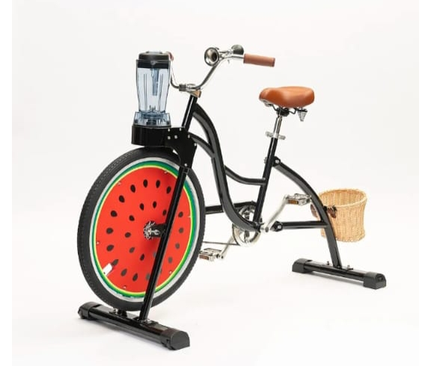
EXISTING SYSTEM
Traditional bicycles are designed only for transportation and fitness but do not offer real-time feedback or utility use. While fitness tracking devices exist, they are typically expensive and separate from the cycle.

Slide 5
EXISTING SYSTEM DISADVANTAGES
No built-in calorie or speed tracking.
Requires additional devices to monitor fitness.
Lack of energy utilization from pedaling.
Limited user interaction or data display.

Slide 6
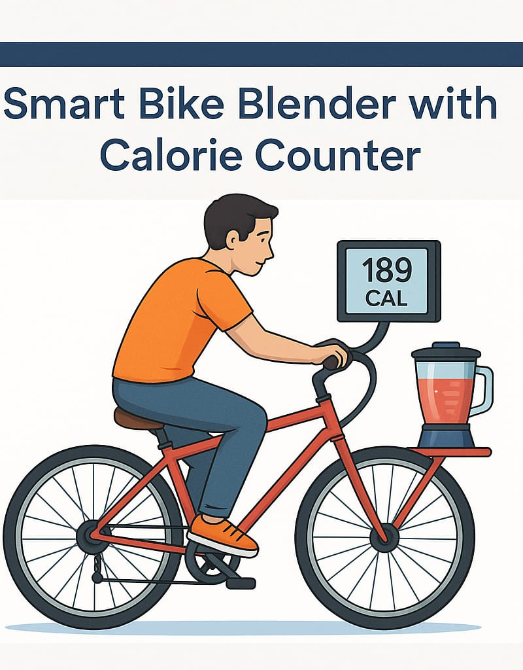
PROPOSED SYSTEM
The Calorie Burner is a smart bicycle that includes sensors to measure calories burned and speed, a TFT screen to display real-time stats, and a mixer at the rear that operates using mechanical energy from pedaling. An ESP8266 microcontroller processes the data and controls the system.

Slide 7
PROPOSED SYSTEM ADVANTAGES
Tracks calories and speed in real-time.
Mixer is powered by human pedaling, saving electricity.
Encourages healthy habits through engaging utility.
Uses affordable sensors and open-source microcontroller.
Eco-friendly and energy-efficient.

Slide 8
WORKING PRINCIPLE
A Hall effect or IR sensor detects wheel rotation.
The ESP8266 processes rotation data to calculate speed and calories.
The calculated data is shown on a TFT display.
The rear wheel drives a belt mechanism connected to the mixer to blend juice when pedaling.

Slide 9
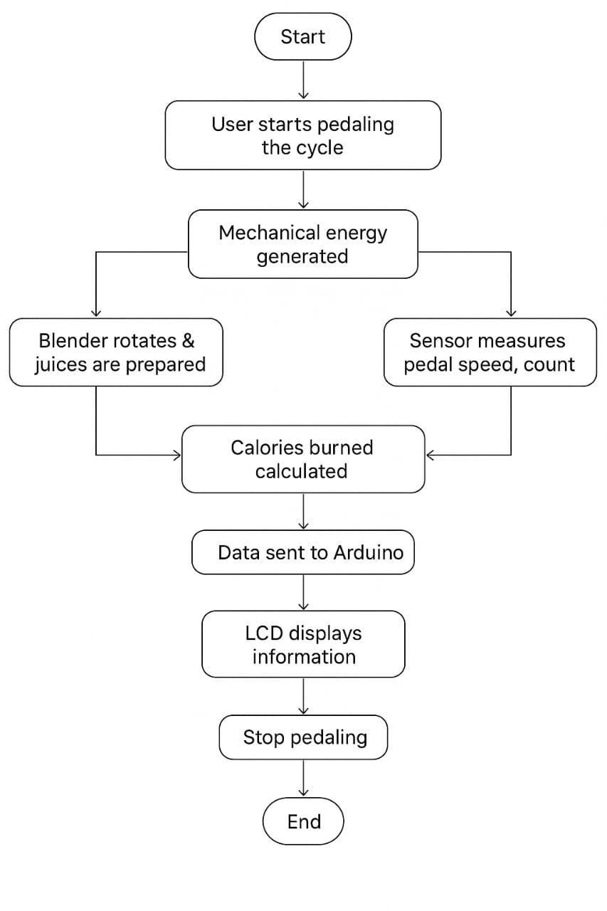
BLOCK DIAGRAM

Slide 10
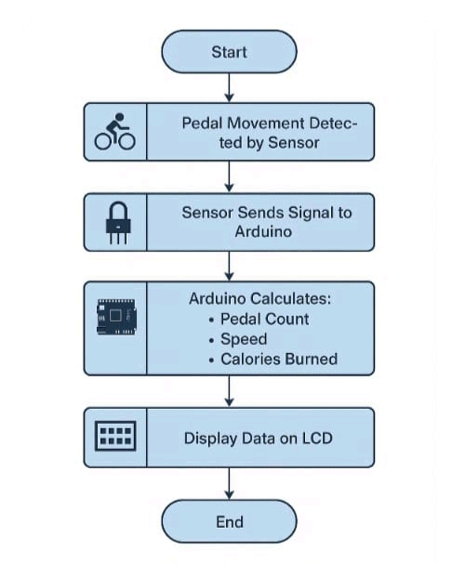
FLOW-CHART

Slide 11
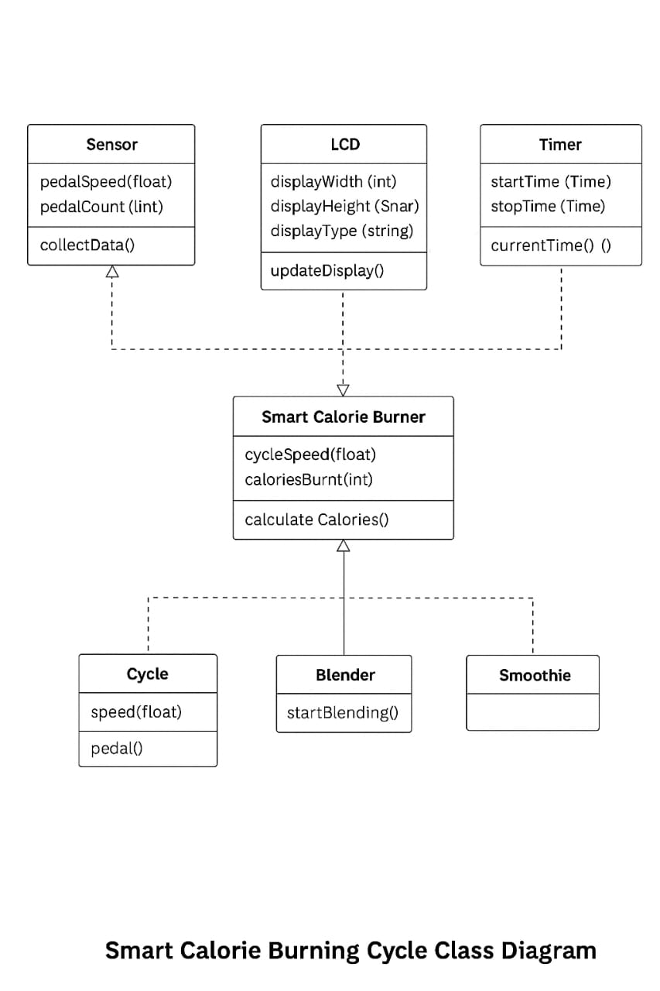
UML DIAGRAM

Slide 12
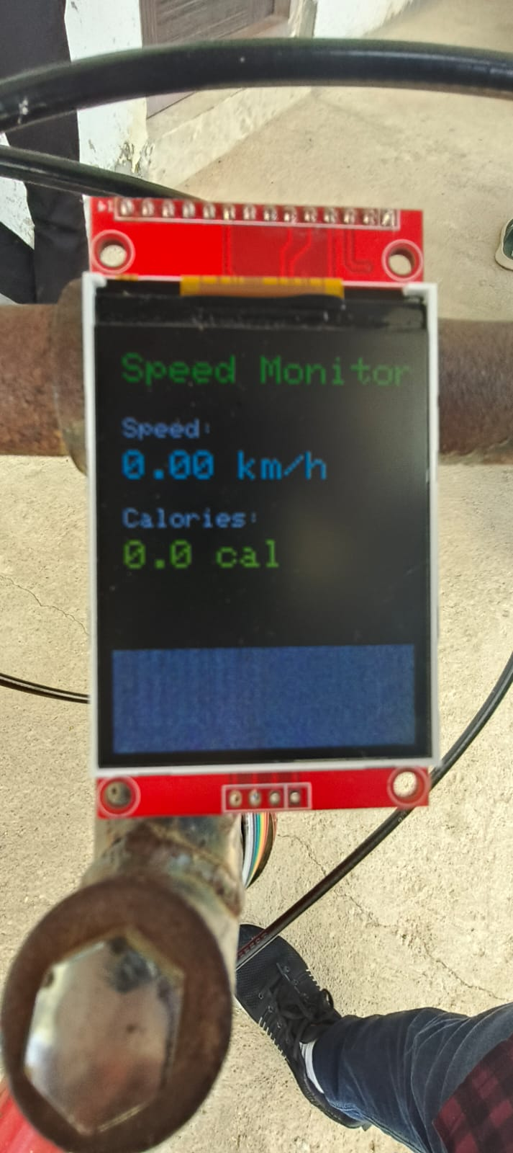
RESULT
Start-up screen:

Slide 13
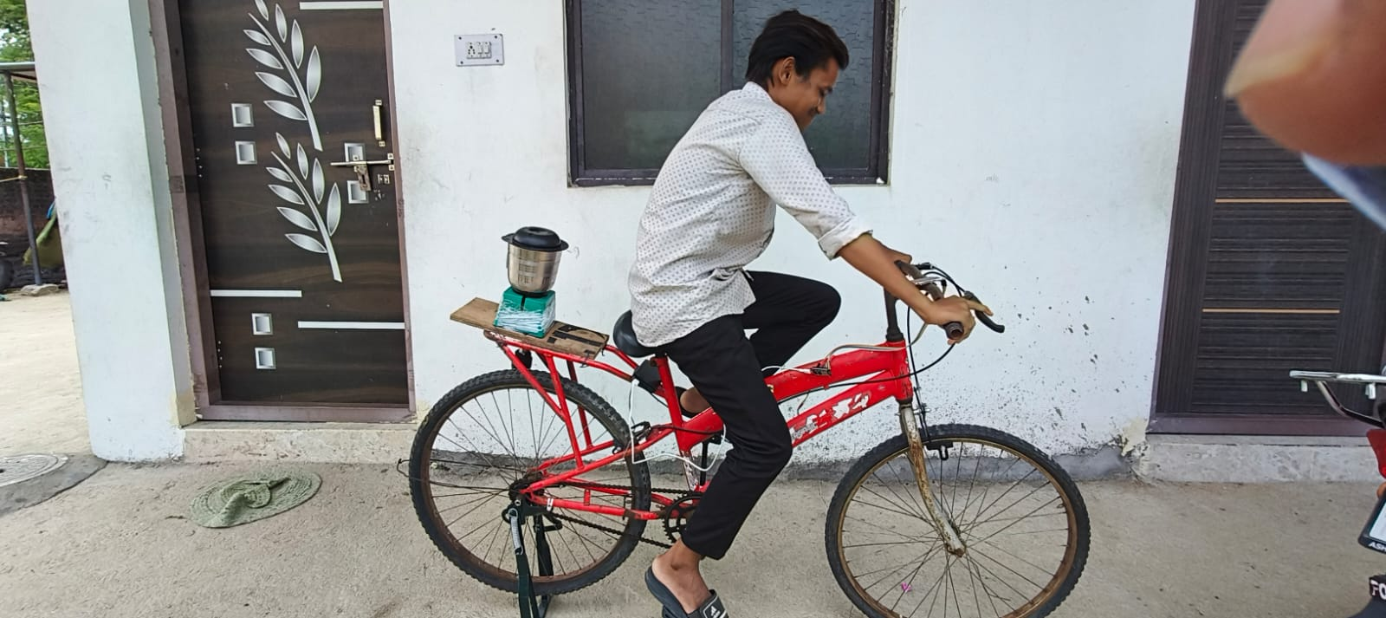
Running State:

Slide 14
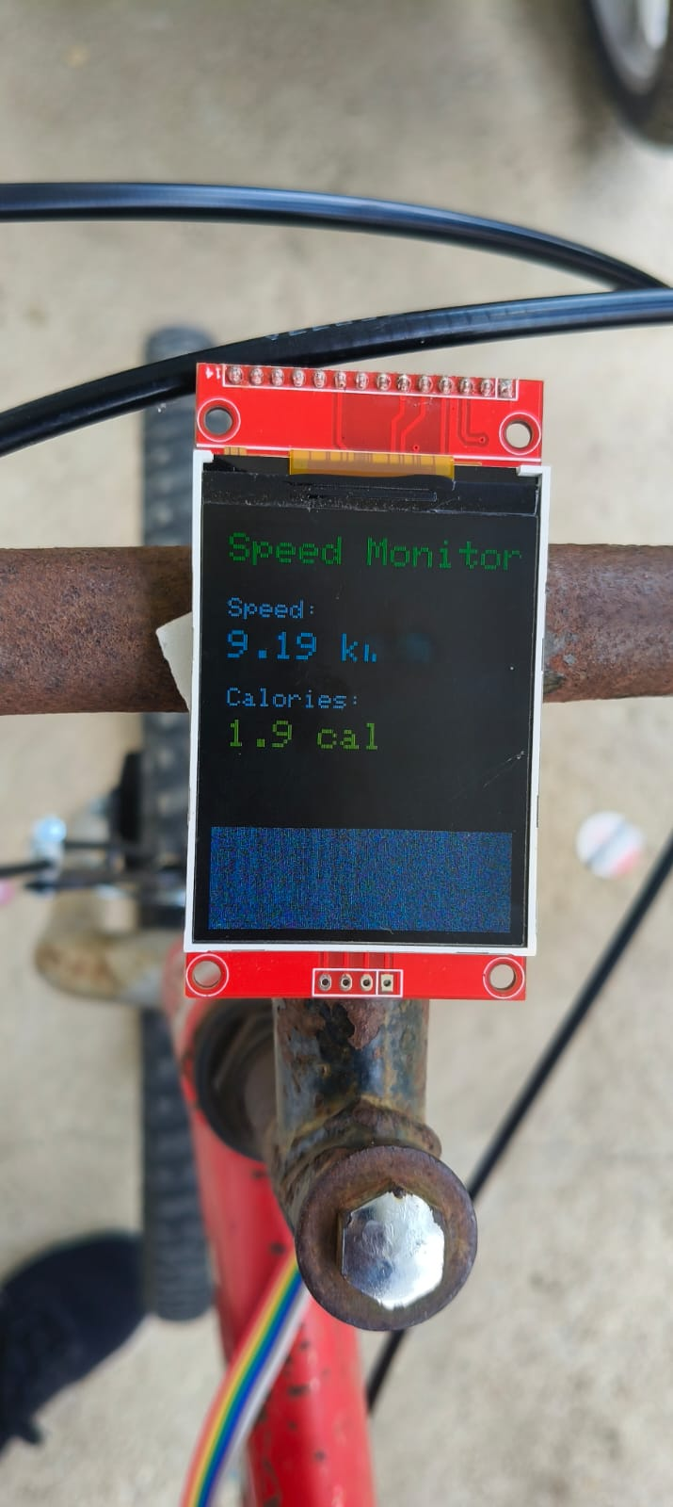
Calories and speed Counted:

Slide 15
CONCLUSION
The Calorie Burner project provides an innovative solution for integrating fitness tracking with daily utility. It encourages physical activity by making cycling more engaging and productive.
The use of embedded systems enables automation and real-time data display, making the user experience interactive and informative.

Slide 16
FUTURE SCOPE
Add Bluetooth/Wi-Fi for data sync to mobile apps.
Include GPS tracking and route mapping.
Implement solar charging for battery.
Add mobile power bank output using pedal energy.
Al-based calorie estimation based on user profile (age, weight, etc.)

Slide 17
THANK YOU

