Slide 1
Skin Lesion Analysis Towards
Skin Cancer Detection
Group 18: “Wonder Women”
Chinmayi Shaligram 001550682
Dona Darji 001044833
Sushmitha Jogula 001546751

Slide 2
About this template
Introduction and Problem Statement
Skin cancer is the most common form of cancer in the United States
annual cost of care exceeding $8 billion.
one in five Americans will develop skin cancer in their lifetime.
Skin cancer can be cured if found and treated early
With early detection, the 5 year survival rate of Melanoma, can be up to 99%
delayed diagnosis causes the survival rate to dramatically decrease to 23%
Detecting these skin diseases early can help millions of people prevent skin mutations and rampant spreading.
Good historical records and knowledge of skincare combined can help detect the type and severity of skin disease.
Skin Lesion analysis used for early cancer detection in patients, improved diagnostic accuracy, and boost up survival rate.
Areas of skin that look different from the surrounding area like bumps, patches

Slide 3
Goal and Importance
Our Solution:
Skin Lesion image analysis for skin disease classification which helps in early skin cancer detection.
Goal:
Distinguish the possibilities by analyzing whether skin lesion images addresses any of the possible skin disease categories.
Submit automated predictions of skin cancer disease classification within dermoscopic images using several ML and DL models, and assess their performance.
Identifying feature set for better classifying the images based on patient records.
Importance:
If discovered and treated early enough, 99 percent of all skin cancer cases are curable.
Accuracy of skin disease diagnoses will be improved by skin lesion image analysis techniques that automate the diagnosis of skin cancers.
Early detection leads to viable treatment and boosting up the survival rate, thus positively impacting millions of people.

Slide 4
Dataset
The HAM10000 Dataset is used in our project.
10015 dermatoscopic lesion images with patient data such as age, sex, lesion localization
Acquired from different populations, different anatomic sites, and stored using different modalities.
Kaggle link: https://www.kaggle.com/datasets/kmader/skin-cancer-mnist-ham10000?select=hmnist_28_28_L.csv
The diagnostic lesion categories included in our analysis are:
Actinic keratoses and intraepithelial carcinoma / Bowen's disease (akiec)
Basal cell carcinoma (bcc)
Benign keratosis-like lesions bkl)
Dermatofibroma (df)
Melanoma (mel)
Melanocytic nevi (nv)
Vascular lesions (angiomas, angiokeratomas, pyogenic granulomas and hemorrhage, vasc)

Slide 5
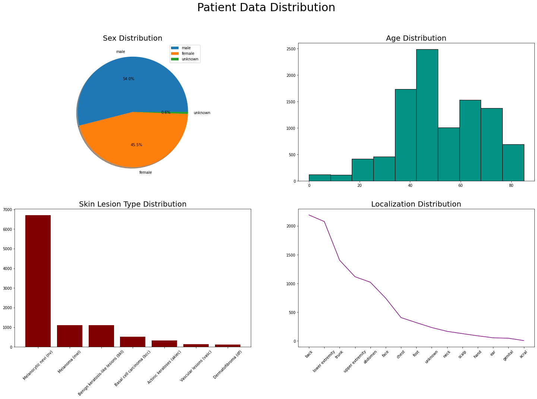

Slide 6
Softmax Regression
Generalization of logistic regression that we can use for multi-class classification.
LogisticRegression class can be configured for softmax regression by setting:
“multi_class” argument to “multinomial” and
“solver” argument to a solver that supports multinomial logistic regression, such as “lbfgs“.
Used to describe data and to explain the relationship between one dependent binary variable and one or more nominal, ordinal, interval or ratio-level independent variables
Packages/Libraries used:
Pandas, numpy, matplotlib, sklearn.metrics, sklearn.linear_model, sklearn.model_selection, seaborn
Evaluation Scores:
Macro F1-score: 0.33
Balanced Multi-class Accuracy (BMCA) score: 0.31

Slide 7
Support Vector Machine (SVM)
Supervised machine learning algorithm that aims to find an optimal boundary between the possible outputs.
SVM does complex data transformations depending on the selected kernel function and tries to maximize the separation boundaries between the data points based on classes defined.
We plot each data item as a point in n-dimensional space (n is number of feature) with the value of each feature being the value of a particular coordinate. Then, we perform classification by finding the best hyperplane that differentiates the two classes.
Packages/Libraries used:
Pandas, numpy, matplotlib, sklearn.metrics, sklearn.svm, sklearn.model_selection, seaborn, sklearn.preprocessing
Evaluation Scores:
Macro F1-score: 0.16
Balanced Multi-class Accuracy (BMCA) score: 0.68

Slide 8
Convolutional Neural Network (CNN)
CNN takes tensor as input and can better understand spatial relation(relation between nearby image pixels) between pixels of images.
A CNN convolves learned features with input data and uses 2D convolutional layers.
Hence, good for complicated 2D image and video classification.
5-layer CNN architecture followed: Convolutional Layer, Pooling Layer, Fully Connected Layer, Dropout Layer, Activation Functions
Packages/Libraries used:
Tensorflow, tensorflow.keras, tensorflow.keras.layers, tensorflow.keras.models, tensorflow.keras.callbacks, pandas, numpy, matplotlib, sklearn.metrics, seaborn
Evaluation Scores:
Macro F1-score: 0.45
Balanced Multi-class Accuracy (BMCA) score: 0.42

Slide 9
XGBoosting
Stands for eXtreme Gradient Boosting.
A decision-tree based ensemble ML algorithm that uses a gradient boosting framework designed for execution speed and model performance.
Optimized distributed gradient boosting library designed to be highly efficient, flexible and portable.
Although outperformed by neural networks for unstructured data (images, text etc.), considered best-in-class for small-to-medium structured/tabular data.
Packages/Libraries used:
Xgboost, pandas, numpy, matplotlib, sklearn.metrics, sklearn.model_selection, seaborn, sklearn.preprocessing
Evaluation Scores:
Macro F1-score: 0.37
Balanced Multi-class Accuracy (BMCA) score: 0.34

Slide 10
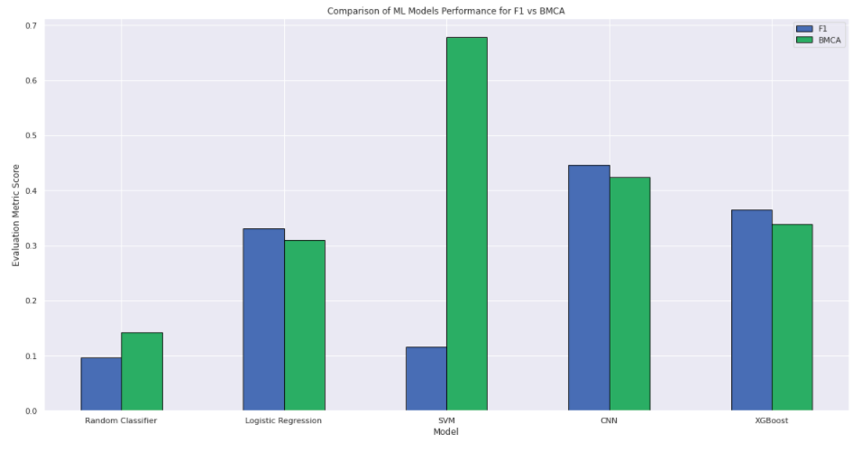
Models Performance Comparison

Slide 11
Conclusion
The CNN model achieved the best macro-f1 over the test set (same over validation set) and SVM model achieved the best BMCA score.
The final results confirms the powerness of CNN in image classification tasks but also the good performances of boosting techniques (XGBoosting).
Final results also prove that all classification models perform better than the baseline random guess classifier.

