Slide 1
Agile

Slide 2
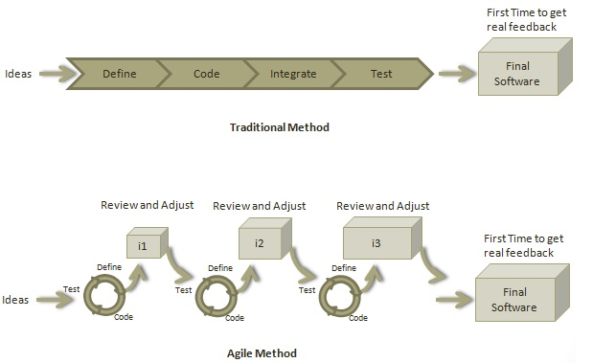
Agile is a software development methodology to build a software incrementally using short iterations of 1 to 4 weeks so that the development process is aligned with the changing business needs. Instead of a single-pass development of 6 to 18 months where all the requirements and risks are predicted upfront, Agile adopts a process of frequent feedback where a workable product is delivered after 1 to 4 week iteration.

Slide 3
Roles in Agile
Scrum Master
A Scrum Master is a team leader and facilitator who helps the team members to follow agile practices so that they can meet their commitments. The responsibilities of a scrum master are as follows −
To enable close co-operation between all roles and functions.
To remove any blocks.
To shield the team from any disturbances.
To work with the organization to track the progress and processes of the company.
To ensure that Agile Inspect & Adapt processes are leveraged properly which includes
Daily stand-ups,
Planned meetings,
Demo,
Review,
Retrospective Meetings, and
To facilitate team meetings and decision-making process.

Slide 4
What is Daily Stand-up?
A daily stand-up is a daily status meeting among all team members and it is held roughly for 15 minutes.
Every member has to answer three important questions −
What I did yesterday?
What I'll do today?
Any impediment I am facing.../ I am blocked due to...
Daily stand-up is for status update, not for any discussion. For discussion, team members should schedule another meeting at a different time.
Participants usually stand instead of sitting so that the meeting gets over quickl

Slide 5
User Story
A user story is a requirement which is formulated in a few sentences in everyday language of an user and it should be completed within an iteration. A user story is done when
All the related code have been checked-in.
All the unit test cases have been passed.
All the acceptance test cases have been passed.
Help text is written.
Product Owner has accepted the story.

Slide 6
Iteration
An iteration is a time boxed collection of user stories / defects to be worked upon and accepted within the release of a product. Iterations are defined during iteration planning meeting and completed with an iteration demo and review meeting. An iteration is also termed as a sprint. An iteration is done when
Product backup is complete.
Performance has been tested.
User stories have been accepted or moved to the next iteration.
Defects have been fixed or postponed to the next iteration.

Slide 7
Release
A release is a major milestone that represents an internal or external delivery of working, tested version of the product/system. A release is done when
System is stress tested.
Performance is tuned.
Security validations are carried out.
Disaster recovery plan is tested.

Slide 8
Thank-you

