Slide 1
Jira
By Varun Chitale

Slide 2
Agenda
What is Jira
Features Provided By Jira
Jira Workflow
Jira Workflow Steps
Jira Reports
Type of Jira Reports
Jira Dashboard and Gadgets

Slide 3
What is Jira?
Jira Software is part of a family of products designed to help teams of all types manage work. Originally, Jira was designed as a bug and issue tracker. But today, Jira has evolved into a powerful work management tool for all kinds of use cases, from requirements and test case management to agile software development.
For teams who practice agile methodologies, Jira Software provides scrum and kanban boards out-of-the-box. Boards are task management hubs, where tasks are mapped to customizable workflows. Boards provide transparency across teamwork and visibility into the status of every work item. Time tracking capabilities and real-time performance reports (burn-up/down charts, sprint reports, velocity charts) enable teams to closely monitor their productivity over time.
Jira Software can help your team manage a project from the start, through execution, to the wrap-up.

Slide 4
Features Provided By Jira
Scrum Boards : Scrum boards help agile teams break large, complex projects into manageable pieces of work so focused teams, working in sprints, ship faster.
Roadmaps : Keep your teams and organization in sync with roadmaps. Full visibility gives teams the context needed to make quick decisions while staying aligned with the bigger goals.
Reports and Insights : Out-of-the-box reports and dashboards in Jira Software offer critical insights within the context of your work to ensure your teams are always up to date and set up for success.
Project Flexibility : 1]Autonomy and structure
Choose from team or company-managed projects. Jira fits around your workflows
2]Customizable workflows
Create customizable workflows that map to any style of work.
3]Extended with app and Integration
Extend the power of Jira Software. 3000+ apps and integrations available

Slide 5
Jira Workflow
In JIRA, workflow is used to track the lifecycle of an Issue. Workflow is a record of statuses and transitions of an issue during its lifecycle. A status represents the stage of an issue at a particular point. An issue can be in only one status at a given point of time like Opened, To Do, Done, Closed, Assigned, etc.
A transition is a link between two statuses when an issue moves from one status to another. For an issue to move between two statuses, a transition must exist. In a simple way, a transition is some kind of work done on the issue, while status is the impact of work on that issue.
JIRA Workflow can be referred as a Defect Lifecycle. It follows the same concepts; the only difference is that it is generic for all issues rather than limited to Defects only.

Slide 6
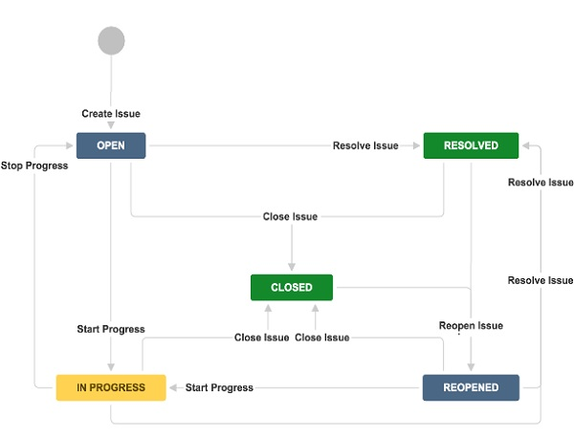
Jira Workflow Diagram

Slide 7
Jira Workflow Steps
JIRA workflow has the following stages to track as soon as an issue is created −
Open Issue − After creation, the issue is open and can be assigned to the assignee to start working on it.
In Progress Issue − The assignee has actively started to work on the issue.
Resolved Issue − All sub-tasks and works of that Issue are completed. Now, the issue is waiting to be verified by the reporter. If verification is successful, it will be closed or re-opened, if any further changes are required.
Reopened Issue − This issue was resolved previously, but the resolution was either incorrect or missed a few things or some modifications are required. From Reopened stage, issues are marked either as assigned or resolved.
Close Issue − The issue is considered as finished, resolution is correct as of now. Closed issues can be re-opened later based on the requirement.

Slide 8
Jira Reports
Organizations across industries rely on Jira’s reporting capabilities to deliver data in accurate, easy-to-understand ways, so they can see how projects are progressing and better achieve their business objectives. Jira is a robust tool that can deliver game-changing insights, but aligning its reports with your organizational needs comes with its share of challenges
Jira’s reporting capabilities are a key part of its value proposition. Reporting takes the value of your Jira deployment to the next level by providing crucial insights in real time—enabling your team to make meaningful, data-backed decisions that boost productivity and performance. Analyzing the status of each project is essential for meeting goals and managing workloads.
Jira reports can help teams rapidly identify and workflow bottlenecks, bandwidth issues, and performance problems, empowering them to stay on top of their short- and long-term tasks.

Slide 9
Type of Jira Reports
JIRA has categorized reports in four levels, which are −
Agile
Issue Analysis
Forecast & Management
Others
Agile
Burn down Chart − Track the total work remaining, also whether sprint is achieving the project goal or not.
Sprint Chart − Track the work completed or pushed back to the backlog in each sprint.
Velocity Chart − Track the amount of work completed from sprint to sprint.
Issue Analysis
Average Age Report − Displays the average age in days of unresolved issues.
Created Vs Resolved Issue Report − Display the number of issues created vs the number of issues resolved in given period.
Pie chart Report − Shows a pie chart of issues for a project grouped by a specified field.

Slide 10
Continued:
Forecast & Management
Time Tracking Report − Shows the original and current time estimates for issues in the current project. It can help to determine whether work is on track for those issues.
User Workload Report − Shows the time estimates for all unresolved issues assigned to a user across projects. It helps to understand how much a user is occupied, whether overburdened or has less work.
Version Workload Report − Displays how much outstanding work is remaining per user and per issue. It helps to understand the remaining work of a version.
In addition to these, there are other types of reports that generally have a pie chart in them, which we will discuss in detail in the subsequent chapters.

Slide 11
Jira Dashboard and Gadgets
In addition to manually generating reports, teams can use Jira dashboards and gadgets to keep key metrics easily accessible at all times. Jira dashboards enable users to track, manage, and update their daily work in a single, user-friendly display.
Each dashboard can be tailored to the user’s needs and preferences with custom gadgets. These gadgets are dynamic tiles that summarize project and issue data by filtering information. They make it easy for team members to organize and access their tasks by providing quick and seamless shortcuts from the dashboard to relevant projects and tools.
Because Jira dashboards — and the gadgets displayed within them — offer a real-time, interactable, and customizable view of your work, they’re a powerful tool for visualizing progress. And with filters that make configuration easy, you can quickly find, update, and evaluate issues across every relevant project.

Slide 12
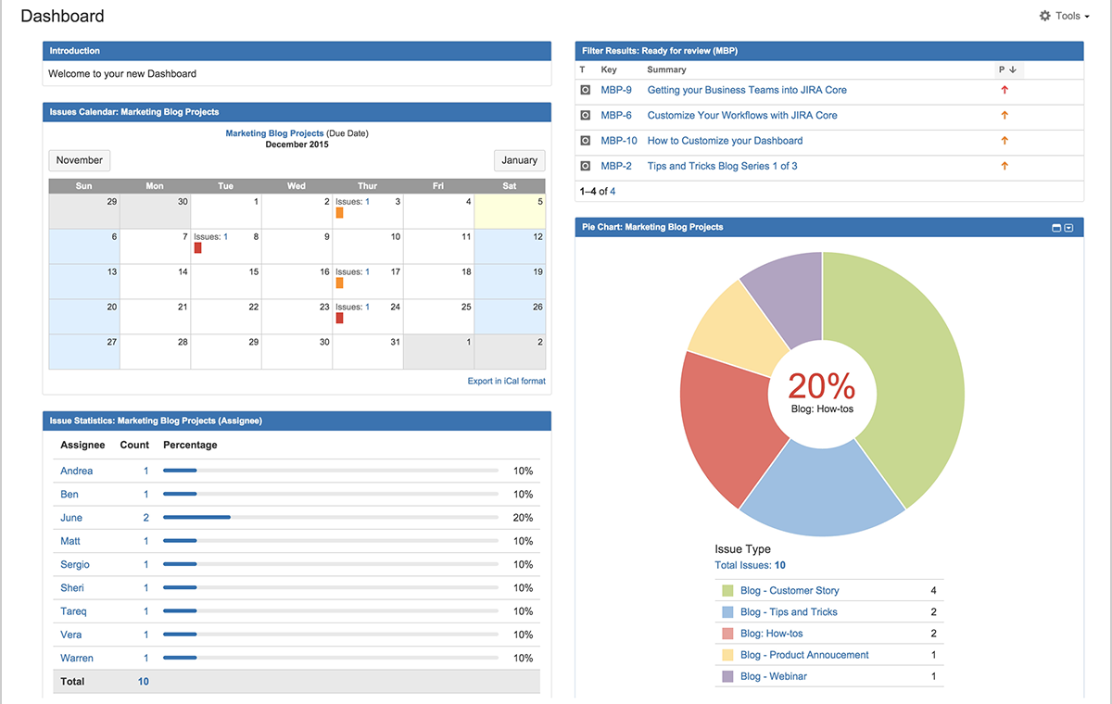
Jira Dashboard

Slide 13
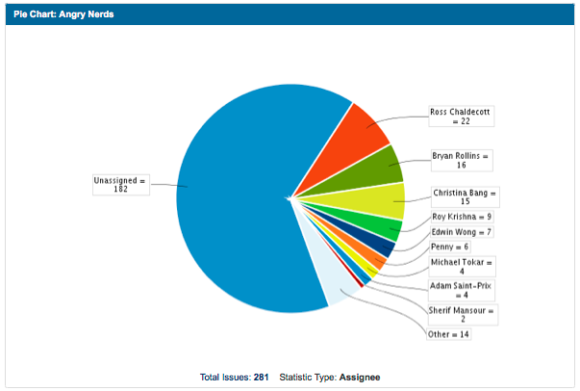
Jira Pie Chart
The 'Pie Chart' gadget displays issues returned from a specified project or issue filter, grouped by a specified field. For example, an issue filter can be created to retrieve all open issues for a particular version of a particular project. The 'Pie Chart' gadget can then be used to display these issues grouped by a specified field (e.g. Assignee).

Slide 14
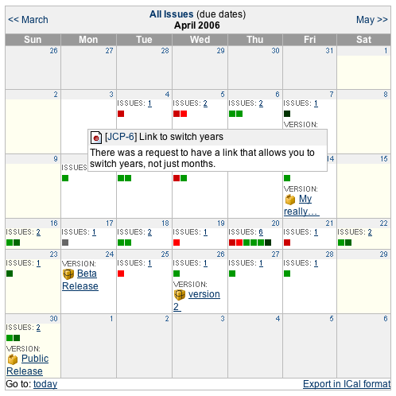
Jira Calendar
The Jira Calendar Plugin shows issues and versions in a calendar format based on their due date. Calendars can be based on a filter or on a project. It is developed and maintained by Atlassian.

Slide 15
Thank you

