Slide 1
Kubernetes

Slide 2
Kubernetes is an extensible, portable, and open-source platform designed by Google in 2014.
It is mainly used to automate the deployment, scaling, and operations of the container-based applications across the cluster of nodes. It is also designed for managing the services of containerized apps using different methods which provide the scalability, predictability, and high availability.

Slide 3
Key Objects of Kubernetes
Pod- It is the smallest and simplest basic unit of the Kubernetes application. This object indicates the processes which are running in the cluster.
Node- A node is nothing but a single host, which is used to run the virtual or physical machines. A node in the Kubernetes cluster is also known as a minion.
Service- A service in a Kubernetes is a logical set of pods, which works together. With the help of services, users can easily manage load balancing configurations.
ReplicaSet- A ReplicaSet in the Kubernetes is used to identify the particular number of pod replicas are running at a given time. It replaces the replication controller because it is more powerful and allows a user to use the "set-based" label selector.

Slide 4
Features of Kubernetes
Horizontal Scaling: It is an important feature in the Kubernetes. This feature uses a HorizontalPodAutoscalar to automatically increase or decrease the number of pods in a deployment, replication controller, replica set, or stateful set on the basis of observed CPU utilization.
Automatic Bin Packing: Kubernetes helps the user to declare the maximum and minimum resources of computers for their containers.

Slide 5
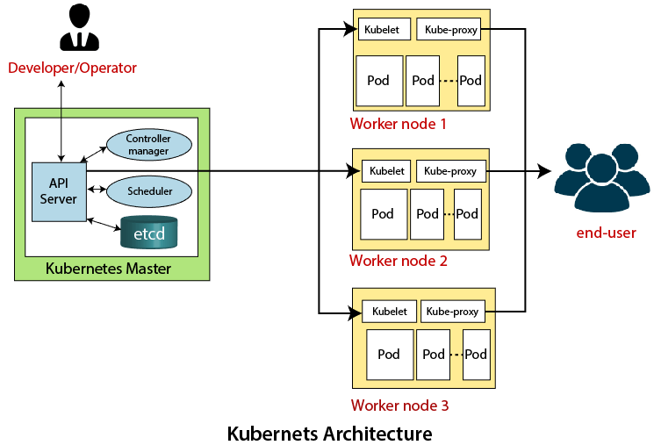
Kubernetes Architecture

Slide 6
The architecture of Kubernetes actually follows the client-server architecture. It consists of the following two main components:
Master Node (Control Plane)
The master node in a Kubernetes architecture is used to manage the states of a cluster. It is actually an entry point for all types of administrative tasks. In the Kubernetes cluster, more than one master node is present for checking the fault tolerance.
API Server
Scheduler
Controller Manager
ETCD
Slave/worker node
The Worker node in a Kubernetes is also known as minions. A worker node is a physical machine that executes the applications using pods. It contains all the essential services which allow a user to assign the resources to the scheduled containers.
Kubelet
Kube-proxy

Slide 7
Commands for Kubernetes
► Get version-related information
kubectl version
► Get configuration details
kubectl config view
► Create deployment
kubectl create deployment <deploy name> –image=<image name>
► Delete deployment
kubectl delete deploy <deploy name>

Slide 8
► List all current pods
kubectl get pods
► Describe pod names
kubectl describe pod<name>
► To scale the replication counter, counting the number of instances
kubectl scale -replicas=<count>rc<name>
► Stopping all pods in <n>
kubectl drain<n>– delete-local-data–force–ignore-daemonset

Slide 9
Lists Services
kubectl get svc
► Shows a service name
kubectl describe svc<name>
► Deletes a pod
kubectl delete pod<name>
► Executes the command on service by choosing a container
kubectl exec<service> <commands>[-c< $container>]

Slide 10
Gets logs from the service for a container
kubectl logs -f<name>>[-c< $container>]
► Show metrics for a pod
kubectl top pod
► Launching a pod with a name and image
kubectl run<name> -image=<image-name>

