Slide 1
OpenShift
By Vishal Pimple

Slide 2
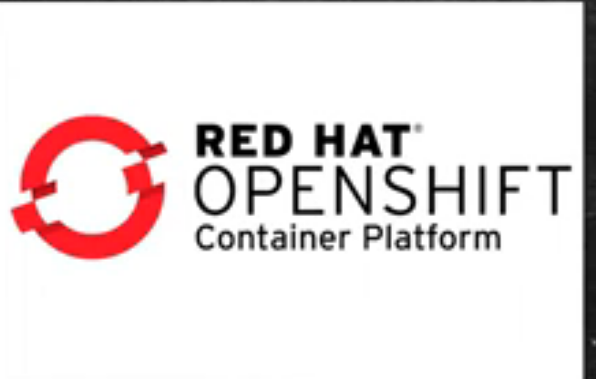
introduction
OpenShift is a cloud development Platform as a Service (PaaS) developed by Red Hat. It is an open source development platform, which enables the developers to develop and deploy their applications on cloud infrastructure

Slide 3
Openshift
OpenShift is an Kubernetes, but Enterprise
▪ Platform as a service offering from RedHat
It's a micro service based architecture
Couple of ways to interact
OpenShift Web Console
OpenShift CLI

Slide 4
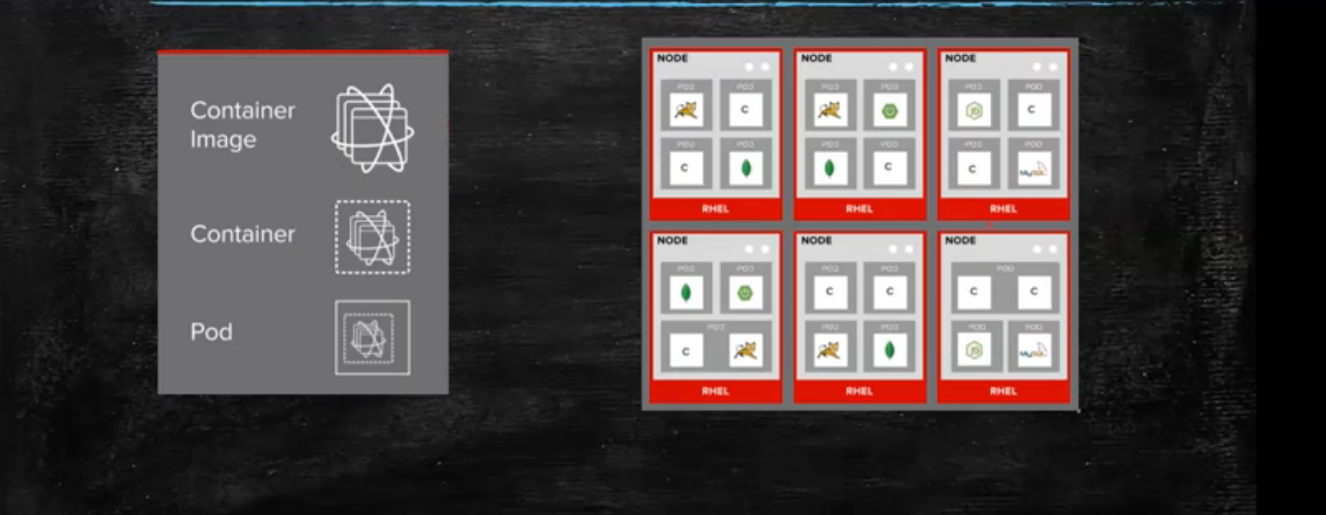
Nodes and pods

Slide 5
POD :
Pod can be defined as a collection of container and its storage inside a node of OpenShift (Kubernetes) cluster. In general, we have two types of pod starting from a single container pod to multi-container pod.
Single Container Pod − These can be easily created with OC command or by a basic configuration yml file.
Multi-Container Pod − Multi-container pods are those in which we have more than one container running inside it

Slide 6
Build Sources :
Git − This source is used when the git repository is used for building images.
Dockerfile − The Dockerfile is used as an input in the configuration file.

Slide 7
features
1)Scalability: Apps running on Red Hat OpenShift can scale to thousands of instances across hundreds of nodes in seconds.
2)Felexibility : Red Hat OpenShift simplifies deployment and management of a hybrid infrastructure, giving you the flexibility to have a self-managed or fully managed service, running on-premise or in cloud and hybrid environments.

Slide 8
features
3) Automation: Streamlined and automated container and app builds, deployments, scaling, health management, and more are included.
4) Enhanced developer experience : Red Hat OpenShift offers a comprehensive set of developer tools, multilanguage support, and command line and integrated development environment (IDE) integrations.

Slide 9


