Slide 1
OpenShift
Red Hat OpenShift is an open source container application platform that runs on Red Hat Enterprise Linux CoreOS (RHCOS) and is built on top of Kubernetes.
It takes care of integrated scaling, monitoring, logging, and metering functions. With OpenShift, you can do anything that you can do on Kubernetes and much more with OpenShift-specific features.
OpenShift includes everything you need for hybrid cloud, like a container runtime, networking, monitoring, container registry, authentication, and authorization.

Slide 2
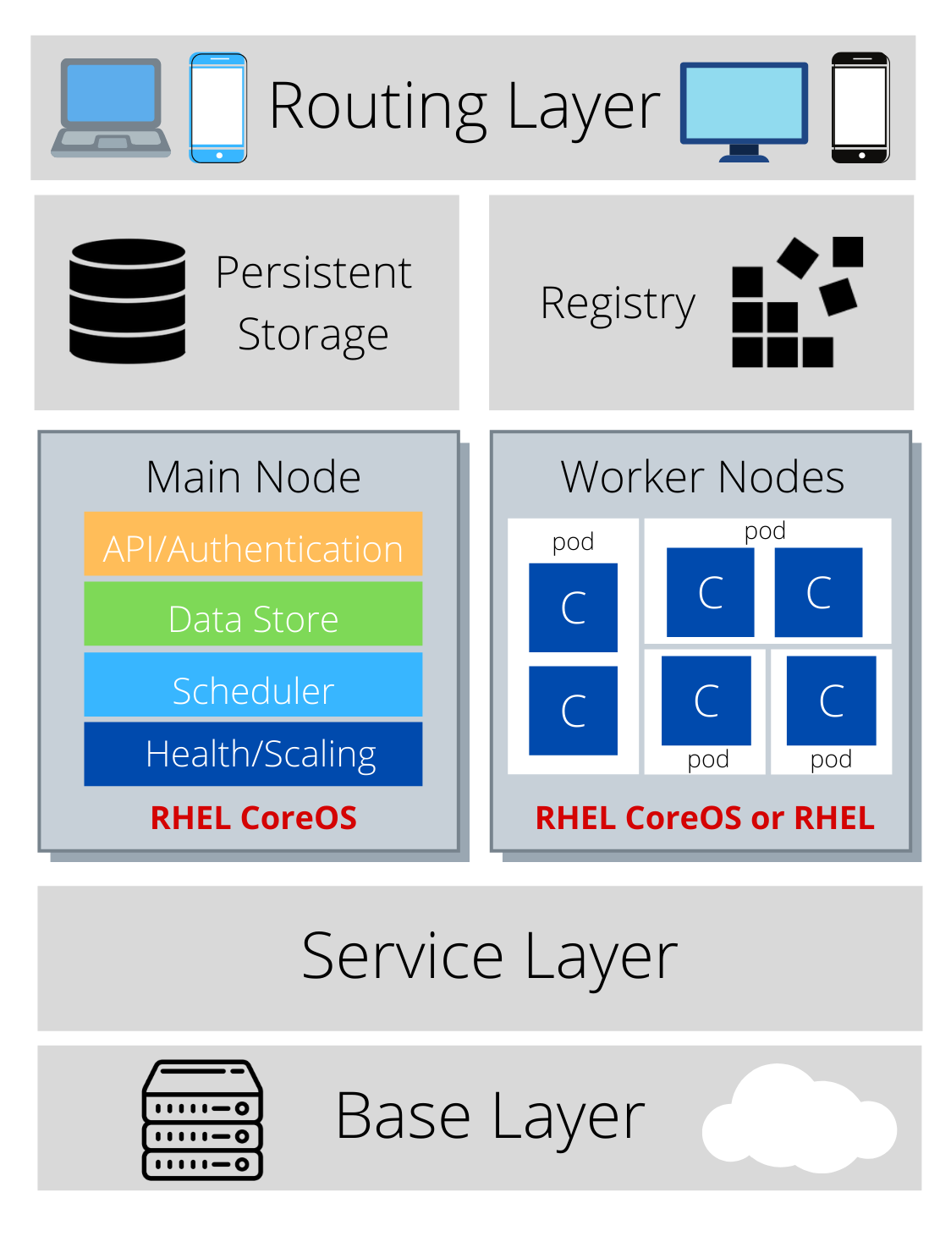
OpenShift Architecture and Components
OpenShift consists of the following layers and components, and each component has its own responsibilities:
Infrastructure layer
Service layer
Main node
Worker nodes
Registry
Persistent storage
Routing layer

Slide 3
Infrastructure Layer
Also addressed as Base Layer.
In the infrastructure layer, you can host your applications on physical servers, virtual servers, or even on the cloud (private/public).

Slide 4
Service Layer
The service layer is responsible for defining pods and access policy.
The service layer provides a permanent IP address and host name to the pods; connects applications together; and allows simple internal load balancing, distributing tasks across application components.
There are mainly two types of nodes in an OpenShift cluster: main nodes and worker nodes. Applications reside in the worker nodes. One can have multiple worker nodes in the cluster; the worker nodes are where all your coding adventures happen, and they can be virtual or physical.

Slide 5
Main Node
The Main node is responsible for managing the cluster, and it takes care of the worker nodes. It is responsible for four main tasks:
API and authentication: Any administration request goes through the API; these requests are SSL-encrypted and authenticated to ensure the security of the cluster.
Data Store: Stores the state and information related to environment and application.
Scheduler: Determines pod placements while considering current memory, CPU, and other environment utilization.
Health/scaling: Monitors the health of pods and scales them based on CPU utilization. If a pod fails, the main node restarts it automatically. If it fails too often, it is marked as a bad pod and is not restarted for a temporary time.

Slide 6
Worker Nodes
The worker node is made of pods. A pod is the smallest unit that can be defined, deployed, and managed, and it can contain one or more containers. These containers include your applications and their dependencies.
All containers in one pod share the same IP Address and same volume.

Slide 7
Registry
The registry saves your images locally in the cluster. When a new image is pushed to the registry, it notifies OpenShift and passes image information.

Slide 8
Persistent Storage
Persistent storage is where all of your data is saved and connected to containers.
It is important to have persistent storage because containers are ephemeral, which means when they are restarted or deleted, any saved data is lost.
Therefore, persistent storage prevents any loss of data and allows the use of stateful applications

Slide 9
Routing Layer
The last component is the routing layer. It provides external access to the applications in the cluster from any device. It also provides load balancing and auto-routing around unhealthy pods.

