Slide 1


Slide 2
What is Docker:
Docker is an open-source platform for building distributed software using “Containerization”, which packages applications together with their environments to make them more portable and easier to deploy.
Docker makes it easy to install and run software without needing to manually install and configure a ton of dependencies.

Slide 3
Docker Components
Docker Image
The basis of a docker container. Represents a full application.
Docker Container
The standard unit in which the application service resides and executes.
Docker Engine
Creates, ships and runs docker containers deployable on a physical or
virtual, host locally, in a data center, or cloud service provider.

Slide 4
Structure Of Dockerfile
FROM: for a base image, the command must be on top of the docker
RUN: To execute Command, it will create a layer in the image.
COPY: Copy files from the local system (docker VM) we need to provide a source, and destination(We can't download files from the internet or any remote directory)

Slide 5
Continue:
ADD: Similar to copy but, it provides a feature to download files from the internet, also we extract files at the docker image side.
WORKDIR: To set a working directory for a container.
CMD: Execute commands but during container creation

Slide 6
Manage Images:
Find an existing image in the docker hub
$ docker search IMAGE NAME
Download an image
$ docker pull IMAGE[:TAG]
Delete an image
$ docker rmi IMAGE
Show a list of all images
$ docker images

Slide 7
Continue:
Delete dangling images
$ docker images prune
Build an image from a Dockerfile
$ docker build DIRECTORY
$ docker build .
Build and tag an image from a Dockerfile
$ docker build -t IMAGE DIRECTORY

Slide 8
Manage Containers:
Show a list of running containers
$ docker ps
Show a list of all containers
$ docker ps –a
Delete a container
$ docker rm CONTAINER

Slide 9
Continue:
Delete a running container
$ docker rm -f CONTAINER
Delete stopped containers
$ docker container prune
Stop a running container
$ docker stop CONTAINER
Start a stopped container
$ docker start CONTAINER

Slide 10
Info and Stats:
Login to a registry
$ docker login
Logout of a registry
$ docker logout
Show installed docker version
$ docker version
Show the logs of a container
$ docker logs CONTAINER

Slide 11
Docker Compose:
Docker Compose is a YAML file that contains details about the services, networks, and volumes for setting up the Docker application.
We can use Docker Compose to create separate containers, host them and get them to communicate with each other.
Each container will expose a port for communicating with other containers.

Slide 12
Continue:
Run docker-compose.yml file by command
$ docker-compose up –d
Bring down the services using this command
$ docker-compose down
We can start all the services using a single command
$ docker-compose up
We can stop all the services using a single command
$ docker-compose down

Slide 13
Project On Docker

Slide 14
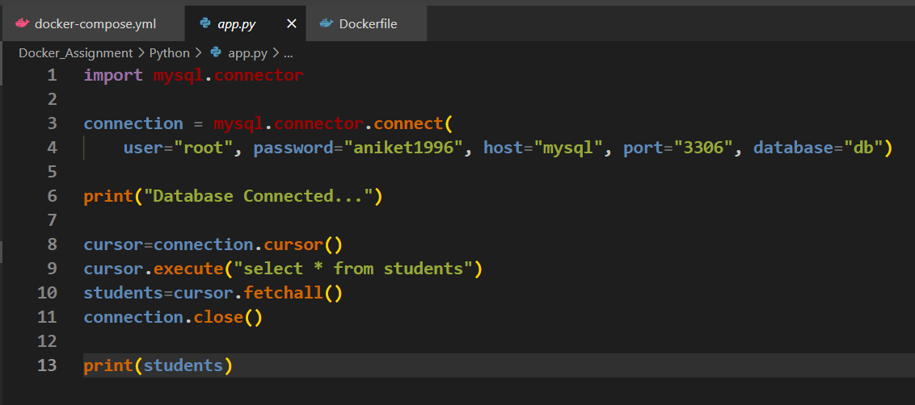
Python File:

Slide 15
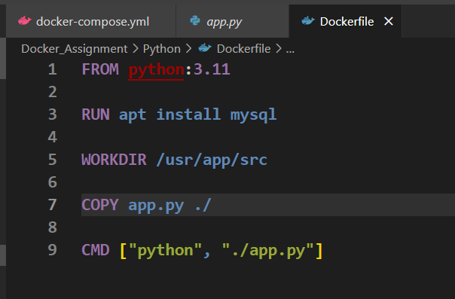
Python Dockerfile:

Slide 16
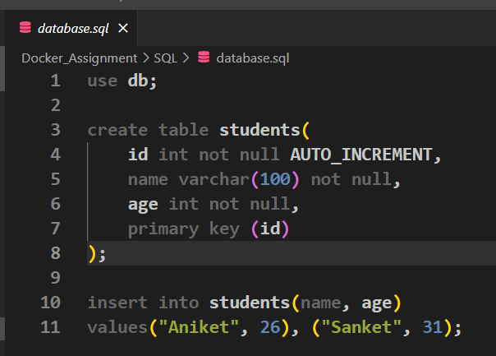
Schema file:

Slide 17
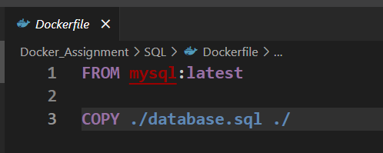
MySQL Dockerfile:

Slide 18
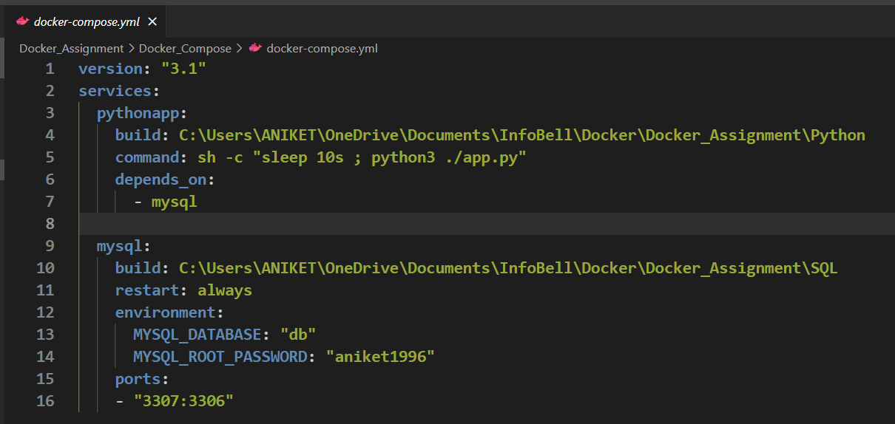
Docker-compose File:

Slide 19
Thank You…

