Slide 1
SHELL SCRIPTING
GOKUL S

Slide 2
SHELL :
It is special user program which provide an interface to user to use operating system services.
Shell accepts human readable commands from user and convert them into something which kernel can understand.
It is a command language interpreter that execute commands read from input devices such as keyboards or from files.

Slide 3
BASIC SHELL PROGRAMMING
A script is a file that contains shell commands
Data structure: variables
Control structure: sequence, decision, loop
Shebang line for bash shell script:
#! /bin/bash
#! /bin/sh
to run:
make executable: % chmod +x script
invoke via: % ./script

Slide 4
COMMAND LINE ARGUMENTS
Command Line Arguments are used to make a script more dynamic by passing input to the code. We pass these arguments at the runtime of the script as the following form:
EG: ./script_name arg1 arg2 arg3.....

Slide 5
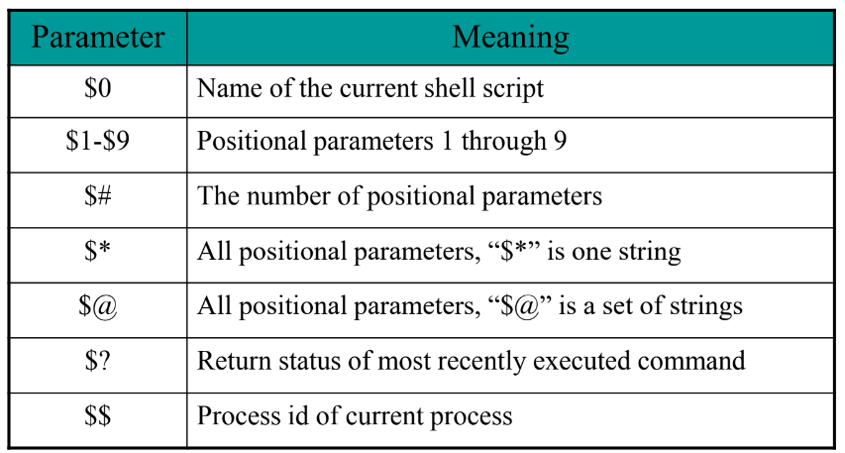

Slide 6
ARITHMETIC OPERATORS
Shell didn't originally have any mechanism to perform simple arithmetic operations but it uses external programs, like bc.
echo “1.1 + 2.2 ” |bc
bc is an arbitrary precisión calculator language
IF-ELSE STATEMENTS
if [ expression ];
then
statements
elif [expression];
statements
else
statements
fi

Slide 7
ARRAYS
An array is a systematic arrangement of the same type of data.
arr=(prakhar ankit rishabh manish abhinav)
echo ${arr[@]} : prints all elements of the array
echo ${arr[@]:1} : prints elements from index 1
echo ${#arr[0]} : prints length of 1st element
echo ${#arr[@]} : prints length of the array

Slide 8
USER INPUT EXAMPLE
read -p "enter your name: " first last
echo $first
echo $last
LOOPS
FOR LOOP
for variable in list
do
commands
done
for (( exp1; exp2; exp3 ))
do
commands
done

Slide 9
CASE STATEMENT
case expression in
pattern_1)
statements
;;
pattern_2)
statements
;;
pattern_3|pattern_4|pattern_5)
statements
;;
pattern
n)
statements
;;
*)
statements
;;
esac

Slide 10
WHILE LOOP
while [ expression ];
do
commands;
multiple commands;
Done
UNTIL LOOP
until [ expression ];
do
command1
command2
. . .
. . . .
commandN
done

Slide 11
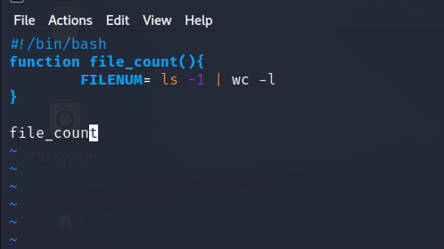
BASH FUNCTIONS
function_name
() {
commands
}
name

Slide 12
THANK YOU

