Slide 1


Slide 2
OpenShift:
OpenShift is a cloud development Platform as a Service (PaaS) developed by Red Hat.
It is an open-source development platform, which enables developers to develop and deploy their applications on cloud infrastructure.
It is very helpful in developing cloud-enabled services.

Slide 3
Use Of OpenShift:
OpenShift provides a common platform for enterprise units to host their applications on the cloud without worrying about the underlying operating system.
This makes it very easy to use, develop, and deploy applications on the cloud.
One of the key features is that it provides managed hardware and network resources for all development and testing.
With OpenShift, PaaS developer has the freedom to design their required environment with specifications.

Slide 4
OpenShift Architecture:
Layers and Components:
Infrastructure layer
Service layer
Main node
Worker nodes
Registry
Persistent storage
Routing layer

Slide 5
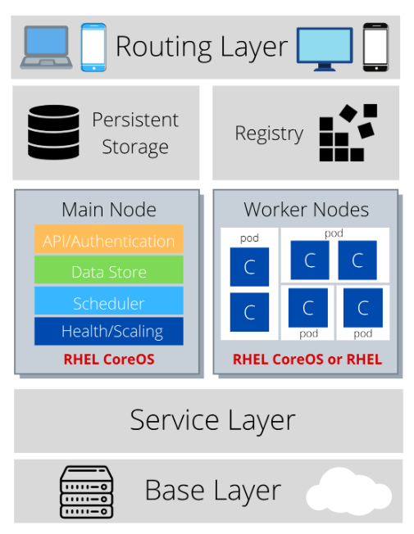

Slide 6
Infrastructure layer
In the infrastructure layer, you can host your applications on physical servers, virtual servers, or even on the cloud (private/public).

Slide 7
Service layer:
The service layer is responsible for defining pods and access policy. The service layer provides the pods with a permanent IP address and hostname, connects applications together, and allows simple internal load balancing.
There are mainly two types of nodes in an OpenShift cluster: main nodes and worker nodes.

Slide 8
Main node:
The Main node is responsible for managing the cluster, and it takes care of the worker nodes. It is responsible for four main tasks:
API and authentication: Any administration request goes through the API.
These requests are SSL-encrypted and authenticated to ensure the security of the cluster.
Data Store: Stores the state and information related to the environment and application.

Slide 9
Continue:
Scheduler: Determines pod placements while considering current memory, CPU, and other environment utilization.
Health/scaling: Monitors the health of pods and scales them based on CPU utilization.
If a pod fails, the main node restarts it automatically. If it fails too often, it is marked as a bad pod and not restarted temporarily.

Slide 10
Worker nodes
As shown in the following image, the worker node is made of pods.
A pod is the smallest unit that can be defined, deployed, and managed, and it can contain one or more containers.
These containers include your applications and their dependencies.

Slide 11
Registry
The registry saves your images locally in the cluster. When a new image is pushed to the registry, it notifies OpenShift and passes image information.

Slide 12
Persistent storage:
Persistent storage is where all of your data is saved and connected to containers.
It is important to have persistent storage because containers are ephemeral, which means when they are restarted or deleted, any saved data is lost.
Therefore, persistent storage prevents any loss of data and allows the use of stateful applications

Slide 13
Routing layer:
The last component is the routing layer. It provides external access to the applications in the cluster from any device. It also provides load balancing and auto-routing around unhealthy pods.

Slide 14
Procedure to Deploy an Application on OpenShift.

Slide 15
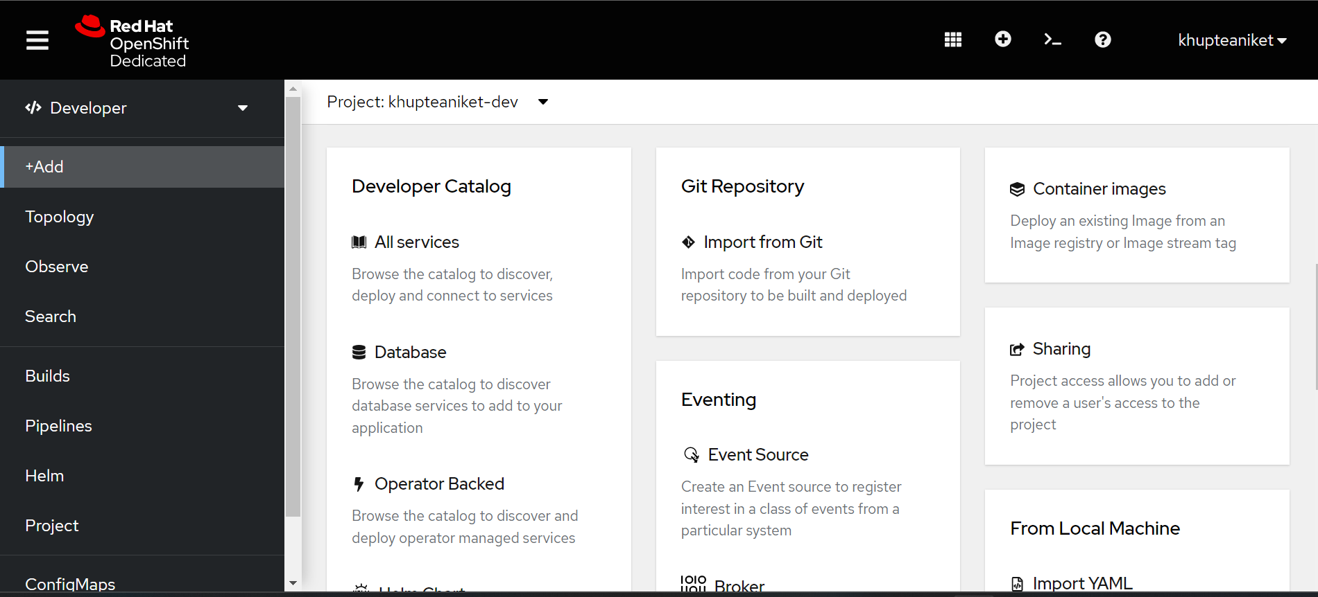

Create Pod using OpenShift UI:

Slide 16
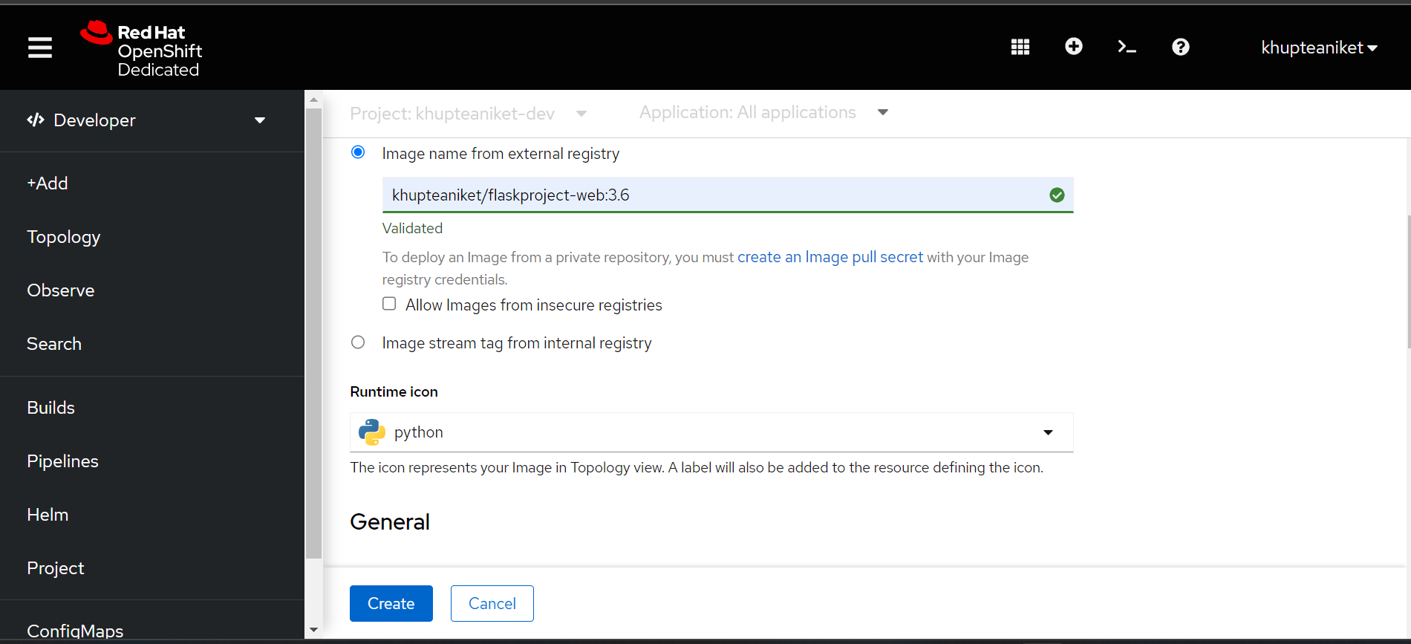

Slide 17
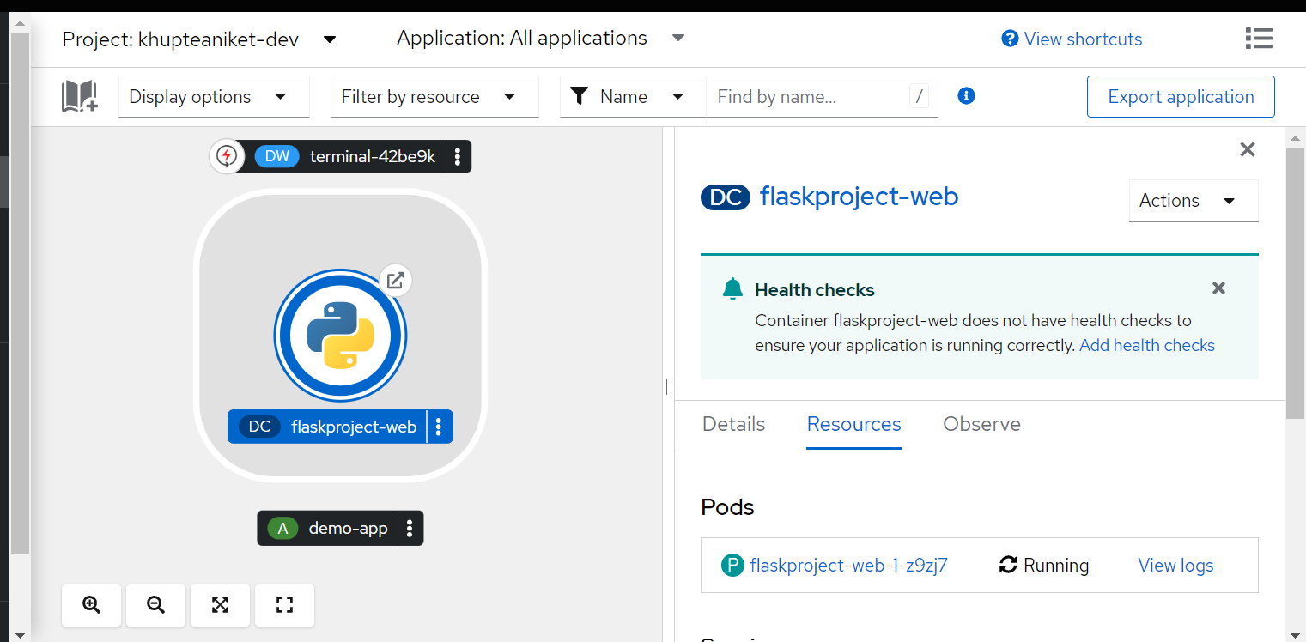

Slide 18
Creating Pod Using OpenShift Terminal.

Slide 19
Command To Create New Pod:
oc new-app --name mysql-6 -e MYSQL_USER=root -e MYSQL_PASSWORD=root -e MYSQL_ROOT_PASSWORD=root -e MYSQL_SERVICE_HOST=db -e MYSQL_DATABASE=test -e MYSQL_SERVICE_PORT=32000:3306 khupteaniket/mysql:5.7

Slide 20
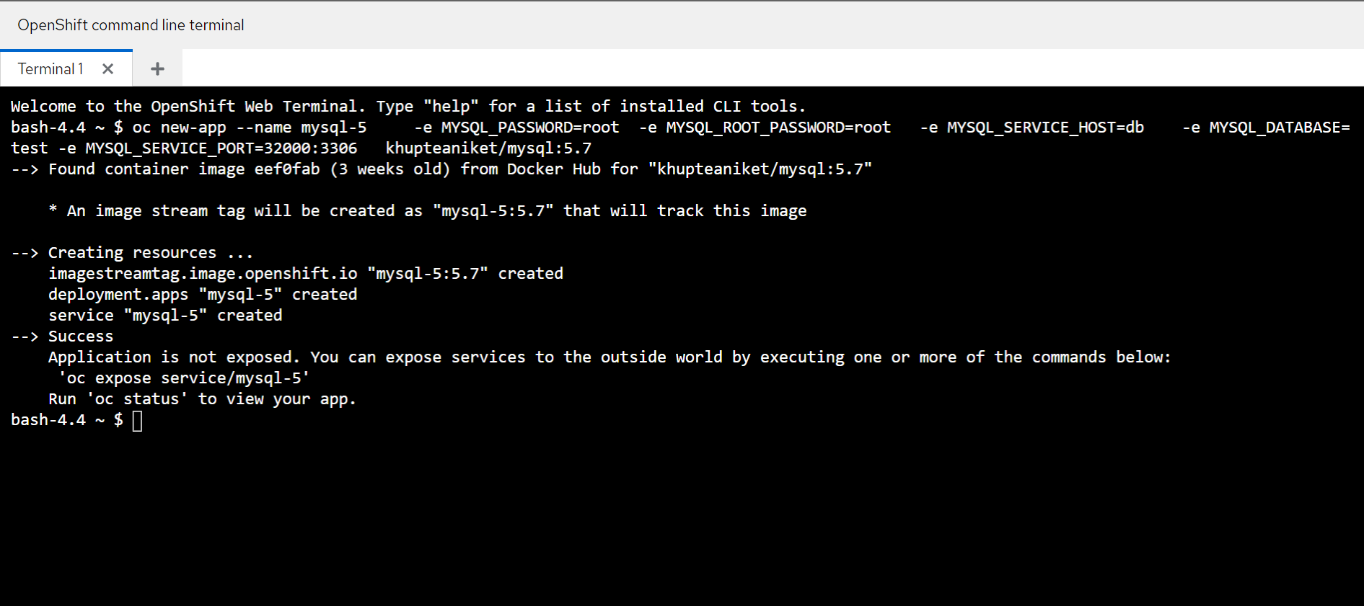

Slide 21
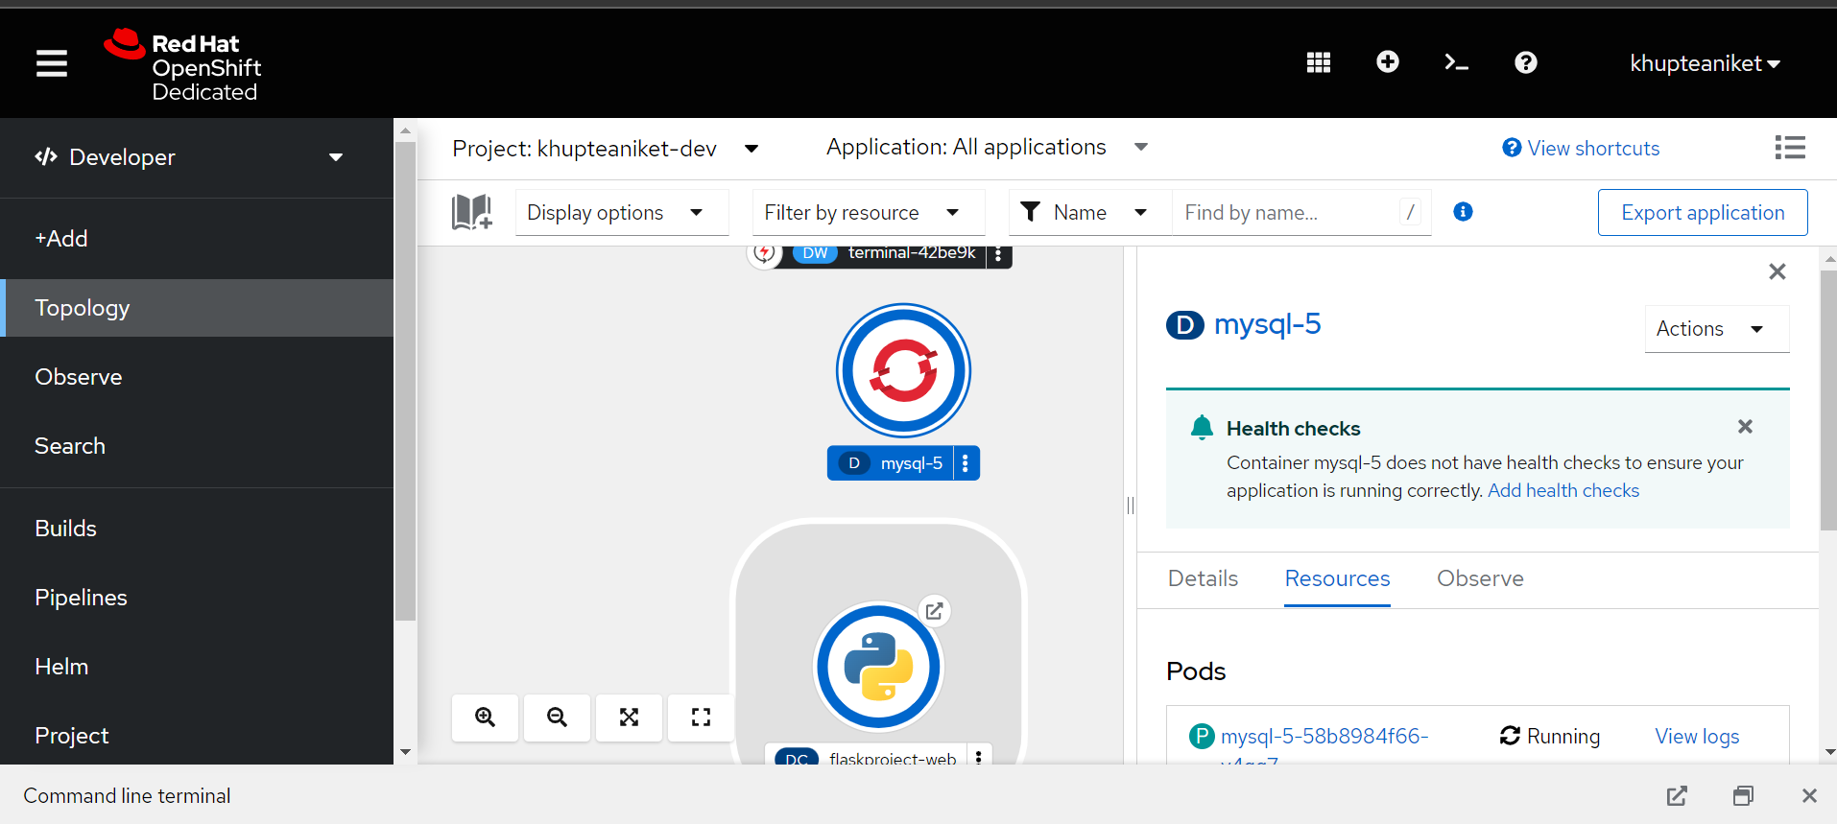

Slide 22
Thank You!!!

