Slide 1
JIRA

Slide 2
JIRA is a project management tool used for issues and bugs tracking system. It is widely used as an issue-tracking tool for all types of testing.
JIRA is developed by Atlassian Inc., an Australian Company.
JIRA is a platform independent tool; it can be used with any OS.
To utilize JIRA services, a license is required.

Slide 3
Why JIRA?
JIRA tool is used because of the following reasons:
Plan, Track and Work Faster
The main source of information:-JIRA is the primary source of information for the next software release. On JIRA, the whole team of the software developers can plan for the new features which are to be added and bugs to be fixed in the next release.
Organize the documentation tasks.
Track the progress of our documentation.
Helps to meet the deadlines of a documentation release.
Measures the time spent on documentation.
Provides feedback faster.

Slide 4
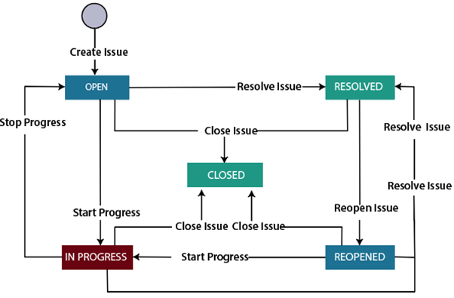
JIRA Workflow
Workflow is a set of activities which are performed to track the status and the transition of an issue during the lifecycle of an issue.
Where transition represents some work in the form of link between the two statuses when an issue moves from one status to another.

Slide 5
What is an Issue?
JIRA Issue is used to track the individual pieces of work that has been completed or not. JIRA issue can be a software bug or any other issue. Once you have imported the project in Jira, you can create issues.
There are three types of Issue types:
JIRA Core Default Issue types
Task: The task is a work item done by the team but not connected directly to the user's requirements.
Subtask: It is a part of another issue. It is used to break an issue into different pieces of work. While creating an issue, sub task issue is not given in the issue type field drop-down as it contains some parent issue, so we can say that subtask issue cannot be created independently.
JIRA Software default issue types
Story: It is a requirement from the user's perspective.
Bug: It is a flaw in a product that needs to be fixed by the developers. It can be tracked with its own issue type to differentiate from other types of work.
Epic: An epic is a big issue that contains other issues.
JIRA Service desk default issue types
Incident
Service Request
Change
Problem

Slide 6
JIRA Dashboard
When you log in to Jira, the first screen that will appear is Dashboard. The Dashboard can only be customized by the Admin, and based on the roles, an admin can access to Jira.
An admin can even change the color and the Jira logo.
You can create multiple dashboards that help you to organize your projects, assignments, and achievements in different charts.

