Slide 1
Agile
By : - Varun Chitale

Slide 2
Agenda
What is Agile
Traditional development process
Agile Development Process
Traditional vs Agile methodologies
Scrum Methodology

Slide 3
What is Agile?
Agile is an iterative approach to project management and software development that helps teams deliver value to their customers faster and with fewer headaches.
Instead of betting everything on a "big bang" launch, an agile team delivers work in small, but consumable, increments. Requirements, plans, and results are evaluated continuously so teams have a natural mechanism for responding to change quickly.
Agile isn't defined by a set of ceremonies or specific development techniques. Rather, agile is a group of methodologies that demonstrate a commitment to tight feedback cycles and continuous improvement.

Slide 4
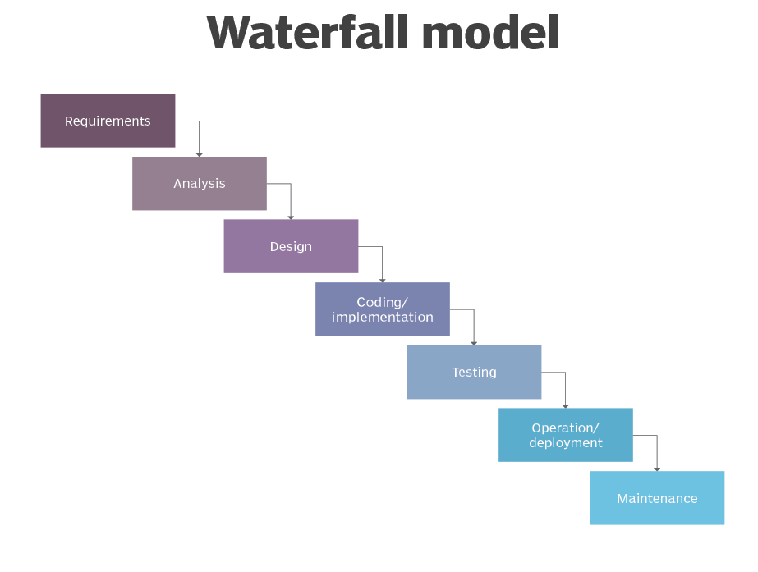
Traditional Development Process Lifecycle

Slide 5
Traditional Development Process
Requirements : we need to know and understand what we have to design, what we have to develop, its processes, what will be its functionality
Analysis : It results in designing models, schema, and business rules.
Design : System design. It helps in specifying software and hardware requirements for the product design. It also helps in the overall architecture of the system design
Implementation : With system design fully verified, the implementation phase comes in a row. In this phase, the inputs from system design are taken, and it is first developed in small programs known as units, which are tested and implemented
Integration and Testing : Each unit design and development in the earlier phases are incorporated from the implementation phase, which is integrated into a module or system for various tests like load test, load test, etc., after testing each unit

Slide 6
CNTD :
Deployment of the System / Operations : Once the non-functional, functional, alpha, and beta testing are done, the software product is deployed to the user or customer system or released to the market.
Maintenance : Itt is the last but the most important phase in the waterfall workflow model. This step comes just after installation, and it includes making the appropriate modification to the product or system or enhancing, changing, or modifying attributes related to performance issues related to the system. its main role is to improve the performance of the system with the maximum accuracy result of the software output.

Slide 7
But Why Agile?
Agile methodology is a good approach when the final results are not fixed.
Lets say after completion of 70 % work with the waterfall model we will be in the
Testing or deployment phase.
Now at this moment if the stackholders of the project changes the final results then for the traditional development process its not possible to go back and change everthing.
So at this level Agile comes in a picture where we always take reviews from project owners or stackholders after completion of a small work in the project.

Slide 8
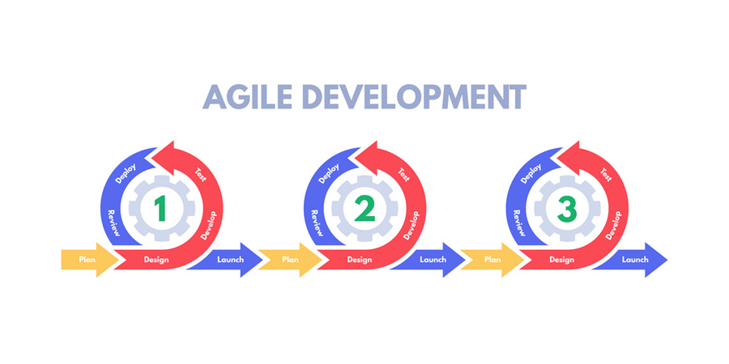
Agile Development Lifecycle:

Slide 9
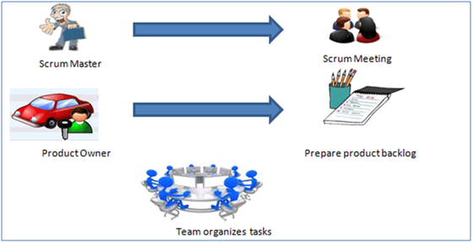
Scrum :
SCRUM is an agile development method which concentrates specifically on how to manage tasks within a team-based development environment. Basically, Scrum is derived from activity that occurs during a rugby match. Scrum believes in empowering the development team and advocates working in small teams (say- 7 to 9 members). Agile and Scrum consist of three roles, and their responsibilities are explained as follows:

Slide 10
Roles and Responsibilities
Scrum Method
Scrum Master
Scrum Master is responsible for setting up the team, sprint meeting and removes obstacles to progress
Product owner
The Product Owner creates product backlog, prioritizes the backlog and is responsible for the delivery of the functionality at each iteration
Scrum Team
Team manages its own work and organizes the work to complete the sprint or cycle

Slide 11
Product Backlog
This is a repository where requirements are tracked with details on the no of requirements(user stories) to be completed for each release. It should be maintained and prioritized by Product Owner, and it should be distributed to the scrum team. Team can also request for a new requirement addition or modification or deletion
A sprint is a short, time-boxed period when a scrum team works to complete a set amount of work. Sprints are at the very heart of scrum and agile methodologies, and getting sprints right will help your agile team ship better software with fewer headaches.

Slide 12
Process flow of Scrum Methodologies:
Process flow of scrum testing is as follows:
Each iteration of a scrum is known as Sprint
Product backlog is a list where all details are entered to get the end-product
During each Sprint, top user stories of Product backlog are selected and turned into Sprint backlog
Team works on the defined sprint backlog
Team checks for the daily work
At the end of the sprint, team delivers product functionality

Slide 13
Agile Model Vs Waterfall Model
Agile Model | Waterfall Model
Agile methodology definition: Agile methodologies propose incremental and iterative approach to software design | Waterfall Model: Development of the software flows sequentially from start point to end point.
The Agile process in software engineering is broken into individual models that designers work on | The design process is not broken into an individual models
The customer has early and frequent opportunities to look at the product and make decision and changes to the project | The customer can only see the product at the end of the project
Agile model is considered unstructured compared to the waterfall model | Waterfall model are more secure because they are so plan oriented
Small projects can be implemented very quickly. For large projects, it is difficult to estimate the development time. | All sorts of project can be estimated and completed.

Slide 14
Thank You

