Slide 1
Kubernetes
By Vishal S. Pimple

Slide 2
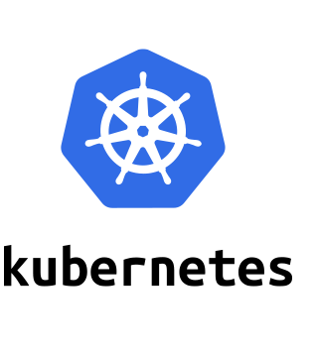
introduction
Kubernetes, also known as K8s, is an open-source system for automating deployment, scaling, and management of containerized applications.
Modern software is increasingly run as fleets of containers, sometimes called microservices. A complete application may comprise many containers, all needing to work together in specific ways. Kubernetes is software that turns a collection of physical or virtual hosts (servers) into a platform that:
This Photo by Unknown Author is licensed under CC BY-ND

Slide 3
Features:
Auto-scaling. Automatically scale containerized applications and their resources up or down based on usage
Resilience and self-healing. Auto placement, auto restart, auto replication and auto scaling provide application self-healing
Persistent storage. Ability to mount and add storage dynamically
Load balancing. Kubernetes supports a variety of internal and external load balancing options to address diverse needs
Horizontal Scaling:It modifies the compute resources of an existing cluster, for example, by adding new nodes to it or
b

Slide 4
Orchestration
what is Container Orchestration?
Container orchestration automates most of the tasks required to run containerized workloads and services, including the operations that are essential to the Kubernetes container lifecycle: provisioning, deployment, scaling, networking and load balancing.

Slide 5
Pod
Pods are the smallest, most basic deployable objects in Kubernetes. A Pod represents a single instance of a running process in your cluster. Pods contain one or more containers, such as Docker containers.

Slide 6
commands
Start minikube
minikube docker-env
minikube docker-env | Invoke-Expression
: to give persmission to k8s to use images from local system
Minikube ip:shows ip
Minikube service <name> : to acces app in browser

Slide 7
commands
kubectl get pods : getlist of pods
Kubectl describe pod<name> : get detail info about pod
kubectl get svc : get list of available services
kubectl apply -f db-deployment.yaml : run deployment file
kubectl delete pod<name> : delete the specific pod

Slide 8
thank you
Vishal S. Pimple

