Slide 1
Bash Shell Scripting

Slide 2
Shell in Linux OS
Shell: A UNIX Shell is a program or command line interpreter that interprets the user commands either entered by the user directly or read from a file (i.e., Shall Script), and then passes them to the operating system for processing. It is important to note that Shell scripts are interpreted and not compiled, as the computer.

Slide 3
Bash Scripting:
A Bash Shell Script is a plain text file containing a set of various commands that we usually type in the command line.
It is used to automate repetitive tasks on the Linux filesystem.
It might include a set of commands or a single command or contain the hallmarks of imperative programming like loops, functions, conditional constructs, etc.
Effectively, a Bash script is a computer program written in the Bash programming language.

Slide 4
Create and run a Bash Script:
To create an empty bash script, first, change the directory in which you want to save your script using the cd command.
Try to use a text editor like nano in which you want to type the shell commands.
gedit file_name.sh OR nano file_name.sh OR vi file_name.sh
first line should start with : #!/bin/bash
Where #! is referred to as the shebang and the rest of the line is the path to the interpreter specifying the location of the bash shell in our operating system.

Slide 5
Continue:
Bash use # to comment on any line.
Bash uses the echo command to print the output.
At the end, execute the bash script prefixing with ./filename.sh
Have a look at the basic terms of a Bash Script, i.e., SheBang and echo command.

Slide 6
File Permission:
When we try to execute the .sh file, then that time we get the message “Not Permission”.
So, before executing the file, we have to change the file permission.
i.e. chmod +x file_name.sh
Then, we execute the file.
i.e. ./file_name.sh

Slide 7
Some Examples Of Shell Scripting

Slide 8
Write a shell script that consists of a function that displays the number of files in the present working directory. Name this function “file_count” and call it in your script. If you use a variable in your function, remember to make it a local variable.

Slide 9
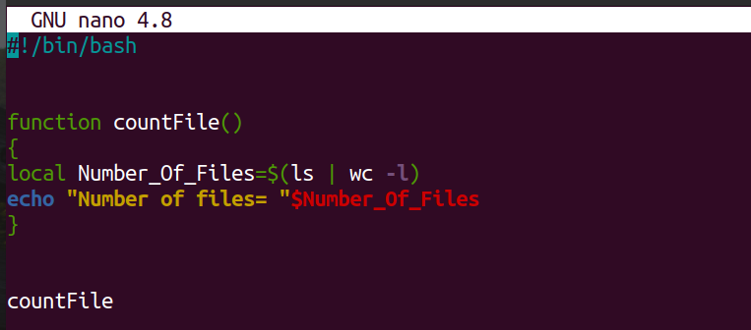
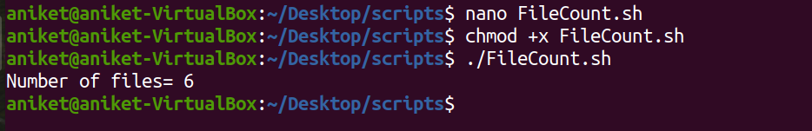

Slide 10
For each directory in the $PATH, display the number of executables in that directory

Slide 11
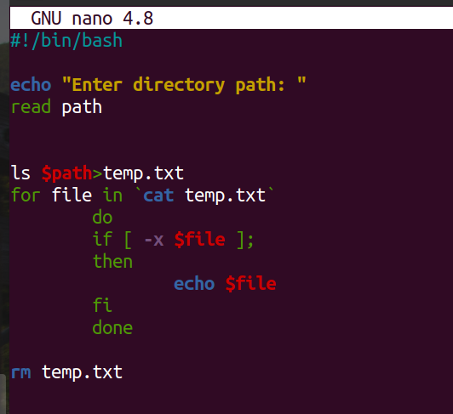
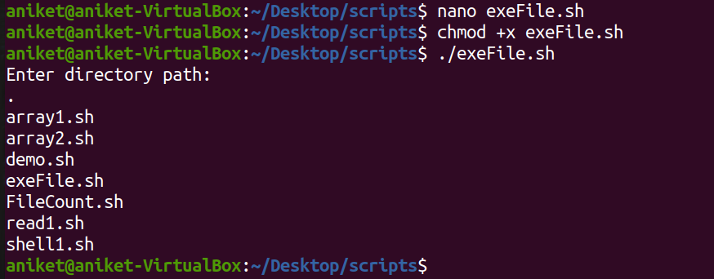

Slide 12
Write a script that takes any number of directories as command-line arguments and then lists the contents of each of these directories.

Slide 13
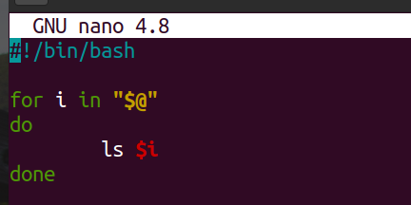
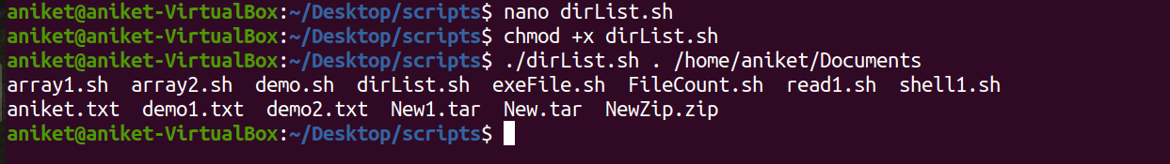

Slide 14
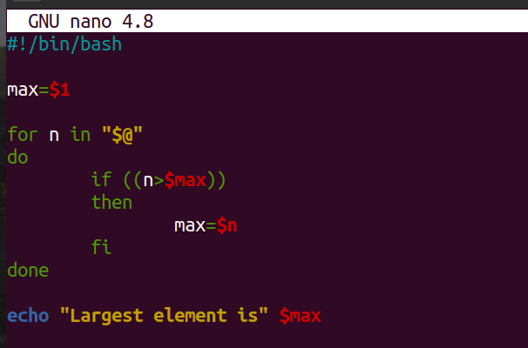
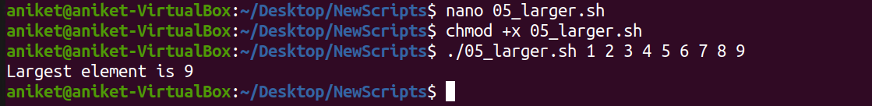
Description- Script to compare larger integer values from an 'n' number of arguments using command line arguments

Slide 15
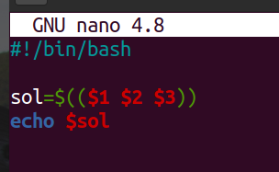

Description- Script to perform an arithmetic operation on digits of a given number depending upon the operator.

