Slide 1
Docker
By Vishal Pimple

Slide 2
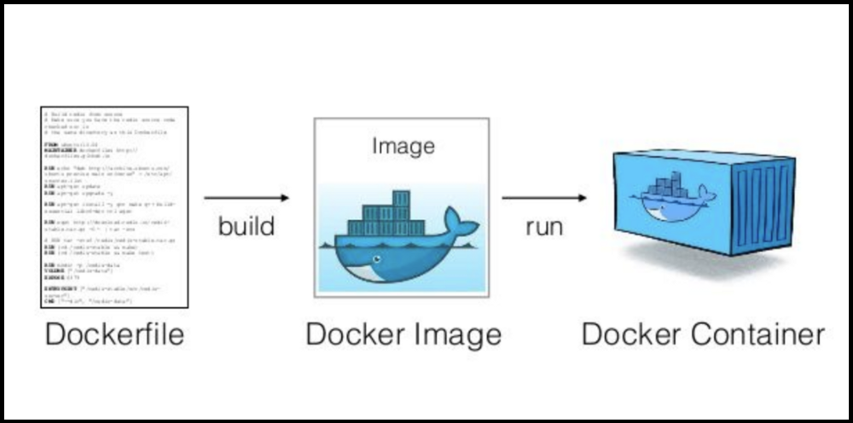
introduction
Docker is a set of platform as a service products that use OS-level virtualization to deliver software in packages called containers
Docker is tool which used to create virtual machine
Also knows as container

Slide 3
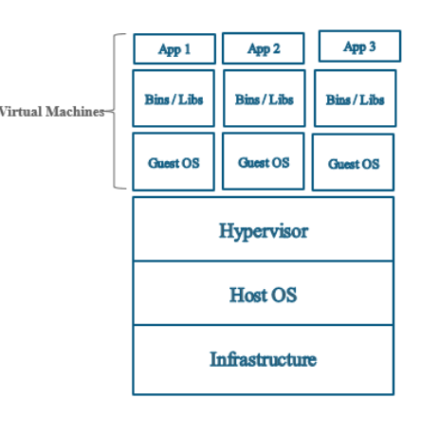
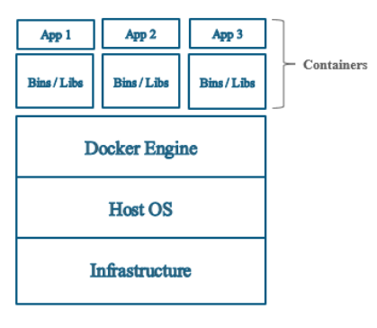
Docker structure
Hyperviser
Docker

Slide 4

Docker Hub
Docker Hub is a cloud-based repository in which Docker users and partners create, test, store and distribute container images. Through Docker Hub, a user can access public, open source image repositories, as well as use a space to create their own private repositories, automated build functions, webhooks and work groups.

Slide 5
Docker commands
$service docker status : see docker engine status
$docker images :- to see available images
$docker pull mysql :- topull image on local machine
$docker build –t image_name . :- to bild image of file
$docker run –it – -name Cname imagename : run image on container
$docker ps : to see info about running container
$docker rm container_name :remove container

Slide 6
Docker
$ docker start container_name :- start exsting container
$ docker push IMAGE : uplod image on dockerrepo
$ docker rmi IMAGE : remove image
$ docker login
$docker logs CONTAINER
docker port CONTAINER

Slide 7
Mysql in docker
$docker pull mysql
$docker run --name mysql-1 -p 3308:3308 -e MYSQL_ROOT_PASSWORD=password -e MYSQL_DATABASE-test -e MYSQL_USER=sa -e MYSQL_PASSWORD=root -d mysql:latest
$docker exec -it my-mysql bin/bash
$mysql -uroot -p -A

Slide 8
Imgae pushing on docker hub
Push image on dockerhub
$docker tag java vishstrong/p1 :tag created
$docker push vishstrong/p1 :pushed on docker hub

Slide 9
Thank You

