Slide 1
OpenShift

Slide 2
What is OpenShift?
OpenShift is a cloud development Platform as a Service (PaaS) hosted by Red Hat. It's an open-source, cloud-based, user-friendly platform used to create, test, and run applications, and finally deploy them on the cloud.
OpenShift can manage applications written in different languages, such as
Ruby
Node.js
Java
Perl
Python
One of the key features of OpenShift is extensible, which helps the users support the application written in other languages.

Slide 3
OpenShift helps organizations move their traditional application infrastructure and platform from physical, virtual mediums to the cloud.
OpenShift supports a huge variety of applications, quickly developed and deployed on the OpenShift cloud platform.

Slide 4
Architecture
OpenShift is a layered system wherein each layer is tightly bound with the other layer using Kubernetes and Docker cluster. The architecture of OpenShift is designed to support and manage Docker containers, which are hosted on top of all the layers using Kubernetes
Infrastructure layer
Service layer
Main node
Worker nodes
Registry
Persistent storage
Routing layer

Slide 5
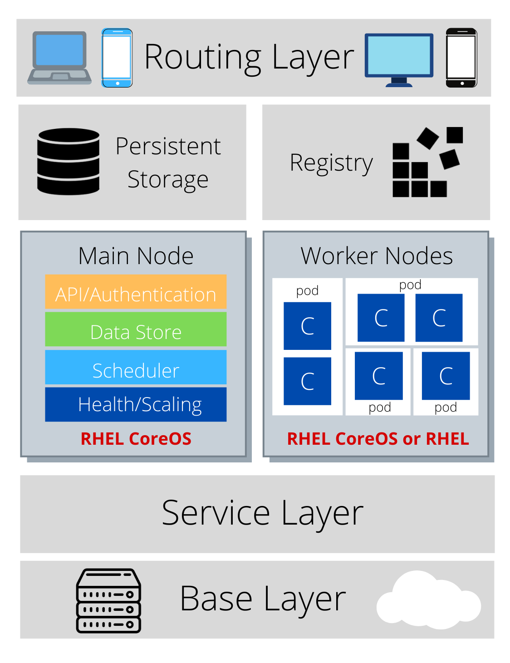
Architecture

Slide 6
Infrastructure layer
In the infrastructure layer, you can host your applications on physical servers, virtual servers, or even on the cloud (private/public).
Service layer
The service layer is responsible for defining pods and access policy. The service layer provides a permanent IP address and host name to the pods.; connects applications together; and allows simple internal load balancing.
There are mainly two types of nodes in an OpenShift cluster: main nodes and worker nodes.

Slide 7
Main node
The Main node is responsible for managing the cluster, and it takes care of the worker nodes. It is responsible for four main tasks:
API and authentication: Any administration request goes through the API; these requests are SSL-encrypted and authenticated to ensure the security of the cluster.
Data Store: Stores the state and information related to environment and application.
Scheduler: Determines pod placements while considering current memory, CPU, and other environment utilization.
Health/scaling: Monitors the health of pods and scales them based on CPU utilization. If a pod fails, the main node restarts it automatically. If it fails too often, it is marked as a bad pod and is not restarted for a temporary time.

Slide 8
Worker nodes
As shown in the following image, the worker node is made of pods.
A pod is the smallest unit that can be defined, deployed, and managed, and it can contain one or more containers.
These containers include your applications and their dependencies.

Slide 9
Registry
The registry saves your images locally in the cluster. When a new image is pushed to the registry, it notifies OpenShift and passes image information.
Persistent storage
Persistent storage is where all of your data is saved and connected to containers. It is important to have persistent storage because containers are ephemeral, which means when they are restarted or deleted, any saved data is lost. Therefore, persistent storage prevents any loss of data and allows the use of stateful applications
Routing layer
The last component is the routing layer. It provides external access to the applications in the cluster from any device. It also provides load balancing and auto-routing around unhealthy pods.

Slide 10
Pods & Services
POD :
Pod can be defined as a collection of container and its storage inside a node of OpenShift (Kubernetes) cluster. In general, we have two types of pod starting from a single container pod to multi-container pod.
Single Container Pod − These can be easily created with OC command or by a basic configuration yml file.
Multi-Container Pod − Multi-container pods are those in which we have more than one container running inside it.

Slide 11
Builds and Streams
BUILDS:
In OpenShift, build is a process of transforming images into containers.
It is the processing which converts the source code to an image.
The build processes multiple strategies and sources.
Build Strategies
Source to Image − This is basically a tool, which helps in building reproducible images. These images are always in a ready stage to run using the “Docker run” command.
Docker Build − This is the process in which the images are built using Docker file by running simple “Docker build” command.

Slide 12
Build Sources :
Git − This source is used when the git repository is used for building images.
Dockerfile − The Dockerfile is used as an input in the configuration file.

Slide 13
Image Streams
Image Streams − Image streams are created after pulling the images.
The advantage of an image stream is that it looks for updates on the new version of an image.
This is used to compare any number of Docker formatted container images identified by tags.
Image streams can automatically perform an action when a new image is created.

