Slide 1
Openshift
By Varun Chitale

Slide 2
Agenda
What is OpenShift?
Containers & Images
Pods & Services
Builds and Streams
Layers and Components
OpenShift Architecture

Slide 3
What is OpenShift and Why to use it?
OpenShift is a cloud development Platform as a Service (PaaS) developed by Red Hat. It is an open source development platform, which enables the developers to develop and deploy their applications on cloud infrastructure. It is very helpful in developing cloud-enabled services.
OpenShift provides a common platform for enterprise units to host their applications on cloud without worrying about the underlying operating system. This makes it very easy to use, develop, and deploy applications on cloud. One of the key features is, it provides managed hardware and network resources for all kinds of development and testing. With OpenShift, PaaS developer has the freedom to design their required environment with specifications.

Slide 4
Containers & Images
IMAGES:
These are the basic building blocks of OpenShift, which are formed out of Docker images.
In each pod on OpenShift, the cluster has its own images running inside it.
CONTAINERS:
This gets created when the Docker image gets deployed on the OpenShift cluster.
One container can have multiple images running inside and all the containers running on cluster node are managed by OpenShift Kubernetes.

Slide 5
Pods & Services
POD :
Pod can be defined as a collection of container and its storage inside a node of OpenShift (Kubernetes) cluster. In general, we have two types of pod starting from a single container pod to multi-container pod.
Single Container Pod − These can be easily created with OC command or by a basic configuration yml file.
Multi-Container Pod − Multi-container pods are those in which we have more than one container running inside it.

Slide 6
Builds and Streams
BUILDS:
In OpenShift, build is a process of transforming images into containers.
It is the processing which converts the source code to an image.
The build processes multiple strategies and sources.
Build Strategies
Source to Image − This is basically a tool, which helps in building reproducible images. These images are always in a ready stage to run using the “Docker run” command.
Docker Build − This is the process in which the images are built using Docker file by running simple “Docker build” command.

Slide 7
Layers and Components
Infrastructure layer
Service layer
Main node
Worker nodes
Registry
Persistent storage
Routing layer

Slide 8
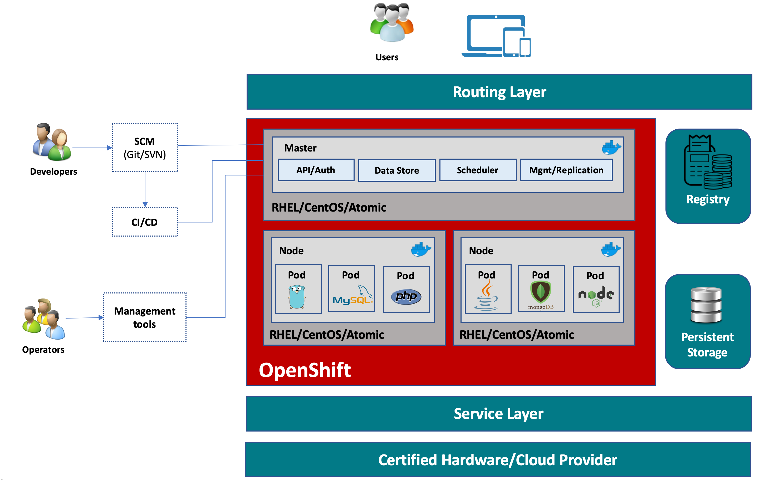
OpenShift Architecture

Slide 9
Infrastructure layer
In the infrastructure layer, you can host your applications on physical servers, virtual servers, or even on the cloud (private/public).
Service layer
The service layer is responsible for defining pods and access policy. The service layer provides a permanent IP address and host name to the pods.; connects applications together; and allows simple internal load balancing.
There are mainly two types of nodes in an OpenShift cluster: main nodes and worker nodes.

Slide 10
Main node
The Main node is responsible for managing the cluster, and it takes care of the worker nodes. It is responsible for four main tasks:
API and authentication: Any administration request goes through the API; these requests are SSL-encrypted and authenticated to ensure the security of the cluster.
Data Store: Stores the state and information related to environment and application.
Scheduler: Determines pod placements while considering current memory, CPU, and other environment utilization.
Health/scaling: Monitors the health of pods and scales them based on CPU utilization. If a pod fails, the main node restarts it automatically. If it fails too often, it is marked as a bad pod and is not restarted for a temporary time.

Slide 11
Worker nodes
As shown in the following image, the worker node is made of pods.
A pod is the smallest unit that can be defined, deployed, and managed, and it can contain one or more containers.
These containers include your applications and their dependencies.

Slide 12
Registry
The registry saves your images locally in the cluster. When a new image is pushed to the registry, it notifies OpenShift and passes image information.
Persistent storage
Persistent storage is where all of your data is saved and connected to containers. It is important to have persistent storage because containers are ephemeral, which means when they are restarted or deleted, any saved data is lost. Therefore, persistent storage prevents any loss of data and allows the use of stateful applications
Routing layer
The last component is the routing layer. It provides external access to the applications in the cluster from any device. It also provides load balancing and auto-routing around unhealthy pods.

Slide 13
Thank you

