Slide 1
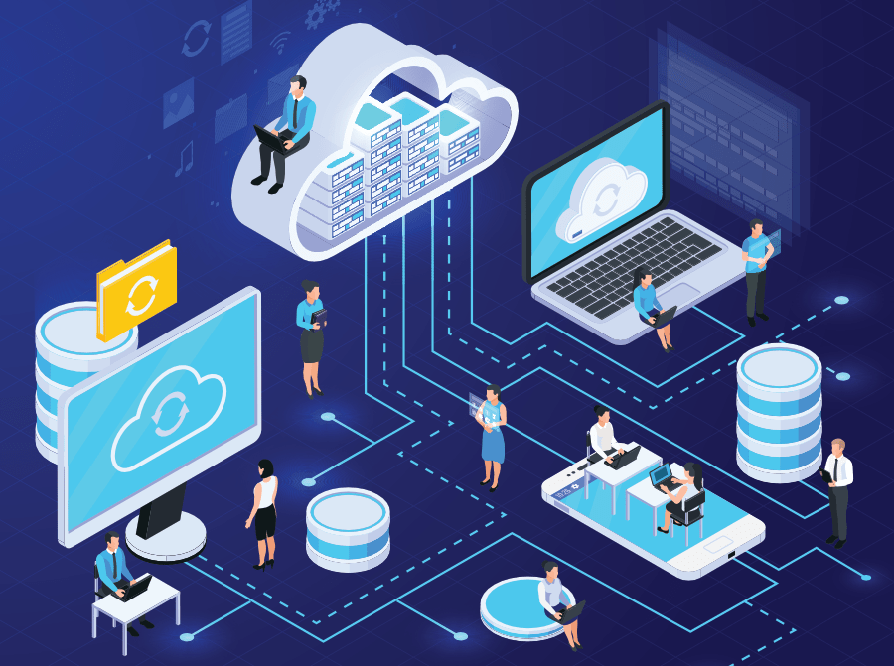
Cloud Computing

Slide 2
Cloud Computing:
Cloud Computing is the delivery of on-demand computing services over the internet on a pay-as -you-go-basics.
Rather than managing files on a local storage device, cloud computing makes it possible to save them over the internet and Access them over the internet.

Slide 3
Why Cloud Computing?
Cloud is incredibly important for businesses because it provides flexibility, data recovery, virtually no maintenance, and easy access to its users.
Furthermore, its high level of security provides ease of mind as you can rest assured knowing your data is right where it needs to be and only accessible by authorized individuals.

Slide 4
History:
Concept evolved in 1950(IBM) called RJE (Remote Job Entry Process).
In 2006 Amazon provided First public cloud AWS(Amazon Web Service).

Slide 5
Cloud Components:
Cloud Components has three components:
Client computers
Distributed Servers
Datacenters

Slide 6
Clients:
Clients are the devices that the end user interacts with the cloud.
There are three types of clients:
Mobile
Thick or Fat
Thin (Most Popular)

Slide 7
Datacenter:
A data center - also known as a data center or data center - is a facility made up of networked computers, storage systems, and computing infrastructure that businesses and other organizations use to organize, process, and store large amounts of data.
It is a collection of servers where an application is placed and is accessed via the internet.

Slide 8
Distributed servers:
A cloud server is a pooled, centralized server resource that is hosted and delivered over a network—typically the Internet—and accessed on demand by multiple users.
Often servers are in geographically different places, but server acts as if they are working next to each other.

Slide 9
Service Models:
SaaS(Software as a service): Required software, Operating system & network is provided.
PaaS(Platform as service): Operating system and network are provided.
IaaS(Infrastructure as a service): just Network is provided.

Slide 10
Deployment of Cloud Service:
Public Cloud
Private Cloud
Community Cloud
Hybrid Cloud(Combined Cloud)

Slide 11
Continue:
Public Cloud: The cloud method is open to all with the Internet on a pay-per-use method.
Private Cloud: This is a cloud method used by organizations to make their data centers accessible only with the organization's permission.
Hybrid cloud: It is a cloud method that combines public and private clouds. It caters to the various needs of an organization for its services.
Community cloud is a cloud method that provides services to an organization or a group of people within a single community.

Slide 12
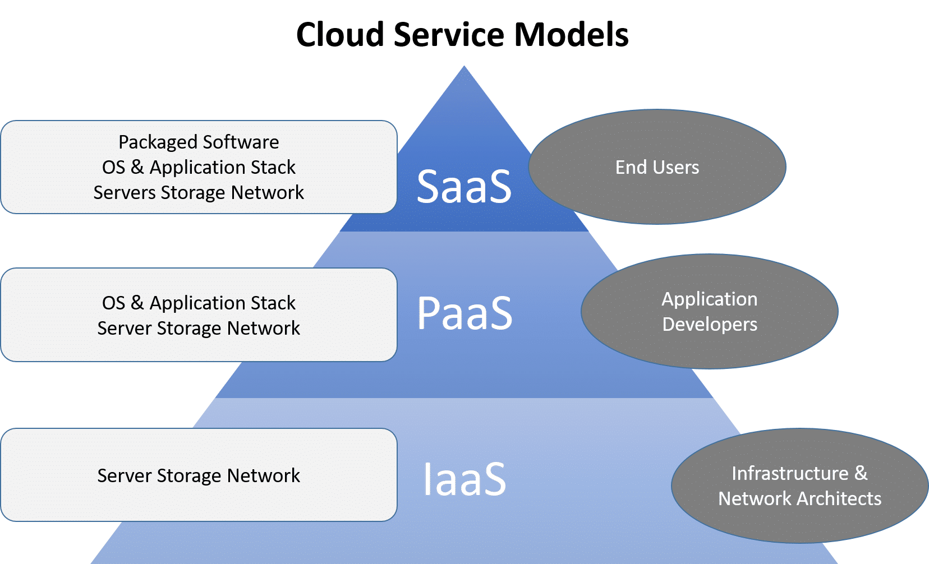

Slide 13
Why is cloud service popular?
Reduce the complexity of networks.
Does not have to buy software licenses.
Customization.
Cloud providers that have specialized in a particular area (such as ) can bring advanced services that a single company might not be able to afford or develop.

Slide 14
Continue:
Reliability and efficiency.
Information in the cloud is not easily lost.
Scalability means Unlimited processes and storage capacity.

Slide 15
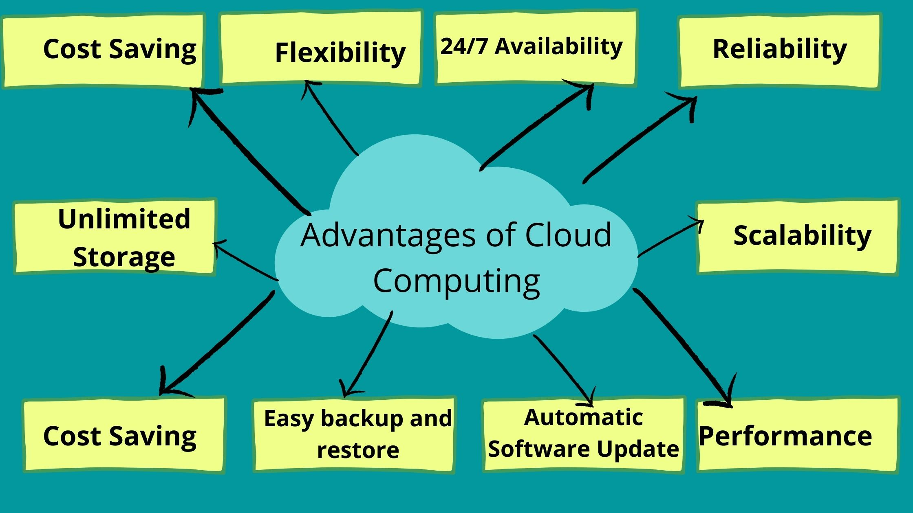

Slide 16
Application of Cloud Computing:
Clout Printing.
Social Networking sites.
Search Engines.
E-mail sites.

Slide 17
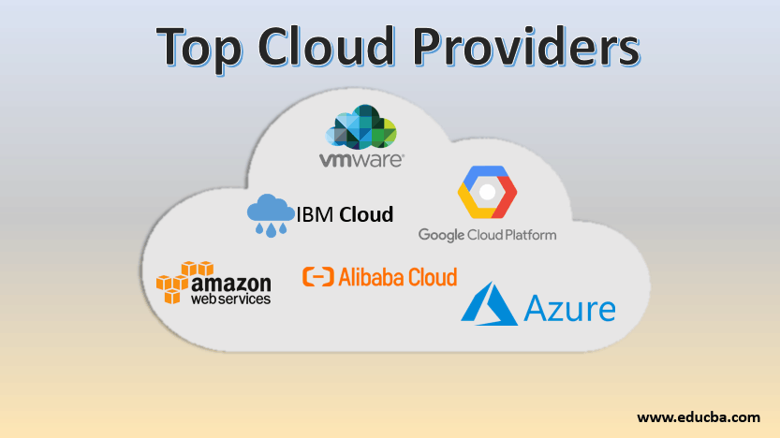

Slide 18
Thank You!!!

