Slide 1
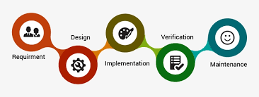
WATERFALL MODEL
Waterfall Development is a traditional approach to SOFTWARE DEVELOPMENT
This approach is highly risky, often more costly and less efficient than Agile approach

Slide 2
AGILE
Agile is an iterative approach to project management and software development that helps teams deliver value to their customers faster.
Instead of betting everything on a "big bang" launch, an agile team delivers work in small, but consumable, increments. Requirements, plans, and results are evaluated continuously so teams have a natural mechanism for responding to change quickly.

Slide 3
Agile Manifesto
The Agile Manifesto is a document that sets out the key values and principles behind the agile philosophy, and serves to help development teams wrok more efficiently and sustainably.
The Agile Manifesto was written in 2001 by seventeen independent-minded software practitioners.

Slide 4
Individuals and Interactions over processes and tools
Working software over comprehensive documentation
Customer collaboration over contract negotiation
Responding to change over following a plan

Slide 5
Agile Methedology
Agile Methodology meaning a practice that promotes continuous iteration of development and testing throughout the software development lifecycle of the project.
Agile is a term used to describe software development approaches that employ continual planning, learning, improvement, team collaboration, evolutionary development, and early delivery. It encourages flexible responses to change.

Slide 6
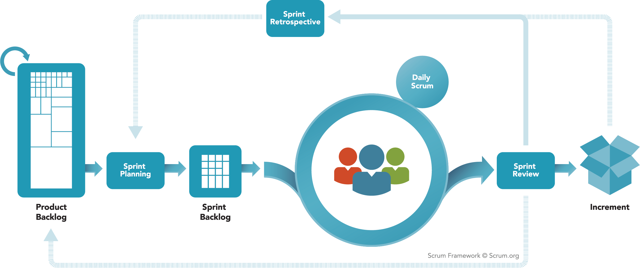
SCRUM
SPLIT ORGANIZATION into small, cross-functional, self-organizing teams.
SPLIT WORK into a list of small, concrete deliverables. Sort the list by priority and estimate the relative effort of each item.
SPLIT TIME into short fixed-length iterations/sprints, with potentially shippable code demonstrated after each iteration.
OPTIMIZE THE RELEASE PLAN and update priorities in collaboration with the customer, based on insights gained by inspecting the release after each iteration.
OPTIMIZE THE PROCESS by having a retrospective after each iteration.

Slide 7
SCRUM TERMINOLOGIES
The project/product is described as a list of features: THE BACKLOG
The features are described in terms of USER STORIES
The scrum team ESTIMATES the WORK associated with each story.
Features in the backlog are RANKED in order of importance.
Result: a RANKED and WEIGHTED list of product features, a ROADMAP
DAILY SCRUM MEETING to discuss What did you do yesterday? What will you do today? Any obastacles?

Slide 8
SCRUM ACCOUNTABILITIES The People on the Scrum Team
SCRUM MASTER- the person on the Scrum Team who uses their knowledge of Scrum to help the team and organization to be as effective as they can be; they do so by taking approaches like coaching, teaching, facilitating and mentoring
PRODUCT OWNER - the person on the Scrum Team who makes sure that the team is creating the most valuable product they can create
DEVELOPERS - the people on the Scrum Team who work together to create the product

Slide 9
SCRUM EVENTS Events that create regularity and minimize other meetings
SPRINT - short cycles of one month or less, during which the work is done; the Sprint contains all of the other Scrum events; a new Sprint starts immediately after the conclusion of the previous Sprint
SPRINT PLANNING - event dedicated to planning out the work that will take place during the Sprint
DAILY SCRUM - event held every day where the Developers inspect the progress toward the Sprint Goal, uncover anything that may be getting in their way and adapt accordingly
SPRINT REVIEW - event held at the end of the Sprint where the Scrum Team and key stakeholders review what was accomplished in the Sprint and what has changed in their environment; next, attendees collaborate on what to do next
SPRINT RETROSPECTIVE - the Scrum Team gets together during this event to talk about how the last Sprint went and identify the most helpful changes to improve their effectiveness

Slide 10
SCRUM ARTIFACTS The plans and work which are transparent and can be inspected allowing for future adaptation; Each artifact has its own Commitment which helps the team understand if they are making progress
PRODUCT BACKLOG - an evolving, ordered list of what is needed to improve the product; it is the single source of work undertaken by the Scrum Team
SPRINT BACKLOG - a highly visible list of work that is the Developer’s plan for the Sprint, which may evolve as they learn
INCREMENTS - small pieces of work that serve as concrete stepping stones toward the Product Goal. You can deliver as often as needed during the Sprint and are not limited to only one release per Sprint.

