Slide 1
Docker
By - prathmesh dalve
- Dhiraj deore

Slide 2
Introduction to Docker
Docker is an open-source platform for building distributed software using “Containerization”, which packages applications together with their environments to make them more portable and easier to deploy.
Docker makes it easy to install and run software without needing to manually install and configure a ton of dependencies.
The software that hosts container is ‘Docker Engine’.

Slide 3
Docker Components
● Docker Image
The basis of a docker container. Represents a full application.
● Docker Container
The standard unit in which the application service resides and executes.
● Docker Engine
Creates, ships and runs docker containers deployable on a physical or virtual, host locally, in a datacenter or cloud service provider.

Slide 4
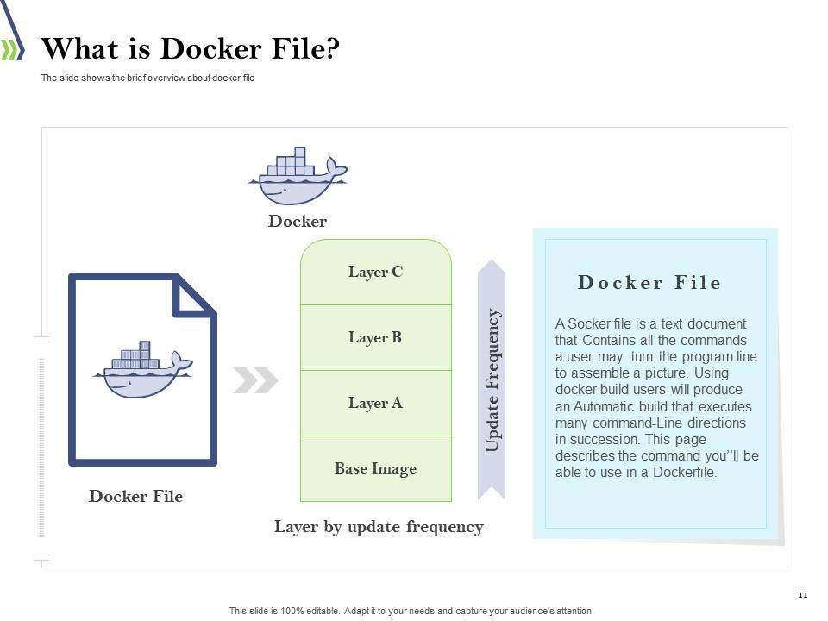
Dockerfile

Slide 5
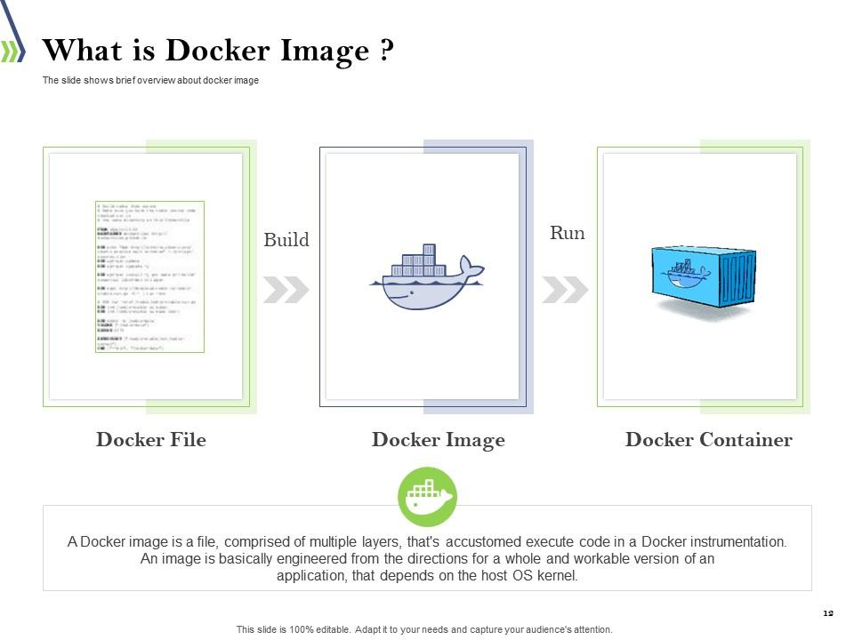
How container made

Slide 6
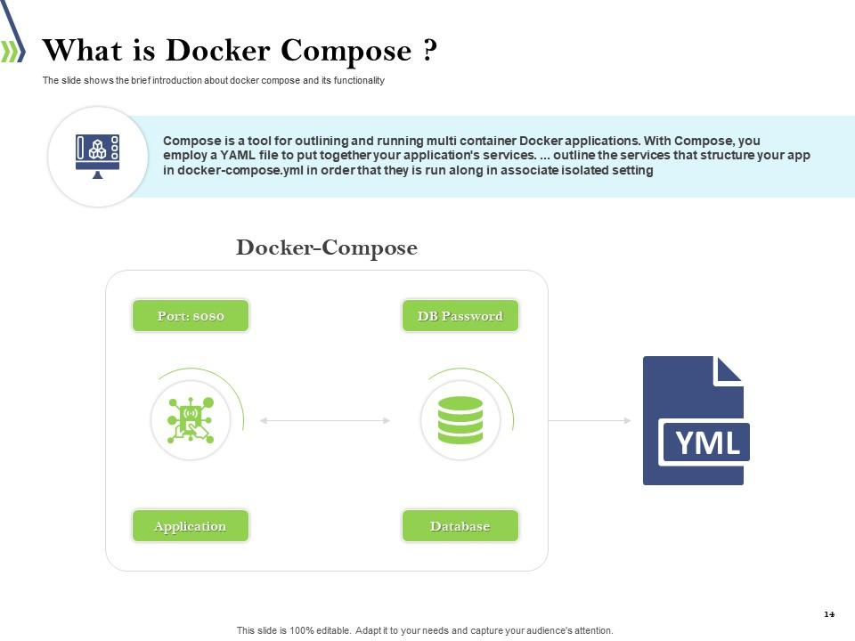
Compose

Slide 7
Docker Compose
● Docker Compose is a YAML file which contains details about the services, networks, and volumes for setting up the Docker application.
● We can use Docker Compose to create separate containers, host them and get them to communicate with each other.
● Each container will expose a port for communicating with other containers.

Slide 8
Dockerfile context
FROM: for a base image, the command must be on top of the docker
● RUN: To execute Command, it will create a layer in the image.
● MAINTAINER: Author/owner/description
● COPY: Copy files from the local system (docker VM) we need to provide a source, destination(We can't download file from the internet and any remote directory)
● ADD: Similar to copy but, it provides a feature to download files from the internet, also we extract files at the docker image side.
● WORKDIR: To set a working directory for a container.
● CMD: Execute commands but during container creation

Slide 9
Docker commands
Show the version of your docker:- docker –v
Show the docker images:- docker images
Show the docker container:- docker ps/ docker ps –a
To login:- docker login/logout
To find an images :- docker search image name
To download an image:- docker pull image(tag)/from hub
To upload image:- docker push (repo)

Slide 10
Docker commands
Delete an image :- docker rmi IMAGE
Delete all unused images :- docker images prune –a
Build an image from a Dockerfile:- docker build –t myimage .
To run an image :- docker run myimage
To delete container:- docker rm container
To delete running container:- docker rm –f container

