Slide 1
GitHub Demo

Slide 2
Commands to connect Git to GitHub
To link Github to git:
1: By using username
$ git config --global user.name “khupteaniket“
2: By using email
$ git config --global user.email “khupteaniket1996@gmail.com"

Slide 3
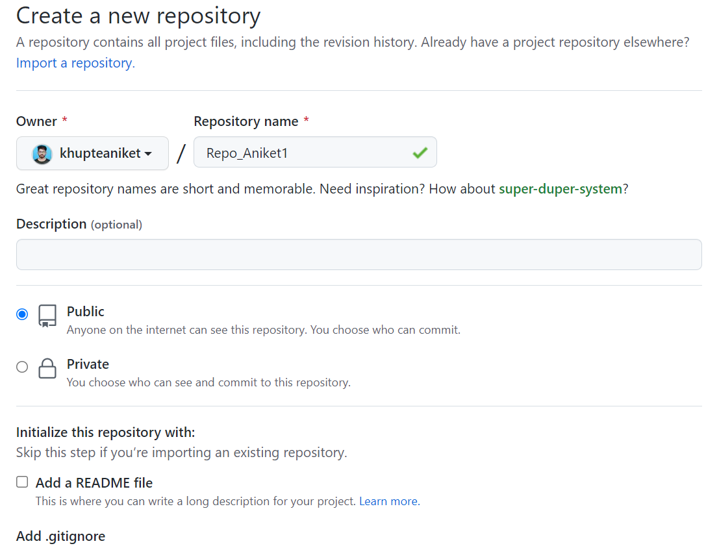
Create a "repository" (project) with a GitHub

Slide 4
Clone the repository to your local machine
Clone - Brings a repository that is hosted somewhere like in Github into a folder on your local machine.
$ git clone https://github.com/khupteaniket/Repo_Aniket.git

Slide 5
Add a file to your local repo and "commit" the changes
Add - Track your files and changes in git.
$ git add .
Commit - Save your files in Git.
$ git commit -m “1st Commit”

Slide 6
"Push" your changes to your main branch
Push - Upload Git commits to a remote repository like Github.
$ git push -u origin main

Slide 7
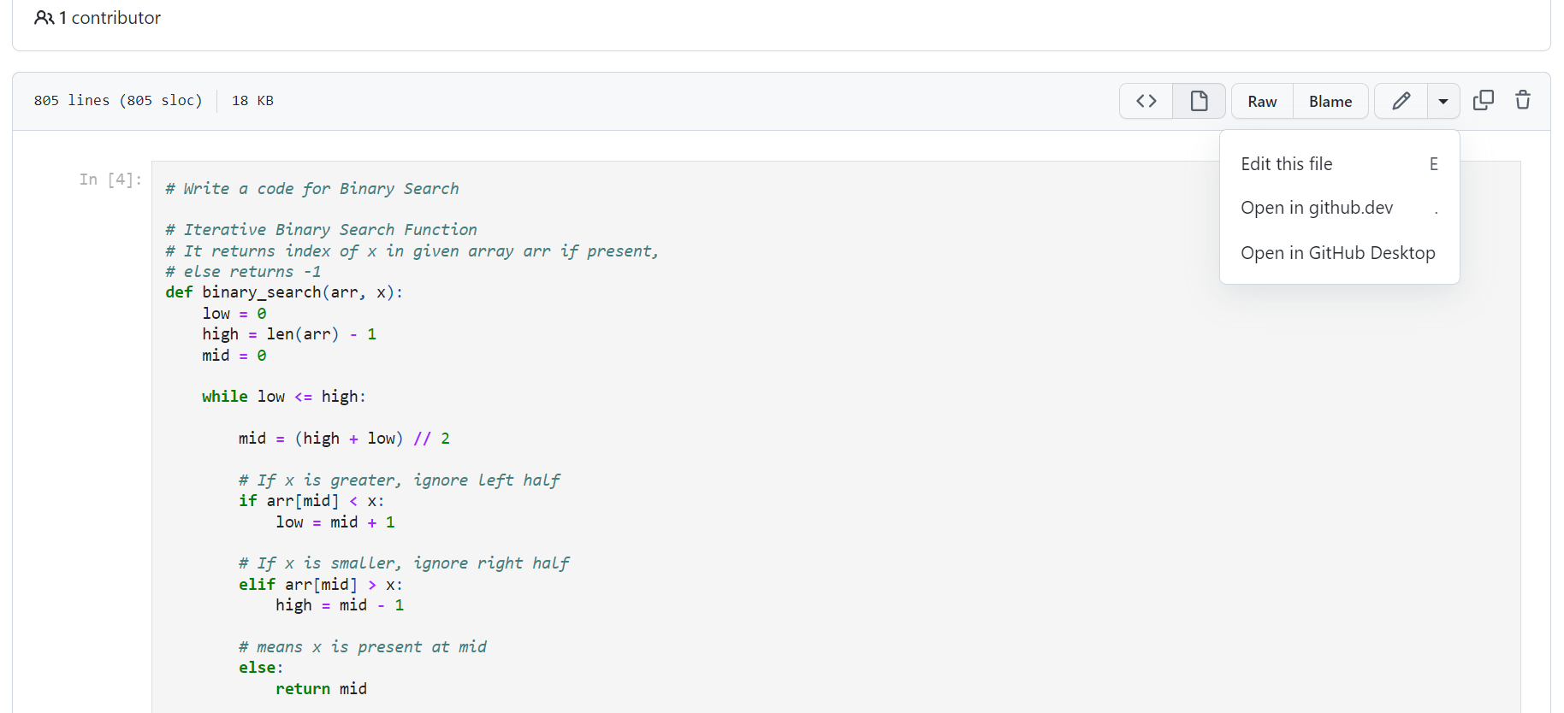
Make a change to your file with a git hosting tool and commit

Slide 8
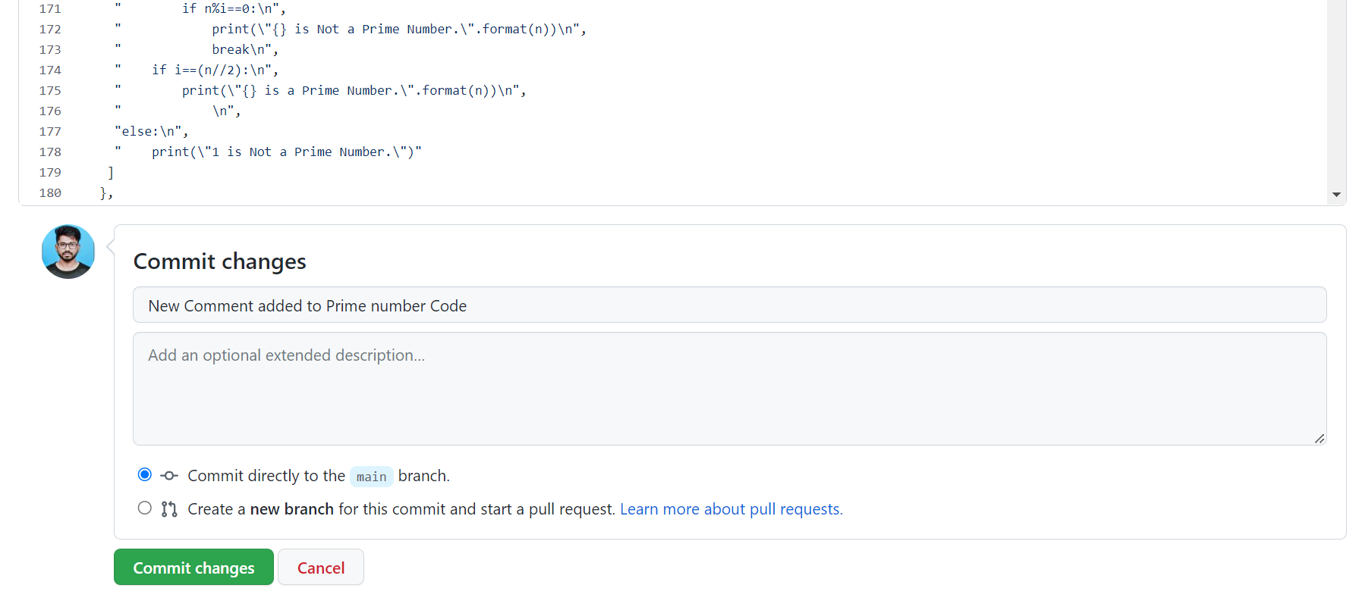
Continue:

Slide 9
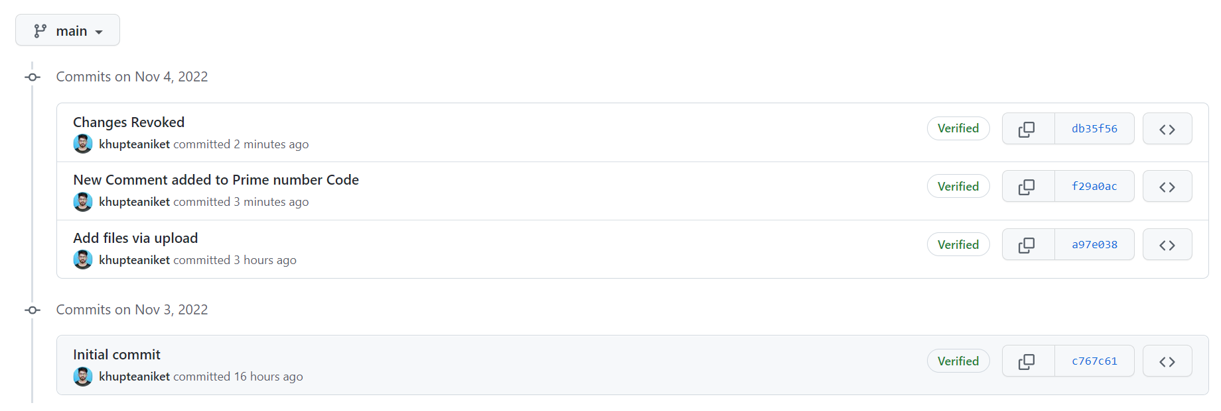
All Commit Histories:

Slide 10
"Pull" the changes to your local machine
Pull - Download changes from remote repo to your local machine the opposite of push.
$ git pull https://github.com/khupteaniket/Repo_Aniket.git

Slide 11
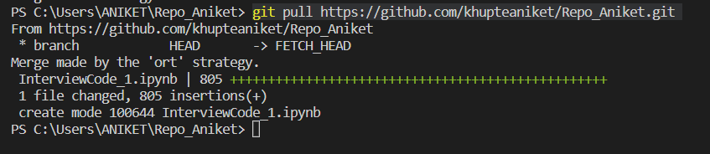
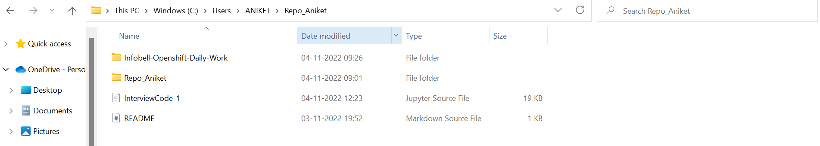

Slide 12
Create a "branch", make a change, commit the change
To create a branch:
$ git branch “NewBranch”
Checkout branch used to logout from the current branch to the required branch:
$ git checkout “NewBranch”

Slide 13
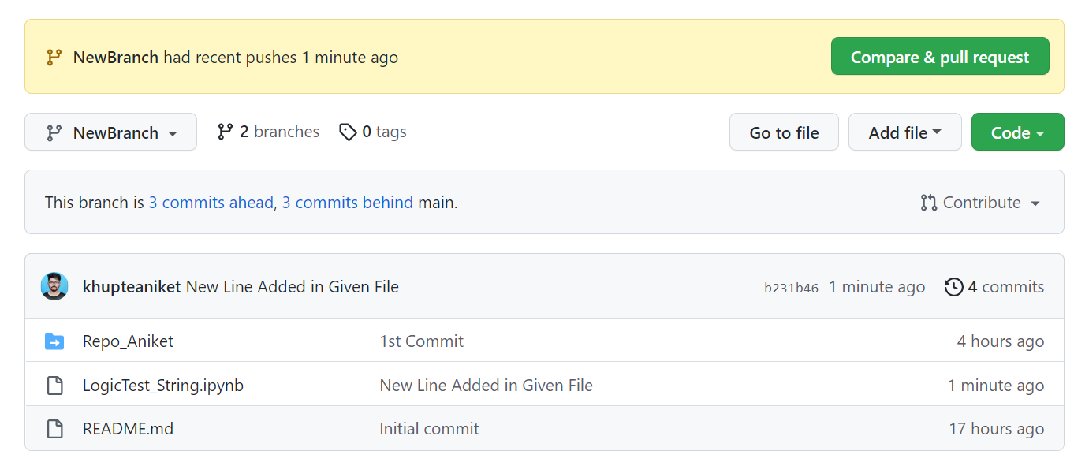
Edit file in NewBranch and Commit Changes:

Slide 14
"Merge" your branch to the main branch & Resolve conflicts.
There are two ways of squashing:
1. While merging the branch :
$ git merge –squash “NewBranch”
2. Using git rebase:
$ git rebase -i HEAD ~3 (combines last 3 commits to 1)

Slide 15
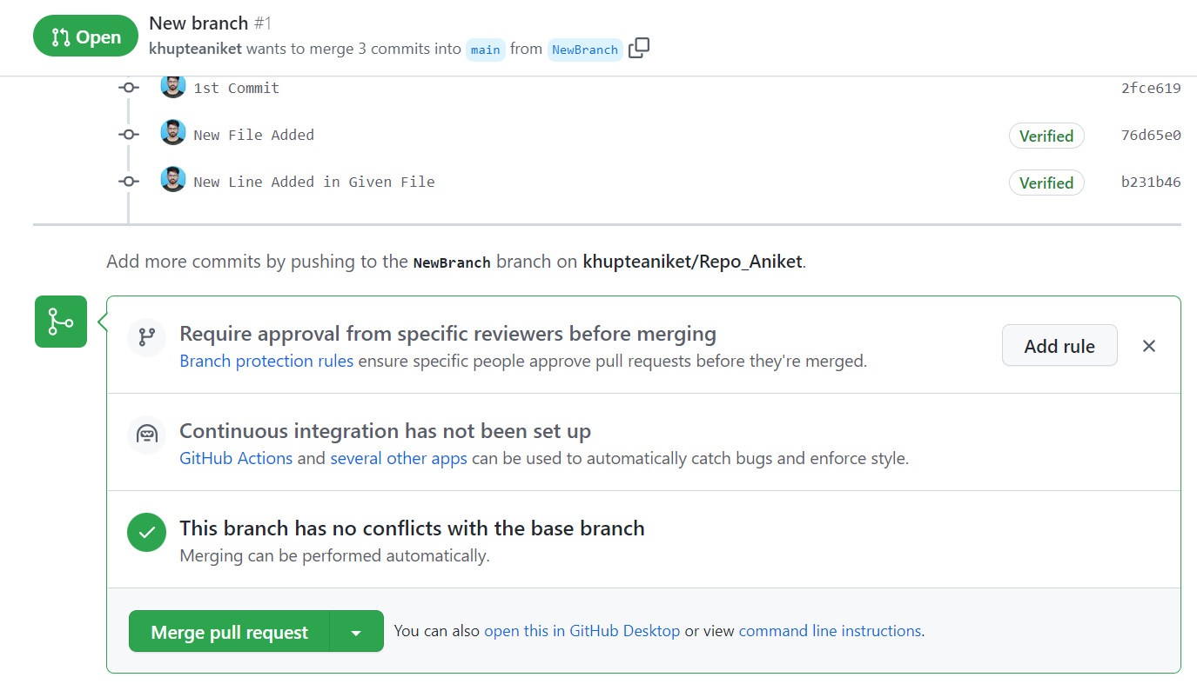
“Merge” using GitHub:

