Slide 1
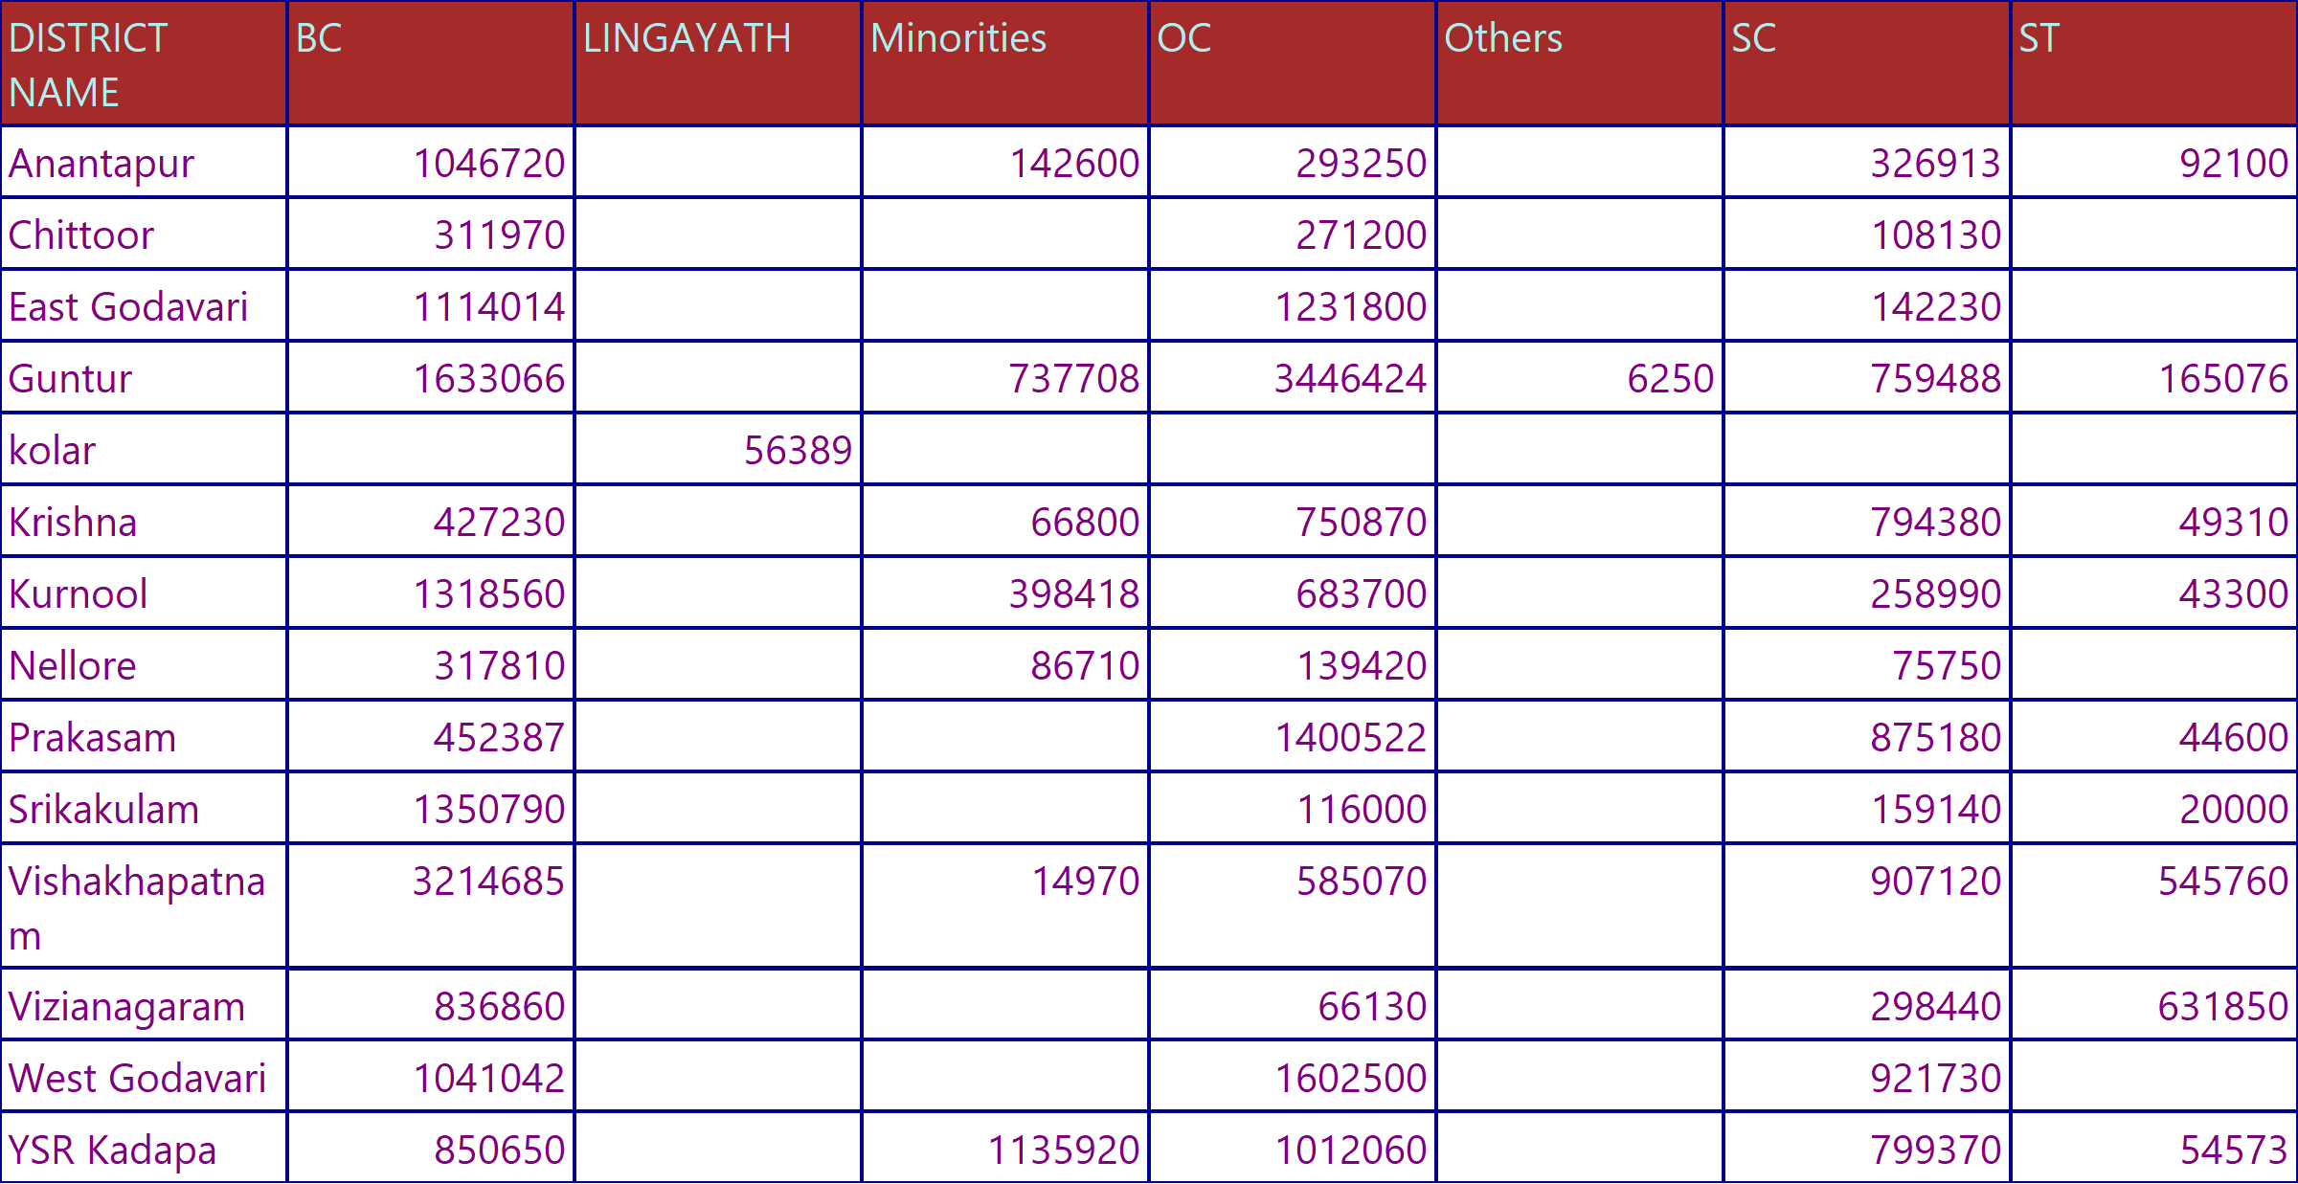
INSURANCE REPORT ACC TO DISTRICT
CLAIM_AMT BY EACH CASTE w.r.t DISTRICT REPORT

Slide 2
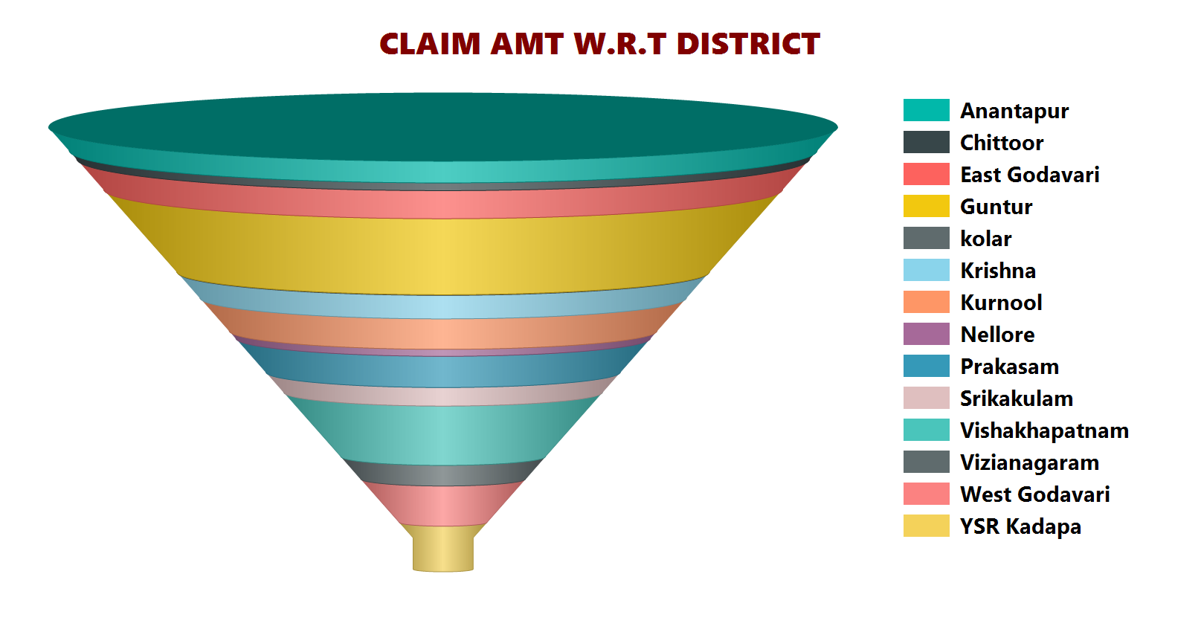
INSURANCE REPORT ACC TO DISTRICT
CLAIM_AMT BY EACH CASTE w.r.t DISTRICT REPORT

Slide 3
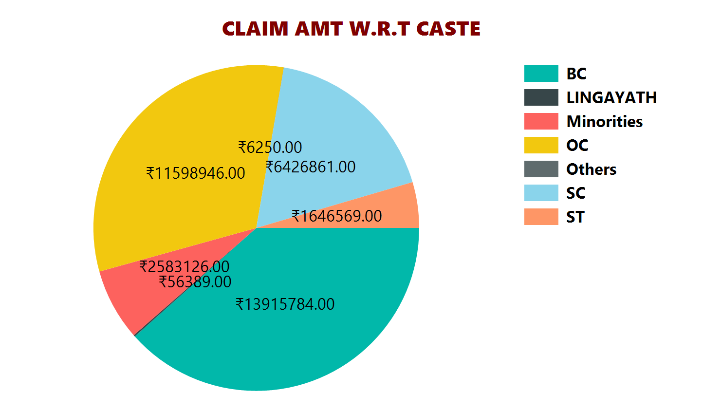
INSURANCE REPORT ACC TO DISTRICT
CLAIM_AMT BY EACH CASTE w.r.t DISTRICT REPORT

