Slide 1
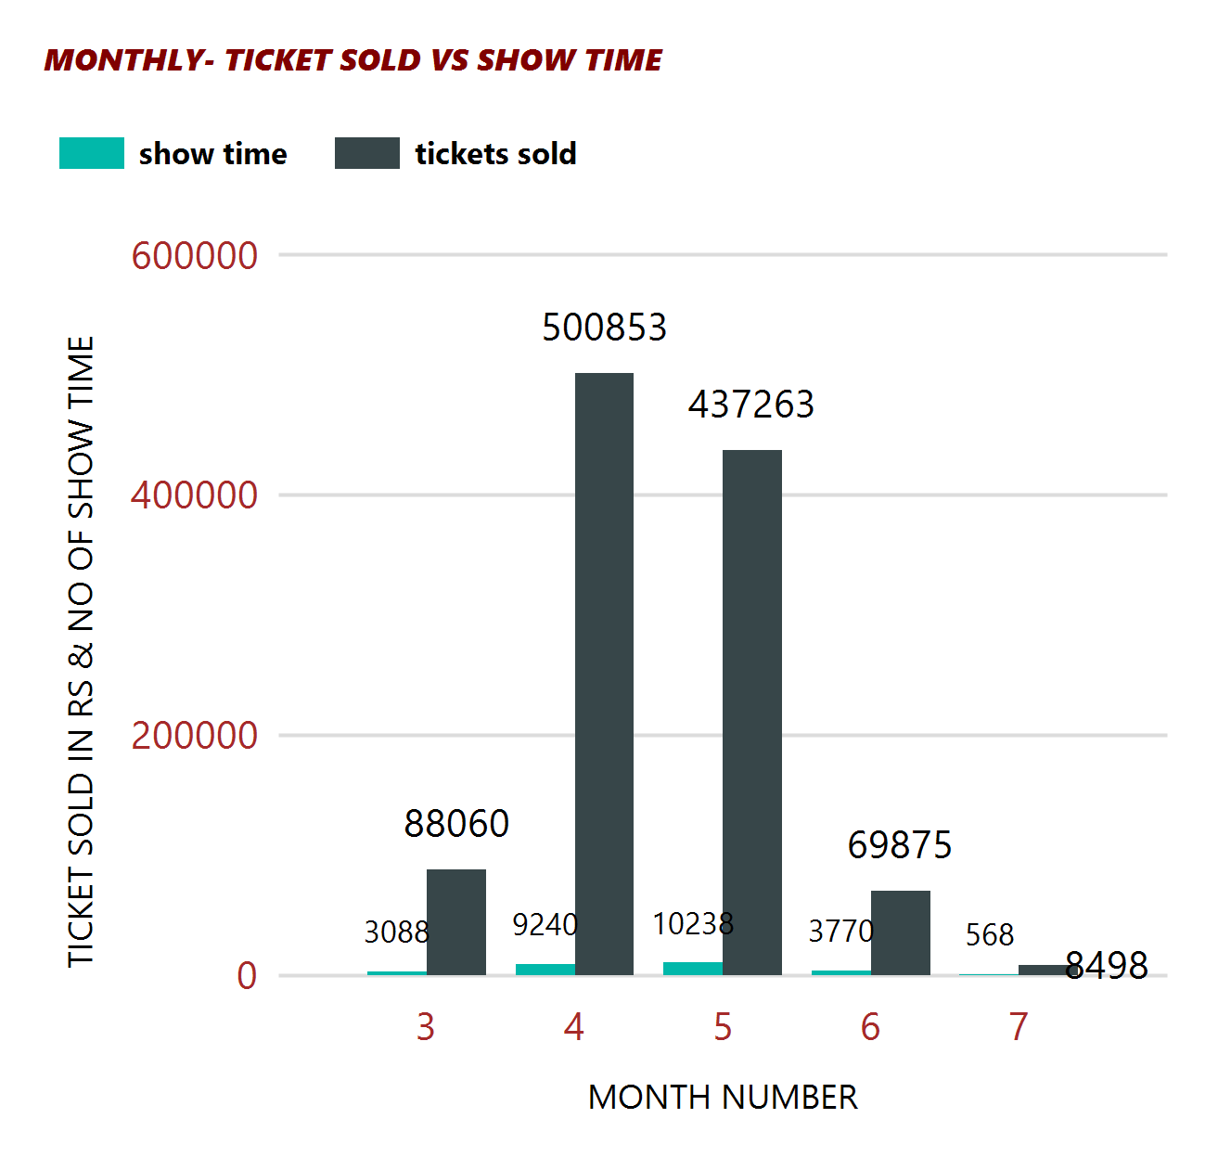
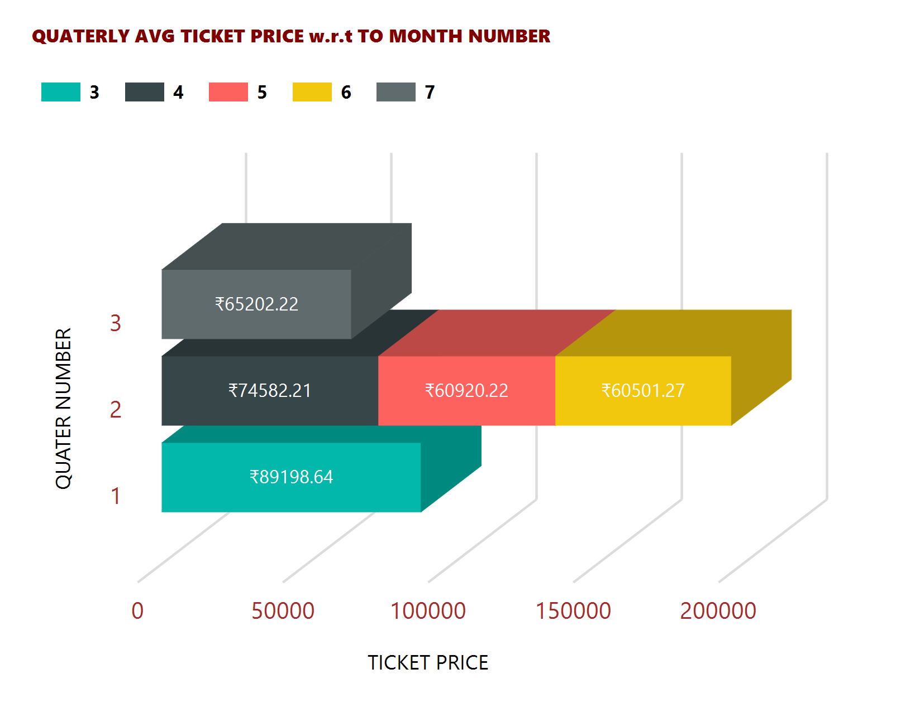
DASHBOARD
CINEMA TICKET ANALYSIS
3 - MARCH
4 - APRIL
5 - MAY
6 - JUNE
7 - JULY

Slide 2
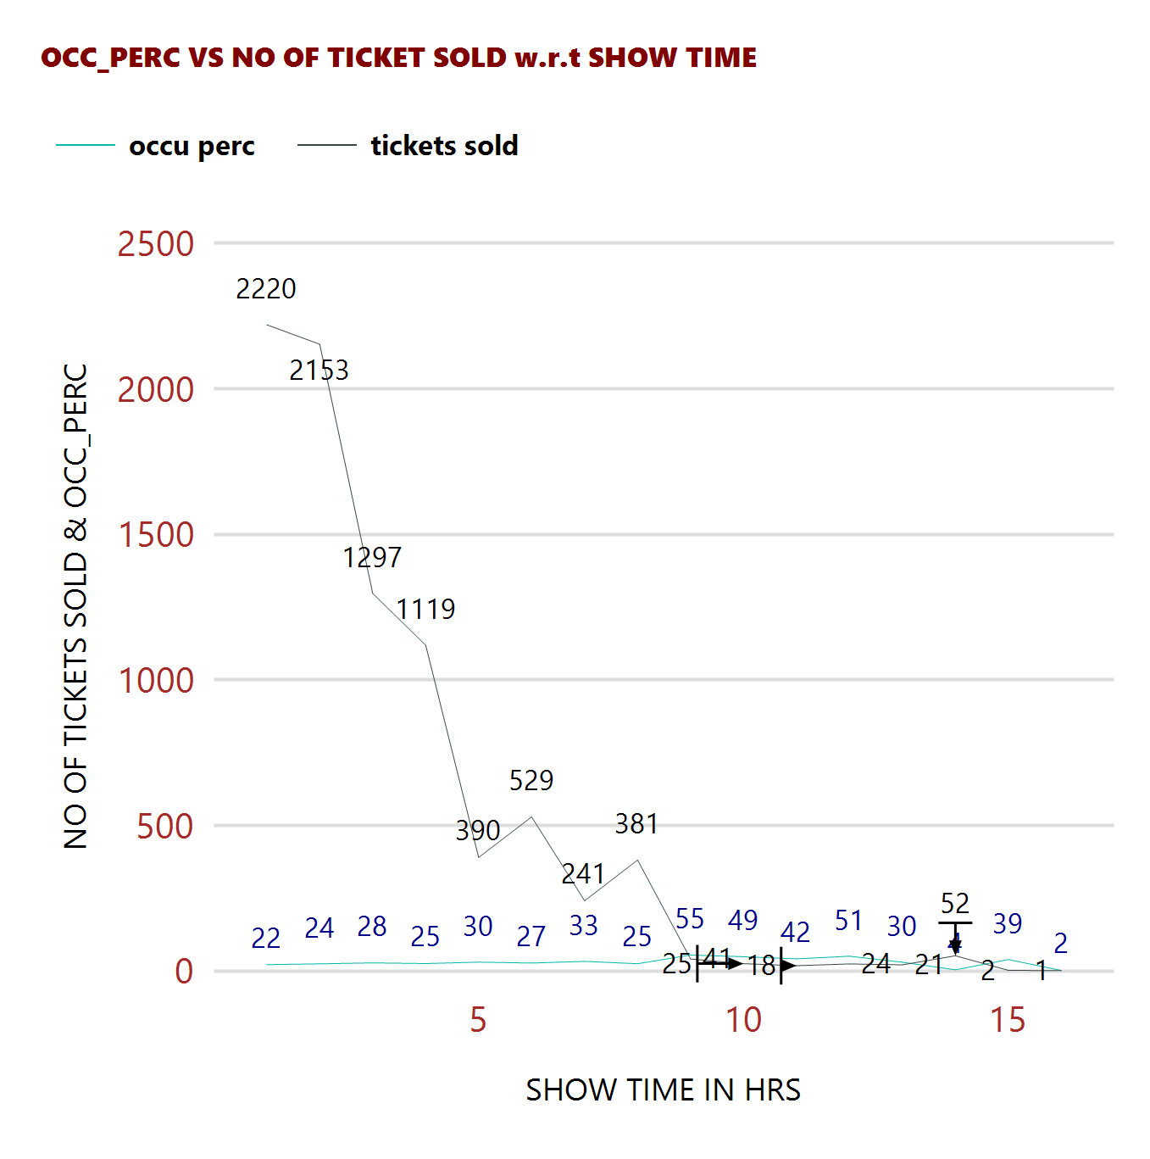
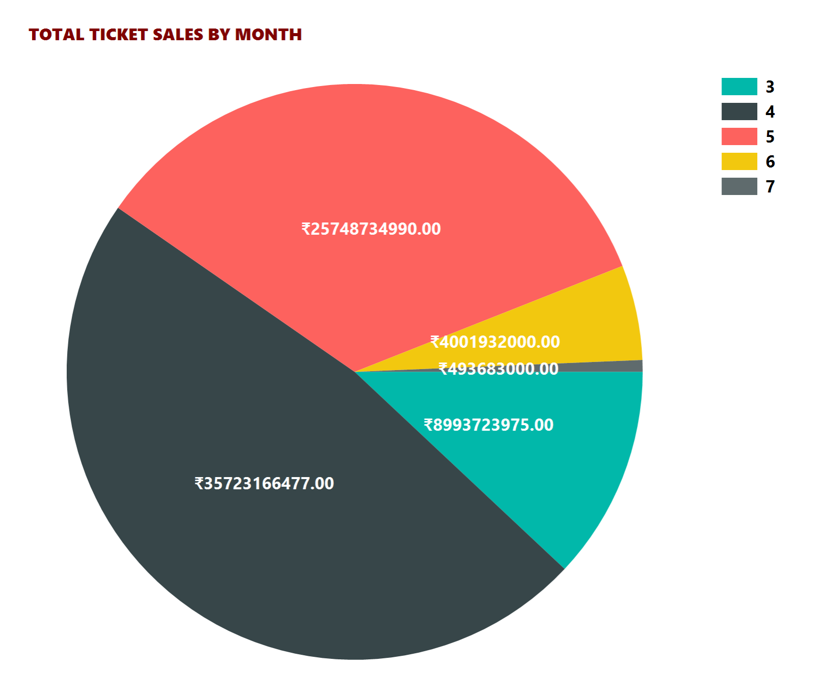
DASHBOARD
CINEMA TICKET ANALYSIS

Slide 3
DASHBOARD
CINEMA TICKET ANALYSIS

