Slide 1
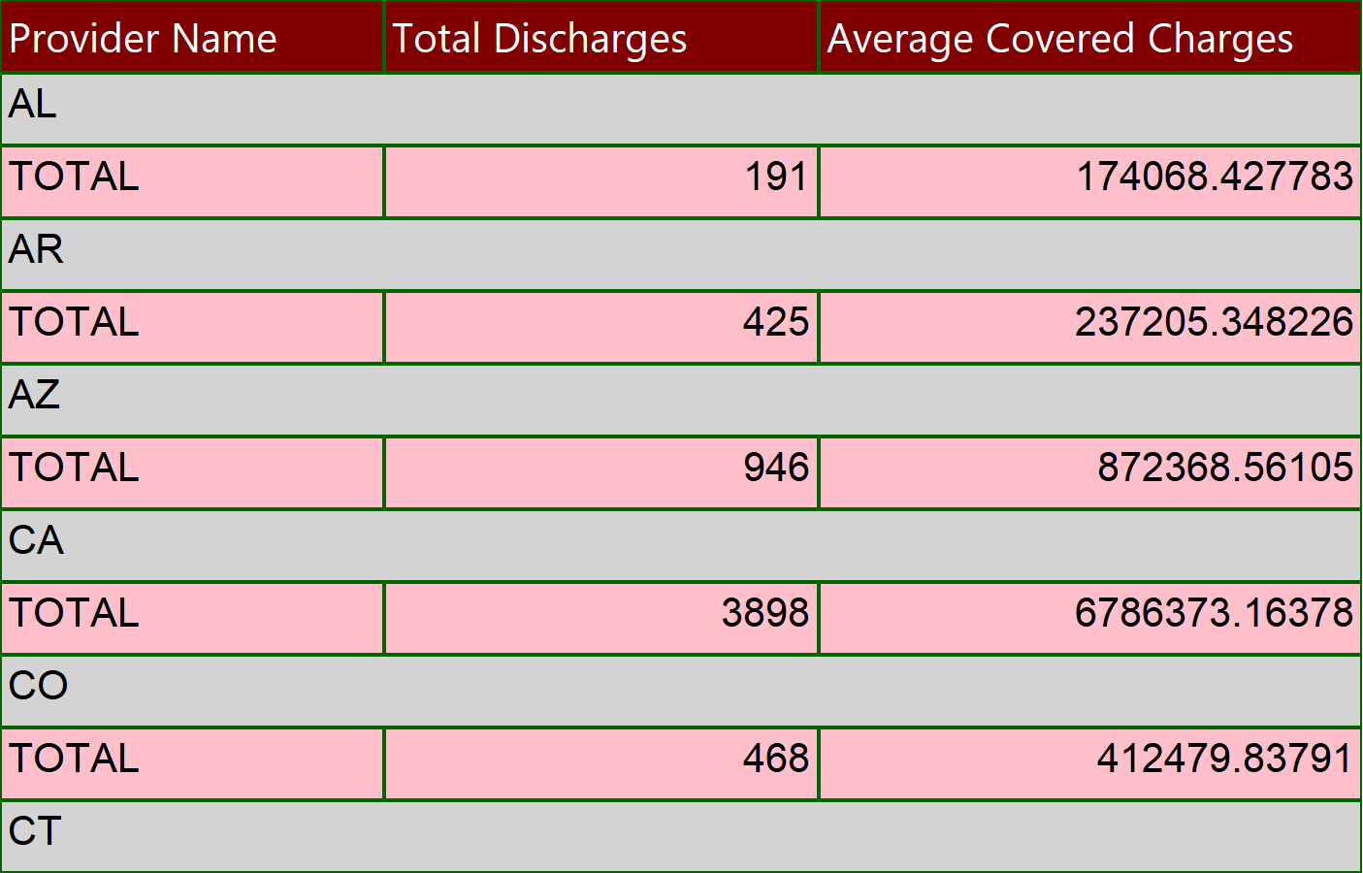
COVID STATE REPORT
Execution Time-10/6/2022 4:36:05 PM
1 of 9

Slide 2
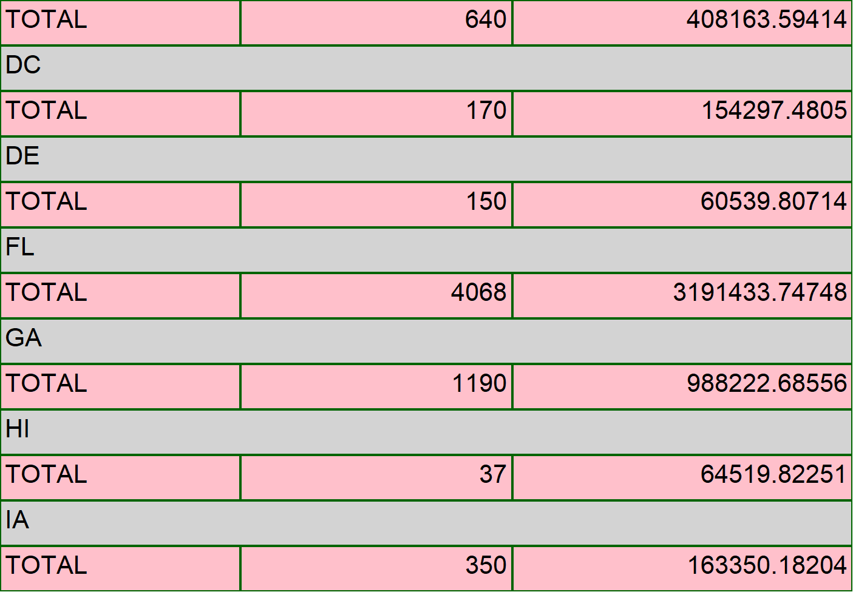
COVID STATE REPORT
Execution Time-10/6/2022 4:36:05 PM
2 of 9

Slide 3
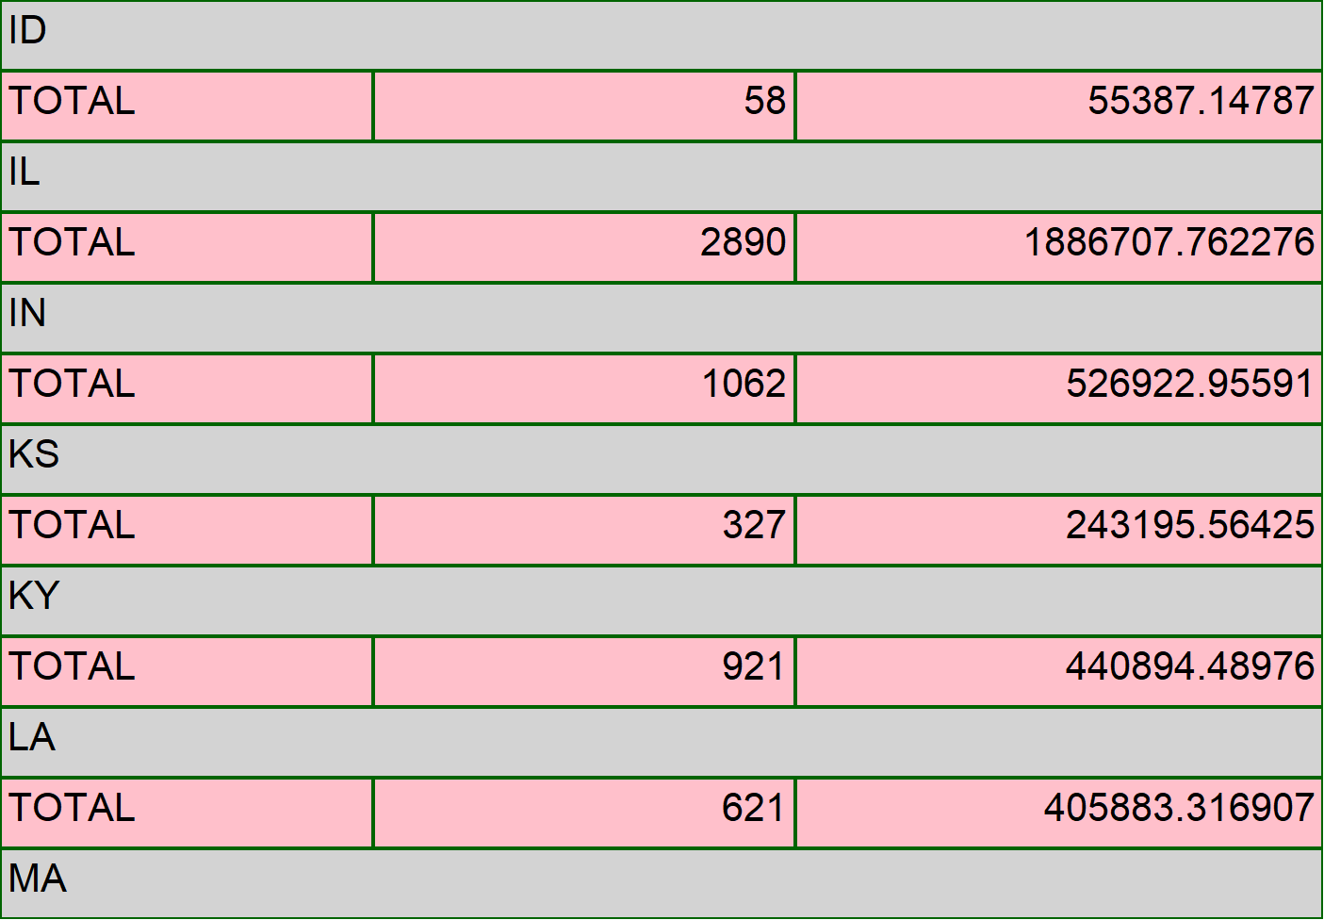
COVID STATE REPORT
Execution Time-10/6/2022 4:36:05 PM
3 of 9

Slide 4
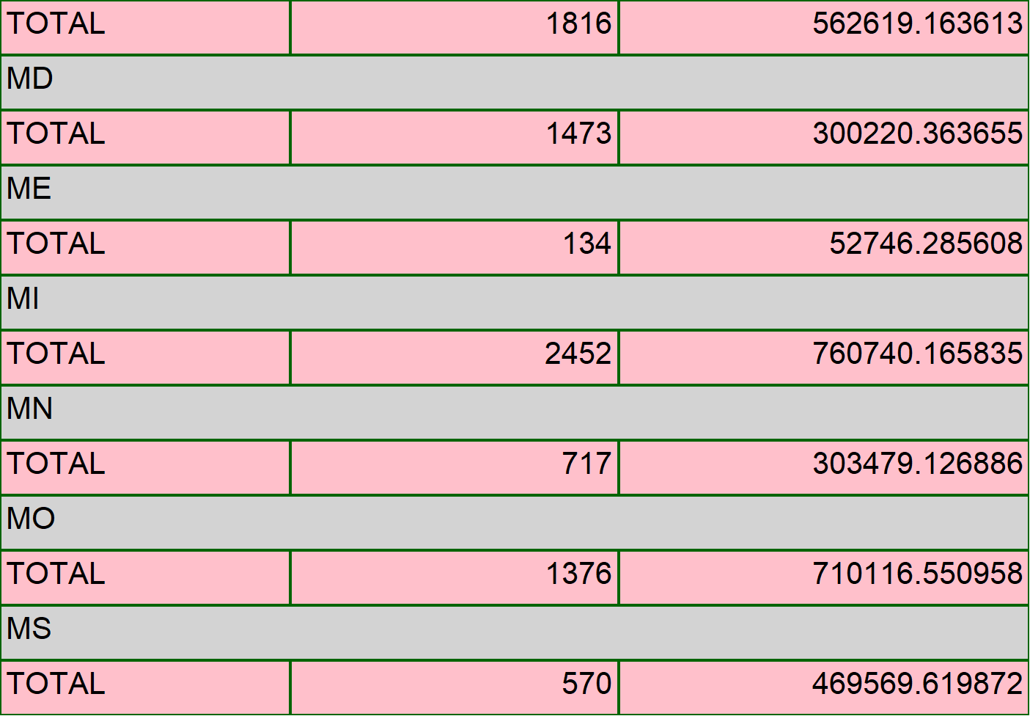
COVID STATE REPORT
Execution Time-10/6/2022 4:36:05 PM
4 of 9

Slide 5
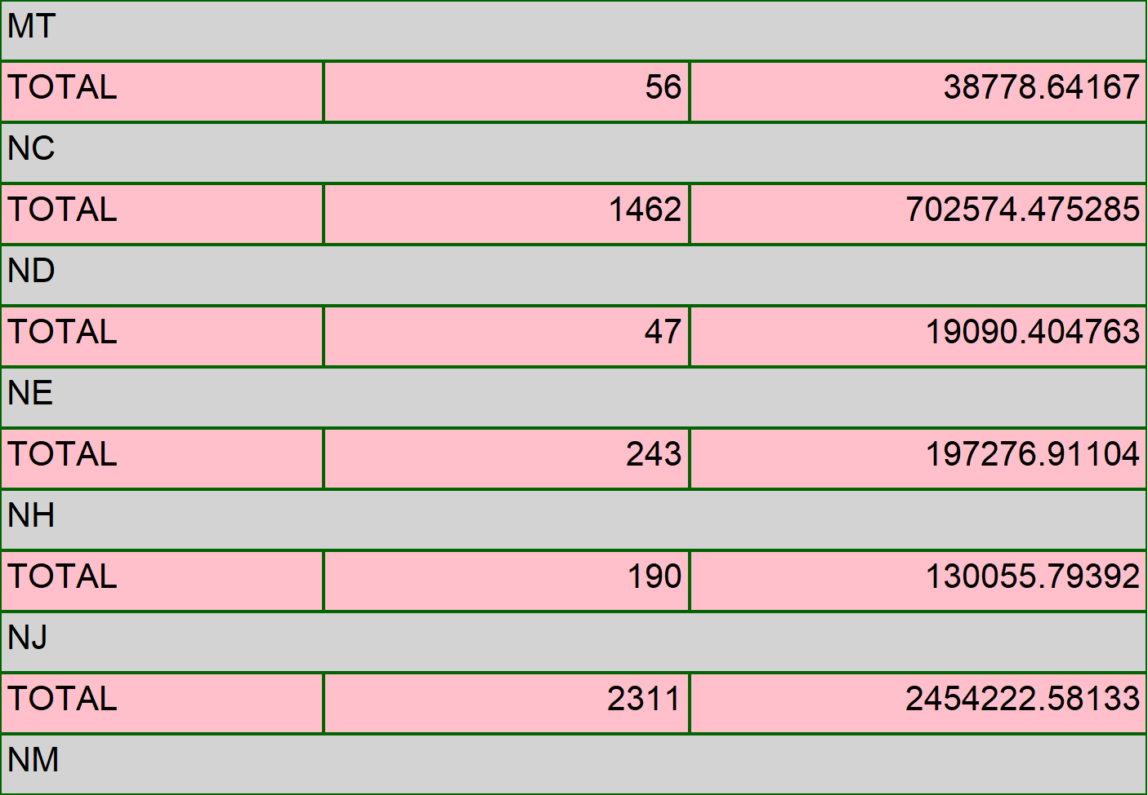
COVID STATE REPORT
Execution Time-10/6/2022 4:36:05 PM
5 of 9

Slide 6
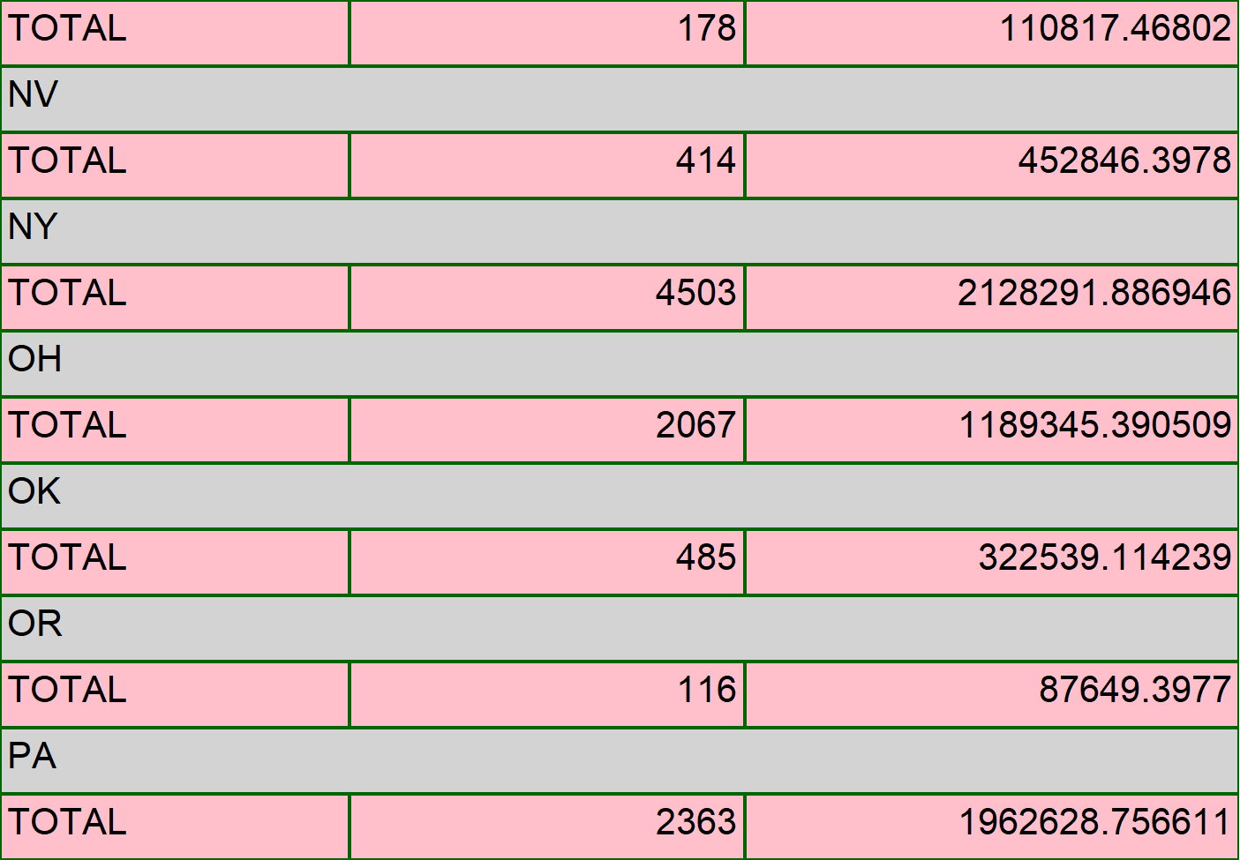
COVID STATE REPORT
Execution Time-10/6/2022 4:36:05 PM
6 of 9

Slide 7
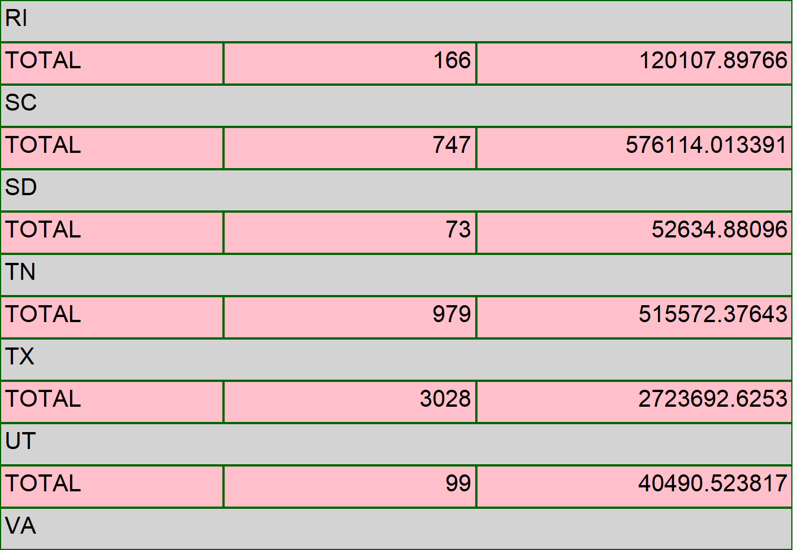
COVID STATE REPORT
Execution Time-10/6/2022 4:36:05 PM
7 of 9

Slide 8
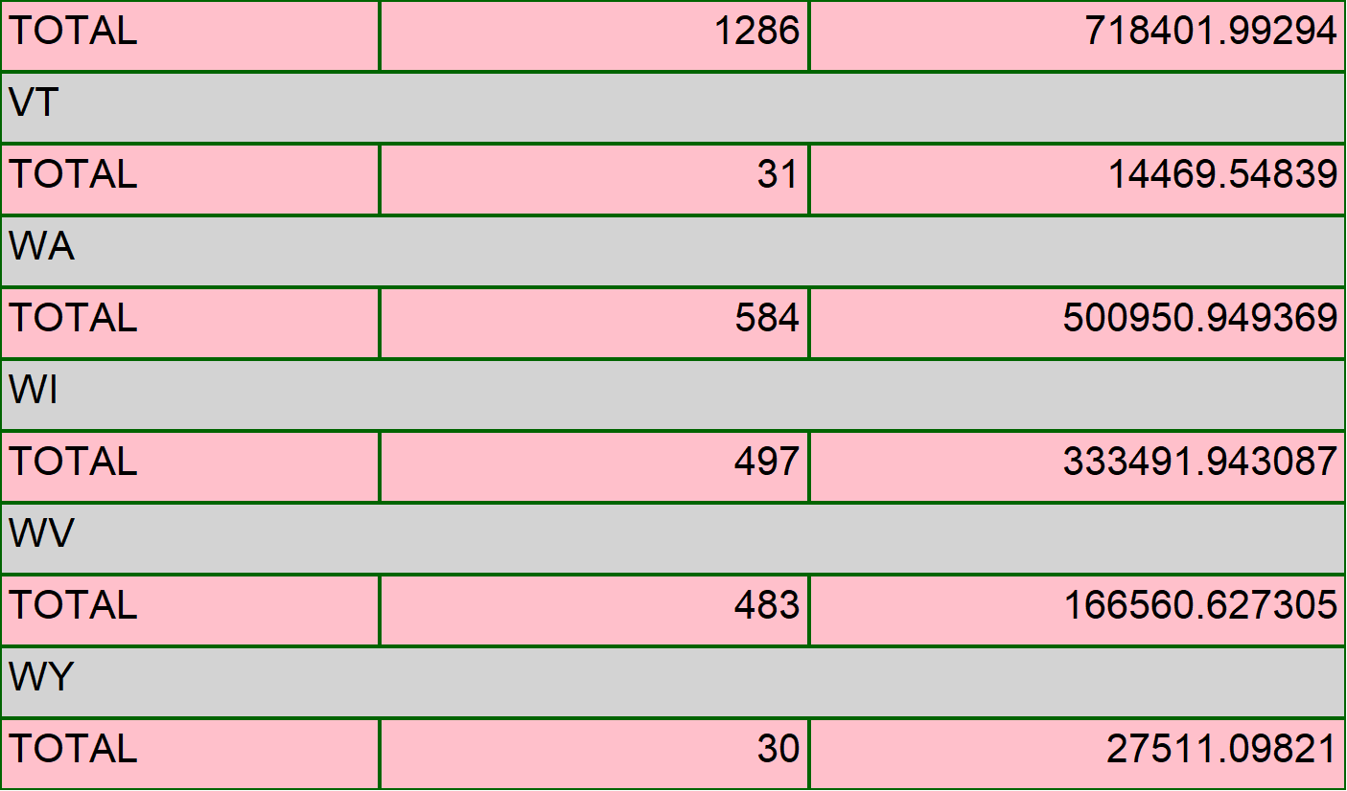
COVID STATE REPORT
Execution Time-10/6/2022 4:36:05 PM
8 of 9

Slide 9
COVID STATE REPORT
Execution Time-10/6/2022 4:36:05 PM
9 of 9

