Slide 1



Book Readership During Movie Releases: An Exploratory Analysis
Sushobhan Parajuli, Vittoria Vineis, Samira Vaez Barenji, and Michael D. Ekstrand
INERTIA Laboratory, Drexel University
https://bit.ly/3VziGMl
Notes:
Our work: Explores effect of movie releases on book readership.

Slide 2

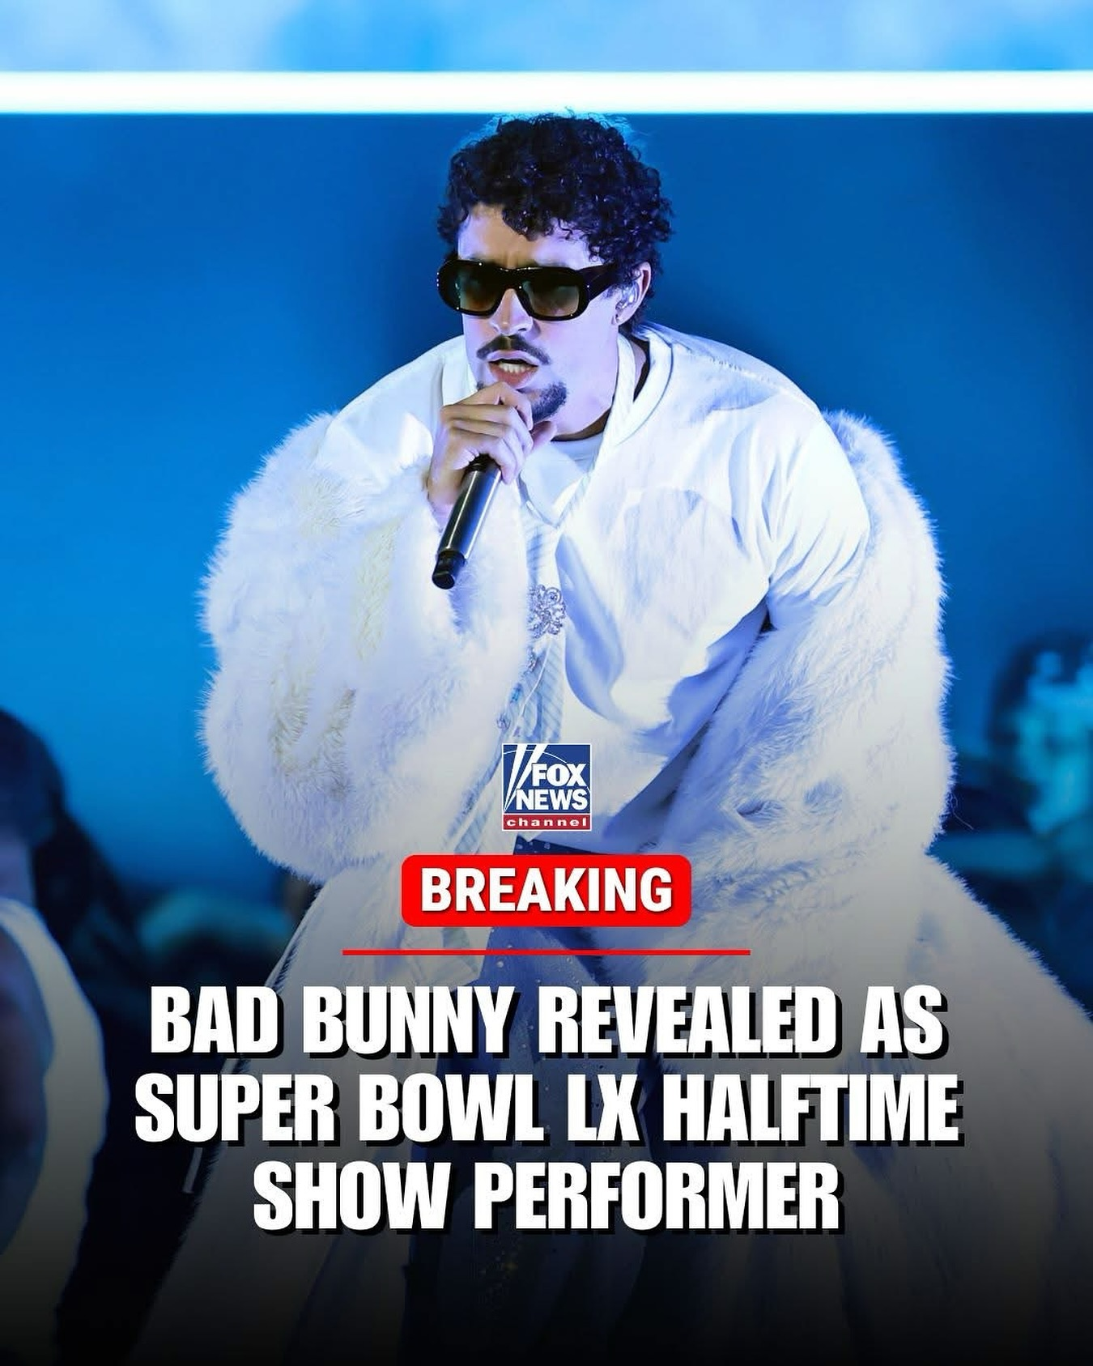


The Exogenous Event Problem
“Nolan’s film could make The Odyssey the most sought-after book in the US” – The Guardian
Exogenous events like these temporarily shift item relevance
Notes:
When The Odyssey was released, U.S. sales of the book rose by 76%.
When Bad Bunny performed at the Super Bowl halftime show, football fans who had never listened to him might have started streaming his music.
When Hamilton Musical was produced, people might have developed interest in historical sources.
And during COVID, people started reading the book The Plague by Albert Camus.
These events happen outside the platform, and often outside the domain entirely.
We call them exogenous events, and they can temporarily shift what users engage with.

Slide 3
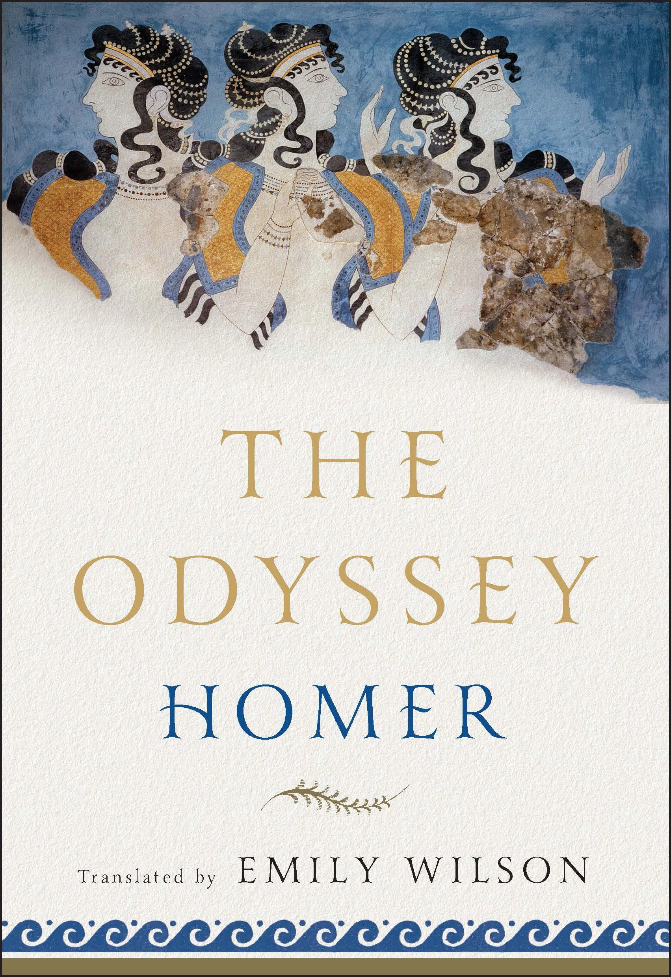
Research Questions
We narrow the exogenous-event question to one domain: movie adaptations and book readership
RQ1 How much does readership change?
RQ2 Does the change depend on popularity?
RQ3 Do collaborative filters pick up the signal?
Notes:
how exogenous events affect user activity and preferences.
As a first study, we look at one case: movie adaptations and book readership.
First, when a movie based on a book is released, does readership of that book change?
Second, does that change depend on the popularity of the book or the movie?
Third, do collaborative filtering models pick up a signal from that change?
To answer these, we built a dataset of movie–book pairs.

Slide 4
Datasets
UCSD Goodreads dataset: 228M+ user-book interactions across 876,145 users and 1.52M books (2007-2017)
U.S. movies from Wikidata and TMDB (≥1,000 votes) matched to their source books
287 movie-book pairs released between 2007 and 2017

Slide 5
Measuring Readership Change
6-month event window (1 month before release to 5 months after), pre-release (-7 to -1 months) and post-release (+5 to +11 months) windows
261 adapted books matched to non-adapted control books via nearest-neighbor matching on pre-release readership
Difference-in-Difference (DiD) to isolate the release’s effect from baseline trends

Slide 6
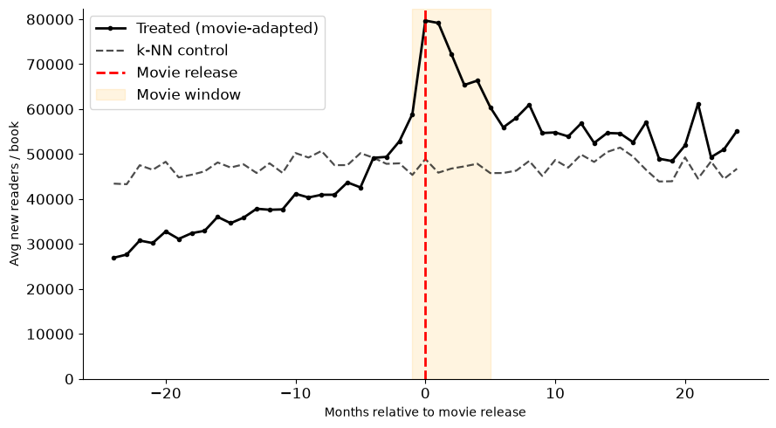
Movie Releases Increase Readership
Movie releases were associated with an estimated 144K new readers (p<0.001)

Slide 7
Movie Releases Increase Readership
Readership shows a sharp increase around the release month
Analysis check: shifting the release date 12 months earlier produced no significant effect (p=0.14)

Slide 8
Absolute vs. Relative Readership Gains
Already-popular books gained the largest total number of new readers
Lesser-known books saw proportional increases 5-6x larger than popular books relative to their baseline
Higher movie popularity correlated with larger readership spikes

Slide 9
Models Miss the Signal
ImplicitMF, BPR, SLIM, and a 12-month time-bounded Popularity baseline
Models retrieved 71%-91% of active movie books, median ranks were low, ranging between 255 and 301 for personalized models (Top-2500 Retrieval)
Personalized models placed under 7% of movie-adapted book interactions in the top-10 during the release window
The Popularity placed 15.6% in the top 10

Slide 10
The Causal Effect on Model Scores
Computed ATT for movie release on recommendation output
Personalized Models: near-zero standardized ATT (0.040-0.062), with 95% confidence intervals all spanning zero
Popularity Baseline: appears higher (ATT = 0.528), but this is inflated by near-zero score variance across users, and its CI includes zero
Takeaway: Collaborative filtering does not implicitly raise books during their movie release time based on interaction data alone

Slide 11
Implications and Future Directions
Systems miss short-term, exogenous relevance shifts
Ideas:
Incorporate adaptation status and time-to-release directly as temporal item features
Apply temporary re-ranking books to adapted titles during their movie release time
Acknowledgements: NSF Grant No. IIS 24-09199 https://bit.ly/3VziGMl

