Slide 1
Text Summarization of Cricket Matches using Neural Networks
SUSHRITH REDDY - 21BDS0214
MADHUR PATEL - 21BDS0283
ADWAIT AMBEKAR - 21BDS0261

Slide 2
Problem Statement
The increasing volume of cricket match videos poses challenges in effective analysis and comprehension due to manual, time-consuming summarization methods. Existing approaches often overlook critical match moments, leading to biased analyses. Moreover, the abundance of commentary and extraneous footage complicates the process further. Our project aims to develop an automated summarization system to efficiently extract key insights from cricket match videos, enabling quick and unbiased analysis for stakeholders.

Slide 3
Abstract
The increasing volume of cricket match videos poses challenges in effective analysis and comprehension due to manual, time-consuming summarization methods. Existing approaches often overlook critical match moments, leading to biased analyses. Moreover, the abundance of commentary and extraneous footage complicates the process further. Cricket is one of the most followed sports by audience throughout the world. It is a highly sought out form of entertainment with 2.5 billion spectators though it’s a niche in terms of geography but still leaves a lot of untapped audience and applications due to its long matches and underperforming summarizers. Our project aims to develop an automated summarization system to efficiently extract key insights from cricket match videos, enabling quick and unbiased analysis for stakeholders. In this Study, we dive into a new totality of the framework for cricket match video summarization. We propose the use of advanced Deep Learning techniques like VGG16 Convolutional Neural Networks (CNNs), Optical Character Recognition (OCR), Long Short-Term Memory Recurrent Neural Networks (RNNs) and You Only Look Once (YOLO) for text and object detection from the match. This ensures the quality summary and also makes sure that there- exist no bias and get a better version than existing summarizing systems. From this study we get an ultimate summarization tool which performs better while capturing crucial events and display text for the user to consume.

Slide 4
Literature Survey
Title | Authors | Algorithms Used | Algorithms Details | Results
Soccer Video Summarization Using Deep Learning | Rockson Agyeman Rafiq Muhammad Gyu Sang Choi | Convolutional Neural Network (CNN), Long Short Term Memory (LSTM), Residual Network (ResNet), Feature extraction, Mean Opinion Score (MOS), normalization, Batch Rectified Linear Units (ReLU). | 3D-CNN: Modified ResNet for spatiotemporal feature extraction. LSTM: Models temporal evolution of soccer actions. Integrated Framework: Combines both for concise video summarization. | Summarized soccer videos receive a collective 4 out of 5 Mean Opinion Score (MOS) in evaluations, indicating good overall performance.
Sports Video Summarization with Limited Labeling Datasets Based on 3D Neural Networks | ChingShunLin YuChingChen | 3D Convolutional Neural Networks (3D-CNN) 2D Convolutional LSTM | 3D-CNN: Used for enhanced spatiotemporal feature extraction. 2D Convolutional LSTM: Combines spatial and temporal features for event detection. Audio & Visual-Based Detection: Combines audio (e.g., cheering, hitting sounds) and visual cues (e.g., score display) for event identification. | Achieve a high recall rate, precision rate, and F1 score in summarizing baseball events, proving effectiveness.

Slide 5
Title | Authors | Algorithms Used | Algorithms Details | Results
Video Summarization for Large Sports Video Archives | Yoshimasa Takahashi, Naoko Nitta, Noboru Babaguchi | Play-Cut Method Greedy Method | Play-Cut & Greedy Methods: Used to assess the significance of play scenes, rank them, and generate concise video summaries. Metadata Usage: Leverages metadata to prioritize significant play scenes, improving the summarization process. | Successful generation of video summaries with high recall and precision rates.
Video Summarization using CNN and Bidirectional LSTM by Utilizing Scene Boundary Detection | Muhammad Zeeshan Khan, Saira Jabeen, Saleet ulHassan,M.A Hassan, Muhammad UsmanGhaniKhan | CNN (Convolutional Neural Networks) Bidirectional LSTM (Long Short-Term Memory) | Scene Boundary Detection: Identifies scene changes based on motion features. CNN: Analyzes frame importance within scenes to select relevant content. Bidirectional LSTM: Removes redundant frames by addressing temporal dependencies. | Achieves a superior F measure score of 0.84% compared to other state-of the-art methods on the TVSU M50 Dataset

Slide 6
Title | Authors | Algorithms Used | Algorithms Details | Results
Automatic Lecture Video Content Summarization with Attention-based Recurrent Neural Network | Muhammad Andra Bagus Tsuyoshi Usagawa | Attention-based Recurrent Neural Network (RNN) ROUGE Evaluation Metrics Seq2seq Model | The system uses an attention-based RNN to process and segment lecture transcripts. It generates concise summaries using linguistic features, evaluated with ROUGE. | Significant improvements in ROUGE scores, demonstrating the proposed model's effectiveness in capturing key content compared to baseline methods
Automatic Video Summarization from Cricket Videos Using Deep Learning | Solayman Hossain Emon, A.H.M Annur, Abir Hossain Xian, Kazi Mahia Sultana, Shoeb Mohammad Shahriar | Deep Cricket Summarization Network (DCSN), CNN, LSTM, Deep Reinforcement Learning, Diversity Reward, Representativeness Reward, Maximum Likelihood Estimation | DCSN uses an encoder-decoder architecture to predict frame-level probabilities for summarization. It combines CNN for feature extraction, LSTM for sequence modeling, and reinforcement learning for optimizing summary selection with diversity and representativeness rewards. | The models perform the task with 60.6% accuracy

Slide 7
Title | Authors | Algorithms Used | Algorithms Details | Results
SGRNN-AM and HRF-DBN:ahybridmachinelearningmodel for cricket video summarization. | Hansa Singrakhia, HetalPatel. | Employsspeech-to-text frameworks to detect excitement. | Detects key moments through audio excitement analysis, classifies shots using hue histogram differences, performs OCR for scoreboard analysis, and recognizes umpire gestures using joint-based features. | The model performs the task with 96.32% accuracy.
Combination of a 3D ResNet34andaLSTMNeural NetworkModel | Besta Srikanth, Sagarla Aravind, Mopuri Veera Narayana,NarayanaSatyaNarayana | Manual Annotation, Feature Extraction,LSTM Network | CNN to extract visual features and LSTMto generate text summarization using the visual features. And Ranking mechanism to rank highlights. | By human assessment, the accuracy for MOS received an 80% (4/5) rating.

Slide 8
Research Gaps
1. Soccer Video Summarization Using Deep Learning Authors: Rockson Agyeman, Rafiq Muhammad, Gyu Sang Choi
Does not consider variations in video quality.
Lacks integration of audio cues (e.g., commentary, crowd noise).
Limited adaptability to different sports and datasets.
No scalability for large video archives.
No real-time performance consideration.
Absence of user feedback for refinement.
2. Sports Video Summarization with Limited Labeling Datasets Based on 3D Neural Networks Authors: ChingShun Lin, YuChing Chen
Doesn’t address real-time events or rapid scene changes.
Misses integration of audio-visual cues (e.g., crowd reactions, commentary).
Lacks scalability and computational efficiency for high-resolution videos.
No performance evaluation across various sports genres.
Does not consider user engagement or subjective satisfaction.

Slide 9
3. Video Summarization for Large Sports Video Archives Authors: Yoshimasa Takahashi, Naoko Nitta, Noboru Babaguchi
Lacks flexibility in ranking significant plays.
Cannot handle live broadcasts or real-time events with multiple angles.
Relies on metadata, risking bias and missing important events.
Doesn’t address performance with low-quality videos or noisy metadata.
4. Video Summarization Using CNN and Bidirectional LSTM by Utilizing Scene Boundary Detection Authors: Muhammad Zeeshan Khan, Saira Jabeen, Saleet ul Hassan, M.A Hassan, Muhammad Usman Ghani Khan
Struggles with rapid transitions and low-contrast scenes.
Misses audio features like commentary and crowd noise.
Doesn’t evaluate across different sports or video types.
Lacks real-time summarization capability.

Slide 10
5. Automatic Lecture Video Content Summarization with Attention-based Recurrent Neural Network Authors: Muhammad Andra, Bagus Tsuyoshi Usagawa
Does not address dynamic content like sports videos where visual cues are crucial.
ROUGE metrics do not capture visual or temporal coherence.
No adaptation to user preferences in segment selection.
Lacks handling of incomplete or noisy video content.
No real-time processing capability for live events or streaming.
6. Automatic Video Summarization from Cricket Videos Using Deep Learning Authors: Solayman Hossain Emon, A.H.M Annur, Abir Hossain Xian, Kazi Mahia Sultana, Shoeb Mohammad Shahriar
Pre-defined rewards may not align with subjective viewer preferences.
Lacks multimodal data integration (audio/textual cues).
No evaluation for low-quality or noisy footage.
Does not address scalability or real-time processing for large video archives.
No customization options for defining highlights based on individual user preferences.

Slide 11
HARDWARE REQUIREMENTS
The hardware requirements for application development include:
CPU: A modern multi-core processor (Intel Core i5 or equivalent) for efficient computational tasks.
GPU: A dedicated GPU (NVIDIA GeForce GTX 1060 or equivalent) with CUDA support for accelerated deep learning computations.
RAM: Minimum 8GB RAM (16GB recommended) for smooth processing of large datasets and model training.
Storage: At least 500GB HDD or SSD for storing video datasets, image frames, trained models, and intermediate data files

Slide 12
SOFTWARE REQUIREMENTS
The software requirements for application development include:
Operating System: Compatible with Windows 10, macOS Mojave (10.14) or later, or Linux distributions such as Ubuntu 18.04 LTS or newer.
Python Environment: Python 3.x with essential libraries like TensorFlow, Keras, scikit-learn, NumPy, NLTK, and OpenCV for machine learning, NLP, and image processing.
Development Tools: IDEs such as PyCharm, Jupyter Notebook, or VSCode for coding, debugging, and experimentation.
Version Control: Git for version control to facilitate collaboration and track code changes.
External Libraries and Models: Additional libraries and pre-trained models such as Paddle OCR, BART (Bidirectional and Auto-Regressive Transformers), and VGG16 for image processing and text summarization.
Internet Connectivity: High-speed internet connection for accessing online resources, downloading datasets, and retrieving cricket match footage.

Slide 13
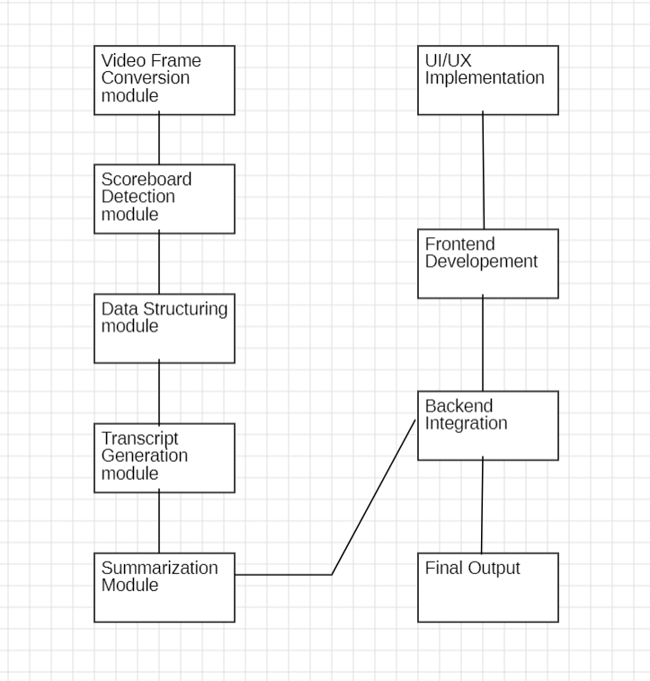
GANTT CHART (WBS)

Slide 14
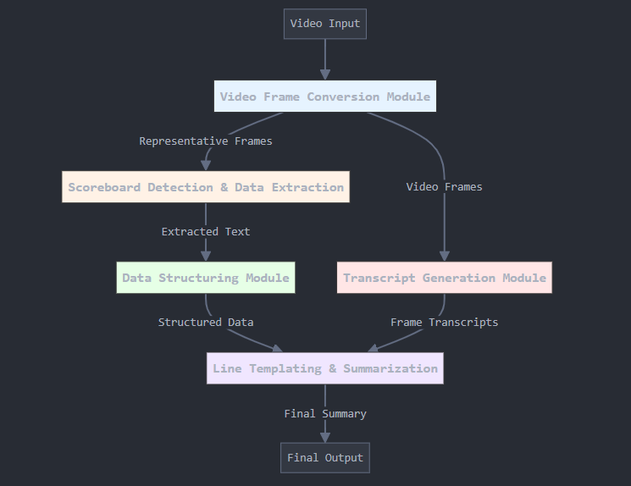
Proposed System Architecture

Slide 15
List Of Application Modules
Video Frame Conversion Module: Efficiently transforms video into frames, filters redundant frames for analysis.
Scoreboard Detection and Data Extraction Module: Automates cricket scoreboard detection and data extraction for streamlined analysis.
Data Structuring Module: Structures unstructured cricket match data for comprehensive analysis and interpretation.
Transcript Generation Module: Generates descriptive cricket video transcripts using CNN and LSTM integration.
Line Templating and Summarization Module: Utilizes advanced NLP to summarize textual content extracted from the videos

Slide 16
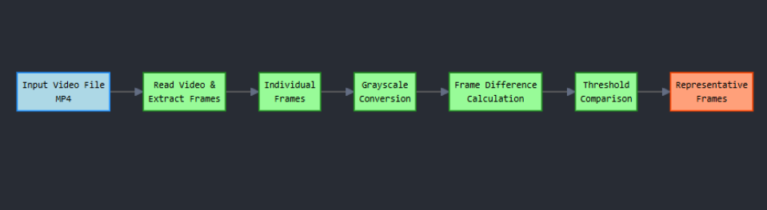
Video Frame Conversion Module

Slide 17
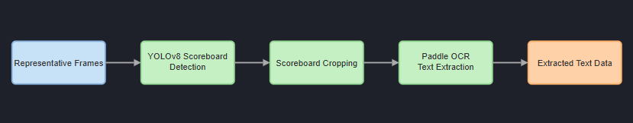
Scoreboard Detection and Data Extraction Module

Slide 18
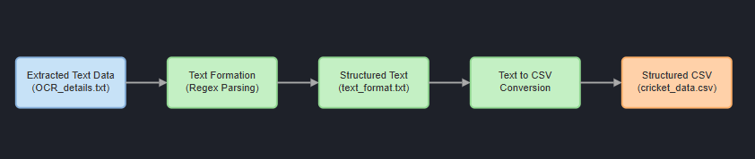
Data Structuring Module

Slide 19
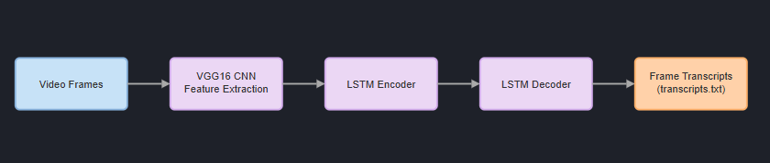
Transcript Generation Module

Slide 20
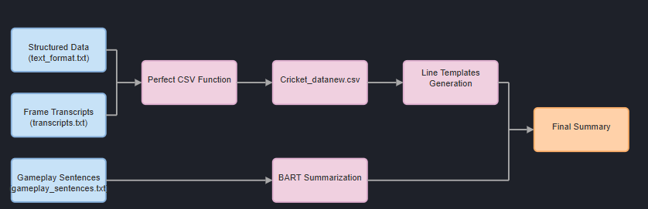
Line Templating And Summarization Module

Slide 21
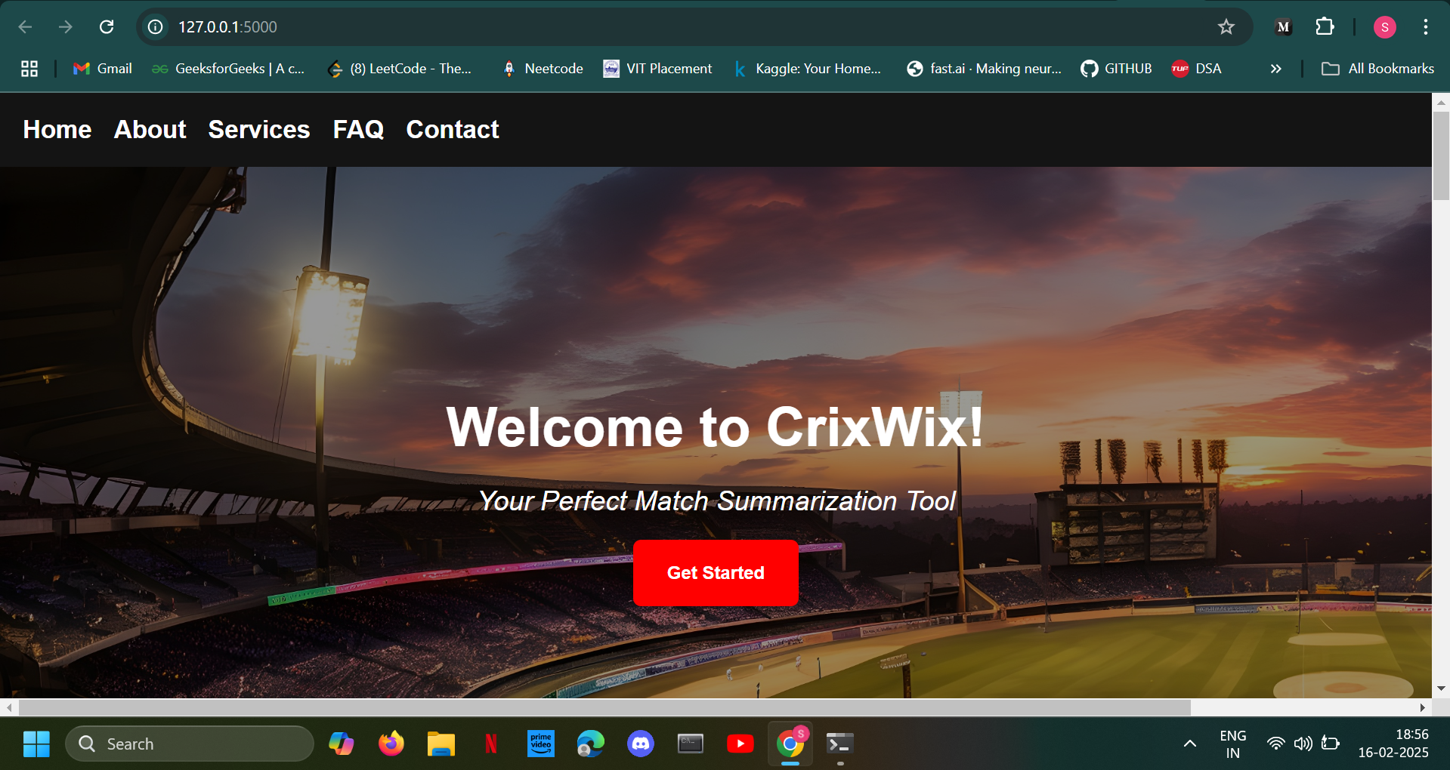

Module Implementation (30%)
Web Design (UI/UX)

Slide 22
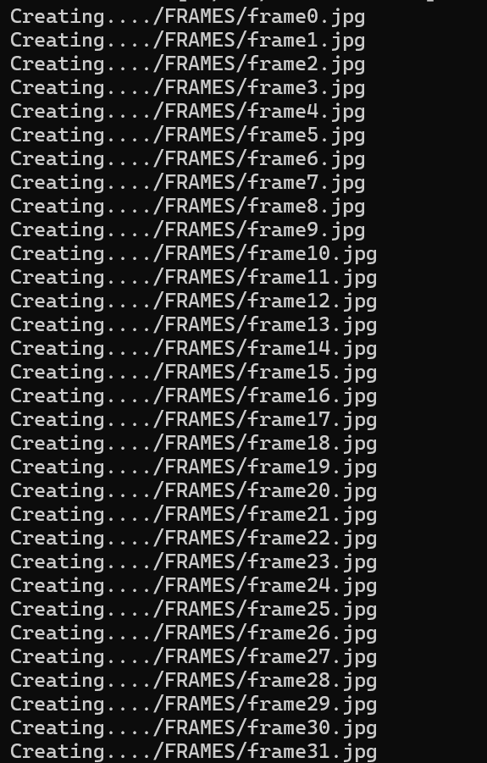
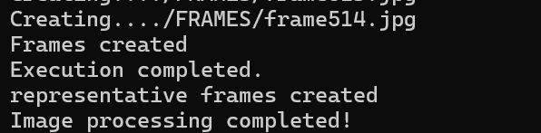
Module Implementation
Video Frame Conversion Module

Slide 23
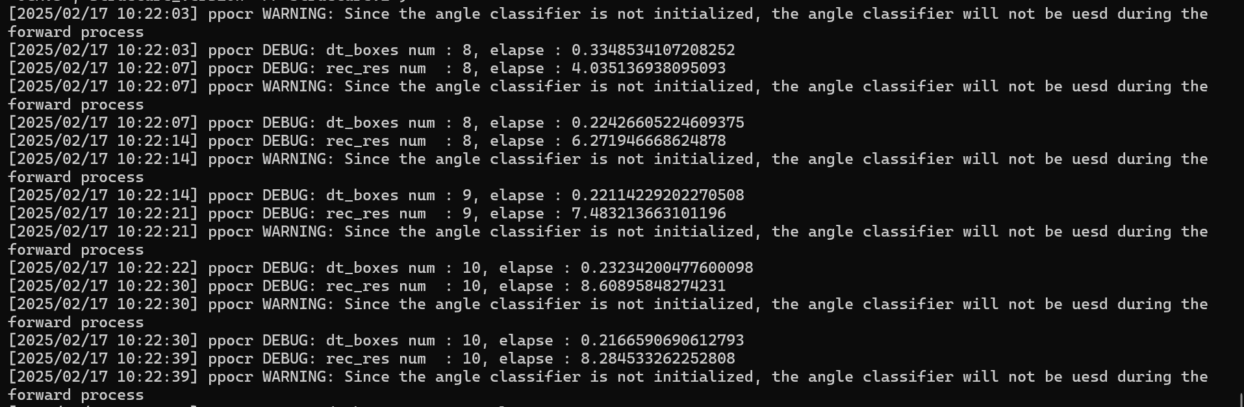
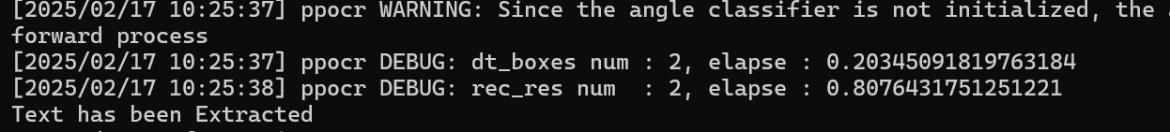
Module Implementation
Scoreboard Detection and Data Extraction Module

Slide 24
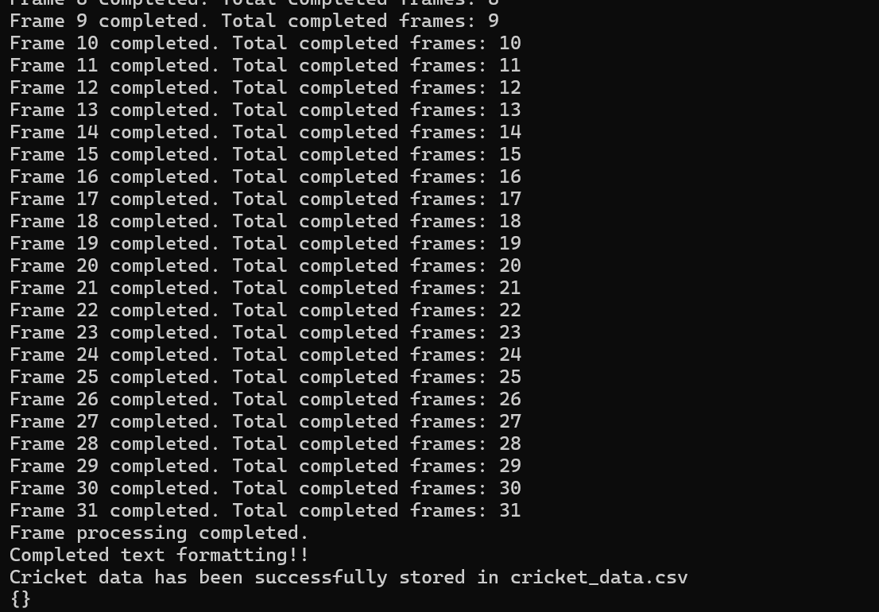
Module Implementation
Data Structuring Module

Slide 25
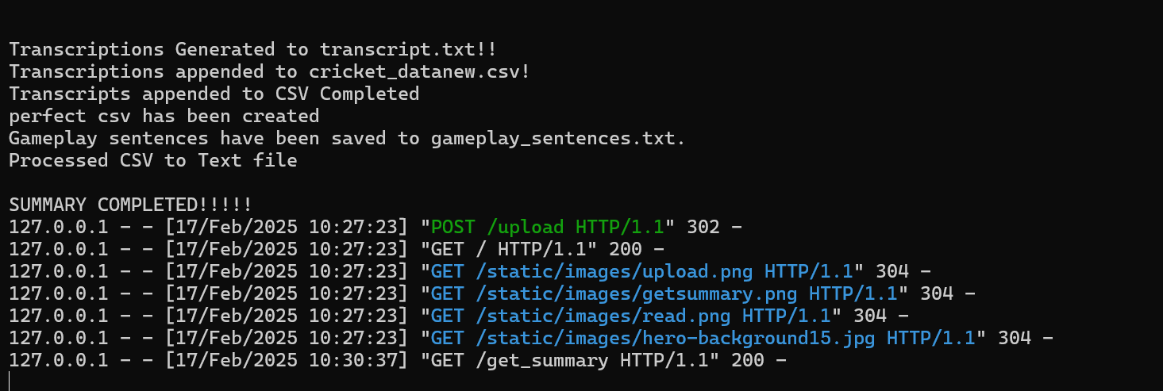
Module Implementation
Transcript generation and Summarization Modules

