Slide 1

RETAIL ANALYTICS | CAPSTONE PROJECT
Retail Revenue Analysis
For Leadership Decision Making
Turning retail data into actionable business insights
Presented by: Sushreesangita Behera
Date:

Slide 2
Project Overview & Problem Statement
⚠️
🔎
🎯
📊
The Challenge
Key Challenges
Project Objective
Expected Outcomes
The B&J Biscuit Company cannot clearly understand its sales performance due to unclean, unstructured, and disconnected datasets.
Inconsistent buyer information, missing product links.
Lack of consolidated KPIs
Difficult to identify top-performing products or evaluate sales representative performance.
Clean, organize, and merge transaction data with product details to create an interactive dashboard that supports data-driven leadership decisions.
Identify top-performing products, buyers, and sales representatives.
Analyse revenue, cost, profit, and profit margin drivers.
Measure sales across locations and payment methods.

Slide 3


Task 1-
Data Cleaning & Formatting
🎯
OBJECTIVE
Clean, standardize, and format raw transaction data for accurate analysis.
CORE PROBLEM-SOLVING POINTS
Removing Noise
Text Splitting
01.
Use TRIM( ) and CLEAN( ) functions to eliminate unwanted leading/trailing spaces and non-printable special characters.
Extract Location from the combined Buyer Name and Location field using Flash Fill (Ctrl + E) or the Text to Columns feature.
02.
Casing Standardization
Structural Organization
03.
Apply the PROPPER( ) or UPPER( ) function to ensure uniform text formatting across all name and location columns.
Convert the cleaned data range into an official Excel Table (Ctrl + T) to apply clear headers and enable auto-filtering.
04.

Slide 4
Task 2 – Lookup Mapping
(VLOOKUP / XLOOKUP)
Connect data | Find values | Build smarter reports
Transaction Data
Product Reference Data
Objective
Data Enrichment
Transaction Date | Buyer Name | Payment Method | Quantity Purchased | Product Code
45,304.00 | AllenSantos | Credit Card | 284 | Pro02
45,421.00 | BrendaShaw | Debit Card | 90 | Pro05
45,432.00 | RobertHernandez | Cash | 475 | Pro04
45,410.00 | Alexander Smith | Debit Card | 299 | Pro02
Product Code | Biscuit Brand | Cost Price | Unit Price
Pro01 | Good Day | 10 | 11
Pro02 | Britannia | 18 | 22
Pro03 | Sunfeast | 3 | 5
Pro04 | Malkist | 10 | 14
Merge the Products reference sheet with the Transaction Data sheet using the common Product Code identifier.
Efficiently fetch and map Unit Price, Cost, and Product Category fields into the main transaction sheet.
Strategic Lookups
Error Handling
VLOOKUP / XLOOKUP
Utilize XLOOKUP( ) as the primary function for its flexibility (no column index counting needed), failing back on VLOOKUP( ) where legacy compatibility is required.
Wrap lookup formulas inside an IFERROR( ) function to handle missing codes cleanly and avoid broken #N/A displays.
Lookup-Enriched Transaction Data
Transaction Date | Buyer Name | Payment Method | Quantity Purchased | Product Code | Biscuit Brand | Cost Price | Unit Price
13-01-2024 | Allen Santos | Credit Card | 284 | Pro02 | Britannia | ₹18.00 | ₹22.00
09-05-2024 | Brenda Shaw | Debit Card | 90 | Pro05 | Oreo | ₹14.00 | ₹28.00
20-05-2024 | Robert Hernandez | Cash | 475 | Pro04 | Malkist | ₹10.00 | ₹14.00
28-04-2024 | Alexander Smith | Debit Card | 299 | Pro02 | Britannia | ₹18.00 | ₹22.00
Financial Formatting
Apply proper Currency formatting to the newly populated Unit Price and Cost columns to maintain professional data presentation standards.

Slide 5

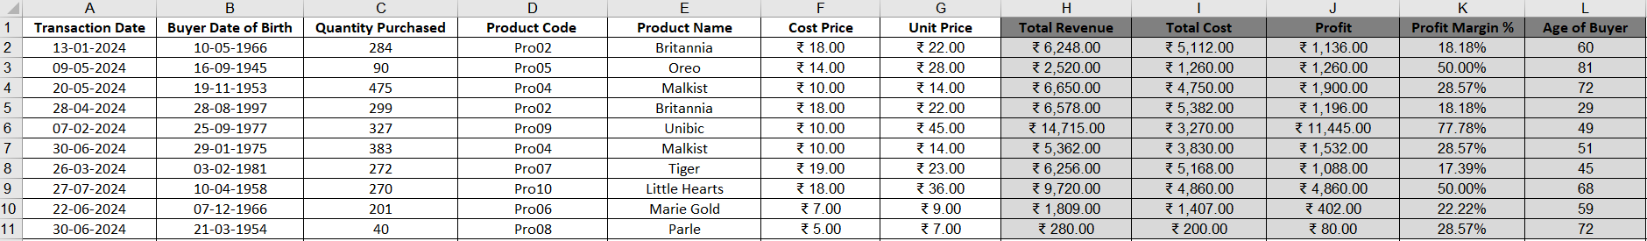
TASK 3 – Create New Calculation Columns
Using Excel formulas, we create new columns to calculate key business metrics from the existing data.
💰
📜
📈
％
📆
Total Revenue
Total Cost
Profit
Profit Margin %
Age of Buyer
Quantity Purchased x Unit Price
Quantity Purchased x Cost
Revenue – Cost Amount
(Profit / Revenue) x 100
Current Year – Buyer DOB year

Slide 6
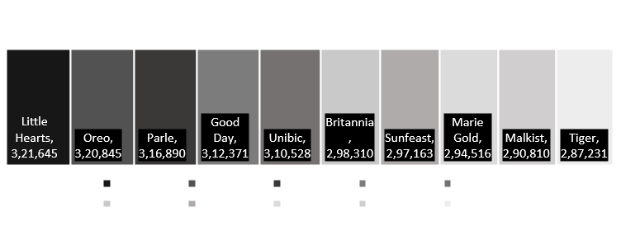
TASK 4 – Product- Level Insights
Key Insight: Unibic leads revenue & profit; Little Hearts leads quantity sold.

Slide 7
TASK 5 – Customer & Demographic KPIs
Understand your customers | Target the right segments | Drive more revenue
👥
1. Sales by Gender
👤
1. Sales by Age Group
Male buyers drive the vast majority of revenue, with female and other categories representing a significantly smaller share.
The 69+ group contributes the highest sales, followed closely by 29-38 demographic.
🛒
3. Top Buyer Profiles
Customers with higher purchase quantities are more likely to be high-value buyers. The average quantity per buyer segment shows a clear difference across segments.
🏆4. Identified High Value Buyer
Buyer Segment | Avg. Purchase Quantity
High Value | 925,137
Mid Value | 1,698,727
Low Value | 426,445
Top Buyer: Robert Hernandez
Gender: Male
Age Group: 69+
Quantity Purchased: 7,141
Total Revenue: 132,558

Slide 8
TASK 6 – Sales Representative Performance & KPIs
Performance Analysis: Revenue Leaders, Profit Margins, and Contributors
Top 3 by Total Revenue
Top 3 by Profit Margin %
Top 5 Revenue Contributors (Ranked & Detailed)
01. | Travis Doyle | 10,880,651 | 23.06%
02. | Joseph Hill | 10,539,847 | 22.34%
03. | April Watkins | 9,402,955 | 19.93%
04. | Susan Dean | 8,667,028 | 18.37%
05. | Sara Robertson | 7,697,702 | 16.31%
Travis Doyle
Susan Dean
Sl. No.
Sales Persons
Actual Revenue
% Contribution
1,088,0651
35.11%
Joseph Hill
Sara Robertson
1,053,9847
35.02%
Grand Total = 47,188,183 100.00%
April Watkins
Joseph Hill
Joseph Hill: 34.95% (Note: Joseph Hill is the only sales rep who ranks in both Top 3 Revenue and Profit Margin)
9,402,955
34.95%

Slide 9
TASK 7 – Location-Based KPIs
Geographic Breakdown of Revenue, Volume, and Profit Margins
Total Revenue
61,567,883
Total Quantity Sold
3,050,309
Total Profit
26,784,833
Overall Profit Margin
43.50%
Key Insights
Highest Revenue
San Antonio ($7.34M)
Highest Profit
San Antonio ($3.37M)
Highest Quantity Sold
San Antonio ((345K)
Highest Profit Margin
San Antonio (35.93%)

Slide 10
TASK 8 – Payment Method Analysis
Comprehensive breakdown of revenue, order volume, and customer preferences.
Executive Summary & Revenue
1. Revenue Share
2.Count of Orders by Payment
Top Channel: Mobile Payment leads all key metrics, driving the highest volume and strong revenue.
Highest Revenue: Debit Card Leads with $1,56,20,114; Mobile Payment follows closely at $1,54,61,629.
Highest Orders: Mobile Payment recorded 3,038 orders, slightly outperforming Debit Card (3,008 orders).
Customer Preferences
By Gender (Male/Female): Both demographics strongly prefer Mobile Payment at checkout.
By Gender (Other): Shows a distinct preference leaning toward Debit Card transactions.
Under 69: Mobile Payment is the dominant choice across all age groups under 69.
Seniors (69+): Cash remains the most preferred payment choice.

Slide 11

TASK 9 – Visual Analysis (Charts)
Row Labels | Sum of Total Revenue
Britannia | 6562820
Good Day | 3436081
Little Hearts | 11579220
Malkist | 4071340
Marie Gold | 2650644
Oreo | 8983660
Parle | 2218230
Sunfeast | 1485815
Tiger | 6606313
Unibic | 13973760
Grand Total | 61567883
Key Visual Insights
Unibic leads product revenue.
Male customers generate the highest revenue.
Monthly revenue and profit fluctuate.
Product performance varies significantly.
Scatter & heatmaps reveal key relationships.

Slide 12
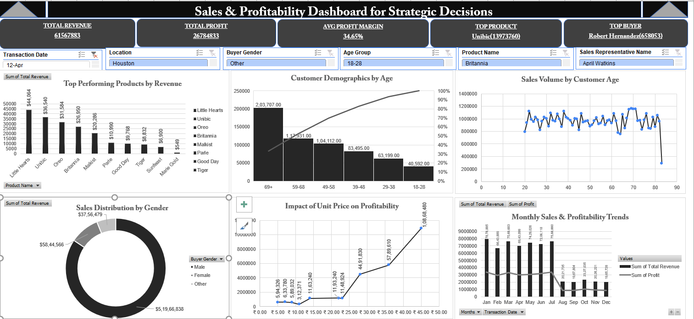
Boost Unibic: Increase marketing and stock for this top-selling product.
Retain Key Buyers: Launch VIP retention strategies for high-value client like Robert Hernandez.
Target Ads: Refine campaigns using age and gender demographic data.

