Slide 1

MARKETPLACE REVENUE LEAKAGE & GAP ANALYSIS USING SQL
Project Goal
Modern marketplaces often seen rising sales alongside declining profits due to hidden operational costs. This SQL project builds a comprehensive database analysis to pinpoint revenue leakage, evaluate discount impacts, and restore profitability margins.

Slide 2
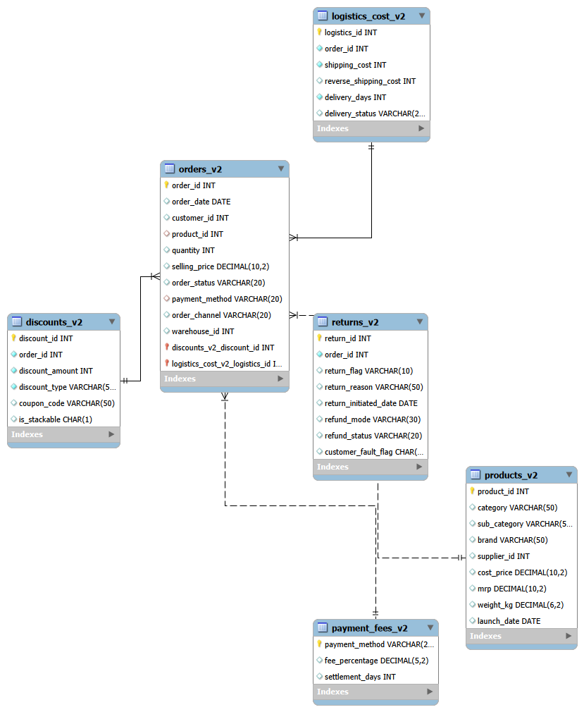
Marketplace Database Architecture (ER Diagram)
Project Objectives
This ER diagram maps a marketplace database to connect products, orders, discounts, logistics and fees. It is built to expose revenue leakage and maximize profit margins.

Slide 3
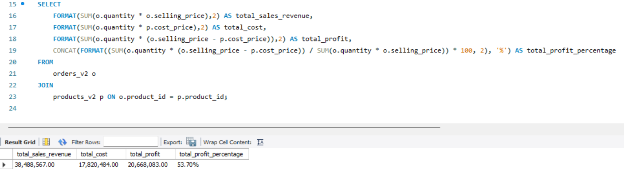
TASK – 1: Revenue vs Profit Reality
Business Insights & Strategic Recommendations
We have successfully verified that our high sales revenue ($38.4M) translates efficiently into actual profit ($20.6M). Because the business is genuinely making money-retaining over 53 cents of every dollar sold-we can safely scale marketing operations to capture more market share.

Slide 4
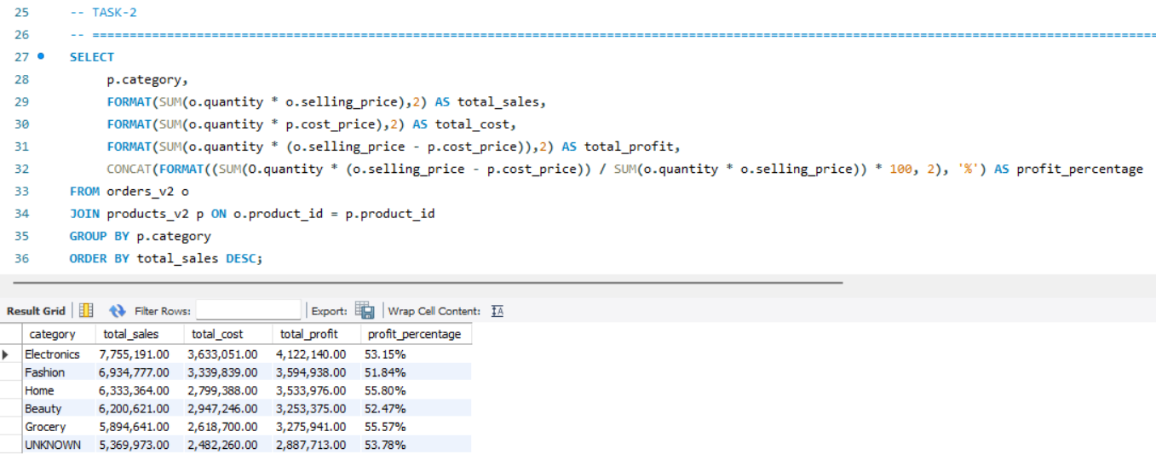
TASK – 2: Category-wise Sales & Profit
Sales and Profitability Insights & Recommendations
Electronics: Leading category with the highest sales ($7,755,191.00), highest profit ($4,122,140.00), and a 53.15%.
Home & Grocery: Lower sales volume but excellent efficiency, boasting the highest profit margins at 55.80% and 55.57%.
Fashion: Second in total sales ($6,934,777.00) but has the lowest profit margin (51.84%), indicating high cost or heavy disc.
Data Quality Alert: A massive $5,369,973.00 in revenue is trapped under UNKNOWN, requiring an immediate data audit.

Slide 5
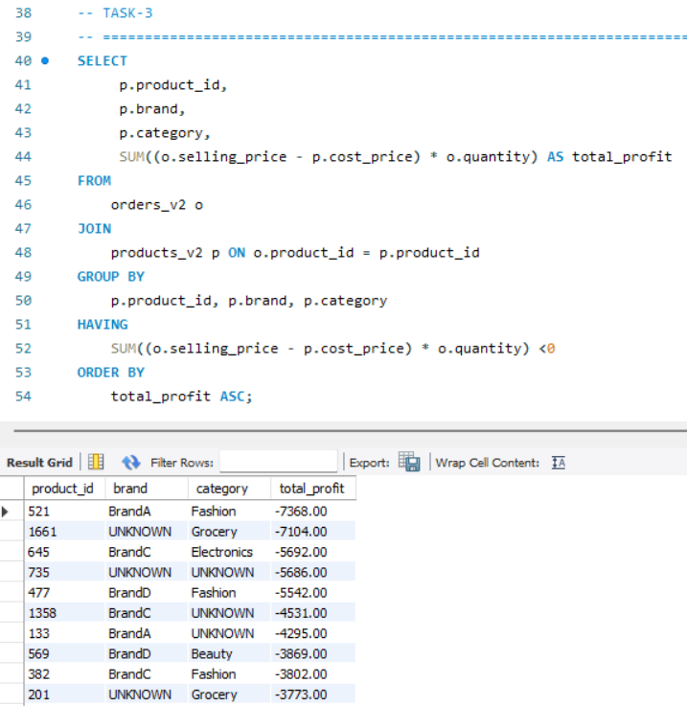
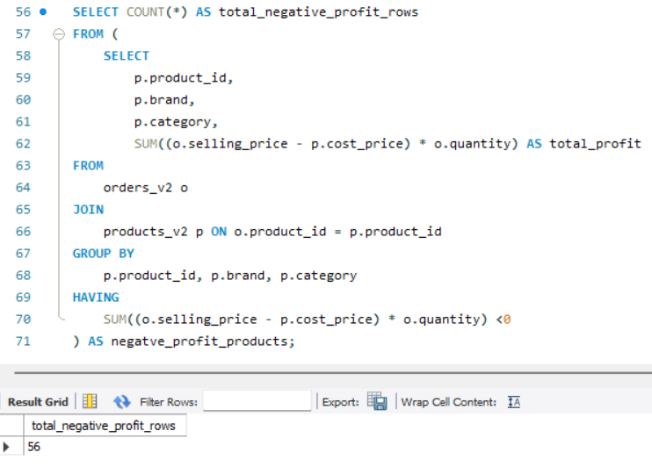
TASK – 3: Loss-Making Products
Project Insights & Recommendations
High Deficit: 56 unique SKUs are structurally unprofitable across Fashion, Grocery, and Electronics.
Top Revenue Drains: Product 521 (-7,368.00) and Product 1601 (-7,194.00) require immediate cost correction.
Data Quality Gaps: Missing vendor details (“UNKNOWN”) create blind sports for supplier accountability.
Reprice or Drop: Audit discount structures and base costs for the top 5 loss-making items.
Vendor Clean-up: Trace “UNKNOWN” brands to identify negative-margin suppliers.
Category Review: Investigate root causes for multiple leading loss-makers in the Fashion category.

Slide 6
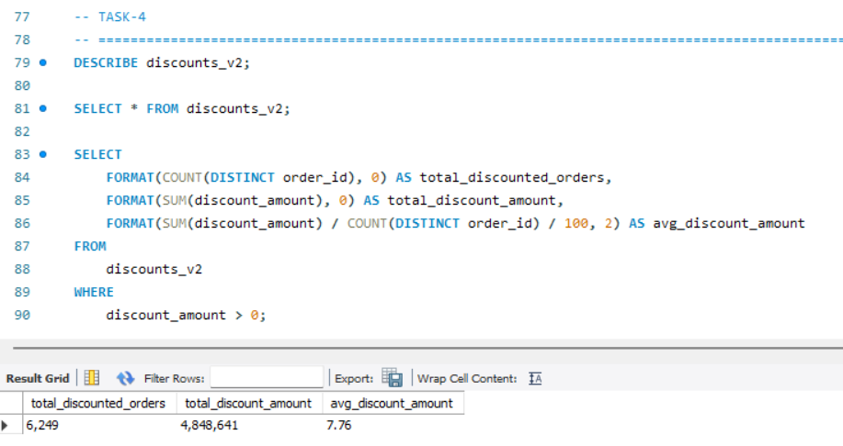
TASK – 4: Discount Usage Overview
Strategic Discount Recommendations
Based on the performance metrics showing 6,249 discounted orders and over 4.8M discount units used, here are the key recommendations to implement:
Optimize Thresholds: Test lowering the 7.76 average discount.
Measure ROI: Track if discount spending drives net revenue.
Perform Segment Analysis: Identify high-discount customer groups.

Slide 7
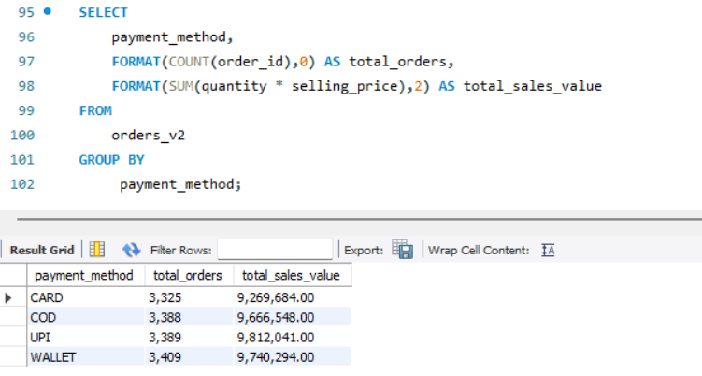
TASK-5: Payment Method Popularity
Data Cleaning
Three invalid records containing zero quantity and zero selling price, despite having ‘Delivered’ or ‘Shipped’ status, were removed from the “orders_v2” table before analysis. This helps prevent invalid transactions from affecting payment-method performance analysis.
Key Insights:
UPI: Highest revenue (9.81M).
Wallet: Highest volume (3,409 orders).
Cards: Lowest volume (3,325) and revenue (9.26M)
Preference: Balanced across all methods (~3.3k-3.4k orders).
Recommendations:
Promote UPI: Offer incentives for highest financial return.
Boost Cards: Use bank partnerships and cashback.
Optimize Wallet: Launch loyalty points for frequent users.
Maintain Gateways: Keep all four payment options active.

Slide 8
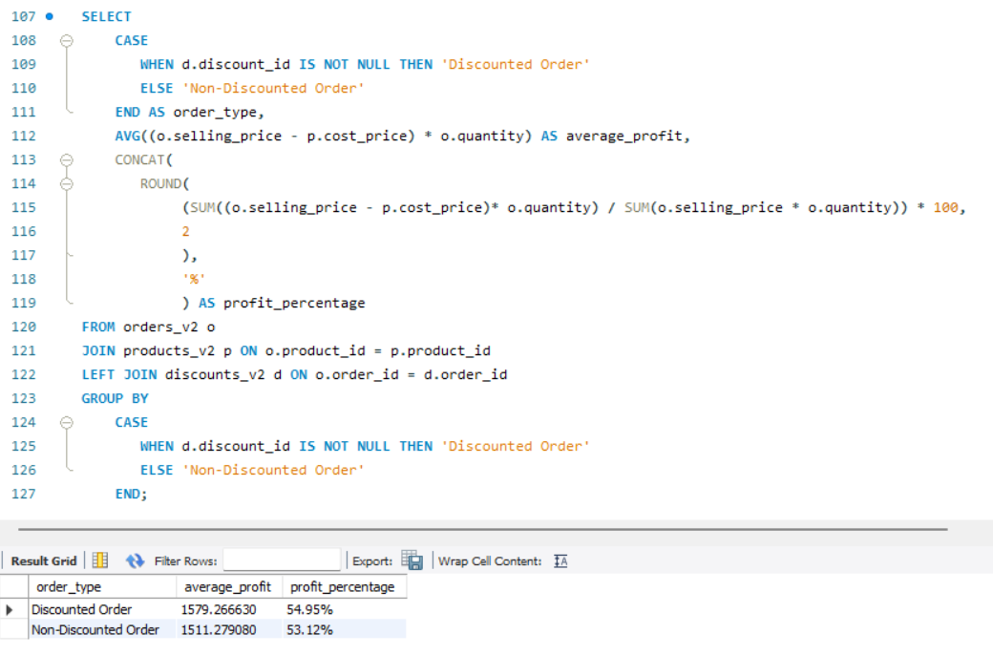
TASK-6: Discount vs Profit Gap
Strategic Pricing Insights & Recommendations
Expand Strategic Discounting: Scale up targeted promos-discounted orders yield a higher 54.95% profit margin vs. 53.12% for regular ones.
Incentivize Larger Baskets: Use discount thresholds-discounted transactions average 1,579.27 in profit vs 1,511.28 for non-discounted ones.
Optimize Product Bundling: Pair slower items with high-margin products to capture the 1.83% margin premium.
Audit Non-Discounted Pricing: Review standard pricing structures to find out why regular items lag behind discounted ones.

Slide 9
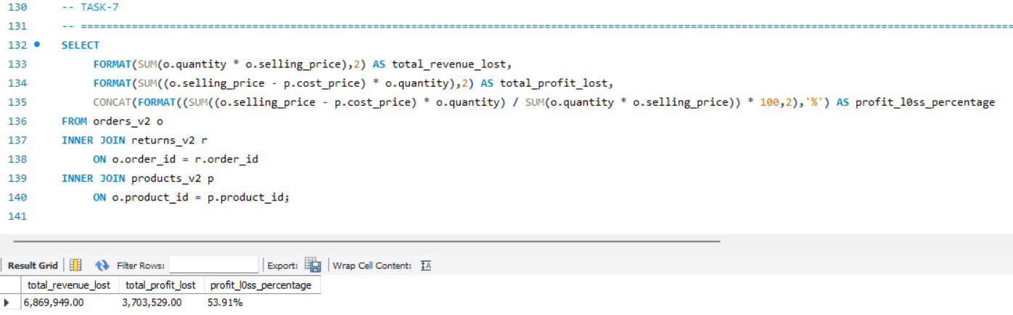
TASK-7: Return Impact on Revenue
Financial Impact
Revenue Loss: $6,869,949.00
Profit Loss: $3,701,529.00
Profit Margin Drop: 53.91% (caused by returns)
Strategic Recommendations
Audit high-return items: Identify and fix specific product quality or sizing defects.
Enhance product pages: Upgrade descriptions, size guides, and images to align customer expectations.
Optimize reverse logistics: Reduce processing costs to salvage margin from returned goods.
Tighten return policies: Restrict return windows or incentivize exchanges over full refunds.

Slide 10
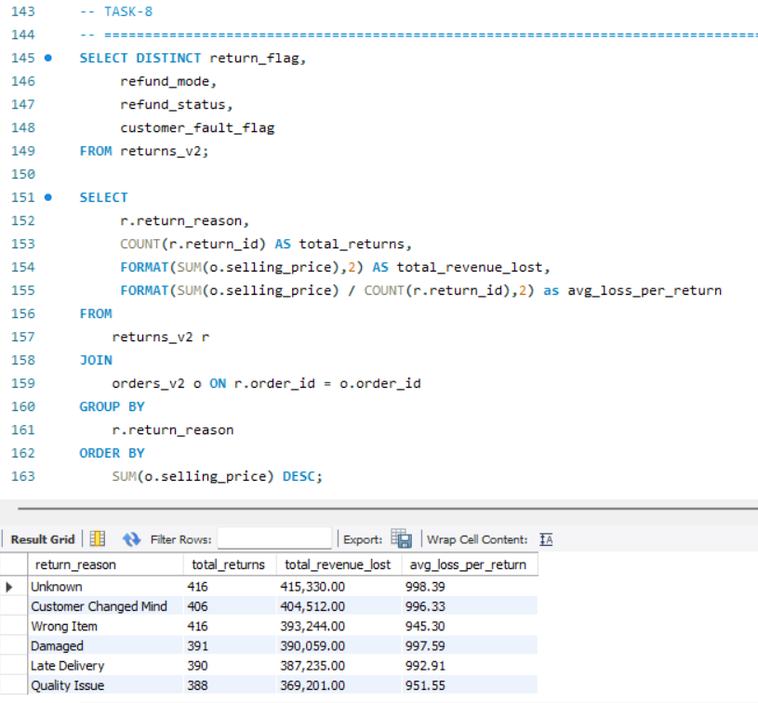
TASK-8: Return Reason Analysis
Data-Driven Recommendations
Investigate “Unknown” Returns: Mandatory surveys to fix 416 returns ($415.3k lost).
Engage Mind-Changing Customers: Targeted incentives to curb 406 returns ($404.5k lost).
Enhance Product Listings: Better sizing and 3D visuals to stop 416 returns ($393.2k lost).
Transit Damage Mitigation: Upgrade to robust protective packaging to stop 391 returns ($390.1k lost).
Optimize Delivery Logistics: Reliable carriers to prevent late delivery leaks ($387.2k lost).
Tighten Quality & Supplier Audits: Stricter quality/vendor checks to resolve 388 returns ($369.2k lost)

Slide 11
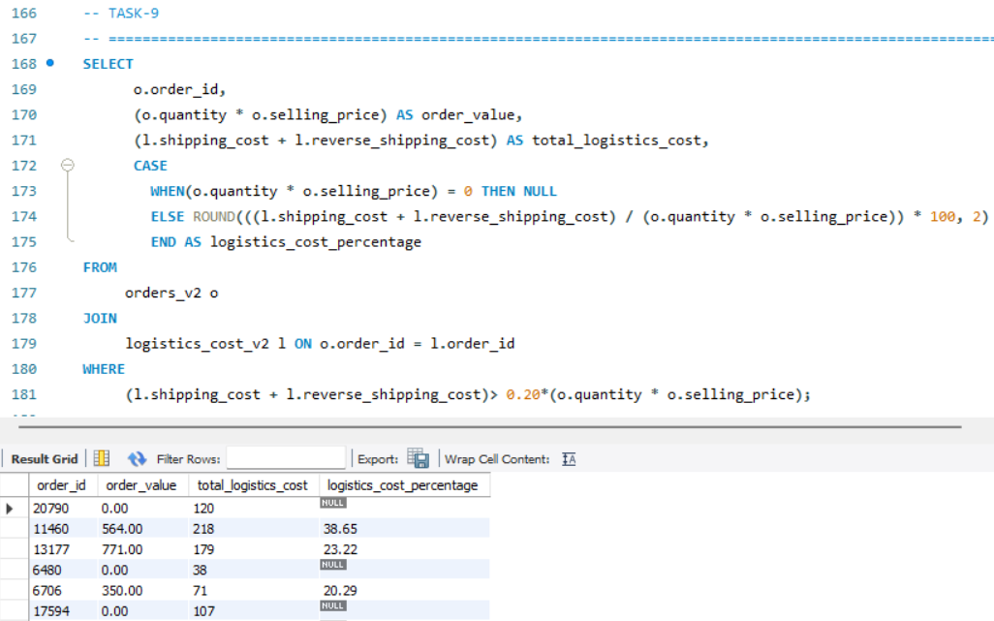
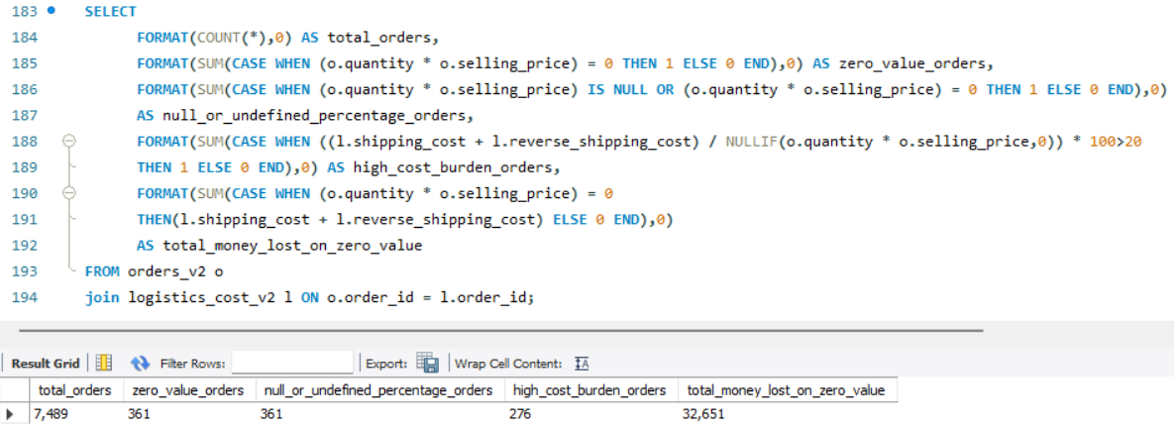
TASK-9: Logistics Cost Burden
Data Summary
Total analysed: 7,489 orders evaluated.
High-burden cost: 276 orders had shipping costs over 20% of product value.
Zero-revenue bleed: 361 orders generated zero revenue, draining 32,651 in logistics expenses.
Business Strategy Recommendations
Set Minimum Order Value: Stop low-value orders from hurting profits.
Revise Shipping Fees: Charge flat or dynamic fees when delivery costs are too high.
Audit Zero-Value Orders: Investigate why 361 orders had zero value.
Optimize Reverse Logistics: Fix return policies to cut high return shipping costs.
Adjust Category Pricing: Raise retail margins or bundle low-cost items together.

Slide 12
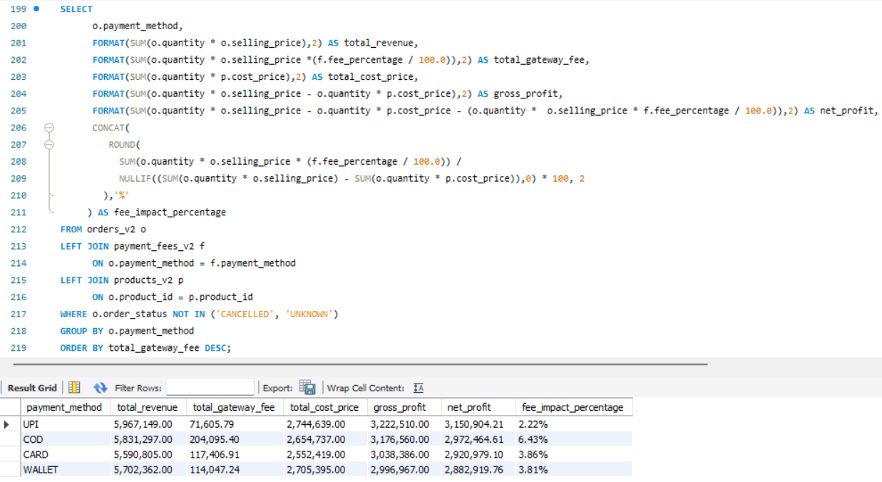
TASK-10: Payment Fee Leakage
Business Strategy Recommendations
Promote UPI heavily: UPI is your most profitable channel, yielding the highest net profit of 3,150,904.21 due to the lowest gateway fee (71,605.79) and lowest net profit impact (2.22%).
Optimize COD terms: COD causes the highest fee leakage at 204,095.40, reducing gross profits by a massive 6.42% down to a net profit of 2,972,464.61; consider adding a small convenience fee for cash collection.
Negotiate CARD and WALLET rates: Both methods carry similar moderate profit impacts (3.86% for CARD costing 117,408.91 in fees; 3.81% for WALLET costing 114,047.24); renegotiate terms with vendors to lower these transaction costs.

Slide 13
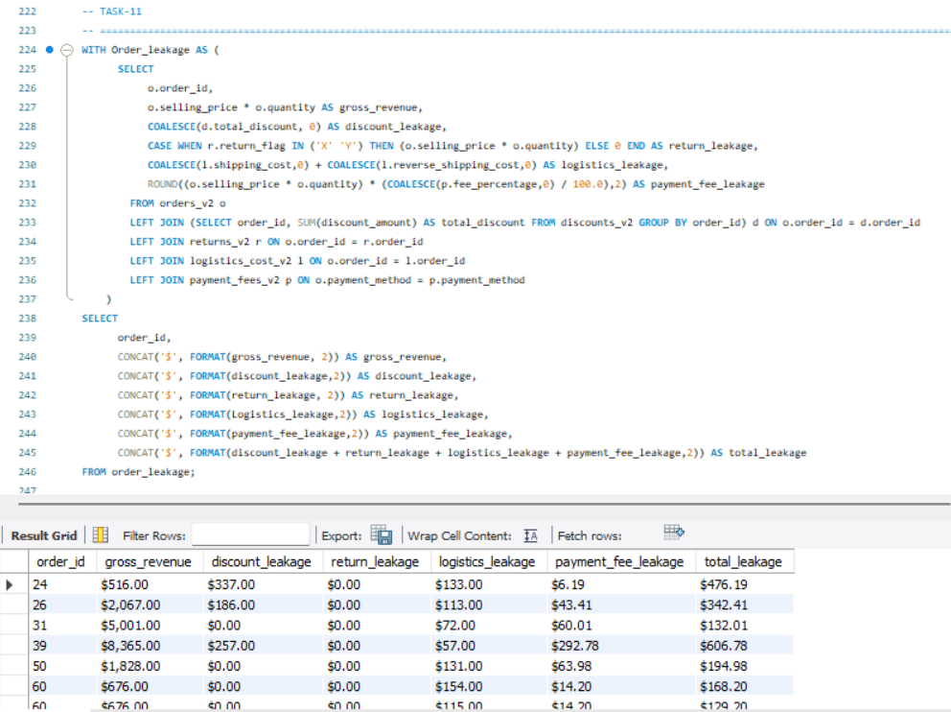
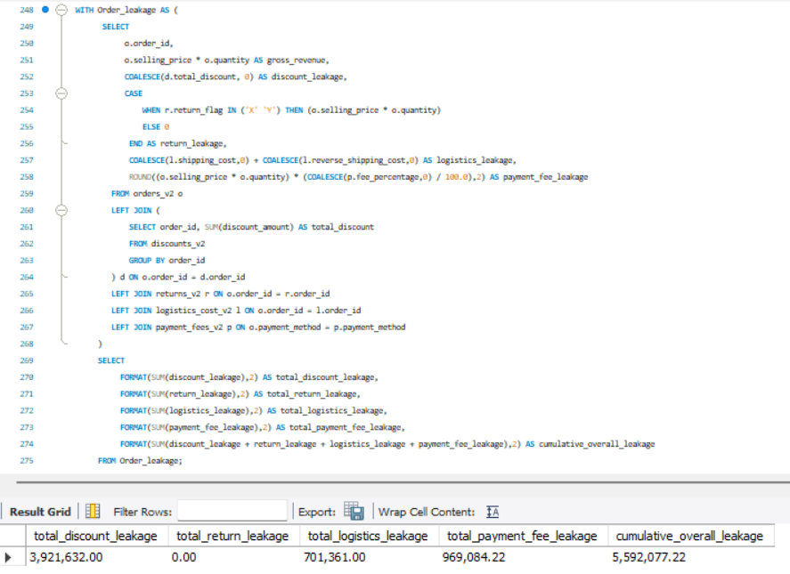
TASK-11: Revenue Leakage Breakdown
Strategic Recommendation for Revenue Leakage Mitigation:
Optimize discounts: Restructure aggressive promotions to fix discount leakage, the top loss driver at $3.92M(~70% of total).
Renegotiate payments: Audit gateway vendor terms to cut transaction fees, targeting the second-highest leakage at $969K.
Streamline logistics: Evaluate fulfilment routes and carrier contracts to save $701K lost to operational inefficiencies.

Slide 14
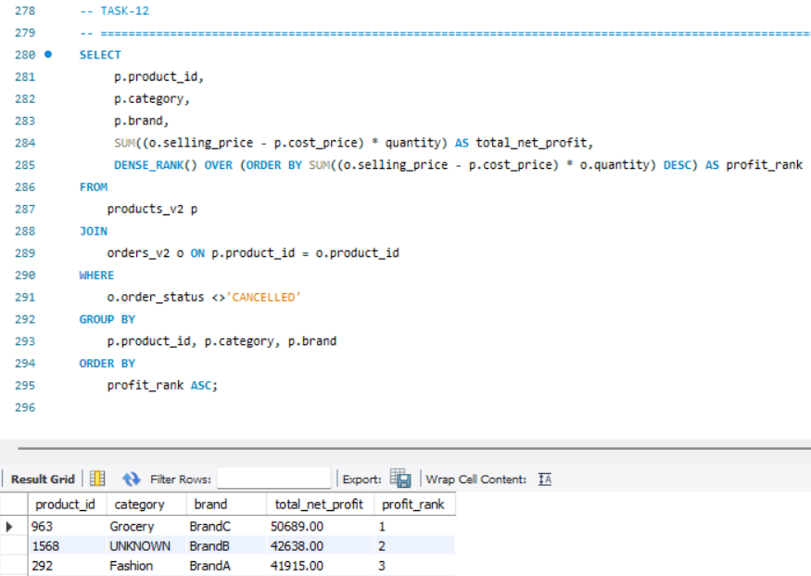
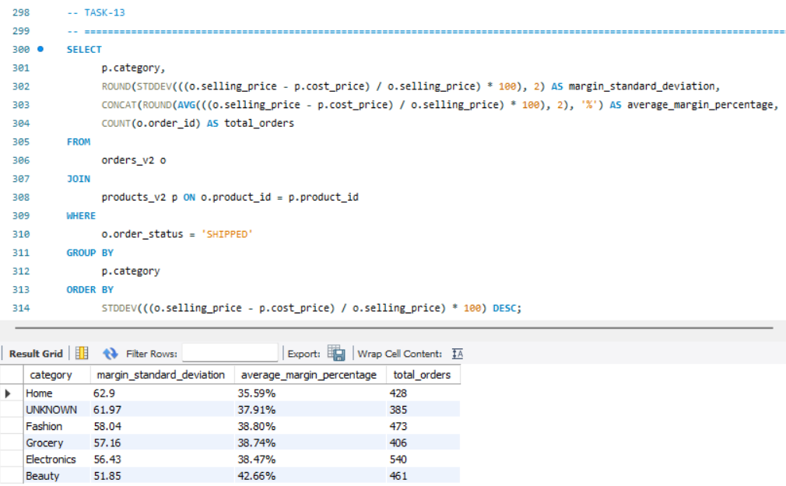
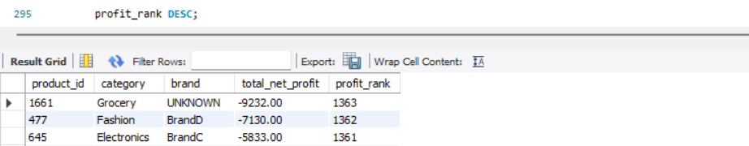
TASK-12 & 13: Product Profitability and Category Margin Stability
Strategic Profit & Margin Optimization Initiative
Stabilize Home Category Pricing: Address high margin volatility (62.9 SD) in the Home category to fix poor pricing control.
Capitalize on Beauty Margins: Scale Beauty products due to their superior and stable average margin (42.66%).
Eliminate Bottom-Performer Leaks: Liquidate or reprice top loss-making products like Product 1661 (-$9,232.00).
Double Down on Grocery Winners: Allocate more marketing spend to high-performing assets like Product 963 ($50,689.00).
Clean Data Anomaly Tracking: Investigate the UNKNOWN category to resolve missing brand and product tracking.

Slide 15
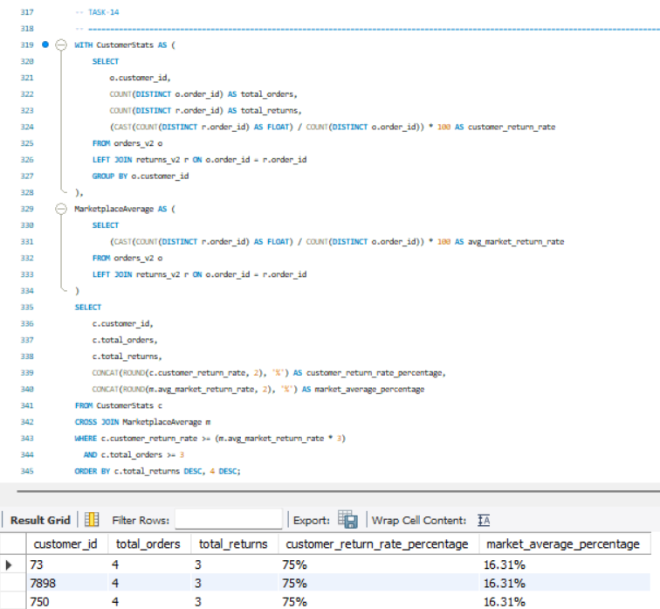
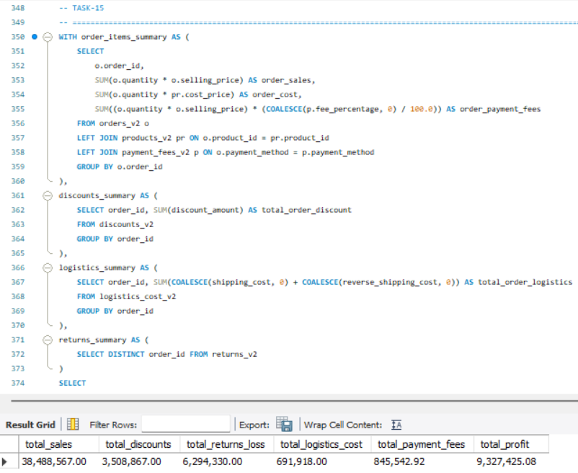
Task- 14 & 15: Customer Risk, Executive profitability & Project Conclusion
Project Conclusion & Results
Baseline Cohort: Screened 1,950 total customers and isolated 135 high-priority anomalies (>1 purchase).
Margin Impact: Captured $9.33M net profit on $38.49M gross sales (75.8% margin compression).
Drain Points: High-risk segments hit a 75% return rate, losing $6.29M in returns and $691.9K in logistics.
Fee Erosion: Top-line revenue reduced by $3.51M in discounts and $845.5K in processing fees.
Strategic Next Steps & Action Plan
Audit high-risk customer segments to tackle the high return rate and improve logistics.
Restrict active discounting rules to stop further margin loss and fee erosion.
Renegotiate processing fees to protect net profit margins.

