Slide 1

Aditya College of Engineering and Technology
DEPARTMENT OF ARTIFICIAL INTELLIGENCE
AND DATA SCIENCE
Subject Name | Mini Project | Subject Code | BCS586
Student Name | SUSHRITA.S | USN | 1DI24AD023
 | THANISHKA.H.G |  | 1DI24AD025
 | BINDHU.D.R |  | 1DI24AD003
 | HARSHITHA.A |  | 1DI24DS003
Domain | Cloud computing/DevOps | Group No:
Project Title | Cost-Aware Predictive Autoscaling Using Machine Learning for Kubernetes
Under taken at | Aditya College of Engineering and Technology
Notes:
<number>
Dept. of CSE, GAT 2017-18

Slide 2
Agenda
Introduction
Problem Statement
Literature Survey
Objectives
Expected Outcomes
Methodology/Architecture
Conclusions
References
Dept of AIDS,ACET 2026-27
<number>
Notes:
<number>
Dept. of CSE, GAT 2017-18

Slide 3
Introduction
Modern web applications run on cloud platforms such as Kubernetes, where each application is split into small units called pods. Every pod can handle only a limited amount of traffic and costs money while it runs. Autoscaling adds or removes pods automatically as traffic changes.
The default Kubernetes autoscaler, the Horizontal Pod Autoscaler (HPA), scales only after CPU or memory crosses a fixed threshold. Traffic in real applications follows patterns, such as a lunch rush on a food-delivery app or a deadline rush on an exam-registration portal. Because these patterns can be predicted, machine learning can help the system scale before the spike arrives.
This project builds a simple, explainable autoscaling system that predicts traffic and also considers cost and prediction confidence when deciding how many pods to run.
Dept of CSE,ACET 2025-26
<number>

Slide 4
Problem Statement
HPA is reactive. During sudden spikes (a flash sale, an exam-registration rush, a lunch surge), real users hit slowdowns or failures before new pods are ready.
Recent research uses machine learning to predict traffic and scale ahead of time. But these systems mostly optimize a single goal, avoiding slowdowns, and do not reason about the trade-off between two risks:
Scaling early or aggressively avoids slowdowns but wastes money on idle servers.
Scaling late or conservatively saves money but risks poor performance during real spikes.
There is no simple, explainable system that predicts traffic and picks the most cost-efficient number of pods while accounting for how confident the prediction is.
Dept of CSE,ACET 2025-26
<number>
Notes:
Dept. of CSE, GAT 2017-18
<number>

Slide 5
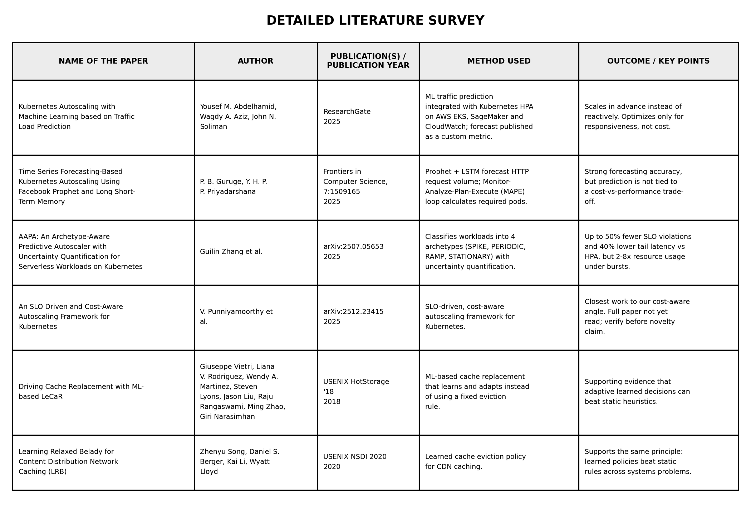
Literature Survey
Dept of CSE,ACET 2025-26
<number>

Slide 6
Objectives
Build a traffic forecasting module (Prophet baseline, optional LSTM) on synthetic traffic modeled after a real domain's usage pattern.
Design a cost-aware decision layer that outputs "scale to N pods" using predicted load, current pods, cost per pod, and prediction uncertainty.
Implement the system on Kubernetes and compare it against default HPA and simple ML-predictive scaling.
Measure performance and cost using pod count, load, SLO-violation time, and cost over time on a Prometheus + Grafana dashboard.
Show that the cost-aware approach reduces wasted spend without a large rise in slowdowns.
Dept of CSE,ACET 2025-26
<number>

Slide 7
Expected Outcomes
These are expected outcomes to be confirmed by the experiments, not results.
Compared with default HPA, predictive scaling should reduce slowdowns during sudden spikes.
Compared with simple ML-predictive scaling, the cost-aware layer should reduce idle pods and total cost while keeping performance within an acceptable limit.
The decision layer should be explainable: each scaling decision can be traced to the forecast, its confidence, and the cost model.
A working dashboard should compare the three strategies side by side.
Dept of CSE,ACET 2025-26
<number>

Slide 8
Methodology/Architecture
Data and workload. Generate synthetic traffic with daily rhythm and sudden spikes (for example, an exam-portal deadline rush or a lunch rush). Use k6 to replay it as load against a test application.
a) Traffic forecasting module. Train Prophet on historical synthetic traffic, with an optional LSTM for comparison. Prophet is interpretable and also gives an uncertainty range, which the next layer uses.
b) Cost-aware decision layer (novel contribution). Inputs are:
predicted load
current number of running pods
cost per additional pod (for example, ₹X/hour)
prediction confidence (the width of the forecast range)
Dept of CSE,ACET 2025-26
<number>

Slide 9
Output is the number of pods to run. One possible design is to compute the pods needed to serve the predicted load within a safe CPU target, then add a safety margin that grows when the forecast is uncertain and shrinks when it is confident. The margin is weighed against the pod cost, so the layer does not over-provision. Exact rules should be settled during implementation.
c) Evaluation dashboard. Prometheus collects pod count, CPU and request metrics, and Grafana plots pod count, load, and cost over time. It compares three strategies:
Default reactive HPA (baseline)
Simple ML-predictive scaling (existing approach)
Cost-aware predictive scaling (our contribution)
Evaluation metrics. Time above the CPU or latency target (SLO violation), average pods, total pod-hours cost, and scaling lag during spikes.
Tooling. Kubernetes (for example Azure AKS or a local cluster), k6, Prometheus, Grafana, and Python for forecasting
Dept of CSE,ACET 2025-26
<number>

Slide 10
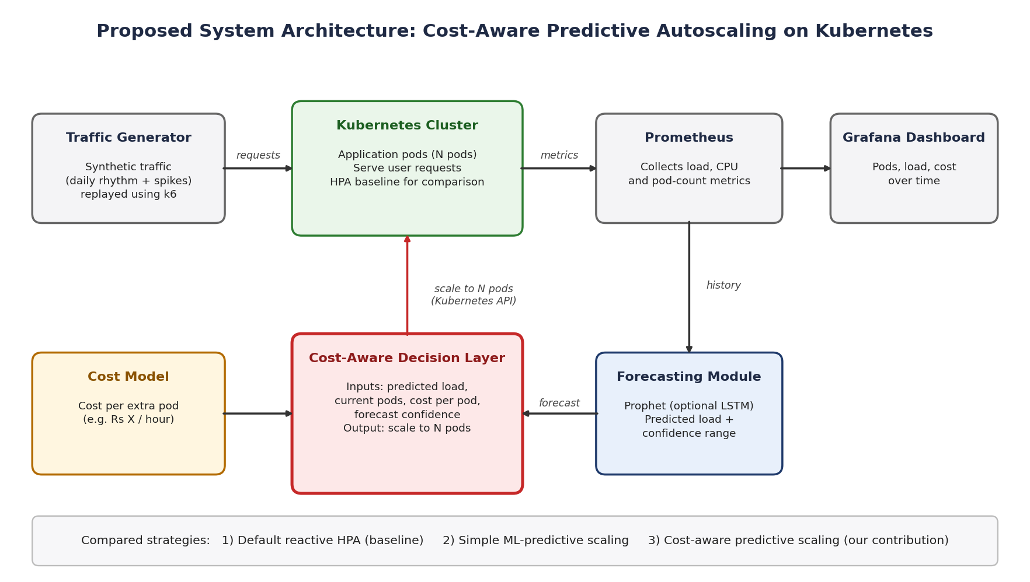
Sample : Architecture
Dept of CSE,ACET 2025-26
<number>

Slide 11
Conclusions
Reactive HPA leaves users exposed during sudden spikes, and existing predictive autoscalers mostly ignore the cost side of the decision. This project proposes a forecasting module with a cost-aware decision layer that turns a prediction and its confidence into a specific pod count. Its aim is to balance performance and cost in an explainable way. Once experiments are complete, this section should state the measured savings and SLO results against HPA and simple predictive scaling, along with limitations such as synthetic data and a small test cluster.
Dept of CSE,ACET 2025-26
<number>

Slide 12
References
Y. M. Abdelhamid, W. A. Aziz and J. N. Soliman, “Kubernetes Autoscaling with Machine Learning based on Traffic Load Prediction,” ResearchGate, 2025.
P. B. Guruge and Y. H. P. P. Priyadarshana, “Time Series Forecasting-Based Kubernetes Autoscaling Using Facebook Prophet and Long Short-Term Memory,” Frontiers in Computer Science, vol. 7, Art. 1509165, 2025.
G. Zhang et al., “AAPA: An Archetype-Aware Predictive Autoscaler with Uncertainty Quantification for Serverless Workloads on Kubernetes,” arXiv:2507.05653, 2025.
V. Punniyamoorthy et al., “An SLO Driven and Cost-Aware Autoscaling Framework for Kubernetes,” arXiv:2512.23415, 2025.
G. Vietri et al., “Driving Cache Replacement with ML-based LeCaR,” in Proc. USENIX HotStorage, 2018.
Z. Song, D. S. Berger, K. Li and W. Lloyd, “Learning Relaxed Belady for Content Distribution Network Caching,” in Proc. USENIX NSDI, 2020.
S. J. Taylor and B. Letham, “Forecasting at Scale,” The American Statistician, vol. 72, no. 1, pp. 37–45, 2018.
S. Hochreiter and J. Schmidhuber, “Long Short-Term Memory,” Neural Computation, vol. 9, no. 8, pp. 1735–1780, 1997.
B. Burns, B. Grant, D. Oppenheimer, E. Brewer and J. Wilkes, “Borg, Omega, and Kubernetes,” ACM Queue, vol. 14, no. 1, pp. 70–93, 2016.
Kubernetes Documentation, “Horizontal Pod Autoscaling.” https://kubernetes.io/docs/tasks/run-application/horizontal-pod-autoscale/
Prometheus Documentation (https://prometheus.io/docs/) and Grafana k6 Documentation (https://grafana.com/docs/k6/).
Dept of CSE,ACET 2025-26
<number>

Slide 13
Thank You
Dept of CSE,ACET 2025-26
<number>

