Slide 1

Analysis of Walmart Sales Data

Slide 2

Outline
Aim of the Study
Exploratory Data Analysis
Prediction of sales using:
Linear Models
Non Linear Models
Time Series Models

Slide 3
Aim of the Study
To forecast sales based on the given variables.

Slide 4
Exploratory Data Analysis

Slide 5
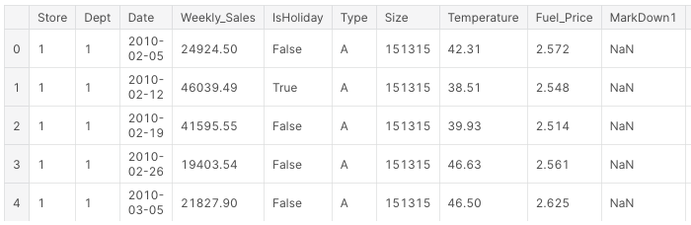
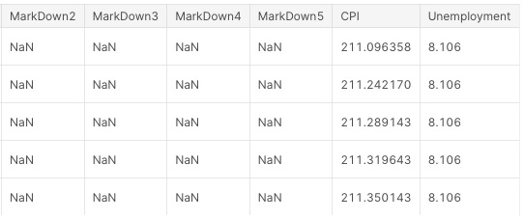

Looking at the data

Slide 6
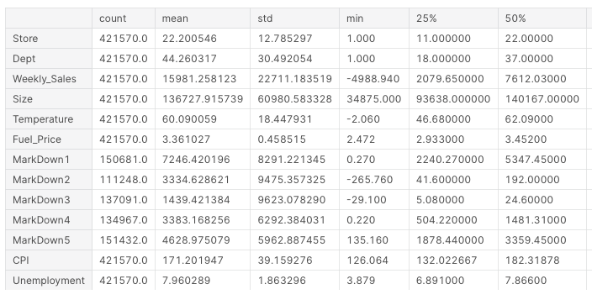
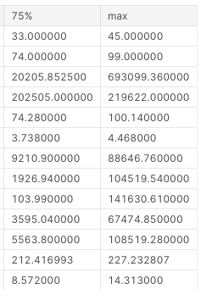
Looking at the data

Slide 7
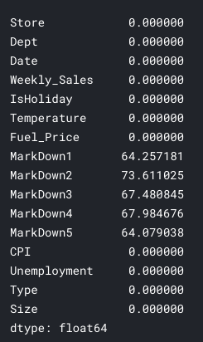
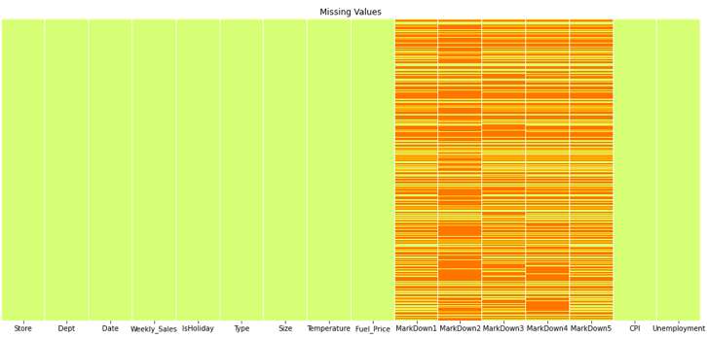
Missing Values

Slide 8
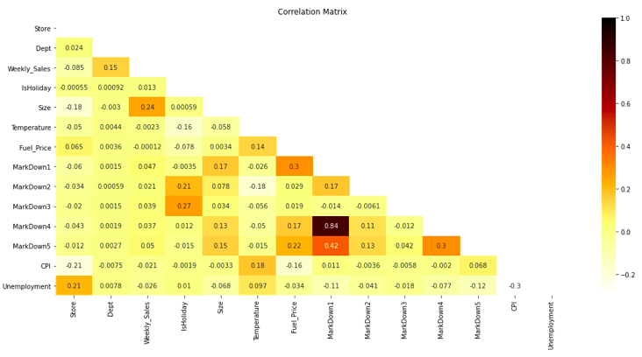
Correlation analysis

Slide 9
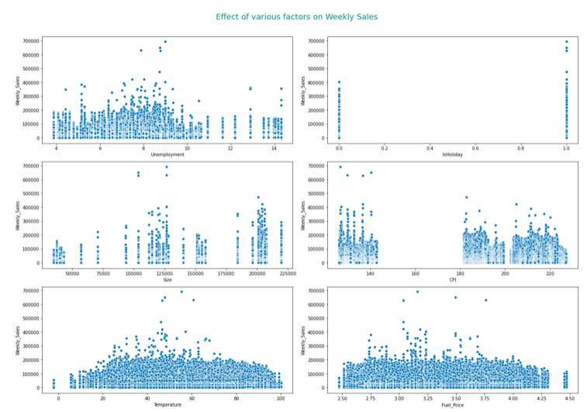
Scatter plot

Slide 10
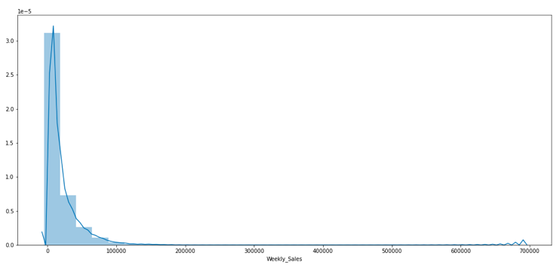
Distribution of Weekly Sales

Slide 11
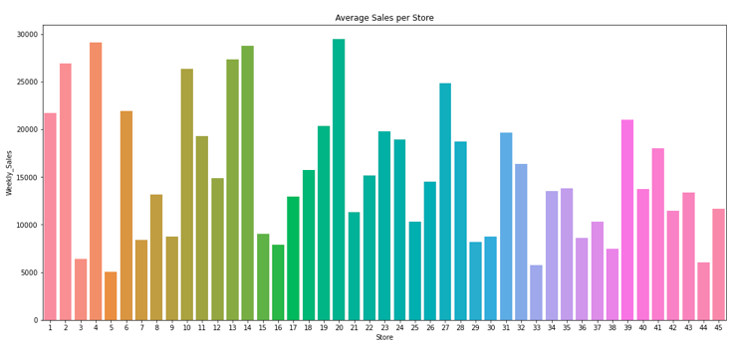
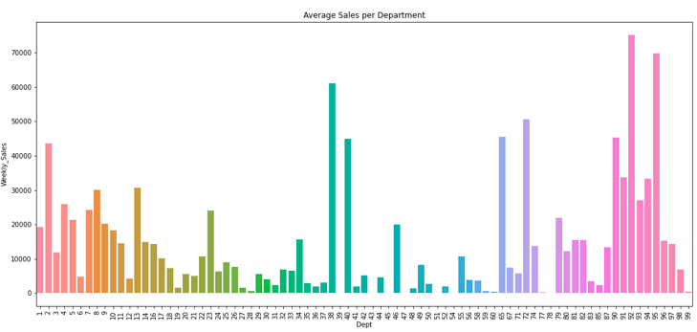
Average sales per Department and Store

Slide 12
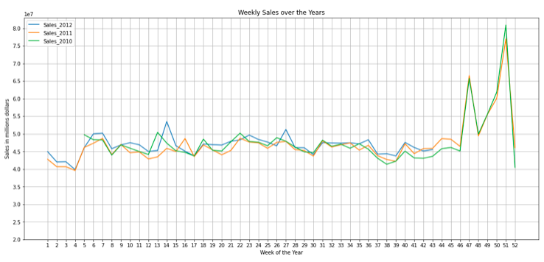
Weekly Sales over the years

Slide 13
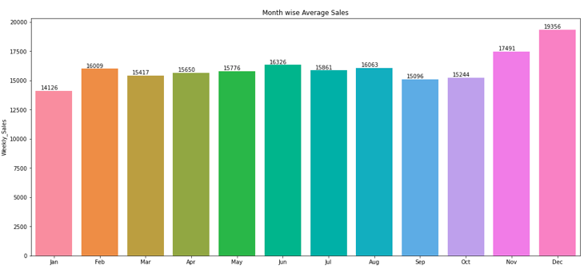
Month wise Average Sales

Slide 14
Prediction of Weekly sales

Slide 15
Prediction of weekly sales using Linear Models
 | Bias Error | Variance Error | Coefficient of Variance
Linear Regression | 22010.21 | 2537.61 | 0.12
Ridge Regression | 22007.24 | 2541 | 8.66
Lasso | 21914.61 | 2651.77 | 8.26
ElasticNet | 21672.02 | 3016.57 | 7.18

Slide 16
Prediction of weekly sales using Linear Models
 | Bias Error | Variance Error | Coefficient of Variance
Linear Regression | 22010.21 | 2537.61 | 0.12
Ridge Regression | 22007.24 | 2541 | 8.66
Lasso | 21914.61 | 2651.77 | 8.26
ElasticNet | 21672.02 | 3016.57 | 7.18

Slide 17
Prediction of weekly sales using Non Linear Models
 | Training Adj R^2 | Testing Adj R^2
DT Base Model | 100 | 90.71
DT Tuned Model | 82.39 | 82.14
RF Base Model | 99.28 | 95.02
RF Tuned Model | 91.45 | 90.63
Gradient Boost | 74.49 | 74.14
XGBoost | 93.04 | 91.83
KNN | 88.51 | 82.65

Slide 18
Time Series Analysis

Slide 19
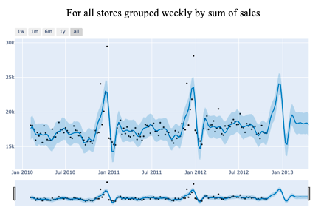
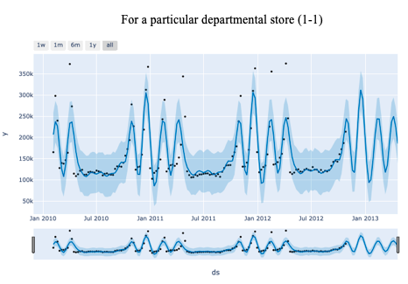
Time Series Analysis - Prophet

Slide 20
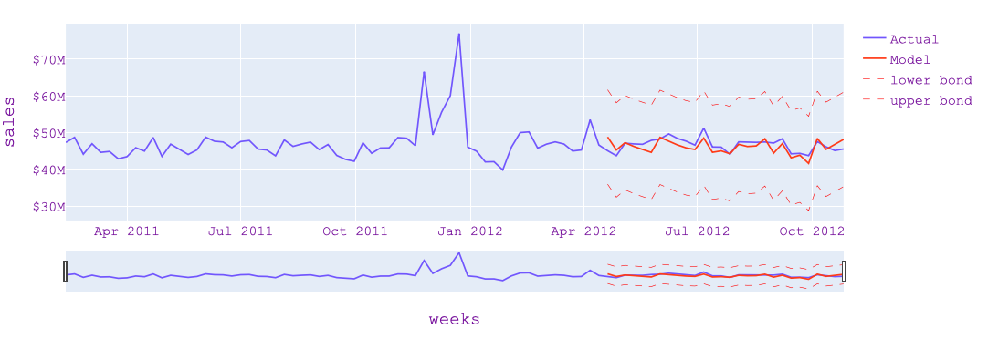
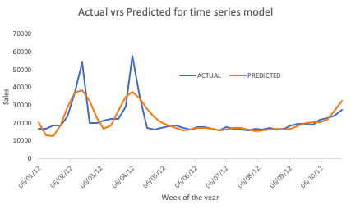
Time Series Analysis - SARIMA

Slide 21
Thank you

