Slide 1

Generative AI Hackathon
Group-6
Mareddy Sushruth Reddy
Heswanth Sypireddy
Sohail Mohammad
Sai Prakash
© Copyright 2023 Merilytics

Slide 2
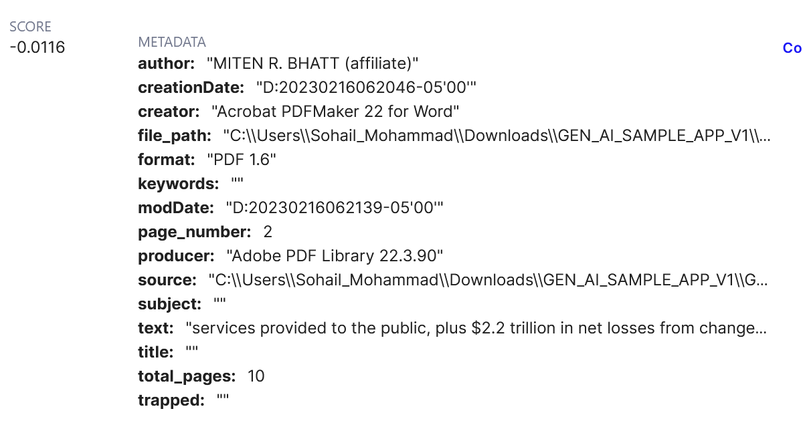
Implementation Flow
START
>
>
>
>
FINISH
Importing the required libraries
Loading files
Chunking and loading
Retrieval and getting results
Display Result
Langchain, pinecone, Openai, pymupdf, Recursivecharactertextsplitter, text-embedding-ada-002
,openAi.chatcompletion
Used PyMuPDFLoader to load the files as documents in to the langchain with metadata
Chunking documents using Recursive splitter, embedded using openai embeddings and loaded vectors into pinecone
Created embedding of the user query and queried VDB to fetch top chunks. Created augmented query with context and used as a query for LLM
used Flask to create an API Server and used Streamlit to create webpage UI for user querying
Sample data of a chunk from VDB Index, it also includes metadata like Title, Page Number, Source etc.

Slide 3
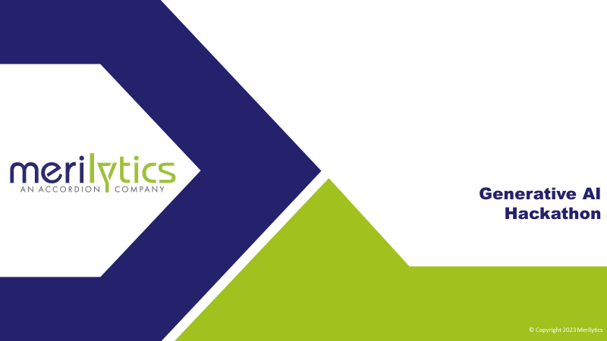
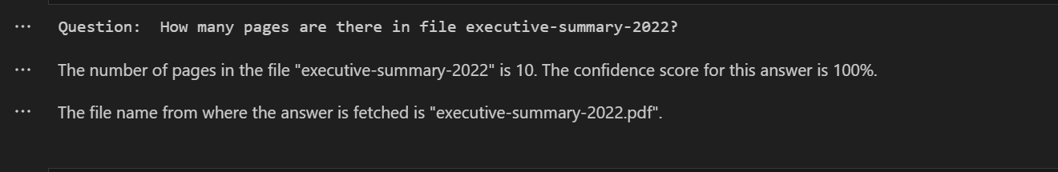
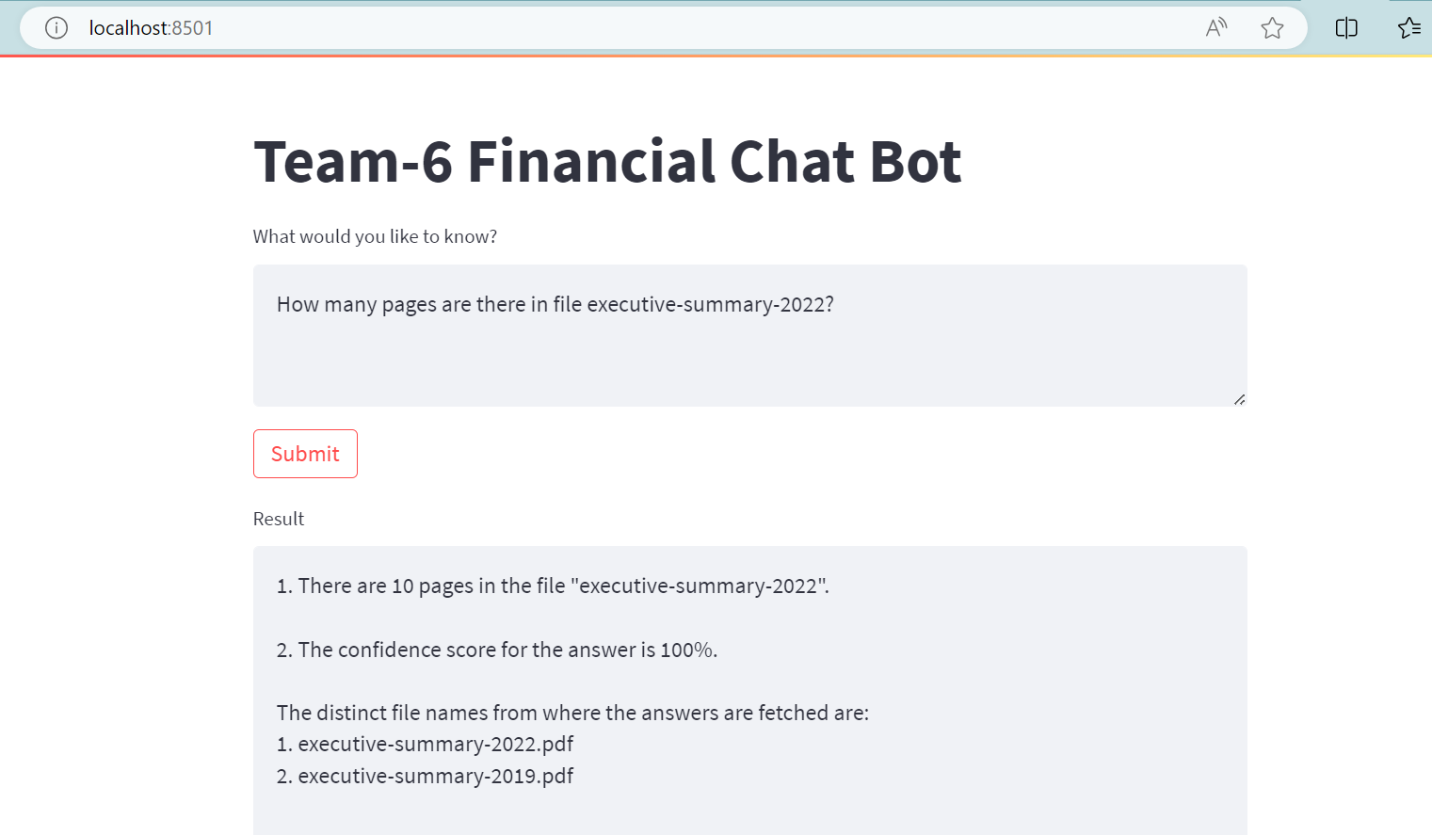
Question-1
Ability to query the metadata from a document and gather meaningful insights from the sources, types of documents etc

Slide 4
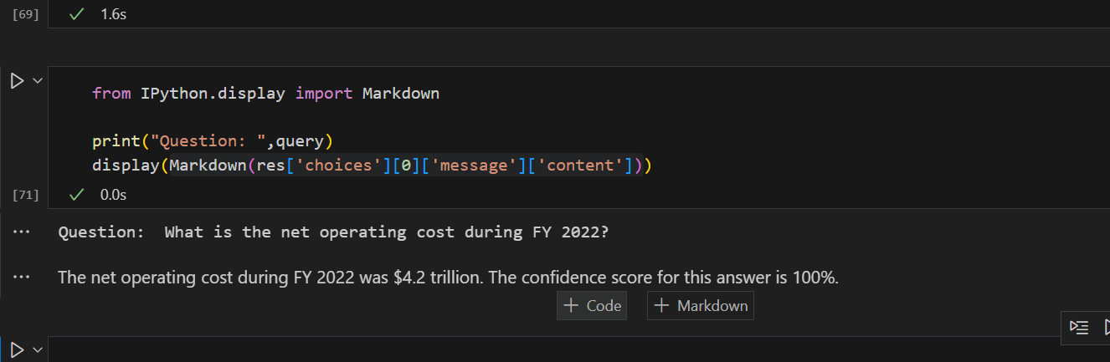
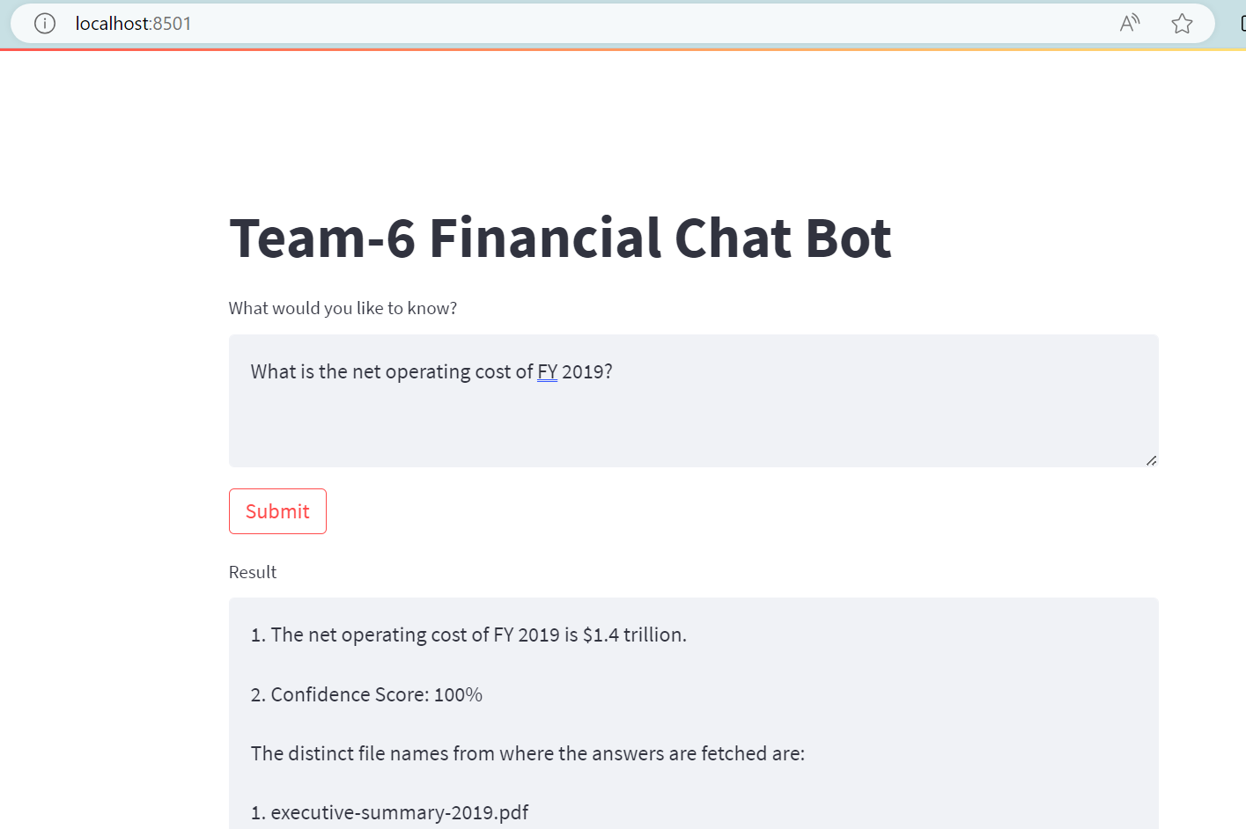
Question-2
Ability to respond to queries on a document from the data repository with the response showing confidence score and relevant source document from where the answer was deduced from.

Slide 5
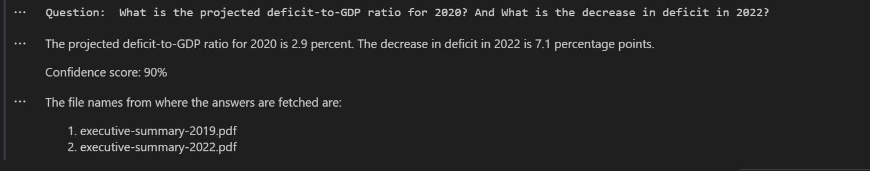
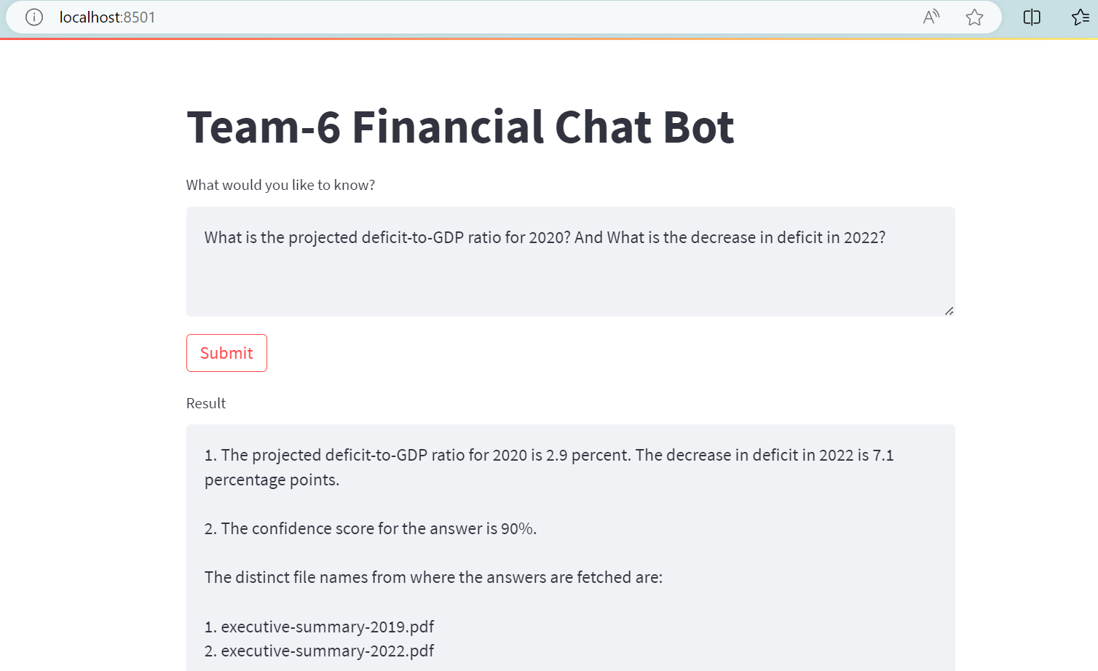
Question-3
Ability to respond to queries that require making inferences and connecting information from multiple documents.

Slide 6
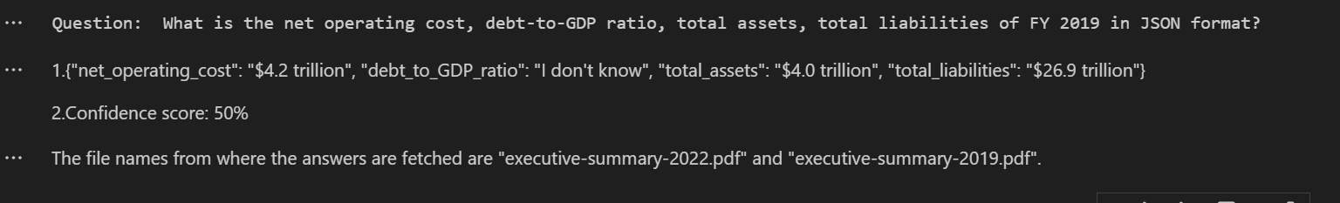
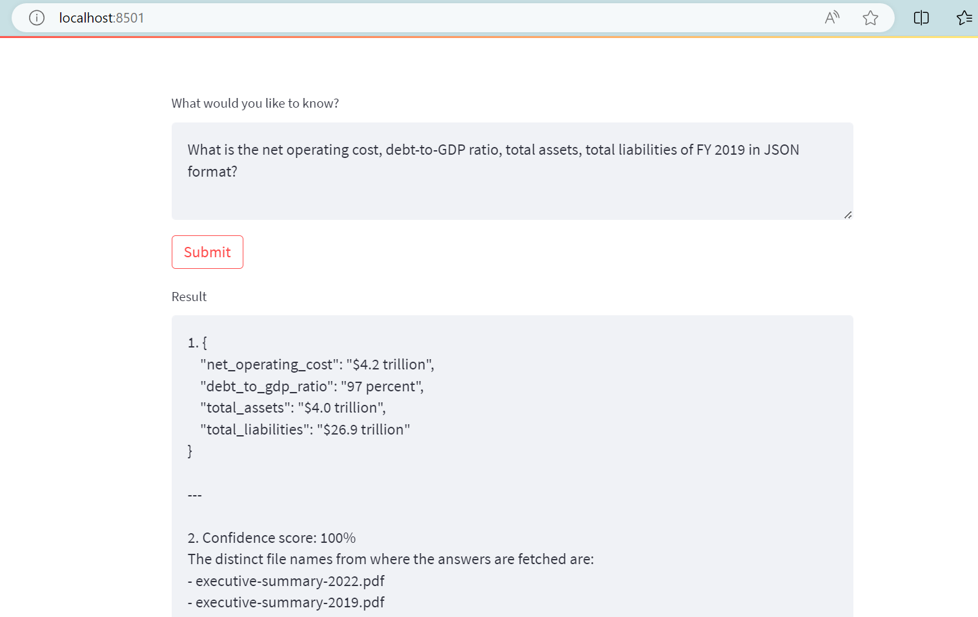
Question-4
Ability to extract specific information in a standard format. Eg: JSON

