Slide 1
The C0de Diaries
What is a C0de Diary?
For experienced software developers
Technical topics condensed into intense slides
Each deck not more than 15 slides
Acts as companion to WWW information and reference books
Also serves as a refresher resource for a crash course

Slide 2
February 2014 - contents
What is Django? HOWTO build a webapp in Django (overview)
Django components/features
Making a django project
FAQs
Misc
How are url requests translated to a View?
How do Views & Templates exchange info?
Related topics to dive into for webapp prog.

Slide 3
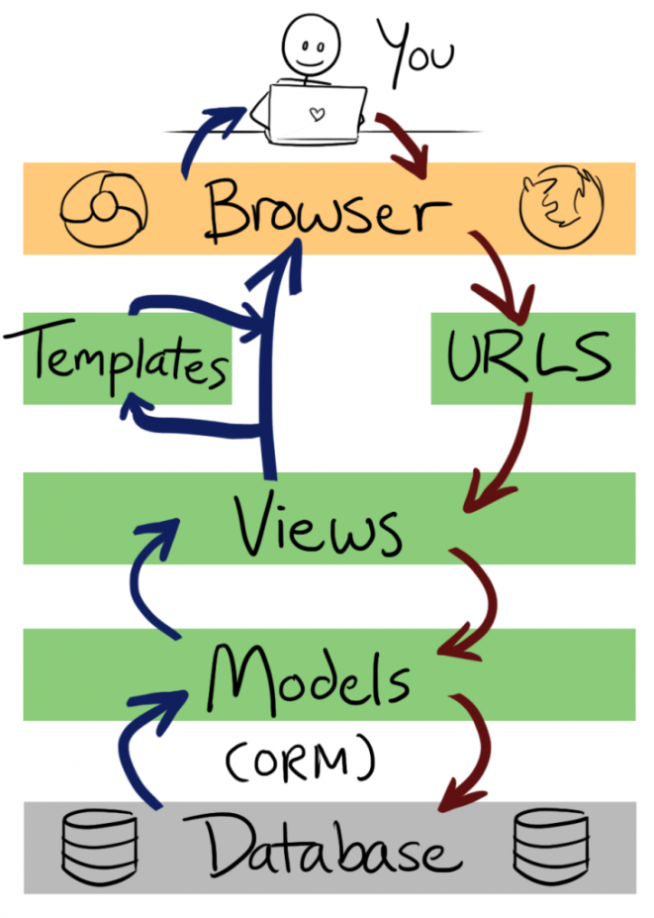
What is Django?
A python based web app development framework
Designed to automate / highly abstract common web app development tasks
Real world web apps can be built in days ready for production runs
Follows MVC pattern (though not in the strictest sense)
Some well known Django sites – Pinterest, Instagram, Mozilla, Washington Times
Competing fwk’s/tech – Ruby on Rails, Java based (Grails, Spring, Struts), PHP based (Symfony, CodeIgnitor)
Typical webapp arch in django
5. Templates contain html files that are referred to in views.py. They render the final html and css alongwith data passed to it by views.
1. Browser requests a url
2. Intercepted via some ‘magic’ and requested url comes to urls.py which redirects to the view (via a regex mapping) responsible for completing the http response
Typical steps for building a webapp. Details here:
Create project using manage.py
Finalize db (sqlite/mysql/…)
Finalize app container (apache /..)
Configure app settings to use your chosen db and app container
Design your model & write models.py
Install model (db sync)
Design urls / navigation scheme and write url.py
Write your views – views.py
Design templates and write html’s & css’s
Test using run server
Deploy on runtime environment
iterate 5-11 ad nauseam
Html’s
urls.py
3. View parses requests + i/p params if any and interacts with the model to form raw response data. Then passes this response data to a template (html)
views.py
models.py
4. Data repository model. Interacts with the actual db via an orm layer. This is where the data resides.
Image src - http://littlegreenriver.com/weblog/2013/03/23/django-for-designers/

Slide 4
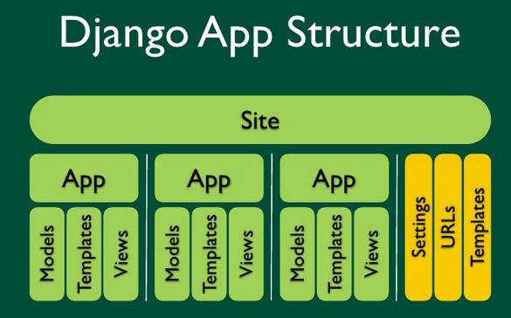
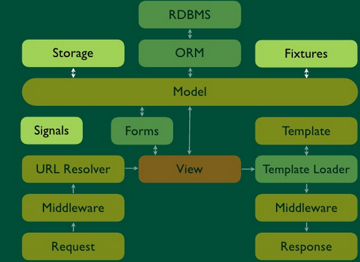
Django components/features
ORM to map between models and db
View – process requests with a web templating system
Regex based url dispatcher
Lightweight standalone webserver for app testing
Caching framework
Html form serializer and validator
Support for middleware classes to intervene at various stages in the django request processing pipeline to carry out custom functions
I18ln system
Serialization system which can produce and read XML and/or JSON representations of Django model instances
System for extending the capabilities of the template engine
Interface to Python's built in unit test framework
Django design philosophy-https://docs.djangoproject.com/en/1.6/misc/design-philosophies/
Image src - http://www.slideshare.net/ryates/jumpstart-django

Slide 5
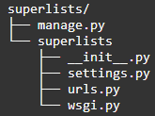
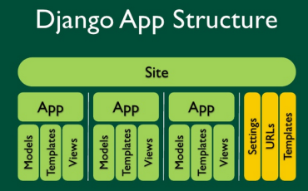
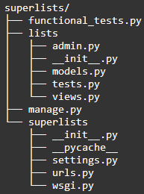
Making a django project*:
Django provided utility for admin tasks-https://docs.djangoproject.com/en/1.6/ref/django-admin/
Project name
Assumption – your dev env is ready (django,mysql,vim,apache)
Create a new django project:
This will create such a folder structure:
Create webapp in the superlists project:
This will create the following folder structure:
manage.py-wrapper around admin.py,use for runserver, django enbaled py shell
Has stuff applicable to whole project
settings.py-global config for whole site
Webapp name
Data Models in lists
Views in lists
Unit tests
Encodes wsgi – the py std for web server and web app communications. Can be used to deploy your web app in different web servers and app containers. Details - https://docs.djangoproject.com/en/1.6/howto/deployment/wsgi/
Base project (superlists) mapping. This will direct queries to lists webapp to a yet-to-be created urls.py in lists
The o/p will tell you where the site is hosted and url to navigate to it
6. Run the website using: “python manage.py runserver”
*Tutorial src - http://chimera.labs.oreilly.com/books/1234000000754/

Slide 6
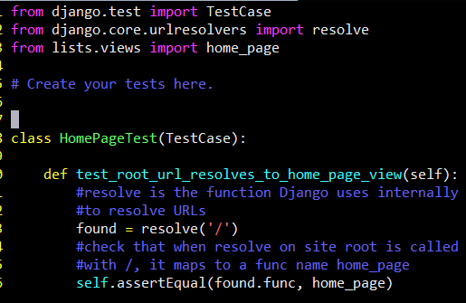
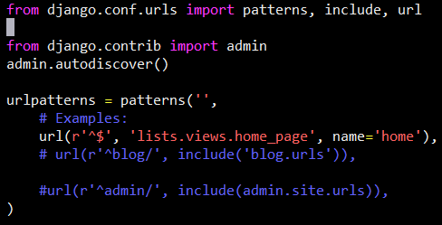
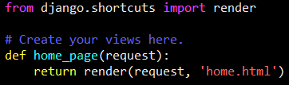

Making a django project-2 (simplest e.g.)
Tests.py can be called from shell using “python manage.py test”. This is the dev alternative to run individual test cases which implicitly creates a test db for the model. Of course, we will actually system test using the website url.
1
/lists/tests.py
/lists/tests.py
resolve is the actual function Django uses internally to resolve URLs, and find what view function they should map to. This will tell django to goto urls.py and search for a regex mapping of ‘/’ to some view.
Django will search for a func named home_page in views.py and throw an error if not found
3
/lists/views.py
/superlists/urls.py
Maps ‘/’ to a func called home_page in /lists/views.py
Django will try to find ‘home.html’ in/lists/templates
NOTE- our app MUST be registered with django for 1 to 4 to work. Do it in /superlists/superlists/settings.py::INSTALLED_APPS
/lists/templates/home.html
2
4

Slide 7
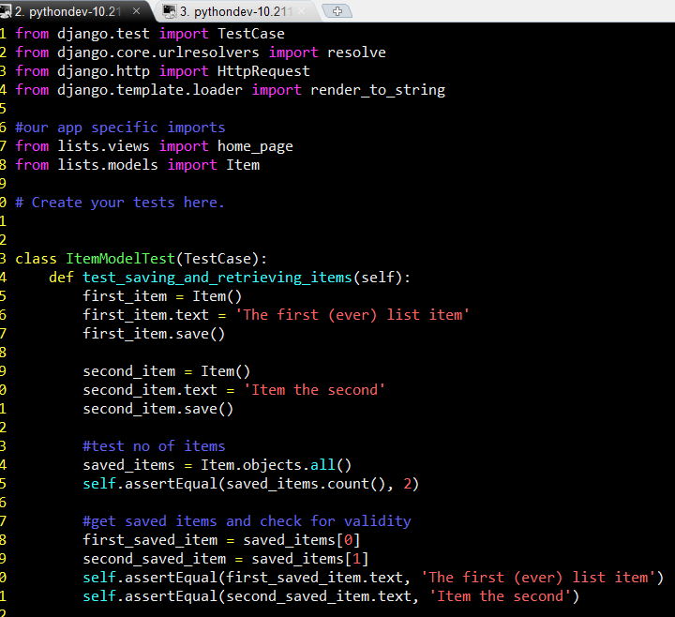
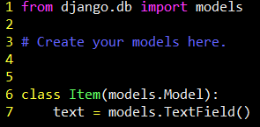
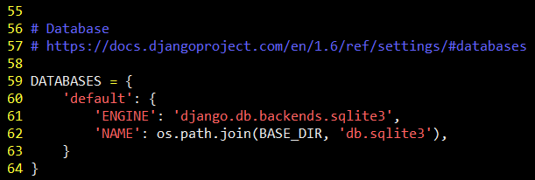
Making a django project-3 – add a simple model
1
/lists/tests.py
/lists/models.py
Import ‘Item’ from ‘models’. This essentially means that our model contains a class named Item (in models.py).
‘Item’ has to have a member called text. This becomes a column in the db table Item.
Class Item inherits from models.Model which gives it access to save() (as called in tests.py)
2
$python manage.py syncdb
After writing the model in models.py, make sure that you run this cmd. It will actually create the db instance in the db specified in superlists/settings.py
Creating a new record in the db:
Create an object
Assign attributes to it
Call save()
/superlists/settings.py
.all allows querying the db table for all items (here ‘Item’). Results are in a list like object called QuerySet

Slide 8
FAQ’s
Key tech doc - http://django.readthedocs.org/en/1.6.x/
Django design philosophy- http://django.readthedocs.org/en/1.6.x/misc/design-philosophies.html
Web dev essentials - http://chimera.labs.oreilly.com/books/1234000000754/ch07.html
How to directly call a django based webapp’s REST api’s?
How to plug in a db apart from sqlite? (e.g. mysql, postgreSql, non sql db’s etc)
How to tailor a website to multiple clients – desktop/laptop as well as mobile devices?
How to test for – scalability and performance when using fwk’s like django?
Deploying django based sites:
http://chimera.labs.oreilly.com/books/1234000000754/ch08.html
http://www.rdegges.com/devops-django-part-1-goals/

Slide 9
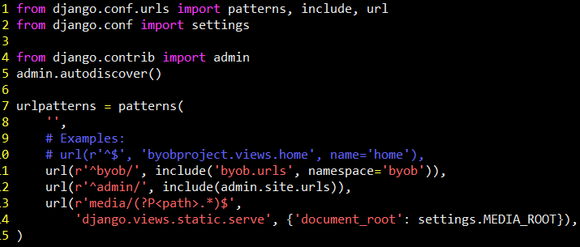
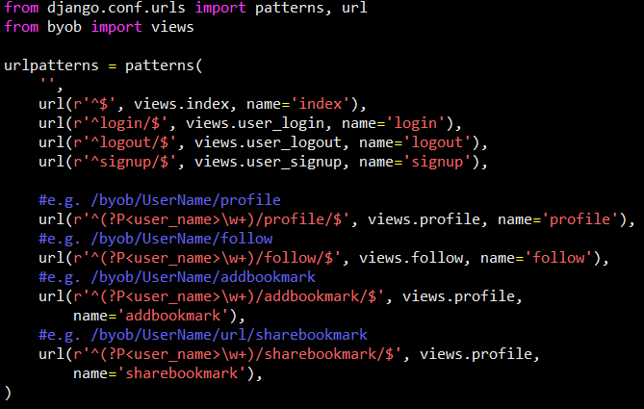
How are url requests mapped to a View?
/byobproject/ byobproject/urls.py
“include” includes another URLConf in this one. In this case it redirects all url requests to the server of form */byob/* to URLConf in /byobproject/byob/urls.py
Byob is a web app under byobproject site
/byobproject/ byob/urls.py
See the comments that call out the url matching with each regex
e.g. calls function ‘profile’ in /byob/views.py. The view fn in turn, calls a html template. user_name’s value is passed for the ‘profile’ fn as an argument.
Details here - http://django.readthedocs.org/en/1.6.x/#the-view-layer

Slide 10
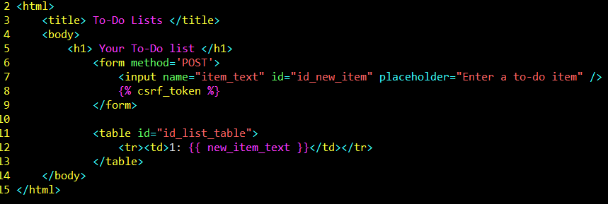
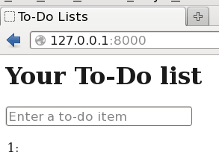
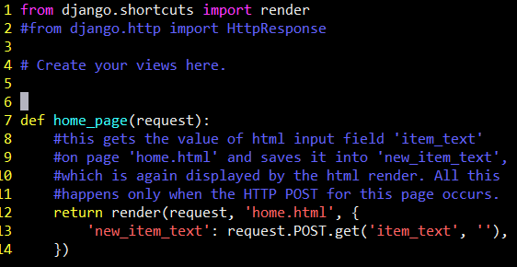
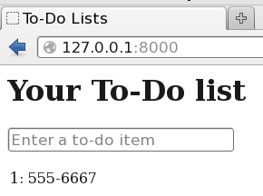
How do Views & Templates exchange info?
/templates/home.html
Input field named ‘item_text’
Show value of var named ‘new_item_text’
Django makes these connections implicitly provided we use the right syntax as shown
/views.py
Page immediately after load
Details here - http://django.readthedocs.org/en/1.6.x/#the-template-layer
Page after entering text into textbox and POSTing

Slide 11
Related topics that you should delve into
Python programming
HTML5 / CSS3 programming
JavaScript programming
Other Python based webapp fwk’s:
Flask
Bottle

