Slide 1
The C0de Diaries
What is a C0de Diary?
For experienced software developers
Technical topics condensed into intense slides
Each deck not more than 15 slides
Acts as companion to WWW information and reference books
Also serves as a refresher resource for a crash course

Slide 2
January 2014 - contents
SDN & Network Virtualization
Various representations of generic SDN arch
Network Virtualization technologies
Technology stacks combining the two
Quick laundry lists
Some prominent controllers and vSwitches
Solution provider’s and their SDN stacks
FAQs
Early thoughts on attacking SDN/NV stacks

Slide 3
What is SDN? What is Network virtualization?
SDN
Goal here is separation of the controller and data planes in networks – the controller is completely independent from data path elements like network switches & routers
Allow apps to create / edit network flow rules& configuration dynamically
Network Virtualization
Goal here is to construct multiple virtual, individually independent networks on top of existing physical network infrastructure
Allow automation of network creation and network settings on demand
Do note that:
Definitions for these terms are muddied today
Once standards develop, a clearer and universally accepted definition will emerge
The definitions above are what is typically accepted today by experts

Slide 4
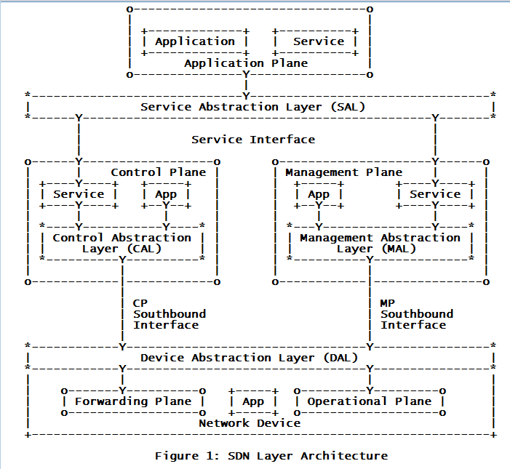
Generic SDN arch - IETF
-s/w programs that consume services without providing access to other apps - can be implemented natively inside a plane or can span multiple planes
-n/w aware apps and services reside here -use SAL interfaces to program n/w
provides service abstractions for use by applications and other services
-manages devices -taking decisions on n/w device states
-decision maker for how pckts are to be fwd’d by n/w devices -push those decisions down to n/w devices
-s/w programs that provide APIs to Apps or other services
abstracts the MP southbound interface and the DAL from the applications and services of the Management Plane
abstracts the CP southbound interface and the DAL from the applications and services of the Control Plane
abstracts the device forwarding and operational plane to the control and management plane, respectively. Variations of DAL may abstract both planes or either of the two.
- Handles pckts in data path - Forwarding, dropping, changing pckts
-op state of the n/w device -active/inactive, # of ports, port state etc
SDN acc. to IETF-http://tools.ietf.org/html/draft-haleplidis-sdnrg-layer-terminology-01

Slide 5
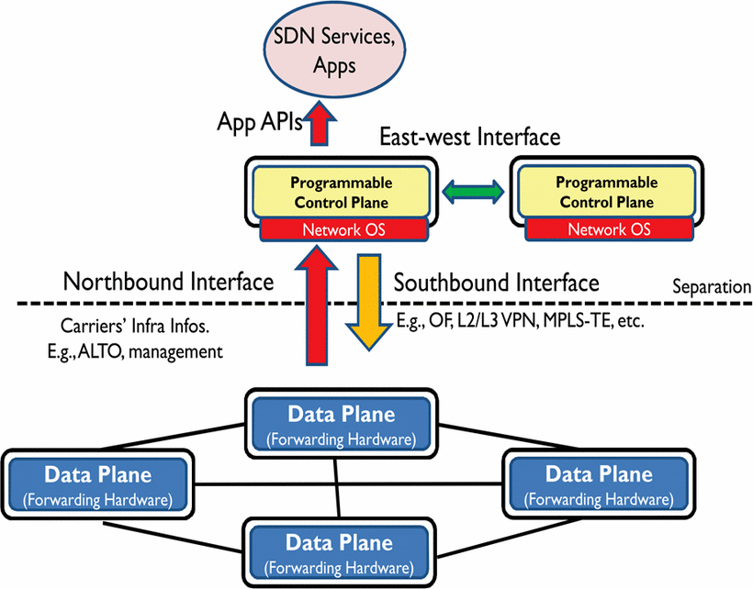
Generic SDN arch - IEEE
http://ieeexplore.ieee.org/xpls/icp.jsp?arnumber=6386859

Slide 6
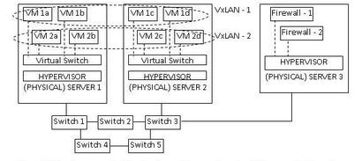
Network Virtualization tech
Virtual network 1
Virtual network 2
Physical network
infrastructure
The problem addressed by network virtualization is this: the manual deployment of network policy, features, and services constructing the network architecture viewed by application’s compute resources (virtual machines).
Typical components in a virtualized network (L2-L7):
Overlays – isolate MAC Addr / IP Addr / VLAN IDs
E.g. overlay protocols: GRE (Hyper V uses a modified version of this), STT (Nicira), VxLAN (VMWare)…
Virtual switches & routers – provide L2 connectivity and routing services
Virtual NICs – allow VM’s to attach themselves to a virtual network
Virtual gateways / firewalls / load balancers
The underlying physical network typically is there to simply provide actual connectivity between each physical server / element.
SDN and Network virtualization are complementary technologies
Clubbed together, and along with server virtualization, they provide an excellent backbone for building software defined data centers.
Figure from book, “Software Defined Networking (SDN) A definitive guide” | some text from bradhedlund.com

Slide 7
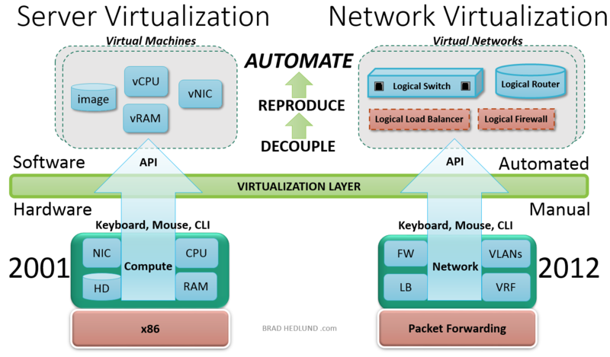
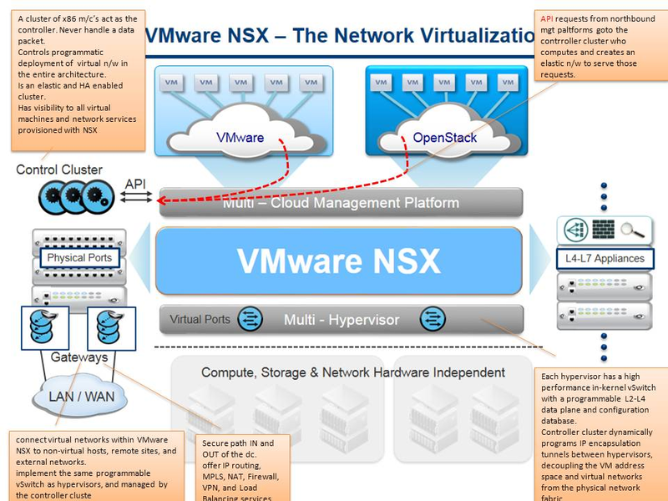
VMWare NSX
API overview:
- data plane – done
- mgt plane – done
- ctrllr plane - tbd
Figures from - bradhedlund.com

Slide 8
Other stacks
Open Stack Neutron
MSFT Hyper V
<Details of the above still pending>

Slide 9
Prominent Controllers and Network Elements
Controllers
Open Daylight
POX
Beacon
Floodlight, Maestro, Trema, FlowER, Ryu
VMWare NSX Controllers
Network Elements (switches)
Open vSwitch
Pantou – turns a commerical wireless router / AP into an OpenFlow enabled switch
Indigo – h/w resident (ASIC) Open Flow implementation
VMWare’s vSwitch and vDS
Hyper V’s Extensible Virtual Switch
LINC, XORPlus, OF13SoftSwitch

Slide 10
‘SDN’ stacks of solution providers
Note that some of these are ‘pure’ SDN while others are solution mix of SDN + NV
Open SDN by Big Switch
Cisco ACI
IBM SDN VE
Midokura MidoNet
Contrail & Open Contrail by Juniper
ProgrammableFlow Networking Suite by NEC
Nuage Networks Virtualized Services Platform by Alcatel
Plexxi
Pica8
NSX by VMWare
List from here - http://www.networkcomputing.com/data-networking-management/10-software-defined-networking-architect/240161899

Slide 11
Some FAQs
Where does OpenStack Neutron fit in?
Is VMWare NSX compatible with ‘non-VMWare’ network elements?
Does Hyper V have a SDN controller?
<add your own>

Slide 12
Attacking such tech stack’s – early thoughts
SDN and NV stacks augment an org’s total attack surface by providing new attack surfaces as shown below:
Switches and Controllers
Are these possible?
MITM attacks? Spoofed peers? DoS?
Host based IPS like CSP may be value add?
Controller<-->Network Element pipe(s)
Eavesdropping, MITM attacks, spoofing either peer?
DoS?
OF protocol hijacking?
Controller<-->Controller pipe(s)
Eavesdropping, MITM attacks, Controller spoofing?
DoS?
OF protocol hijacking?
Controller <---->Net Apps
Unauthenticated and/or unauthorized net apps leveraging controller APIs
Application data flowing on each individual network
Protecting tenant apps using the virtual n/w(s)
Here is where the NETX APIs (VMWare NSX) and Hyper V Extensible Virtual Switch come in
What about other NV technologies?
In a nutshell – SDN/NV enable new threats of a different nature that need to be dealt with separately from traditional n/w threats.
These are just exploratory - further research needed to establish key areas of relevance.

Slide 13
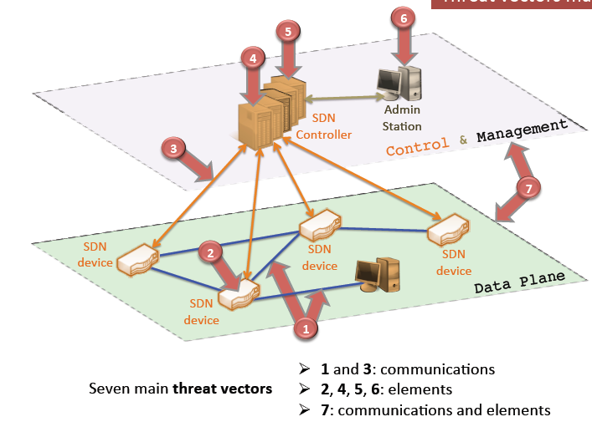
Attacking such tech stack’s – threat vector map
Exploiting vulnerabilities in controllers
Exploiting vulnerabilities in net app’s / malicious net apps
Exploiting vulnerabilities in admin workstations as a bridge to controller attacks
NE-Controller communications
Exploiting remediation – there are lack of trusted resources for forensics and remediation
Exploiting vulnerabilities in switches / forwarding devices
Controller-NE traffic
Data plane flow
Management flow
Spoofed / faked traffic flow
Source – ACM SIGCOMM 2013 paper-http://conferences.sigcomm.org/sigcomm/2013/slides/hotsdn/16.pdf

