Slide 1
The C0de Diaries
What is a C0de Diary?
For experienced software developers
Technical topics condensed into intense slides
Each deck not more than 15 slides
Acts as companion to WWW information and reference books
Also serves as a refresher resource for a crash course

Slide 2
August 2013 - Contents
How to write interfaces in java
How to host apps in tomcat
How to use jersey to create a REST java service
Very basic intro to Oauth
Writing a basic Spring application
DI using Spring
Why Spring? (or any other similar fwk for that matter)

Slide 3
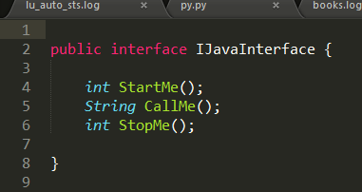

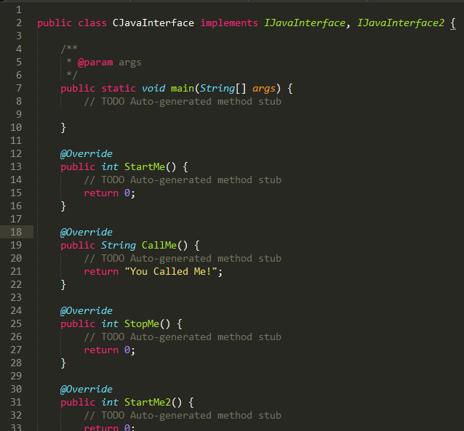
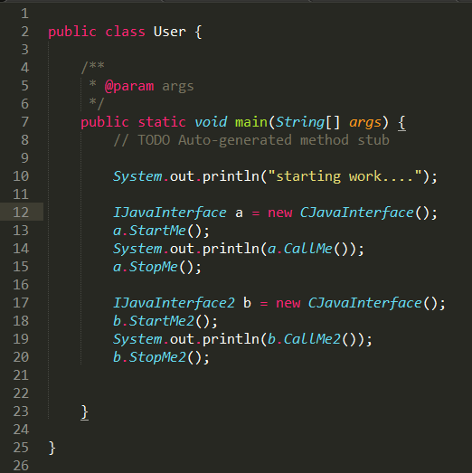
Interfaces in JAVA
Interface 1
Interface 2
Implementation of interface1 and interface2
Uses interface1 and interface2

Slide 4
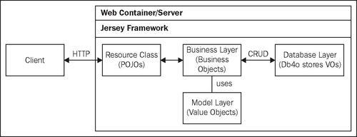
WebApps in Tomcat
Jersey is Sun's production quality reference implementation for JSR 311: JAX-RS: The Java API for RESTful Web Services. Jersey implements support for the annotations defined in JSR-311, making it easy for developers to build RESTful web services with Java and the Java JVM. Jersey also adds additional features not specified by the JSR.
Tomcat
Hello1 (or your java package/class that implements the REST methods.
Root resource classes are POJOs (Plain Old Java Objects) that are either annotated with @Path or have at least one method annotated with @Path or a request method designator such as @GET, @PUT, @POST, or @DELETE
Resource methods are methods of a resource class annotated with a request method designator

Slide 5
RESTful Web Services
RESTful services follow four basic design principles. (Note that these are guidelines and it is possible that they may not be followed in the exact fashion in a certain implementation.)
Use HTTP methods explicitly - that is a 1:1 mapping between CRUD and HTTP methods. These are:
To create a resource on the server - use POST
To retrieve a resource on the server - use GET
To change the state of a resource or update it - use PUT
To remove / del a resource - use DELETE
Be stateless - stateful services are generally always more complicated than stateless services. As complications increase, performance and scalability decrease. REST services typically need to meet high demands and need to scale easily. For this reason, REST services are usually stateless. So how is this achieved? - by making a demand on the REST client, which is that the clients must send requests that include all data needed to be fulfilled so that the components in the servers may forward, route, and load-balance without any state being held locally in between requests.
Expose directory structure-like URIs - REST Web service URIs should be intuitive to the point where they are easy to guess. Think of a URI as a kind of self-documenting interface that requires little, if any, explanation or reference for a developer to understand what it points to and to derive related resources. One way to achieve this level of usability is to define directory structure-like URIs. For e.g. - in a discussion threading service that gathers topics ranging from Java to paper, you might define a structured set of URIs like this: "http://www.myservice.org/discussion/topics/{topic}". The root, /discussion, has a /topics node beneath it. Underneath that there are a series of topic names, such as gossip, technology, and so on, each of which points to a discussion thread. Within this structure, it's easy to pull up discussion threads just by typing something after /topics/.
Transfer XML, JavaScript Object Notation (JSON), or both - a resource representation is usually a snapshot of its state in time. For e.g., a representation of a record in a DB or current state of a GVM etc. Thus, the objects in your data model are usually related in some way, and the relationships between data model objects (resources) should be reflected in the way they are represented for transfer to a client application. To give client applications the ability to request a specific content type that's best suited for them, construct your service so that it makes use of the built-in HTTP Accept header, where the value of the header is a MIME type.

Slide 6
Jersey
Is the JAX-RS API for developing RESTful web services in Java
Designed to make it easy to develop applications that use the REST architecture
Uses Java programming language annotations to simplify the development of RESTful web services:
Developers decorate Java class files with HTTP-specific annotations to define resources and the actions that can be performed on those resources
Jersey annotations are runtime annotations, therefore, runtime reflection will generate the helper classes and artifacts for the resource, and then the collection of classes and artifacts will be built into a web application archive (WAR)
The resources are exposed to clients by deploying the WAR to a Java EE or web server

Slide 7
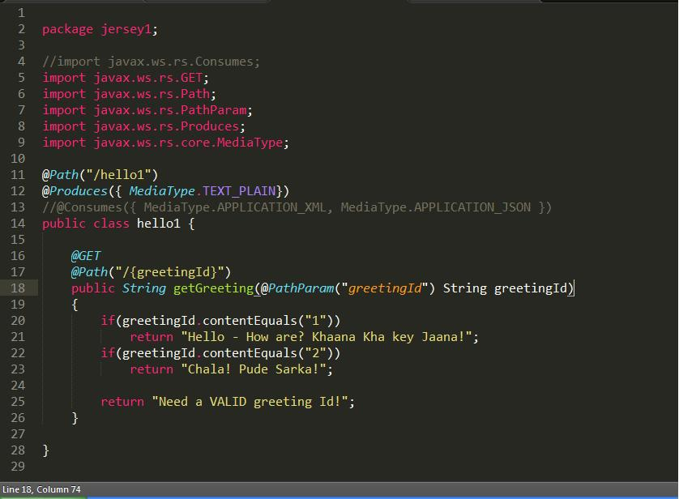
Jersey - 2
@Produces annotation is used to specify the MIME media types or representations a resource can produce and send back to the client
@Consumes annotation is used to specify which MIME media types of representations a resource can accept, or consume, from the client
Package container reference
This is a Root Resource class. @Path supports variables too (like getGreeting below)
url to call – is <base path url>/hello1/
Will produce output of type plain text only (more than 1 type for @Produces and @Consumes allowed)
@GET, @PATH annotations as defined in JAX-RS.
This is a GET method. url to call – is <base path url>/hello1/<parameter>. getGreeting is a Resource method
Example of URL to call - http://10.211.224.115:8080/jersey1/hello1/1

Slide 8
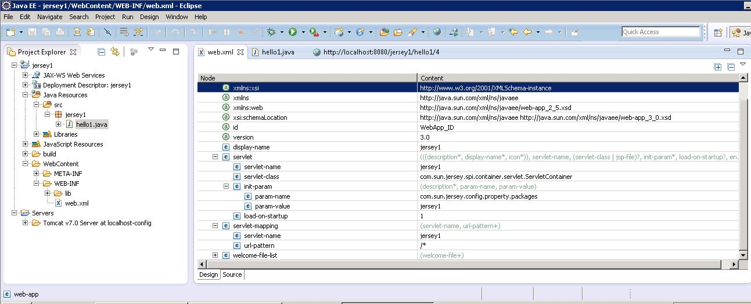
Jersey - 3
Package that implements the service
Hello1.java is the actual class that implements the REST methods
Tells the web server what servlet hosts the url
To deploy on a Tomcat server, just Export (from Eclipse IDE), the project as a WAR package. Copy the .war package to the Tomcat server WebApps folder and restart the server.

Slide 9
OAuth - 1
Solves problem of granting time and/or scope limited access of resources to 3rd parties.
Roles in play - Resource owner (Owns resources to which access is to be granted), client (needs access to resources to do some work, acts on behalf of the resource owner), server (hosts the resources)
3 kinds of credentials-
Client credentials – used for authenticating the client
Token credentials – used in place of owner’s credentials; resource owners authorizes the server to issue a special class of credentials to the client which represent the access grant given to the client by the resource owner.
token cred = token id + unique seq (opt) + secret. Token creds are limited in scope and duration.
Temporary credentials – used to id the authorization request.

Slide 10
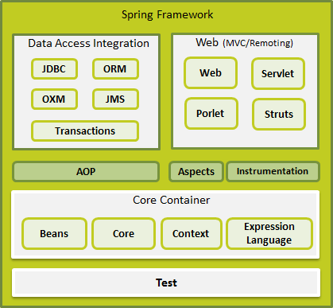
Spring-Overview
provides basic web-oriented integration features such as multipart file-upload functionality and the initialization of the IoC container using servlet listeners and a web-oriented application context
provides integration layers for popular object-relational mapping APIs, including JPA, JDO, Hibernate, and iBatis.
module contains features for producing and consuming messages
contains Spring's model-view-controller (MVC) implementation for web applications
provides an abstraction layer that supports Object/XML mapping implementations for JAXB, Castor, XMLBeans, JiBX and XStream
contains the support classes for integrating a classic Struts web tier within a Spring application
supports programmatic and declarative transaction management for classes that implement special interfaces and for all your POJOs.
provides the MVC implementation to be used in a portlet environment and mirrors the functionality of Web-Servlet module
provides BeanFactory which is a sophisticated implementation of the factory pattern
fundamental parts of the framework, including the IoC and Dependency Injection features
Builds on the solid base provided by the Core and Beans modules and it is a medium to access any objects defined and configured. The ApplicationContext interface is the focal point of the Context module.
provides a powerful expression language for querying and manipulating an object graph at runtime

Slide 11
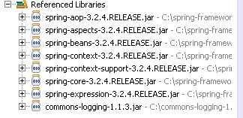
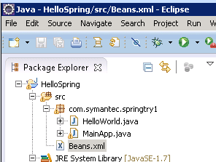
Spring – anatomy of a simple Spring app (also cont. on next slide)
Eclipse IDE project explorer view
Typical Spring JARS to include for a basic Spring app
Glues app context and business logic [IOC]
XML file defines objects (beans) and gives them names. Java code will load file and refer to objects by name.
App context for spring fwk. Tells which config file has the ap context – in this case Beans.xml.
Can have multiple app contexts for a single app (if needed)
Beans.xml
Main business logic
Appcontext is typically used to store settings of an app that it will need at runtime but also need to be configurable.
HelloWorld.java
MainApp.java
HelloWorld.class
MainApp.class

Slide 12
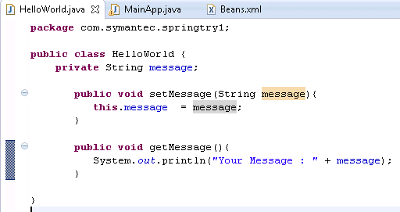
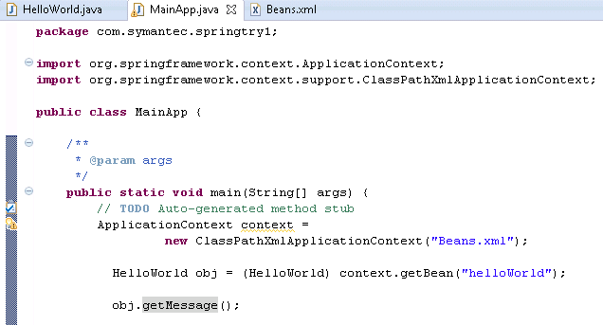
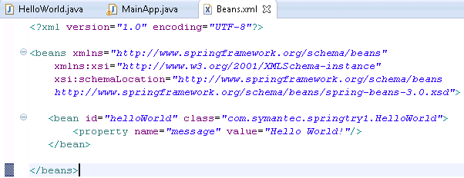
HelloWorld.java (Business Logic)
4
MainApp.java
1
3
Beans.xml
2

Slide 13
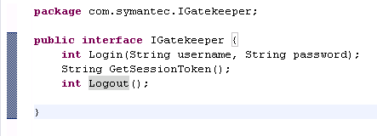
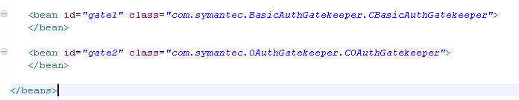
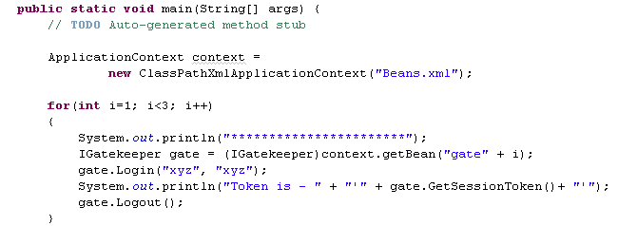

Slightly more complex e.g.
Interface Igatekeeper is implemented by these two classes. They have no Spring dependency and are POJOs
CBasicAuthGatekeeper
COAuthGatekeeper
Binds implementation of IGateKeeper to Bean.
gate1=BasicAuth
gate2=OAuth
CBasicAuthGatekeeper
COAuthGatekeeper
Beans.xml
CGatekeeperTest
CGateKeeperTest uses Igatekeeper at interface level only!!

Slide 14
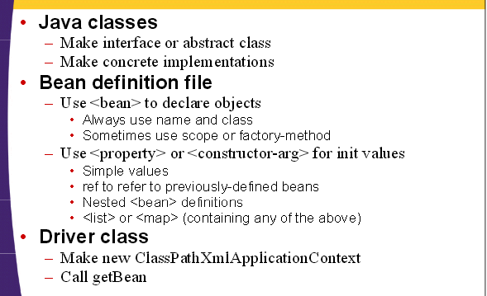
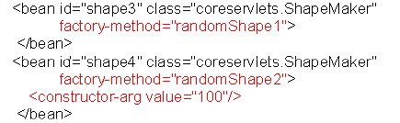
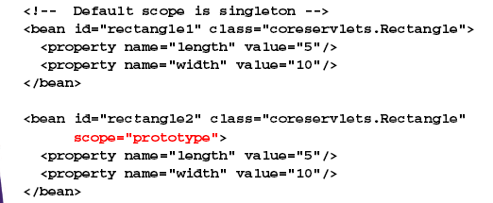
Spring DI - Summary
SCOPE – is to be specified in the Beans.xml
Singleton – is default. Everytime you call getBean on the same name, you get the same instance.
Prototype – everytime you call getBean, you get a new instance
Request – valid only in webapps
Session - valid only in webapps
globalSession - valid only in portal apps
supplying other Beans as properties or constructor args
FACTORY METHODS – use when you don’t know the specific type of bean you will need and need to run some logic to determine it. so, instead of specifying a name/ctr you call a method that returns an object (in the Beans.xml)
This method must be in a separate helper class and must be static.

Slide 15
Why Spring?
Today → complex solutions, incomplete and constantly fluctuating requirements.
Need a flexible arch and easily verifiable components.
Spring has
Simplicity – based on POJO for business logic. => object model based. This allows your same business logic implementation to be easily run as a POJO app, a servlet etc.
Reusability - components that abstract commonly required stuff like n/w, db, messaging etc.. (AoP)
Modularity – allows only relevant reusables to be introduced in your app. All reusables use consistent interfaces.
Flexibility – DI allows a configurable object model. You can inject new implementations of an interface via configuration only. This allows for great testing as well as future proofed arch. (DI/IoC)
http://courses.coreservlets.com/Course-Materials/spring.html
.NET counterparts of Spring-
- 3rd party: Castle Winsdor, Spring.NET, Autofac 3, Structure Map
- MSFT: MEF, Unity (via EL)

