Slide 1
The C0de Diaries
What is a C0de Diary?
For experienced software developers
Technical topics condensed into intense slides
Each deck not more than 15 slides
Acts as companion to WWW information and reference books
Also serves as a refresher resource for a crash course

Slide 2
August 2013 - Contents
Key Python concepts
Simple python app
Calling a REST service from python REST client
Frequently used things in Python & terminology
Pro’s/Con’s
Python vs Other languages

Slide 3
Python – key concepts
Dynamic, interpreted language
Source code does not declare the types of variables or parameters or methods => the code is short and flexible, and you lose the compile-time type checking in the source code.
Multi platform, free, open source
Language properties
Everything is an object
Has modules, classes, functions
Exception handling
Dynamic typing, polymorphism, Op overloading
Static scoping
Uses
Rapid prototyping
Web scripting
XML processing
DB apps
GUI apps

Slide 4
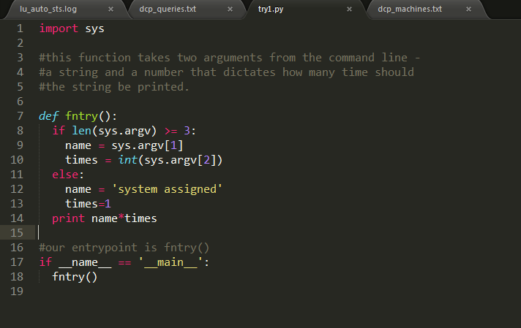
Simple Python example
Import other modules as needed. We use sys.argv in the code
Python module. fntry is available outside it as try1.fntry
A py function – fntry. ‘def’ declares the function and its body follows imeediately
Py is dynamically typed so variables get type checked at runtime
Boilerplate code to define entrypoint. This is not required when we have python modules that are to be used (imported) by other modules.
Indentation is very important ! Wrong indents cause runtime errors!

Slide 5
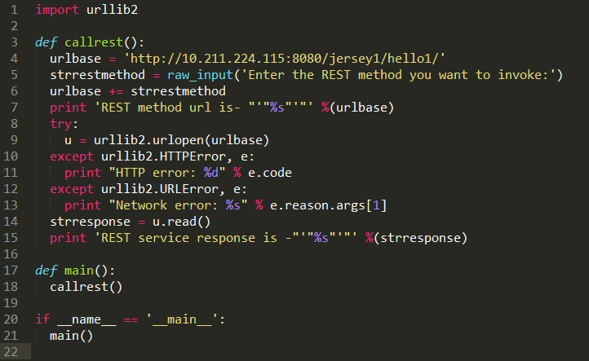
Call REST service from Python
Std library has urlib2 to use for http/rest based comm
These are strings
Formatted string printed to console
Exception handling in python

Slide 6
Frequently used things - 1
for
in
range
while
str
sorted
if,else
tuple*
squares = [1, 4, 9, 16] sum = 0 for num in squares: sum += num print sum
list = ['larry', 'curly', 'moe']
if 'curly' in list:
print 'yay'
*Not a keyword, but is used in place of structures. Similar to list type however, note that tuples usually have a meaning while lists have an order. E.g., the following looks like a list but is really a tuple:
my_location = (42, 11) # page number, line number
## print the numbers from 0 through 99
for i in range(100):
print i
a = [5, 1, 4, 3]
print sorted(a) ## [1, 3, 4, 5]
print a ## [5, 1, 4, 3]
strs = ['ccc', 'aaaa', 'd', 'bb']
print sorted(strs, key=len) ## ['d', 'bb', 'ccc', 'aaaa']
if speed >= 80:
print 'License and registration please'
if mood == 'terrible' or speed >= 100:
print 'You have the right to remain silent.'
elif mood == 'bad' or speed >= 90:
print "I'm going to have to write you a ticket."
write_ticket()
else:
print "Let's try to keep it under 80 ok?"
strings
s = 'hi'
print s[1] ## i
print len(s) ## 2
print s + ' there' ## hi there

Slide 7
Frequently used things -2
dict*
file**
*Not a keyword, but is used in place of dictionaries. Python's efficient key/value hash table structure is called a "dict". The contents of a dict can be written as a series of key:value pairs within braces { }, e.g. dict = {key1:value1, key2:value2, ... }.
dict = {}
dict['a'] = 'alpha'
dict['g'] = 'gamma'
dict['o'] = 'omega'
print dict ## {'a': 'alpha', 'o': 'omega', 'g': 'gamma'}
print dict['a'] ## Simple lookup, returns 'alpha'
dict['a'] = 6 ## Put new key/value into dict
'a' in dict ## True
## print dict['z'] ## Throws KeyError
if 'z' in dict: print dict['z'] ## Avoid KeyError
print dict.get('z') ## None (instead of KeyError)
list = ['a', 'b', 'c', 'd']
del list[0] ## Delete first element
del list[-2:] ## Delete last two elements
# Echo the contents of a file (**not a keyword)
f = open('foo.txt', 'rU')
for line in f: ## iterates over the lines of the file
print line, ## trailing , so print does not add an end-of-line char
## since 'line' already includes the end-of line.
f.close()

Slide 8
Frequently used things - 3
str = 'an example word:cat!!'
match = re.search(r'word:\w\w\w', str)
# If-statement after search() tests if it succeeded
if match:
print 'found', match.group() ## 'found word:cat'
else:
print 'did not find'
# Open file
f = open('test.txt', 'r')
# Feed the file text into findall(); it returns a list of all the found strings
strings = re.findall(r'some pattern', f.read())
re
## Suppose we have a text with many email addresses
str = 'purple alice@google.com, blah monkey bob@abc.com blah dishwasher'
## Here re.findall() returns a list of all the found email strings
emails = re.findall(r'[\w\.-]+@[\w\.-]+', str) ## ['alice@google.com', 'bob@abc.com']
for email in emails:
# do something with each found email string
print email
str = 'purple alice@google.com, blah monkey bob@abc.com blah dishwasher'
## re.sub(pat, replacement, str) -- returns new string with all replacements,
## \1 is group(1), \2 group(2) in the replacement
print re.sub(r'([\w\.-]+)@([\w\.-]+)', r'\1@yo-yo-dyne.com', str)
## purple alice@yo-yo-dyne.com, blah monkey bob@yo-yo-dyne.com blah dishwasher

Slide 9
Frequently used things - 4
File System -- os, os.path, shutil
## Example pulls filenames from a dir, prints their relative and absolute paths
def printdir(dir):
filenames = os.listdir(dir)
for filename in filenames:
print filename ## foo.txt
print os.path.join(dir, filename) ## dir/foo.txt (relative to current dir)
print os.path.abspath(os.path.join(dir, filename)) ## /home/nick/dir/foo.txt
Running External Processes -- commands
## Given a dir path, run an external 'ls -l' on it -- ## shows how to call an external program def listdir(dir): cmd = 'ls -l ' + dir print "Command to run:", cmd ## good to debug cmd before actually running it (status, output) = commands.getstatusoutput(cmd) if status: ## Error case, print the command's output to stderr and exit sys.stderr.write(output) sys.exit(1) print output ## Otherwise do something with the command's output
Exceptions
try:
//code to protect
except exception:
//handler

Slide 10
Python terminology (general)
Module - the basic unit of code reusability in Python: a block of code imported by some other code. Three types of modules present.
pure Python module - a module written in Python and contained in a single .py file (and possibly associated .pyc and/or .pyo files). Sometimes referred to as a “pure module.”
Extension module - a module written in the low-level language of the Python implementation: C/C++ for Python, Java for Jython. Typically contained in a single dynamically loadable pre-compiled file, e.g. a shared object (.so) file for Python extensions on Unix, a DLL (given the .pyd extension) for Python extensions on Windows, or a Java class file for Jython extensions.
Package - a module that contains other modules; typically contained in a directory in the filesystem and distinguished from other directories by the presence of a file __init__.py.

Slide 11
Frequently used things - 5
Redistribution - Say, you want to distribute a module called foo (in foo.py)
Steps:
write a setup script (setup.py by convention)
(optional) write a setup configuration file
create a source distribution
(optional) create one or more built (binary) distributions
install somewhere
from distutils.core import setup
setup(name='foo',
version='1.0',
py_modules=['foo'],
)
Supply Package metadata and what’s in the package
Create the redistrib package. Will create an archive, something like
Foo-1.0.tar.gz (or .zip)
python setup.py sdist
Unpack the archive and run the setup.py
python setup.py install

Slide 12
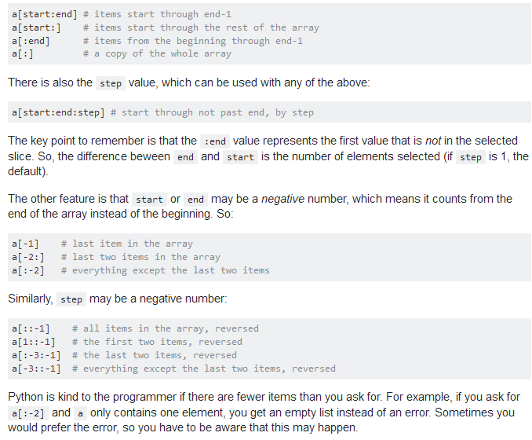
Frequently used things - 6

Slide 13
Pro’s / Con’s
Pro’s
High level interpreted language. Dynamically typed. Can accomplish major tasks in few loc’s.
Fast fast fasssst development possible. Particularly suitable for agile development and prototyping or as a glue for clubbing components.
Huge std lib available.
Con’s
Performance is not always good
Is dynamically typed, so code may not always be very readable if right coding guidelines aren’t followed.
Not clear how suitable for publicly released enterprise class products. Tools for static analysis and ide’s are harder to build. (though DropBox is majorly written in Python. Django fwk is another example)

Slide 14
Python vs. other languages
JAVA
Py programs generally run slower than JAVA programs
But Py programs take much lesser time to develop
Perl
Perl emphasizes support for common app tasks, e.g. by having built-in regex, file scanning and report generating features.
Python emphasizes support for common prog methodologies such as data structure design and oop, and encourages programmers to write readable code.
C++
Where Python code is typically 3-5 times shorter than equivalent Java code, it is often 5-10 times shorter than equivalent C++ code.
Obviously, C++ code runs much faster than Py (or JAVA) code.
Python shines as a glue language, used to combine components written in C++.

Slide 15
Notes from a training
Pdf –
Web links-
https://developers.google.com/edu/python/
http://www.python.org/
Py Stdlib - http://docs.python.org/2/library/index.html#library-index

