Slide 1
Distributed Inference for
On-Device LLMs
Edge-Cloud Split Execution
Sanjai Kumar Chandra Mohan & Sushmitha Vijayakumar
CSU Long Beach | Project Team - BayLabs
AI SYSTEMS · EDGE COMPUTING · LLMs

Slide 2
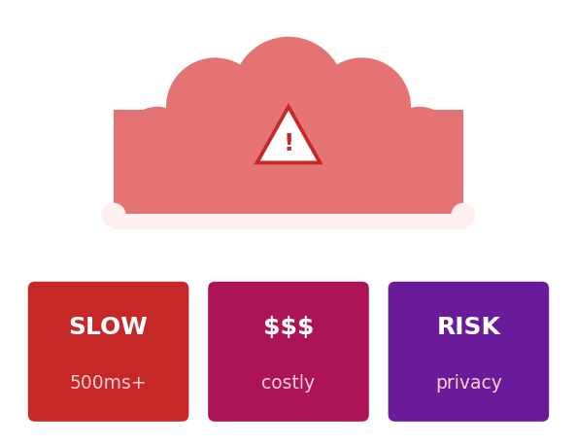
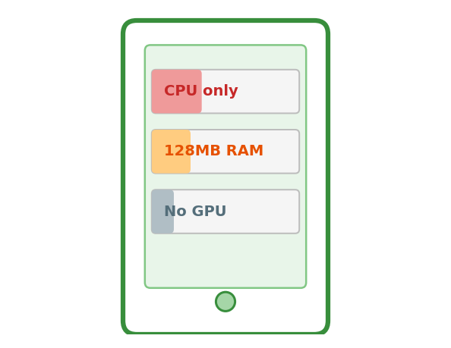
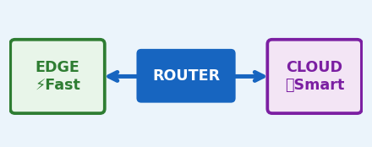
Why Can't LLMs Just Run on Your Phone?
☁ Cloud-Only
📱 Edge-Only
▸ Network latency: 500ms - 2s per query
▸ Limited reasoning capability
▸ Privacy risk - prompts sent to servers
▸ Poor answers on complex prompts
▸ High operational cost (per-token billing)
▸ No multi-step logic
We need BOTH - intelligently combined. A smart router decides which path to take.
▸ Fails without internet connection
▸ Quality gaps on real queries
VS
Edge devices: limited RAM · No GPU · Tight power budget · Billions of LLM parameters

Slide 3
Cloud-Only Inference - The Hidden Costs
⏱ High Latency
Network round-trip adds 500ms–2 seconds per query. Unusable for real-time voice or interactive assistants.
🔒 Privacy Risk
Sensitive user prompts sent to remote servers. No guarantee of data confidentiality or retention control.
💸 Operational Cost
Cloud APIs charge per token. At scale - millions of queries daily - costs compound into significant spend.
📡 No Offline Support
Zero offline capability. Any network disruption renders the system completely unusable for the end user.
Diagram: User → Internet → ☁ Cloud Server → Response (long, exposed, expensive path)

Slide 4
Edge-Only Inference - The Capability Gap
✅ What Edge Models CAN Do
❌ What Edge Models CANNOT Do
Simple definitions & lookups
Short factual Q&A
Fast text completions
Offline without internet
Privacy-safe (data stays local)
Multi-step logical reasoning
Complex model comparisons
Long-form document summarization
Instruction-following tasks
Contextual inference over long text
IDEAL DEVICE TYPES
Mobile Phone
IoT Wearable
Voice Assistant
FAILURE MODES WITHOUT CLOUD FALLBACK
~150ms | Offline
Always-on | Low-power
Privacy-safe
! Hallucination
! Truncation
! Repetition Loop
Model invents facts
on complex queries
Short / incomplete
answers to hard tasks
Token loops signal
model confusion
LATENCY ADVANTAGE
Edge ~240ms
Complex
Query
ROUTER
Cloud
Fallback
Cloud 1.5s+
>>>
>>>
DistilGPT2 (~82M params) is fast - but size comes at the cost of reasoning capability.

Slide 5
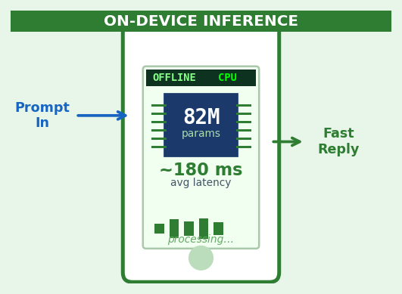
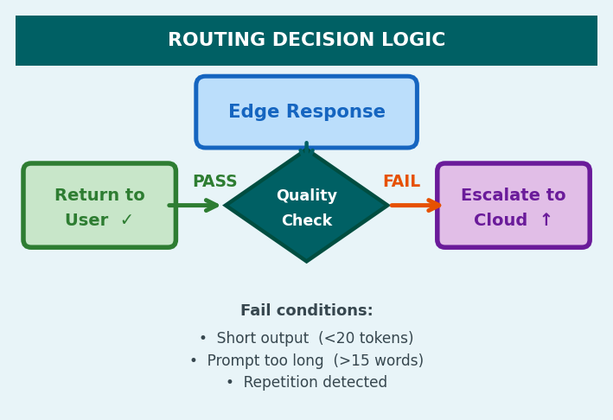
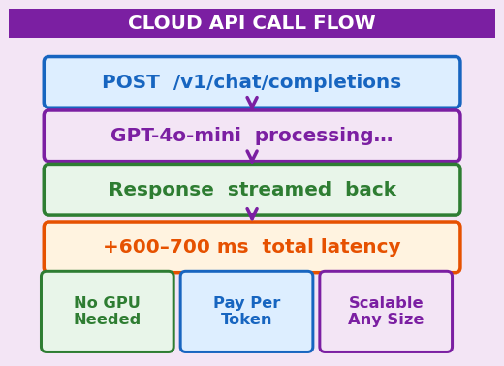
The Hybrid Solution - Best of Both Worlds
📱 EDGE
🔀 ROUTER
☁ CLOUD
DistilGPT2
Confidence Check
GPT-4o-mini
▸ Fast local inference
▸ Evaluates response quality
▸ Deep reasoning power
▸ < 240ms response time
▸ Checks length heuristic
▸ Complex completions
▸ Private: offline-capable
▸ Routes: edge or cloud
▸ Multi-step logic
→
→
▸ Handles simple prompts
▸ Zero overhead decision
▸ REST API fallback
Simple prompts stay on edge - complex prompts escalate to cloud - users always get the best result.

Slide 6
Background - How Transformers Work (Vaswani et al., 2017)
"Attention Is All You Need"
Token Input
▸ Self-Attention: captures long-range token dependencies
▸ Parallel Processing: all tokens computed simultaneously
▸ Faster than RNNs: no sequential bottleneck
Embeddings
▸ Scales to billions of parameters
← Key Innovation
▸ Enables: Q&A, summarization, reasoning, code generation
Multi-Head Attention
Key innovation over RNNs:
Feed-Forward Network
Instead of processing tokens one-by-one, Transformers attend to ALL tokens simultaneously - enabling massive parallelism.
Output Layer

Slide 7
The LLM Landscape - Size vs. Capability vs. Latency
Model | Parameters | Runs On | Best For
GPT-4 | >1T | Cloud | Complex reasoning, generation
GPT-4o-mini | ~8B | Cloud API | Efficient cloud inference
GPT-2 (full) | 117M | Local GPU | General text generation
DistilGPT2 ★ | 82M | CPU / Edge | Fast on-device inference
DistilBERT | 66M | CPU / Edge | Classification, NLU tasks
Trade-off Triangle
Model Size ↑ → Capability ↑ → Latency ↑ → Cost ↑ Our approach: use the right model for the right query - optimizing all three simultaneously.

Slide 8
Edge Computing Paradigm - Bring Compute Closer to the User
Traditional Cloud Model
☁ Central Cloud Server
Every query travels to central servers - high latency, bandwidth cost, privacy risk. Data leaves the device.
High capability, high latency
Edge Computing Model
Processing happens at or near the user device - data stays local, responses are faster, privacy is preserved.
📱 Mobile Device
⌚ Wearable IoT
Key Benefits:
~150ms local
Always-on
Low Latency
Privacy-First
Offline Support
Cost Savings
🚗 Autonomous Car
🏥 Medical Device
Real-time
Privacy-safe
Use cases: wearables · mobile assistants · IoT sensors · autonomous vehicles · medical devices

Slide 9
Module 3 - Cloud Inference with GPT-4o-mini
Model
GPT-4o-mini
What GPT-4o-mini Handles
Multi-step logical reasoning chains
Complex model comparisons
Long-form document summarization
Instruction-following & directive prompts
Contextual inference over long passages
Any prompt the edge model can't complete
Access Method
REST API
Added Latency
+600–700ms
HOW THE CLOUD API CALL WORKS
Edge output
too short
Router sends
POST /v1
GPT-4o-mini
processes
Streams back
response
Trigger
Short edge output
>
>
>
+600–700 ms latency | Pay-per-token | No hardware required
Cost
Pay-per-token
API-based integration: scalable, maintainable - no hardware upgrades required on the device side.

Slide 10
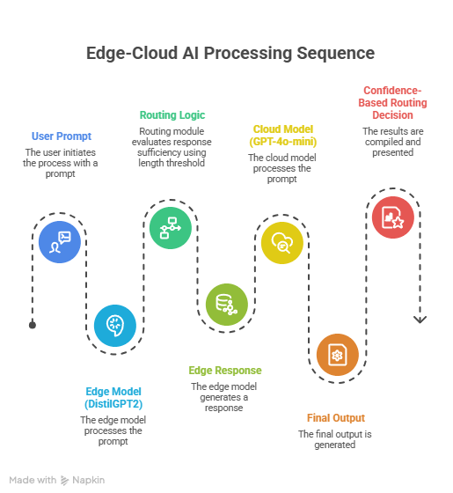
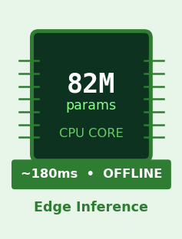
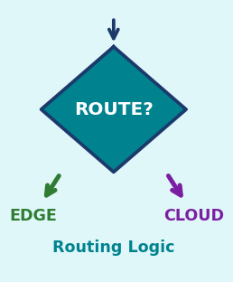
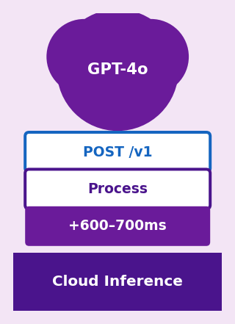
System Architecture - Three Modules, One Intelligent Pipeline
👤 User Prompt
MODULE 1
MODULE 2
MODULE 3
Distributed Edge–Cloud Split Inference Architecture
→
Edge Inference DistilGPT2
Routing Module
Cloud Inference GPT-4o-mini
▸ CPU inference
▸ Evaluates output
▸ REST API call
▸ 82M params
▸ Length heuristic
▸ Deep reasoning
▸ ~120–240ms
▸ Repetition check
▸ +600–700ms
→
→
▸ No internet
▸ Route decision
▸ Complex tasks
✅ Final Response to User - from Edge (fast) or Cloud (complete), whichever serves best

Slide 11
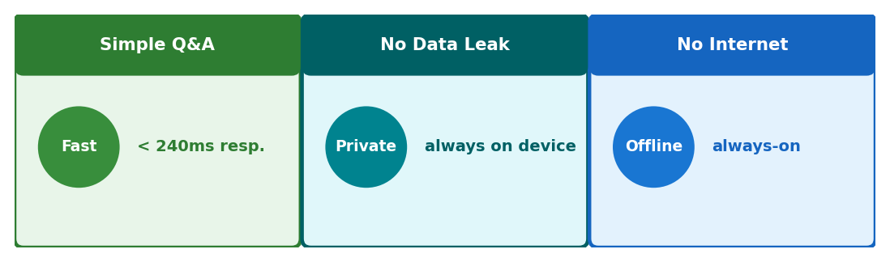
Module 1 - Edge Inference with DistilGPT2
82M
CPU
~180ms
0%
Parameters
No GPU Required
Avg Latency
Cloud Dependency
What is DistilGPT2?
Best For
Distilled version of OpenAI's GPT-2 (117M params) Trained via knowledge distillation technique 30% fewer parameters, same transformer architecture Maintains strong contextual text generation Ideal for always-on, low-power deployment
Short factual Q&A and definitions Simple word lookups and completions Low-complexity conversational prompts Privacy-sensitive local applications
DISTILGPT2 ARCHITECTURE - 6 TRANSFORMER BLOCKS
Input
Tokens
Token
Embeds
6x Self-
Attention
Feed-
Forward
Output
Logits
>
>
>
>

Slide 12
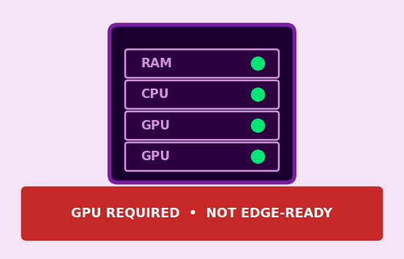
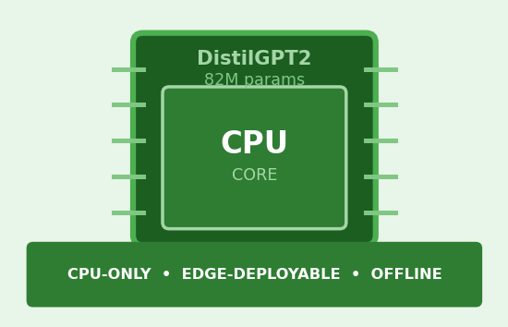
Model Distillation - Compress Knowledge Without Losing Intelligence
TEACHER MODEL GPT-2 (117M params)
STUDENT MODEL Distil GPT2 (82M)
Full-size transformer High accuracy output Slow: GPU-heavy High memory usage Not edge-deployable
30% smaller size Retains ~95% quality CPU-friendly Edge-deployable Fast & efficient
DISTILLATION PROCESS
MODEL PROFILE
Soft probability matching Pruning & quantization Layer reduction
MODEL PROFILE
• 117M total parameters
• Requires GPU / cloud server
• High accuracy - high memory
• Slow for real-time inference
• Not edge-deployable as-is
+ 82M parameters (30% smaller)
+ Retains ~95% task quality
+ Runs on CPU - no GPU needed
+ Edge & mobile deployable
+ Fast startup, low memory use
+ Always-on deployment ready
→
→
STEP-BY-STEP PROCESS
1
Teacher outputs soft
probabilities (richer signal)
2
Student mirrors logit
distributions via KL-divergence
117M -> 82M (30% smaller, 95% quality)
DistilBERT retains 97% of BERT performance at 60% the size - distillation is proven and powerful.

Slide 13
Module 2 - The Routing Brain: 4 Heuristic Signals
📏 1. Prompt Length
📝 2. Response Length
Longer, more complex prompts require deeper reasoning. Long prompts are routed to the cloud fallback model.
If the edge response is too short, the model didn't fully answer. Short outputs trigger cloud escalation.
ROUTING THRESHOLD: PROMPT WORD COUNT
ROUTING THRESHOLD: RESPONSE TOKEN COUNT
<=15 words -> Edge
>15 words -> Cloud
<20 -> Cloud
>20 tokens -> Edge Sufficient
Example: "Define LLM" -> Edge | "Explain how attention works" -> Cloud
Short output = model failed to answer fully -> escalate to cloud
🔁 3. Repetition Detection
⏱ 4. Latency Threshold
Repeated token sequences signal degenerate output - hallucination or model confusion at the edge layer.
If edge inference itself takes too long, escalate rather than compound delay with a slow, poor response.
WHAT DEGENERATE OUTPUT LOOKS LIKE
"...the model the model the model the model..."
<- DETECTED: 3+ repeated n-grams -> Escalate to Cloud
ROUTING THRESHOLD: INFERENCE TIME
<300ms -> OK
>300ms -> Route to Cloud
If edge is slow anyway, cloud gives both speed AND quality
No entropy scoring - lightweight design enables real-time routing decisions with zero model overhead.

Slide 14
Implementation Stack - How the System Was Built
Language
Python 3.x
Modular, object-oriented component architecture with pluggable backends.
Edge Model
HuggingFace Transformers
DistilGPT2 via `transformers` pipeline - CPU inference, no GPU required.
Cloud Model
OpenAI Python SDK
GPT-4o-mini via REST API with streaming support for long-form outputs.
Routing Logic
Custom Python Module
Lightweight heuristic evaluator: response length + repetition detection.
Benchmarking
time.perf_counter()
Per-prompt timing: edge latency, cloud latency, and routing decision logged.
Hardware
CPU-only Commodity Laptop
No GPU - intentionally simulating real mobile/edge device constraints.

Slide 15
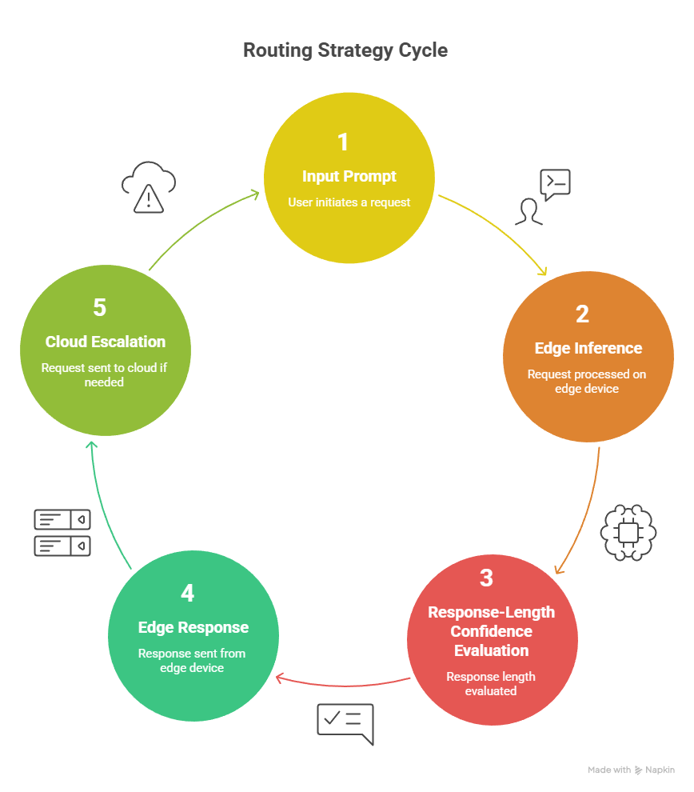
Confidence-Based Routing - Step-by-Step Workflow
Confidence-Based Routing Workflow
1
User sends prompt to system
2
Edge device runs DistilGPT2 locally
3
Router checks response length threshold
4
Sufficient → return edge result to user
5
Insufficient → escalate to GPT-4o-mini
6
Cloud response returned to user
Routing is evaluated after every edge inference - each prompt independently assessed in real-time.

Slide 16
Why Heuristic Routing - Not Entropy-Based Scoring?
Criterion | Entropy-Based Scoring | Heuristic Length Routing ✓
Computational cost | High - full softmax probabilities | Negligible - string length check
Latency impact | Adds 50-200ms overhead | Near-zero, real-time viable
Routing accuracy | High semantic precision | Good proxy for prompt complexity
Implementation effort | Complex, requires logit access | Simple, model-agnostic
Edge hardware viability | Challenging on low-power CPUs | Works on any CPU instantly
Design Trade-off
Slight routing accuracy loss → Massive latency & complexity gain. For real-time edge AI, this is the right trade-off. Future work: RL-based adaptive routing.

Slide 17
Experimental Setup - 4 Prompt Complexity Levels
Prompt Category | Example Prompt | Complexity | Expected Route
Definition | "Define edge computing" | Low | Edge
Explanation | "Explain transformer attention" | Medium | Cloud
Summarization | "Summarize this paragraph" | Medium | Cloud
Comparison | "CNN vs Transformer: compare" | High | Cloud
Evaluation Methodology
▸ 10 benchmark prompts evaluated end-to-end on CPU-only laptop (no GPU acceleration)
▸ Metrics captured: edge latency · cloud latency · routing decision per prompt

Slide 18
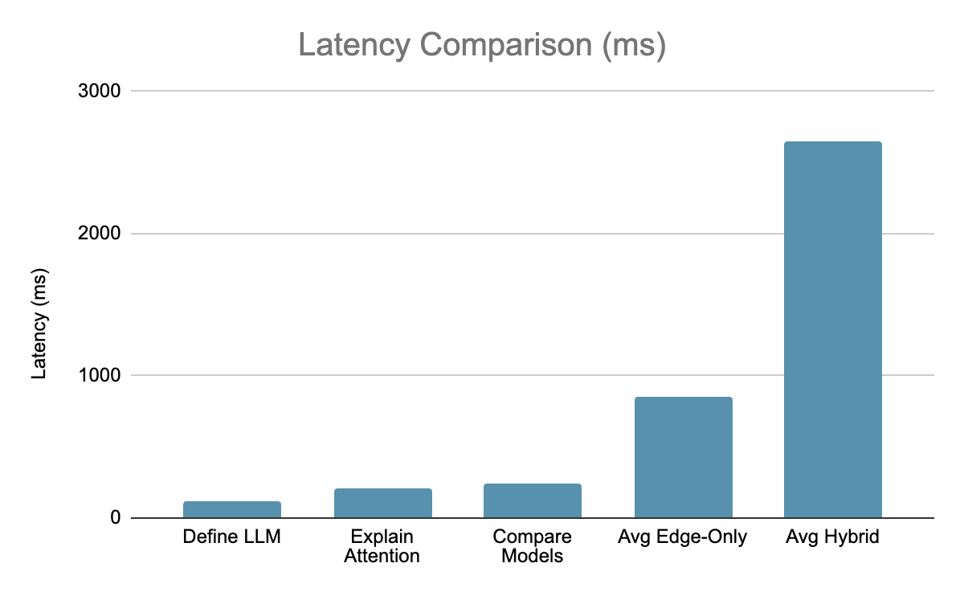
Latency Benchmark Results - Speed vs. Quality Trade-off
0.85s
Avg Edge Latency
2.65s
Avg Hybrid Latency
3×
Edge Speed Advantage
Edge is 3× faster - but only sufficient for ~20% of prompts. Quality justifies the hybrid cost.

Slide 19
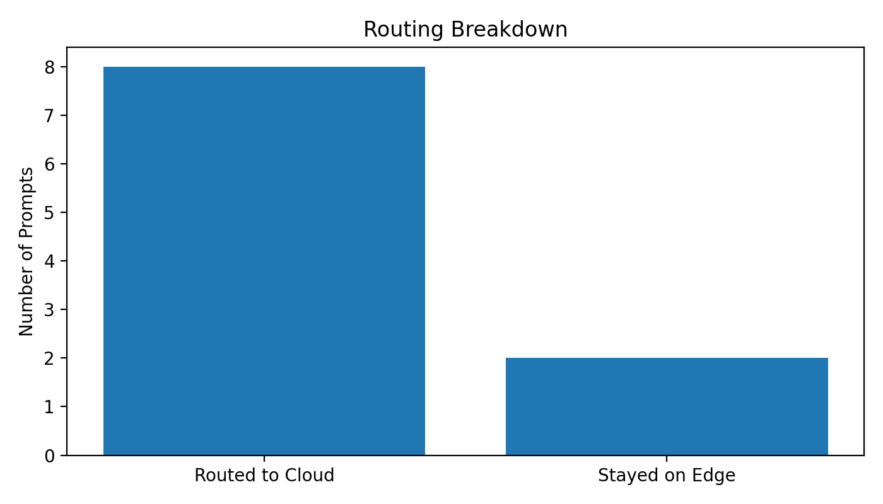
Routing Distribution - Where Did the 10 Prompts Go?
BENCHMARK SUMMARY (10 test prompts)
8 / 10
2 / 10
80% → Cloud
Routed to Cloud
Handled on Edge
80%
20%
8 of 10 prompts required GPT-4o-mini for complete, high-quality answers.
Cloud Escalation
Edge Sufficient
Edge filtering saves ~80% unnecessary API cost
20% → Edge
2 of 10 prompts handled locally - privacy-preserved, zero API cost.
Edge filtering prevents unnecessary API calls and saves cost for low-complexity user queries.

Slide 20
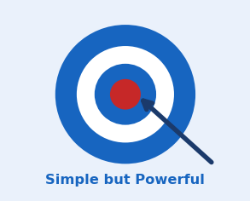
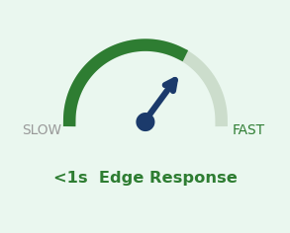
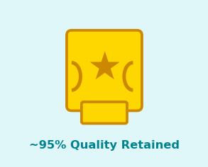
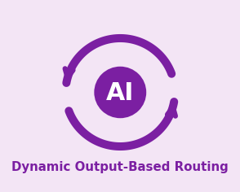
What the Results Tell Us - 4 Key Insights
Effective Heuristic
Latency Preserved
01
Response-length is a surprisingly accurate proxy for prompt complexity - simple but powerful.
02
Hybrid routing keeps ~20% of queries on edge with sub-second latency - matching user expectations.
Quality Improves
Adaptive System
03
Cloud escalation ensures complete, accurate answers without degrading performance on simple queries.
04
Decisions are based on actual output quality - not fixed rules. The system responds dynamically.

Slide 21
Limitations of Current Work - Honest Gaps
⚠ Routing Signal Weakness
Response-length only - no semantic confidence, no intent classification, no topic modeling.
⚠ No Contextual Adaptation
Routing ignores user history, session context, or prior successful routing patterns.
⚠ Instruction-Tuning Gap
DistilGPT2 lacks instruction fine-tuning - struggles with directive and task-specific prompts.
⚠ Static Thresholds
Routing threshold is fixed - doesn't adapt to server load or usage patterns over time.
⚠ Limited Evaluation Scale
Only 10 prompts benchmarked - standardized benchmarks (GLUE, SuperGLUE) needed for validity.
⚠ Text-Only Pipeline
No multimodal support. Modern AI increasingly requires vision, audio, and text together.
Acknowledging limitations is the first step toward building more robust distributed inference systems.

Slide 22
Deployment Considerations - Lab to Real World
📡 Connectivity Resilience
🎚 Threshold Tuning
Implement offline fallback mode. If cloud API is unreachable, serve best available edge response.
Routing thresholds must be calibrated per deployment domain - medical applications differ from casual chat.
💰 API Cost Management
🔒 Privacy-First Deployments
Avoid unnecessary cloud escalations. Over-routing to cloud is expensive at scale - tune conservatively.
Sensitive apps (healthcare, legal) should maximize edge usage and strictly limit cloud calls.
⚡ Latency Budget Awareness
🧪 A/B Testing Framework
Chat tolerates 2-3s; real-time voice requires <500ms. Routing policies must match application latency budgets.
Modular design enables side-by-side testing of routing policies without system downtime.

Slide 23
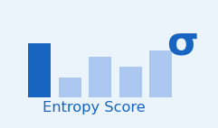
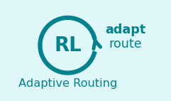
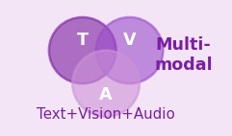
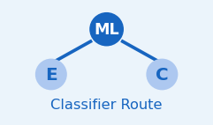
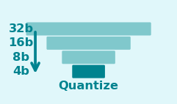
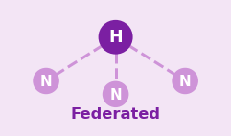
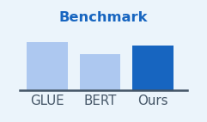
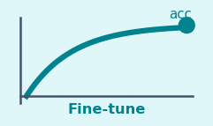
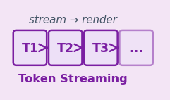
Future Research Directions - What Comes Next
Near-Term
Mid-Term
Long-Term
1
Entropy-based uncertainty scoring
1
RL-driven adaptive routing thresholds
1
Multimodal: text + vision + audio split
2
Classifier-based routing (lightweight ML)
2
Quantized edge models (4-bit, 8-bit)
2
Federated edge network inference
3
Broader benchmarks (GLUE, SuperGLUE)
3
On-device fine-tuning for personalization
3
Token-level streaming routing
The modular architecture makes upgrading any component straightforward - research can iterate independently.

Slide 24

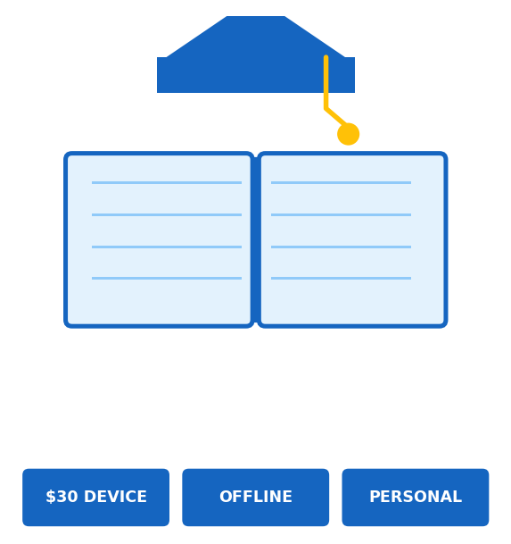
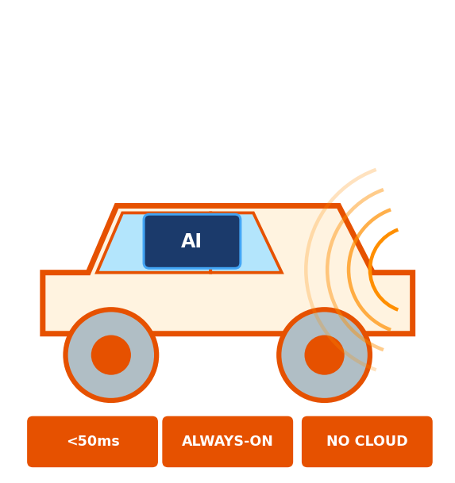
Broader Impact - Why This Matters Beyond the Paper
🏥 Healthcare
📚 Education
🚗 Automotive
▸ Diagnosis aids stay on-device
▸ HIPAA-compliant | No data leakage
▸ Works in rural / offline clinics
▸ Offline tutoring on $30 devices
▸ Zero cloud cost for schools
▸ Personalized at the edge
▸ <50ms reaction time
▸ No internet needed
▸ Always-on co-pilot

Slide 25
Conclusion
→ Hybrid edge-cloud inference is practical, scalable, and production-ready.
→ Confidence-based routing effectively separates simple vs. complex prompts.
→ DistilGPT2 + GPT-4o-mini together outperform either model alone.
→ 0.85s (edge) vs 2.65s (hybrid) - quality gains justify the latency cost.
→ Split execution is the future of on-device LLM deployment.
"The best AI system isn't the biggest one - it's the one that knows when to ask for help."

Slide 26
Thank You
Distributed Inference for On-Device LLMs - Edge-Cloud Split Execution
Open for Questions & Discussion
KEY TAKEAWAYS
3x
82M
~80%
<1ms
Edge is 3x faster
than cloud alone
DistilGPT2 runs on
any CPU - no GPU
Prompts route to
cloud for quality
Near-zero overhead
routing decision

