Slide 1
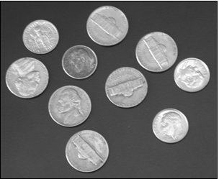
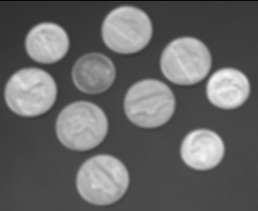
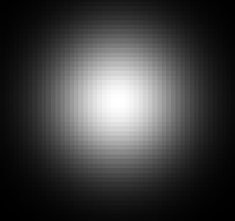
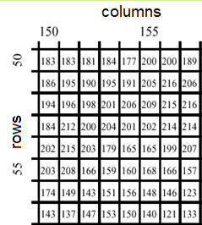
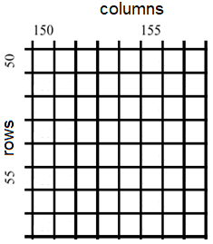



Image Convolution I
basic operation of image processing
an input image (2D mask/array) is locally multiplied, i.e. convolved, by a generally smaller filter kernel (2D mask / array)
convolution $I∘M$of image I and mask M defined as
filter effect only steered by Kernel M. The algorithm for the convolution is rather generic, despite:
normalization for low-pass filters at borders
boundary strategy
parallel execution (on GPU)
$$∘$$
$$=$$
I
M
I’
1
5
9
0
3
I
I’

Slide 2
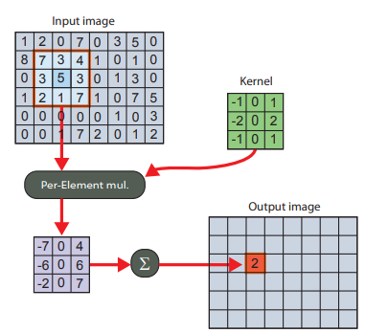
Image Convolution II
convolution at a glance : a new pixel value I′ (𝑥,𝑦) in result image B is calculated in local neighborhood of 𝐼(𝑥,𝑦) in A by local per-element multiplication with M within radius r and pixel-wise summing up the results
X
X
hot-spot
_{(0,0)}
r
Y
I(x,y)
M(u,v)
A
I‘(x,y)
B
https://cg.ivd.kit.edu/downloads/
GPUComputing_assignment_3.pdf

