Slide 1
Infrastructure for Order Processing System
Luiz Leão Junior and Susanne Danninger

Slide 2
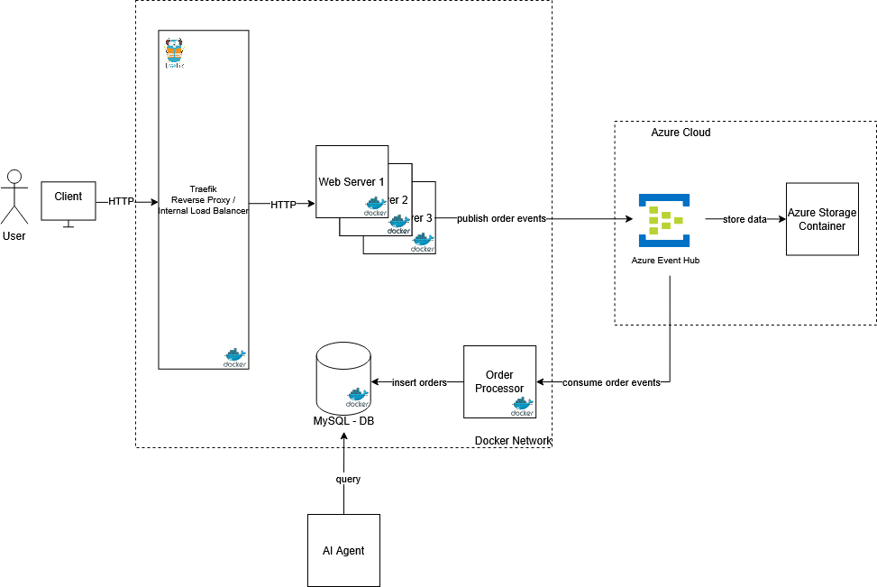

Slide 3
Project Components
Docker: On-premise stetup is done using Docker Compose
Traefik: Reverse Proxy & Load Balancer
Ngnix: Web Server that can be scaled horizontally
Azure Event Hub: Cloud-based event streaming for the order events
Azure Storage Container: Long-term archive for order events

Slide 4
Project Components
Order Processor: Service that consumes events from Event Hub & processes them into the MySQL database
MySQL Database: Operational database for storing orders
Ansible: Automation of on-premise setup & modification of index.html of nginx container
Terraform: Provision of Azure Event Hub & Storage
AI Agent with Langflow: AI-powered agent with which the database can be queried in natural language

Slide 6
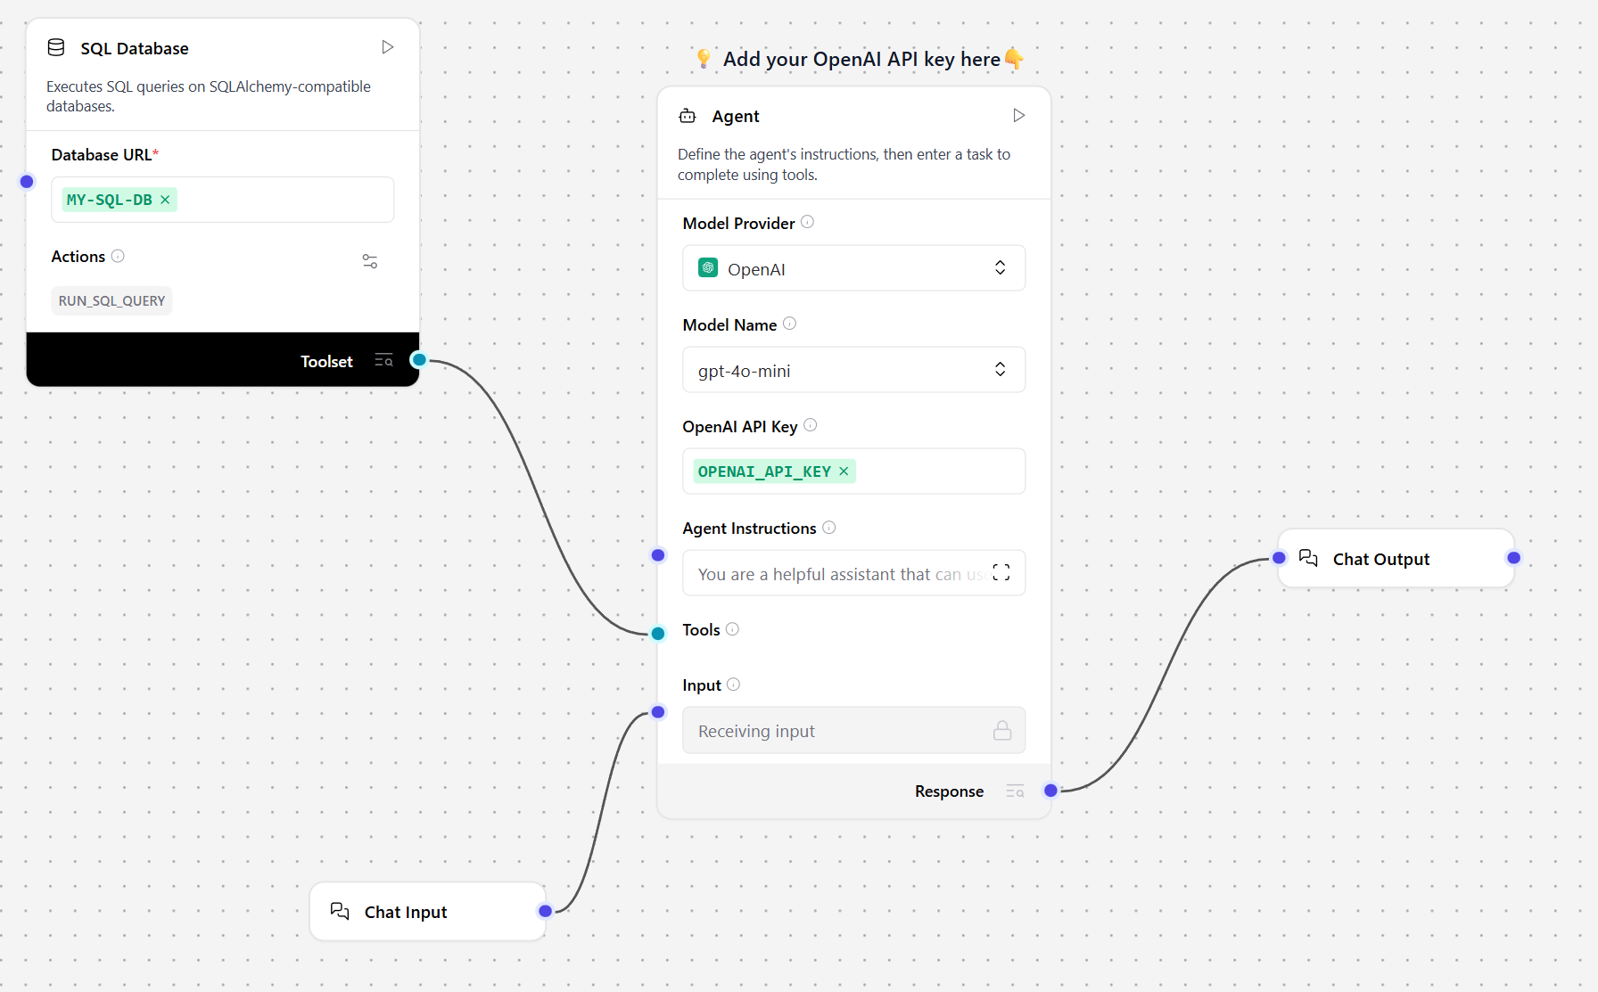
AI Agent Setup

Slide 7
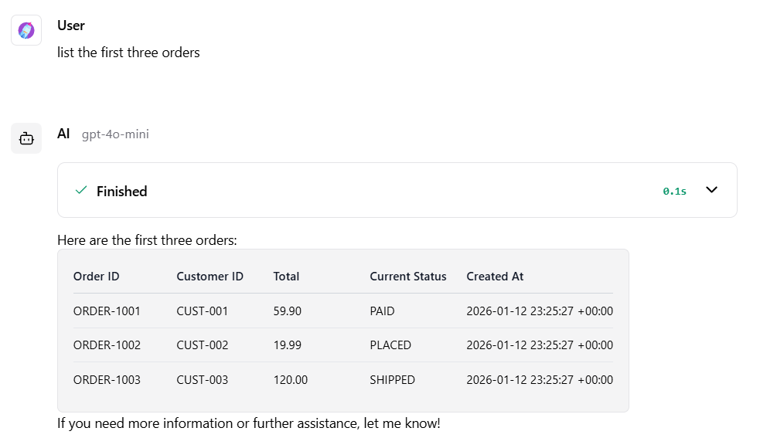
AI Agent Example

